Slide 1
Game Development using Python.
Burhanuddin Naguthanawala – 19IT5001
Ashish Patil – 19IT5008
Rithvik Chavhan – 19IT5012

Slide 2
Features
Pygame Implementation.
Basic python libraries such as pygame, random, math were used.
Less disk space is required.

Slide 3
IDE and FRAMEWORKS
We are using Pycharm to implement this game.
Pycharm provides smart code completion, code inspections, on-the-fly error highlighting and quick-fixes, along with automated code refactorings and rich navigation capabilities.
Pycharm is available on multiple Operating systems which includes Windows, MacOS and Linux.
Pycharm also provides an integrated debugger and Test runner to test your program.

Slide 4
Functions
pygame.init() : Initialization of the game
screen.blit() : Allows us to draw images on a blank screen.
pygame.display.update() : Updates the screen after modification in images or drawings.
pygame.key() : Allows us to generate an event using keyboard keys such as LEFT, RIGHT etc.
pygame.image() : To add images into the program/game.

Slide 5
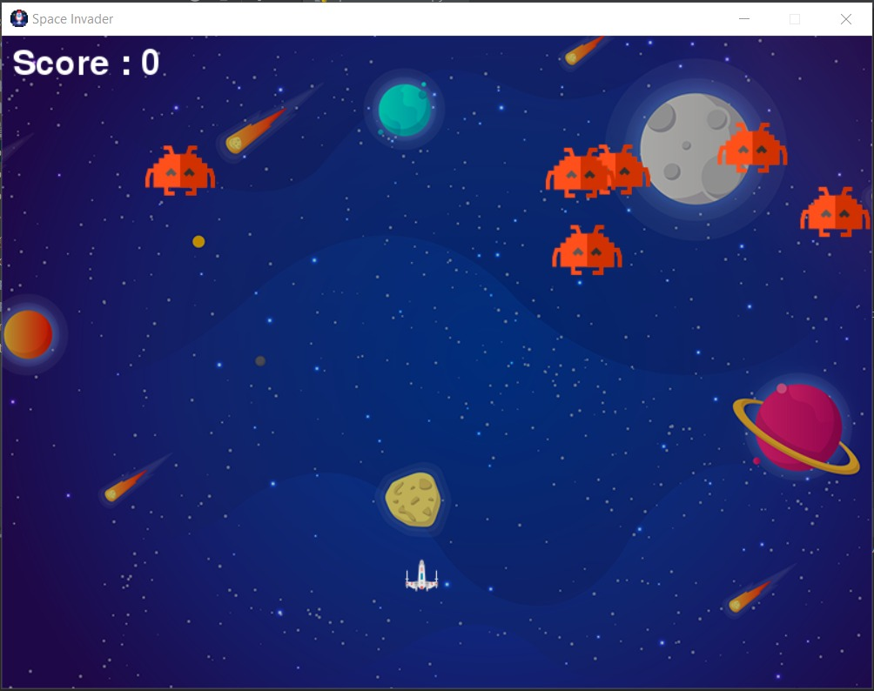
Project Status
We are halfway done with our space invaders game. Here are some screen shots.

Slide 6
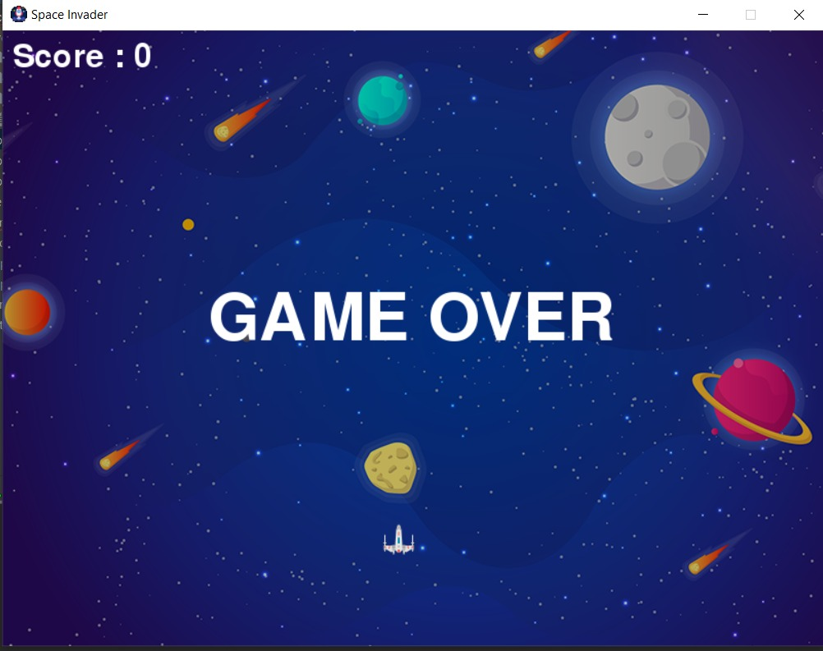

Slide 7
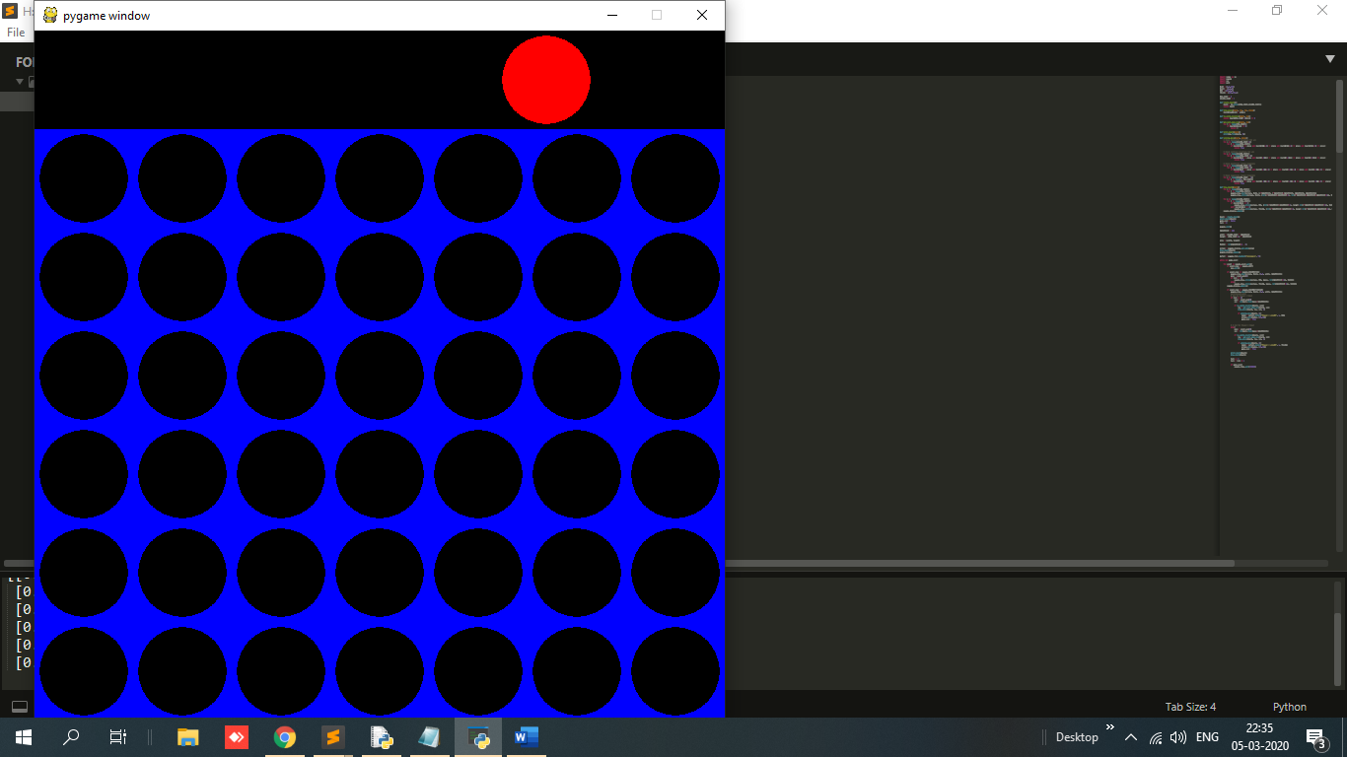
We also developed another game called Connect four dots. Here are some screenshots

Slide 8
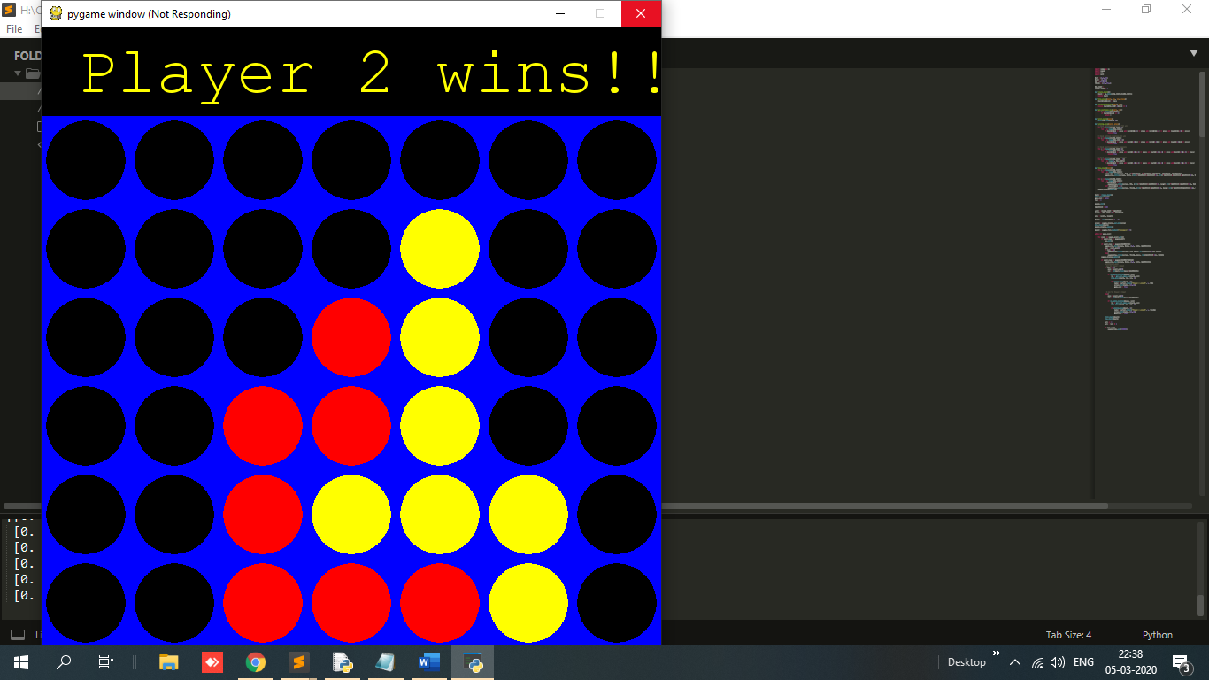

Slide 9
Challenges Faced
Deciding the spaceships design.
Finding 32x32 images for the models i.e. spaceship, the enemy, etc.
Generating random amount of enemys.
Making boundaries so the characters won’t go out of the window screen.

