Slide 1



Greenhouse Gas Emission Prediction using Machine Learning

Slide 2

Learning Objectives
Understand the role of machine learning in predicting greenhouse gas emissions.
Perform data cleaning, exploratory data analysis (EDA), and feature engineering.
Apply regression models to predict CO₂ emissions.
Evaluate model performance using appropriate metrics.
Gain insights into factors influencing emission levels.
GOAL
Source :
www.freepik.com/

Slide 3





Tools and Technology used
Programming Language: Python
Libraries: Pandas, NumPy, Matplotlib, Seaborn, Scikit-learn
IDE: Jupyter Notebook
Modeling Techniques: Linear Regression, Random Forest Regressor
Visualization: Seaborn, Matplotlib

Slide 4
Methodology
Data Collection: Loaded dataset with CO₂ emission indicators.
Data Cleaning: Handled missing values and removed irrelevant columns.
EDA: Visualized correlation between variables and identified trends.
Feature Engineering: Selected key features influencing emissions.
Modeling: Applied Linear Regression and Random Forest algorithms.
Evaluation: Compared models using R² Score and RMSE.
Prediction: Deployed best model to predict emissions.

Slide 5
Problem Statement:
Climate change is largely driven by rising greenhouse gas emissions, especially carbon dioxide (CO₂), which results from industrialization, transportation, and energy use.
Existing analytical models often struggle to capture the complex, non-linear relationships among economic indicators, energy consumption, and emission levels.
As a result, predicting future emissions accurately becomes challenging, limiting the ability to take proactive policy actions.
Machine learning offers a powerful alternative by identifying hidden patterns in historical data and producing more reliable forecasts.
Developing such predictive models is essential to support data-driven environmental planning, regulation, and global climate goals.

Slide 6
Solution:
To address the limitations of traditional forecasting methods, a machine learning-based approach was implemented for predicting greenhouse gas emissions.
The dataset was cleaned and analyzed to identify the most relevant features impacting CO₂ levels, such as GDP, energy use, and industrial output.
Multiple regression models were trained and tested, including Linear Regression and Random Forest Regressor, to find the most accurate predictor.
Among these, the Random Forest model showed superior performance by capturing non-linear patterns and reducing prediction errors.
This predictive system can assist policymakers, researchers, and environmental agencies in understanding emission drivers and planning targeted interventions.
🔗 GitHub Repository: github.com/AshishRaj97/Greenhouse-Gas-Emission-Prediction

Slide 7
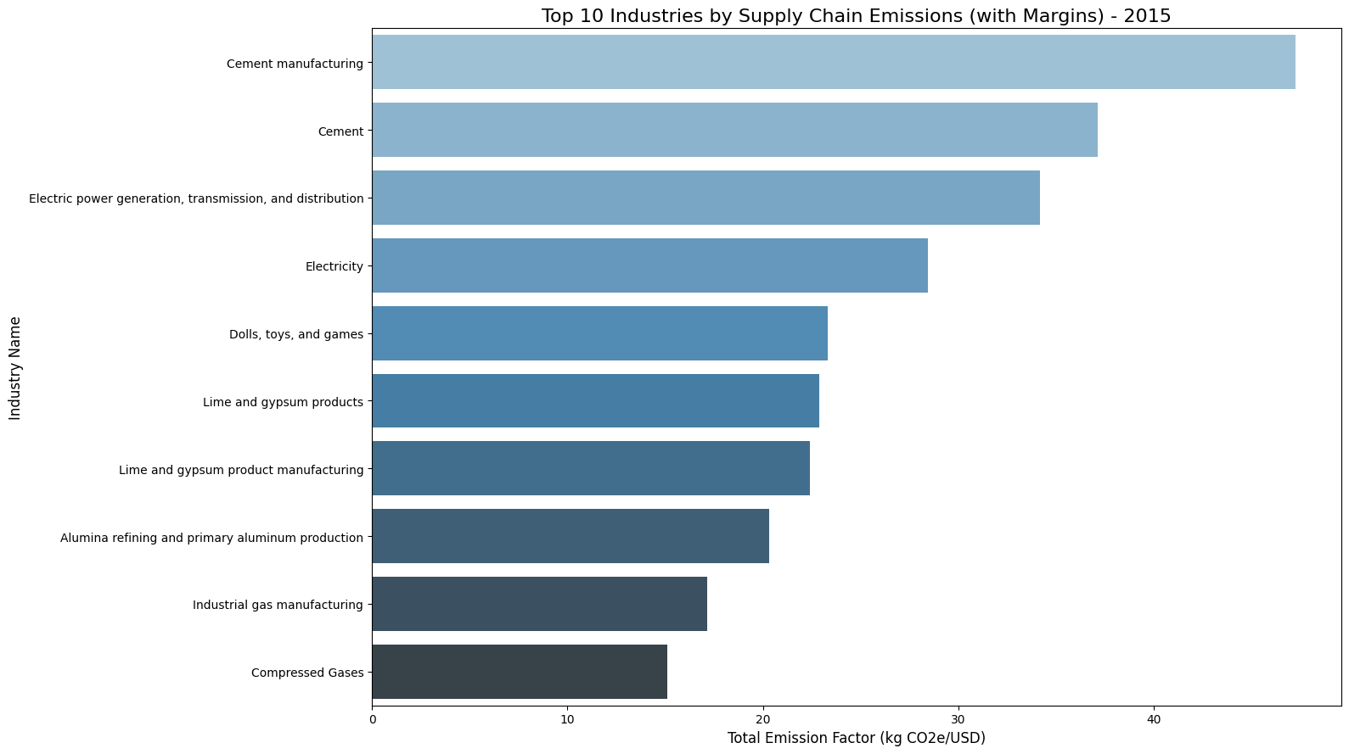
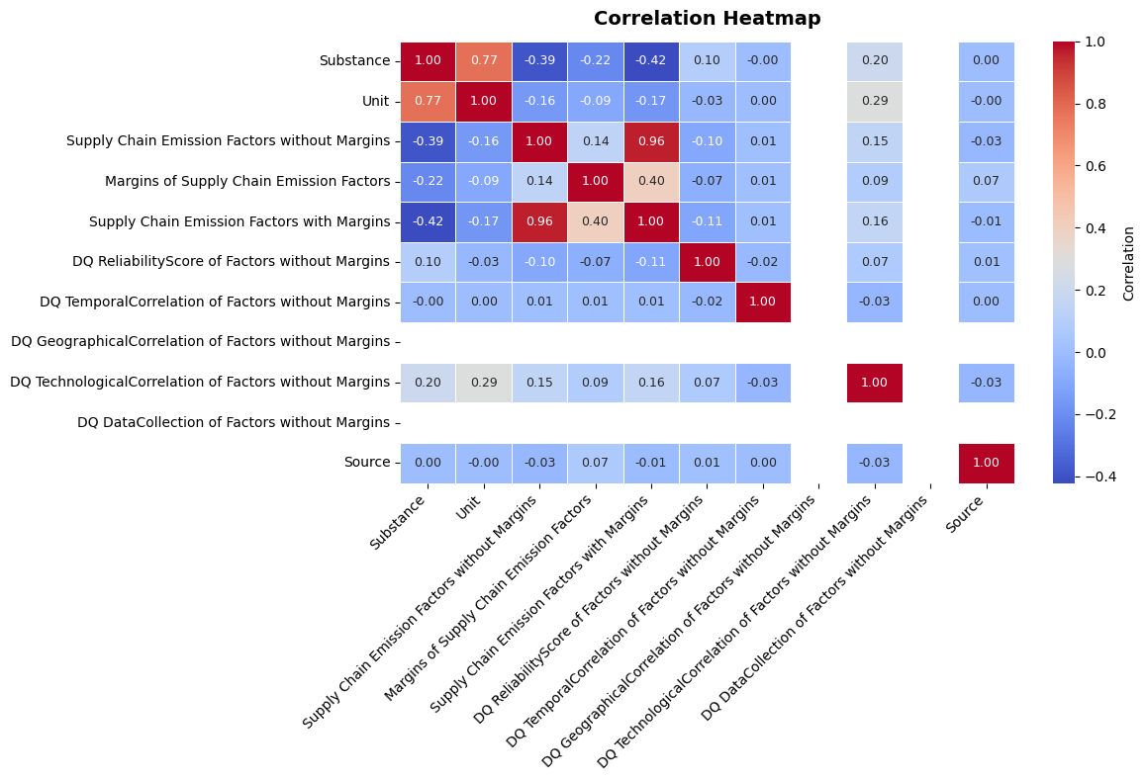
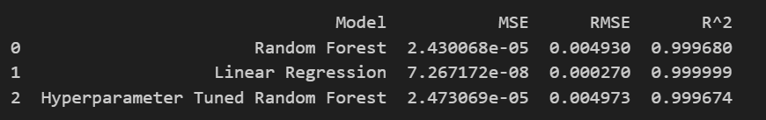
Screenshot of Output:

Slide 8
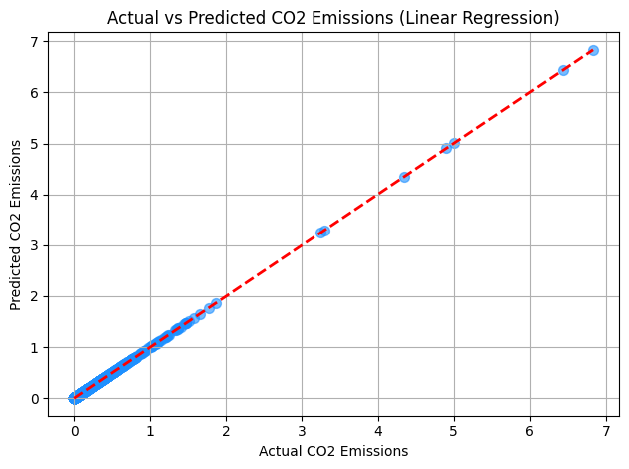
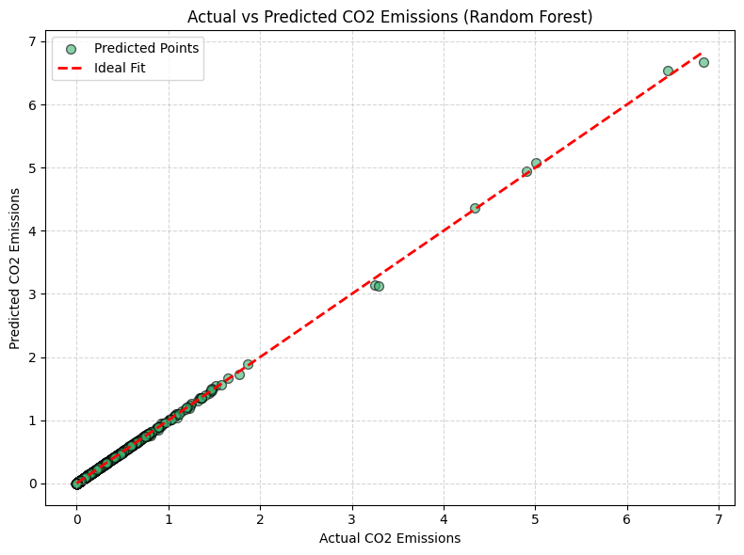
Screenshot of Output:

Slide 9
Conclusion:
Developed a machine learning model to predict greenhouse gas emissions using environmental and supply chain-related features.
Linear Regression outperformed Random Forest in prediction accuracy, achieving the highest R² score and the lowest error.
Strong correlations were observed between margin-adjusted and unadjusted emission factors, guiding effective feature selection.
Data quality indicators, though weakly correlated with emissions, added valuable context for data interpretation and model reliability.
The model provides a reliable tool for forecasting emissions and supporting informed decisions in climate policy and planning.

