Slide 1

INFINITY REMOTE
Sit back and Relax

Slide 2

Team Members
Mukul Jain (200001050)
Gaurav Khushpat Jain (200001023)
Vankayalapati Sai Venkata Satwik (200001077)
Nishit Sushil Singh (200001056)
Mentors
Shaikh Ubaid (180001050)
Ashish Raj (190003013)

Slide 3
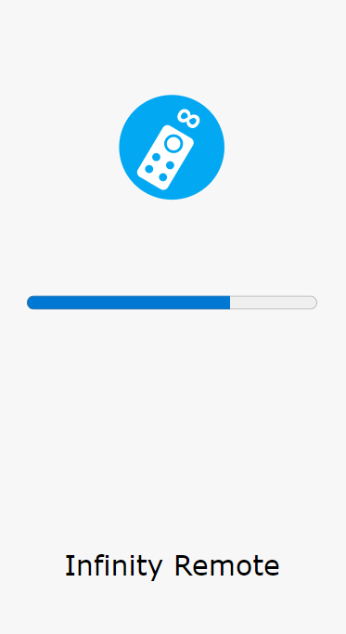
Description
This Project gives you a Chrome Extension and a Progressive Web App (PWA) allowing you to control Youtube on your Desktop Browser from your Mobile's Browser. It enforces a 1-1 connection between the Browser Extension and the PWA. The Extension gets connected to the PWA using a QR Code which has to be scanned using the built-in QR Code Scanner in the PWA. This will land you on the Infinity Remote page that allows you to control the Youtube. Proper Instructions / Icons helps the User control the Utility.

Slide 4




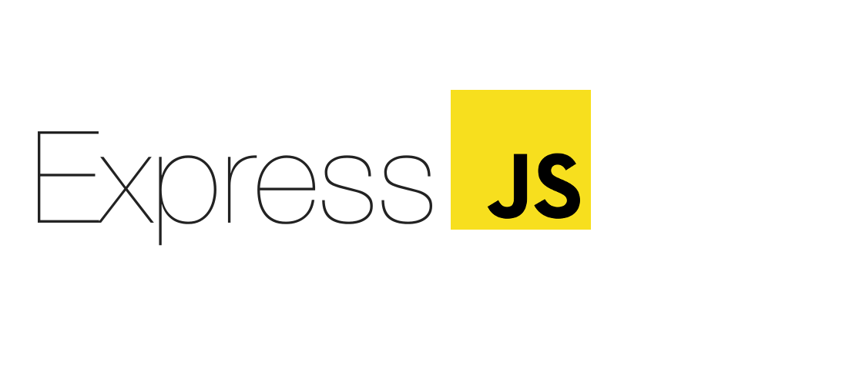
Tech Stacks and Packages
HTML, CSS and Javascript
Chrome Extension and PWA
Socket.IO
Node JS and Express JS for rendering views.
Embedded Javascript EJS to embed Room Id in HTML
Qrious and JSQR to generate and scan QR Codes
Font Awesome for Icons

Slide 5
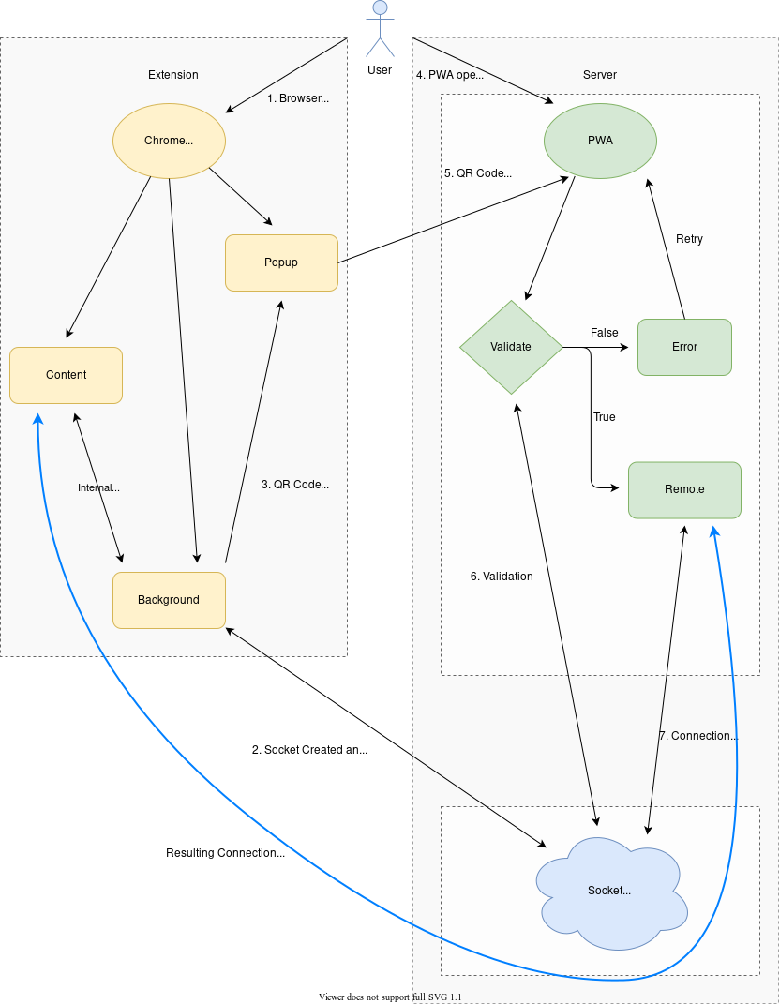
UML Diagram

Slide 6
Salient Features
Connection via Internet
PWA for Easy Accessibility
Selection and Navigation
Playback Controls
Skipping of Advertisements
Instructions and Error Pages

Slide 7

1-1 Connection via Internet
Socket Programming is used to communicate between PWA and the Extension, making the connection live and persistent.
A room gets created in the server whenever a User opens the Chrome browser in the PC and the same room Id gets reflected in the QR code. The User scans this QR code to join the same room.
The socket enforces a 1-1 connection, any other connection to the same socket are redirected to appropriate error page and further instructions are displayed.

Slide 8

PWA for easy accessibility PWA (Progressive Web App) provides a similar experience as a native app. Statistics prove that a user prefers an app way more than a website.
This gets downloaded as an application. The icon appears on the home screen and the app can be used as a native app.

Slide 9
Selection and Navigation
The User can identify the focused-video by the blue-highlight line and navigate through the videos using the arrow buttons on the remote.
A Javascript code is behind this process, it dispatches various keyboard events. These keyboard events remove and add the highlight as per the response received.
The User can select videos on the Home page, Search Result screen and Video Mode Screen by pressing Select button on the remote.

Slide 10
Playback Controls
The User can control the video using various features provided in the remote.
These features include, Play-Pause, Fast-Forward, Playback Rate, Volume Up-Down, Mute-Unmute, Captions, Theatre Mode, Previous Video and Next Video.
These features can be accessed by pressing the respective buttons on the remote, which can be identified using the intuitive icons.

Slide 11

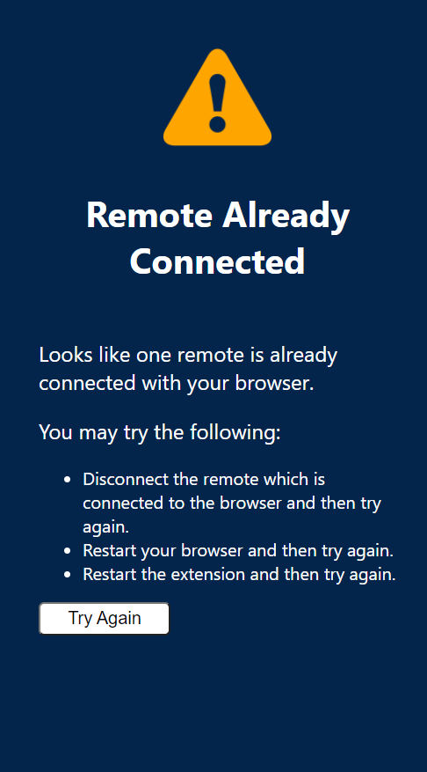
Instructions and Error Pages
The User is guided along the path of the design flow using various instructions provided at different pain-points which enables the user to have a continuous flow and smooth user experience.
A few error pages have also been provided to the User to guide him/her. These pages not only convey information about the issue but also redirect the User back to the appropriate path for the User to continue in.
The User not even needs to enter the PWA URL in the browser Address Bar. A quick QR Scan will help him to reach the website.

Slide 12
Skipping of Advertisements
Ads maybe one of the most annoying items on a user’s list.
We have minimised these ads using Javascript code. All the skippable ads are already removed from the user’s path.
Although, we still recommend the user to use an ad-blocker for the best user experience.

Slide 13
Unique Selling Proposition (USP).
This project is one of its kind. Currently, in the market there’s no Extension through which one can control Youtube remotely.
Through this, one can sit back and control their Youtube from their phone and still enjoy the experience of the big screen view.
Even you can control my screen through your mobile, and that’s what we are going to demonstrate in this demonstration.

Slide 14
Unique Selling Proposition (USP).
This remote has more reach because its available for everyone connected to internet.
This can be of great help to those people who want to connect their laptop to big screen via HDMI port to enjoy their streaming on big screen without having to control on laptop.

Slide 15
Conclusion
We are proud that we have written the whole code from scratch.

