Slide 1

Disease Recognition, Summarized Medical Report Generation and Doctors Recommendation from X-Ray Images
Ashish Raj (190003013)
B.Tech Project under the supervision of
Dr. Chandresh Kumar Maurya

Slide 2
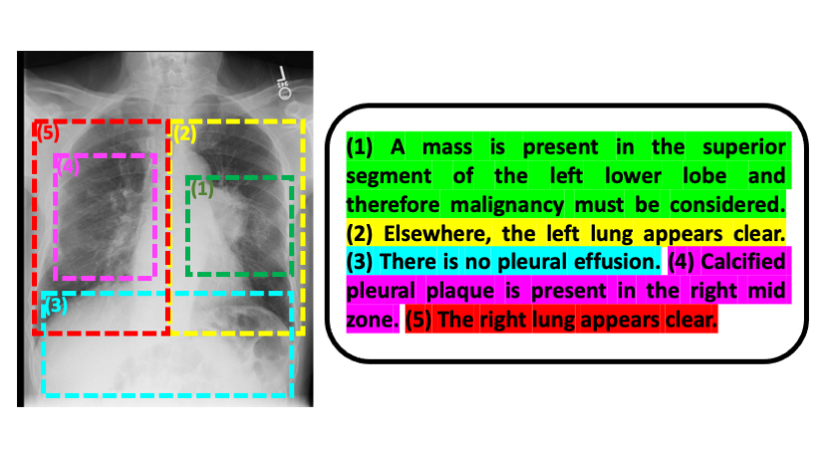
Problem Statement
Given an x-ray image, we have to:
Generate a comprehensive medical report
Translate medical report from english to any local language
Recognise diseases from the generated report
Create a summarization of the medical report in english
and any local language
Recommend doctors based on recognised illness and
In his/her locality

Slide 3
Overall Methodology
Generated medical report from x-ray/ct-scan image
Named Entity Recognition(NER) of medical terms in the report
Recognition of diseases from the extracted medical terms
Generation of abstractive summarised report
Doctors Recommendation using web scraping techniques

Slide 4
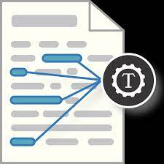
Disease Recognition from Medical Report

Slide 5
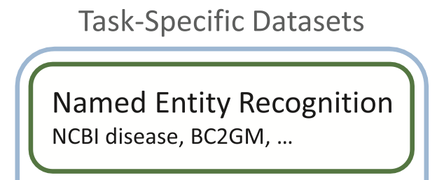
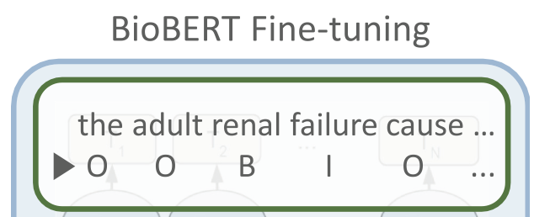
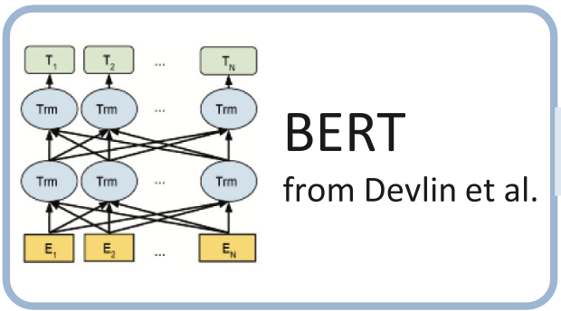
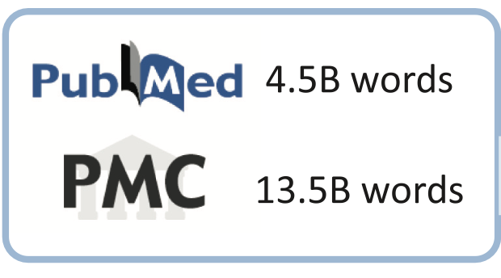
Steps
BERT
Pre-Training
Fine Tuning for NER
NER

Slide 6
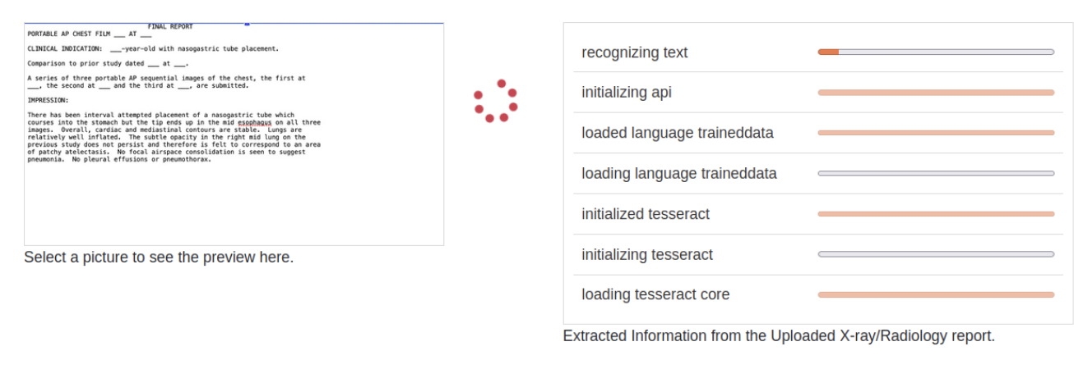
Optical Character Recognition (OCR) using Tesseract.js

Slide 7
Why BioBERT?
01
WT1 missense mutations, associated with male pseudohermaphroditism in Denys–Drash syndrome, fail to . . .
WT1 missense mutations, associated with male pseudohermaphroditism in Denys–Drash syndrome, fail to . . .
Pretrained on NCBI disease dataset
02
Like the DMA, but unlike all other mammalian class II A genes, the zebrafish gene codes for two cysteine residues.
Like the DMA, but unlike all other mammalian class II A genes, the zebrafish gene codes for two cysteine residues.
Pretrained on BC2GM dataset

Slide 8
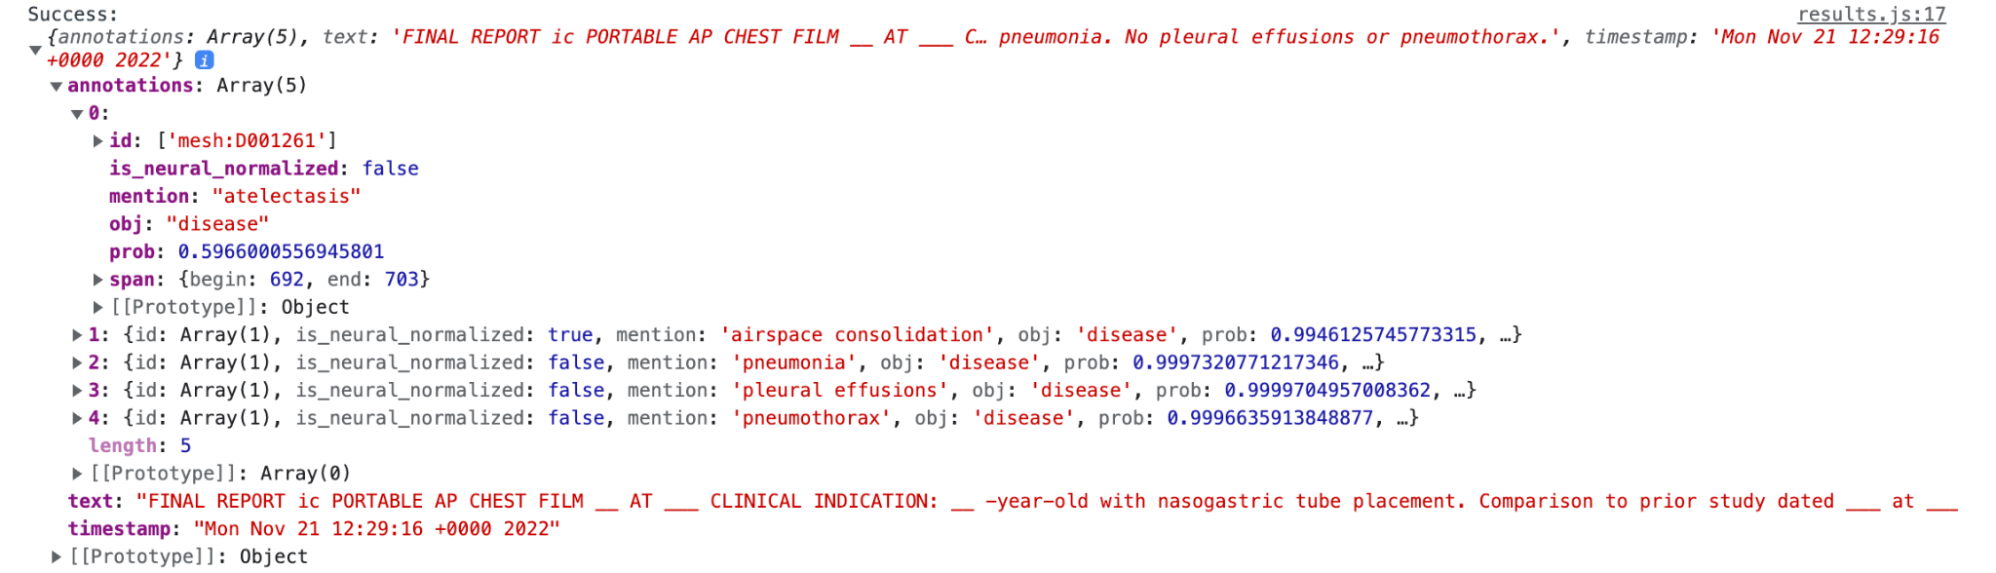
Use of BERN2
BERN2, is a biomedical text mining tool for accurate and efficient biomedical NER, uses BioBERT in the background. (maps BIO taggings to keywords)

Slide 9
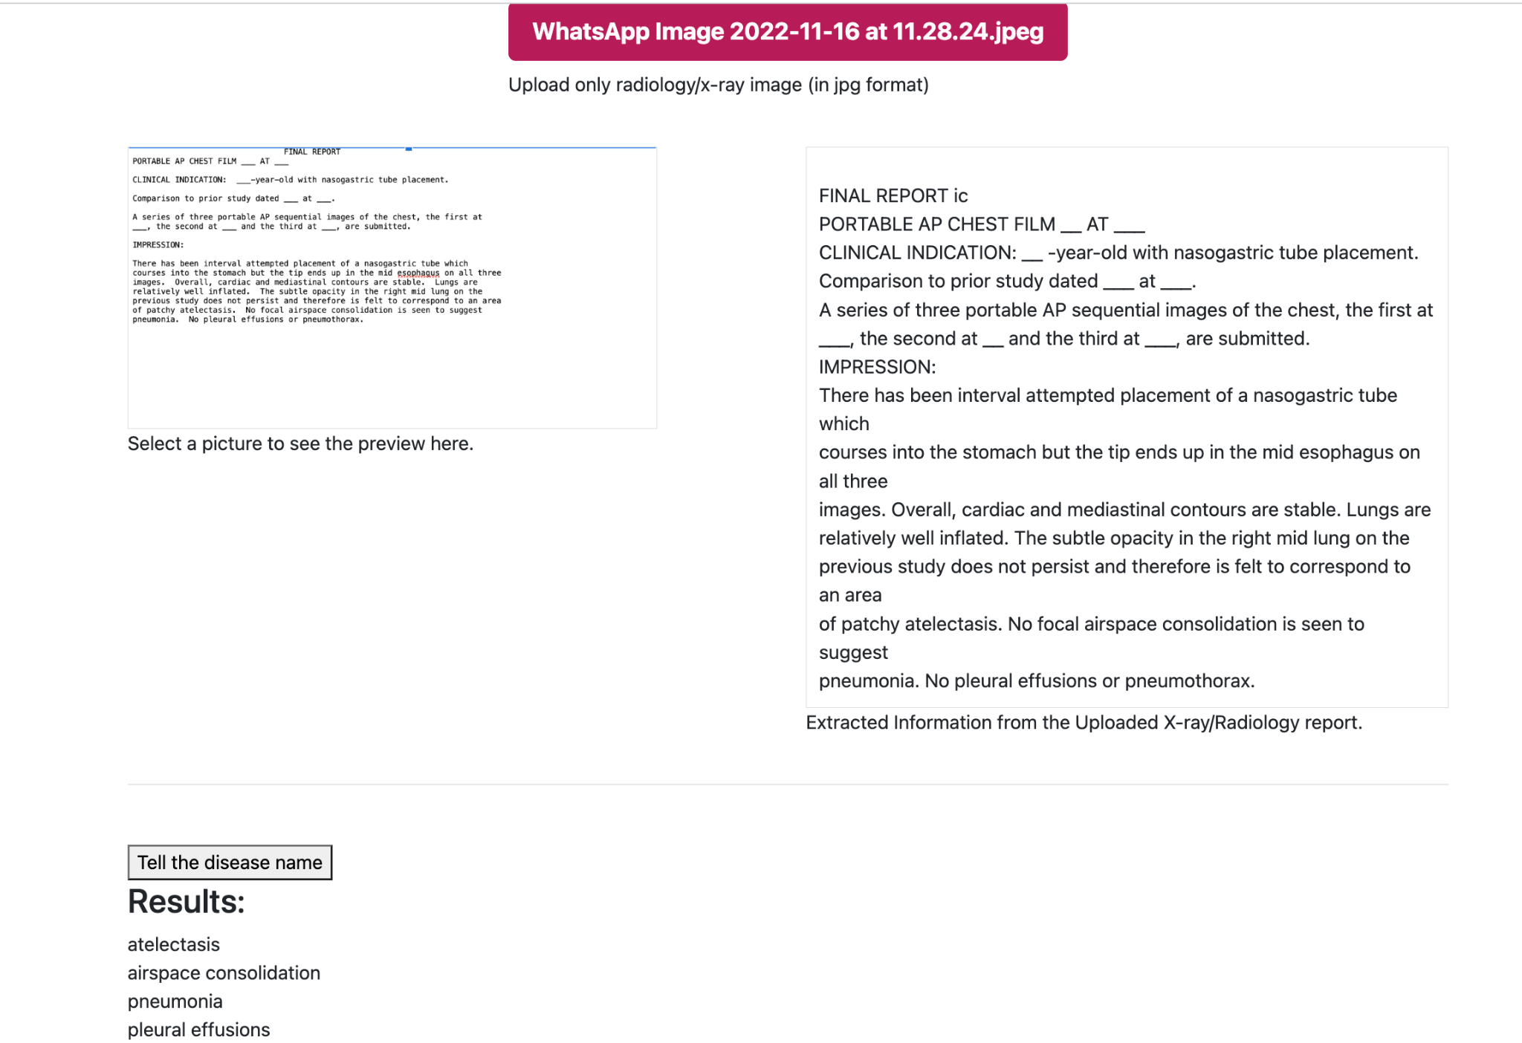
Final Results for NER using BERN2 .

Slide 10
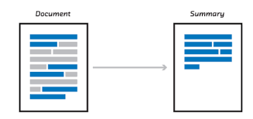
Abstractive Summarization

Slide 11
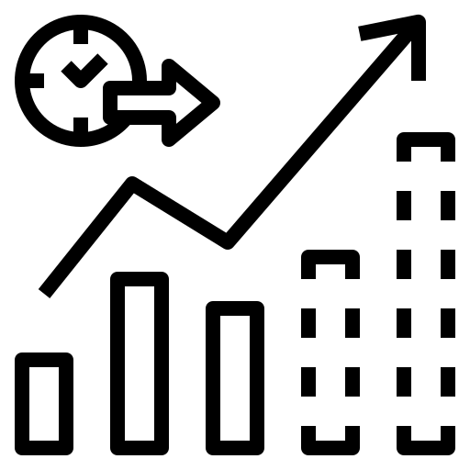
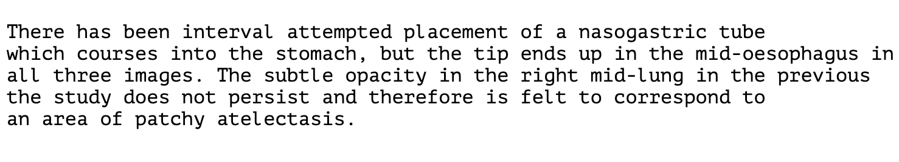
Summarization: English (Helpful for Doctors)
Using BART summarizer.

Slide 12
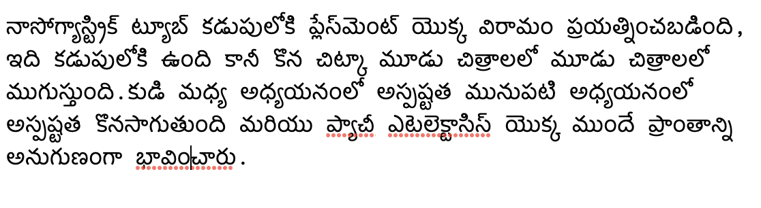
Summarization: Local Language (here, Telugu) (Helpful for Patients)
Take english summarized report and feeding it into the translator model (implemented by Bhuvana)

Slide 13

Recommending Doctors

Slide 14
Recommend Doctors
Took Disease name and patient’s location as parameters.
Implemented the doctor recommendation via 2 methods:
Google Maps text-search api.
Google Search api (used web scraping techniques).
Why two methods?
We don’t want to miss any doctor, if present. Therefore, we take union of doctors list from both of the results.

Slide 15
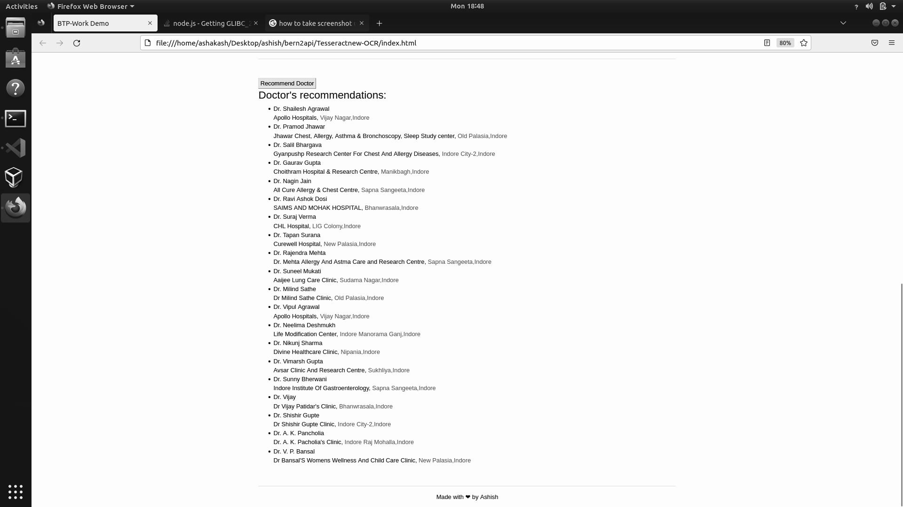
Recommend Doctors: Result

Slide 16

Accuracy of the Underlying Model

Slide 17
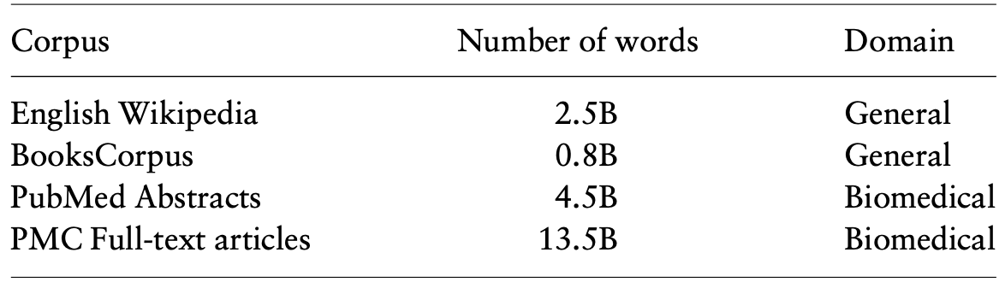
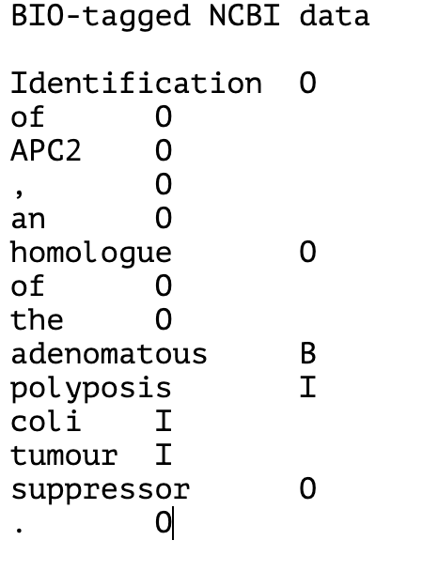
Dataset Overview for BioBERT
Figure1: Pre-training dataset Overview
Pre-Training dataset:
BioBERT-Base v1.1 (+ PubMed 1M)
Fine-Tuning: 2 datasets for fine-tuning for NER:
NCBI-disease dataset
BC5CDR-disease dataset
Figure:2 Example of Fine-training dataset

Slide 18
Accuracy Measure of BioBERT
Fine-tuned on NCBI-disease dataset:
Fine-tuned on BC5CDR-disease dataset:

Slide 19
Conclusion
Proposed a novel method, given an x-ray/ct scan image, can:
Recognise disease
Summarize Medical Report in local language
Recommend doctor
Implemented the above proposed method.
Demo Link: https://www.loom.com/share/11d16f82ba69498480e4ba672a1cff8d
Project github link: https://github.com/AshishRajIITI/bern2api

Slide 20
Use case of this Project
Reports generation takes time (if someone goes to indore city and gives his sample he can’t wait for long for the report, as it may take sometimes 2-3 days). This helps us in a way, if I get the report in the smartphone i can at least tell if there is something serious in it.
There will be huge cost cutting since you just don’t have to first visit any general physician to get referred to someone else. (approaching right doctors).
Can understand the report, since it’s also available in the people’s native language(removing any language barrier in between).
The english summarised report can prove fruitful in case of doctors in PHCs. They can quickly identify the core problem of the patient(reducing time spent per patient).

Slide 21
Motivation
In India, those who reside in rural areas still lack access to basic medical care.
The lack of competent radiologists in these places is the primary cause of challenges.
People must seek out professionals in order to receive proper care, even though they may not even be aware of their true condition. We intend to employ ML and NLP technologies in our project to address these issues.
The patient only needs to upload their x-ray image via a gadget to receive a thorough report in both english and their native tongue. In addition, a summary tool is used to create a brief report that would be beneficial to both patients and clinicians.
Additionally, if they have a sickness, we will extract the name of the illness from the report and give them recommendations for doctors to contact further.

Slide 22
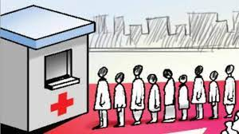
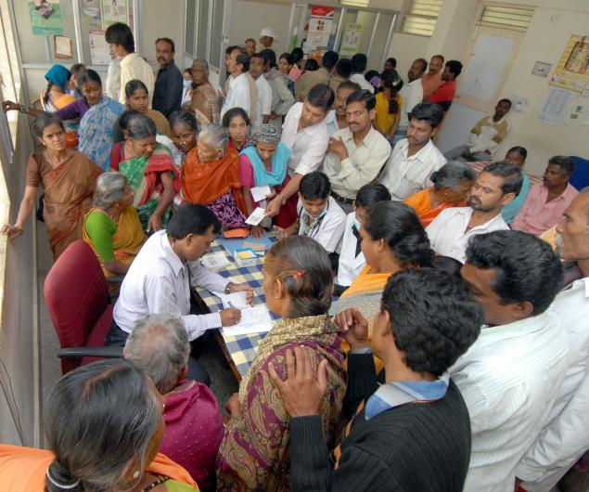
Agenda
Internet Penetration in Indian villages has grown significantly (2022)
Huge queue for medical diagnosis and consultation
Stressful working hours for doctors
Can serve to a wide range of public, especially in villages
Initial diagnosis is done in PHCs

Slide 23
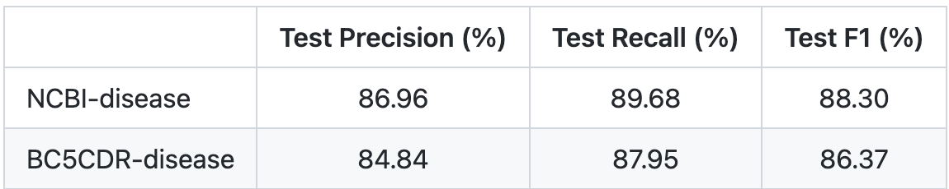
Future Work
The integration of the Image to Text Conversion model.
The BioBERT model’s assessment matrices require improvement.
Integration of Speech to Speech (Translation from one language to another) is currently under development and is anticipated to be finished shortly.
Figure: Expected accuracy

Slide 24
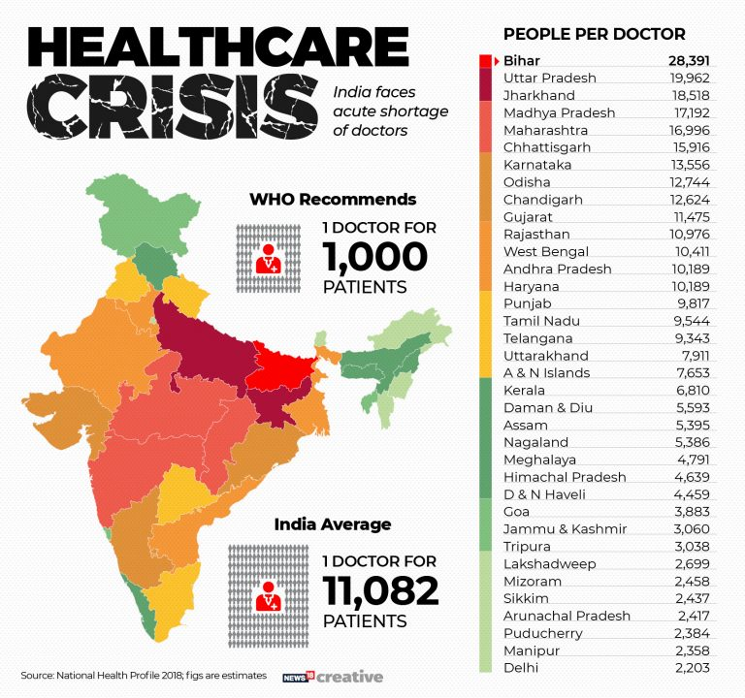

Slide 25
References
Sung, M., Jeong, M., Choi, Y., Kim, D., Lee, J., & Kang, J. (2022). BERN2: an advanced neural biomedical named entity recognition and normalization tool. arXiv preprint arXiv:2201.02080.
Lee, J., Yoon, W., Kim, S., Kim, D., Kim, S., So, C. H., & Kang, J. (2020). BioBERT: a pre-trained biomedical language representation model for biomedical text mining. Bioinformatics, 36(4), 1234-1240.
Vaswani, A., Shazeer, N., Parmar, N., Uszkoreit, J., Jones, L., Gomez, A. N., ... & Polosukhin, I. (2017). Attention is all you need. Advances in neural information processing systems, 30.
Kocaman, V., & Talby, D. (2021, January). Biomedical named entity recognition at scale. In International Conference on Pattern Recognition (pp. 635-646). Springer, Cham.
Wang, X., Zhang, Y., Ren, X., Zhang, Y., Zitnik, M., Shang, J., ... & Han, J. (2019). Cross-type biomedical named entity recognition with deep multi-task learning. Bioinformatics, 35(10), 1745-1752.
Lewis, P., Ott, M., Du, J., & Stoyanov, V. (2020, November). Pretrained language models for biomedical and clinical tasks: Understanding and extending the state-of-the-art. In Proceedings of the 3rd Clinical Natural Language Processing Workshop (pp. 146-157).
Phan, L. N., Anibal, J. T., Tran, H., Chanana, S., Bahadroglu, E., Peltekian, A., & Altan-Bonnet, G. (2021). Scifive: a text-to-text transformer model for biomedical literature. arXiv preprint arXiv:2106.03598.
Kim, D., Lee, J., So, C. H., Jeon, H., Jeong, M., Choi, Y., ... & Kang, J. (2019). A neural named entity recognition and multi-type normalization tool for biomedical text mining. IEEE Access, 7, 73729-73740.
van Aken, B., Papaioannou, J. M., Mayrdorfer, M., Budde, K., Gers, F. A., & Löser, A. (2021). Clinical outcome prediction from admission notes using self-supervised knowledge integration. arXiv preprint arXiv:2102.04110.

Slide 26
Thank You

