Slide 1

DO
Datagami
“Lead Digital Technology"
AI-Powered EduVisualizer & Concept Learning Assistant
Course Name : Generative AI
Institution Name: Medicaps University - Datagami Skill Based Course
Sr no | Student Name | Enrolment Number
1. | UJJAWAL MEHTA | EN22IT301114
2. | ASHISH RANA | EN21CA301016
3. | JAY PATIDAR | EN22IT301040
4. | RAVI PATIDAR | EN22IT301079
Group Name: Group 06D12 Project Number: GAI-44 Industry Mentor Name: Ms. Aashruti Shah University Mentor Name: Mr Ajaj khan Academic Year:2025-2026
Medi-caps University - Datagami Skill Based Course - Project Report | 1

Slide 2
'§% MEDICAPS OO
UNIVERSITY Datagami
“Lead Digital Technology"
I.Problem Statement & Objectives
Problem Statement
In today’s education system, students often struggle to understand complex concepts through plain text or theoretical explanations. Traditional learning methods rely heavily on books and static content, which lack visual representation and interactive engagement. This makes it difficult for students to grasp abstract topics such as scientific processes, mathematical theories, or technical concepts.
Most existing platforms do not combine textual explanations with visual learning in a dynamic and automated way. Learners are required to manually search for diagrams, notes, and explanations separately, which is time-consuming and inefficient. This fragmented approach reduces learning efficiency and makes the process less engaging for students.
Additionally, modern learners expect personalized and interactive learning experiences that adapt to their level of understanding. However, many traditional systems fail to provide customized explanations or visually enriched content based on individual needs. The lack of integration between advanced AI technologies and educational platforms limits the potential of effective learning.
Therefore, there is a need for an intelligent system that can automatically generate both conceptual explanations and visual representations from a single input. By leveraging Generative AI, such a system can simplify complex topics, improve knowledge retention, and make learning more efficient, engaging, and learner-centric.
Project Objectives
The primary objective of this project is to design and develop EduVisualizer, a multimodal Generative AI-based education system that enables effective concept visualization by combining textual explanations with visual representations. The system allows users to input any concept and receive a structured explanation along with a relevant visual in the form of a flashcard, making learning more engaging and easier to understand.
Another key objective is to generate clear and context-aware explanations using Large Language Models (LLMs) and automatically create meaningful image prompts for AI-based image generation. This integration of text-to-text and text-to-image models highlights the practical use of multimodal AI in education. The project also focuses on providing fast responses and an interactive user interface for a smooth learning experience.
Additionally, the system aims to support learners at different levels by adjusting the complexity of explanations and improving knowledge retention through visual learning. Overall, the project demonstrates the practical application of Generative AI
Medi-caps University - Datagami Skill Based Course - Project Report | 2

Slide 3
DO
Datagami
“Lead Digital Technology"
in transforming traditional educational content into interactive and visually enriched study material.
Scope of the Project
The project is designed to handle text-based financial documents such as investment reports, PDFs, and analytical summaries. It includes the development of an interactive frontend interface where users can upload financial documents and attempt AI-generated quizzes based on the content. The system provides a smooth and engaging user experience by allowing users to interact with the application through a structured quiz format.
On the backend, the system performs key operations such as document processing, extraction of relevant financial content, automatic generation of multiple-choice questions (MCQs), and intelligent evaluation of user responses using a Large Language Model (LLM). The system also generates contextual explanations for each answer, helping users understand financial concepts more effectively and improving their learning outcomes.
The scope of the project also includes personalized learning, where the system analyzes user performance and adapts question difficulty or feedback accordingly. This makes the application suitable for beginners as well as intermediate learners in the finance domain. The integration of AI ensures that the questions and explanations are aligned with real-world financial data, enhancing practical understanding.
However, the scope of the project is limited in certain areas. It does not include advanced features such as real-time multi-user collaboration or support for multimedia inputs like images, audio, or video-based financial content. The system primarily focuses on text-based documents and relies on pre-trained Large Language Models rather than domain-specific fine-tuned models. Additionally, enterprise-level scalability, high-end security features, and large-scale deployment are beyond the current scope of this project.
Despite these limitations, the project effectively demonstrates the practical application of Generative AI in the finance domain by building an intelligent quiz-based learning system that bridges the gap between theoretical knowledge and real-world financial analysis.
2.Proposed Solution
The proposed solution is to develop EduVisualizer, an AI-driven multimodal education system that transforms simple textual concepts into interactive and
Medi-caps University - Datagami Skill Based Course - Project Report | 3

Slide 4
DO
Datagami
“Lead Digital Technology"
visually enriched learning content. The system allows users to enter any educational concept and automatically generates a structured explanation along with a relevant visual representation in the form of a flashcard using Generative AI models.
Unlike traditional learning methods, this solution not only provides textual explanations but also enhances understanding through AI-generated visuals, helping users grasp complex topics more effectively. The system generates meaningful image prompts from the explanation and uses image generation models to create high-quality educational visuals. This ensures that learners can both read and visualize the concept, improving retention and clarity.
The application integrates text generation, image generation, and flashcard creation into a single unified platform. By leveraging the power of multimodal Generative AI, the system bridges the gap between theoretical knowledge and visual learning, making education more engaging, efficient, and accessible.
Key features
• AI-based concept explanation generation using Large Language Models (LLMs)
• Automatic image generation for visual representation of concepts
• Flashcard creation by combining text and visuals
• Downloadable flashcards in image format
• Support for different student learning levels
• Interactive and user-friendly interface
• Fast and real-time content generation
• Integration of multiple AI models (OpenAI, Gemini, HuggingFace)
Overall Architecture / Workflow
Medi-caps University - Datagami Skill Based Course - Project Report | 4

Slide 5
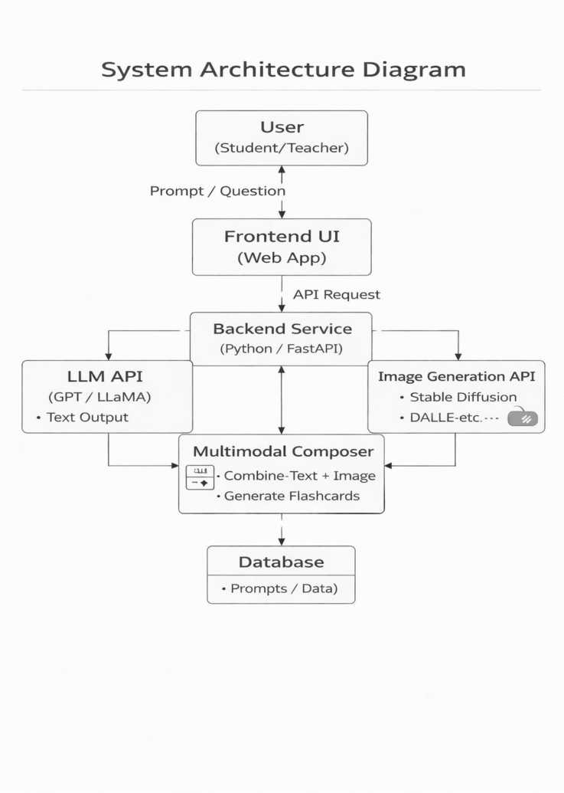
DO
Datagami
“Lead Digital Technology"
Tools & Technologies Used
Frontend Technologies
Medi-caps University - Datagami Skill Based Course - Project Report | 5

Slide 6
DO
Datagami
“Lead Digital Technology"
The frontend of the application is developed using Streamlit, which provides a simple and interactive user interface for inputting concepts and displaying generated explanations and flashcards. It enables rapid development and smooth user interaction.
Backend Technologies
The backend is built using Python, which handles the core logic of the application including explanation generation, image generation, and flashcard creation. The system follows a modular approach with separate services for different functionalities.
AI and Machine Learning Technologies
OpenAI API and Gemini API are used for generating structured explanations using Large Language Models (LLMs). Image generation is performed using HuggingFace, OpenAI, or Gemini image models. The project follows a multimodal AI approach by integrating text-to-text and text-to-image generation.
Image Processing
PIL (Python Imaging Library) is used to process images and generate flashcards by combining text and visuals into a single output.
API and Integration
External AI APIs are integrated for both text and image generation. The system dynamically selects providers based on configuration, ensuring flexibility and efficient performance.
Development Tools
VS Code is used as the code editor for development. Git and GitHub are used for version control and project management. dotenv (.env) is used for secure management of API keys and environment variables.
Deployment and Execution
The application runs locally using Streamlit on http://localhost:8501. The architecture is scalable and can be deployed on cloud platforms in the future.
3. Results & Output
Screenshot:
Medi-caps University - Datagami Skill Based Course - Project Report | 6

Slide 7
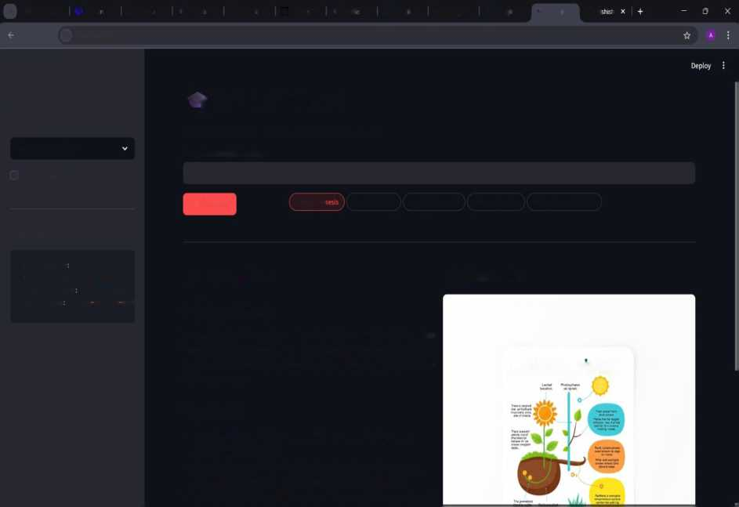
DO
Datagami
“Lead Digital Technology"
v 9 GitHul X * You a X (§ Strear X i EduVi X ® Newl X C3 API kc X T EduV X ft Hugq X M (Hugo X £ Hugo X ; EduVi X Q A
*f C 0 Iocalhost8502
Settings
Y EduVisualizer
Student level
Turn any concept into an Al-generated explanation + visual flashcard
elementary school
Enter an educational concept
Show raw LLM output
Photosynthesis
if Generate
Photosynt! Newton's Laws Supply & Demand DNA Replication Pythagorean Theorem
Models in use
LLM Provider gemini LLM Model: gemini-2.5-flash Image Provider huggingface Image Model black forest lab
■ Explanation Photosynthesis
Photosynthesis is the amazing way plants make their own food! Think of plants as tiny chefs that use sunshine, water, and a gas from the air to cook up sugary fuel to help them grow big and strong. As a super bonus, they also release fresh air for us to breathe.
9 Flashcard
Photosynistlin
Key Points
• Sunlight is Energy: Plants use energy from the sun, just like we use electricity to cook our food.
• Ingredients: They get water from the soil through their roots and a gas called carbon dioxide from the air through tiny holes in their leaves.
• Kitchen is the Leaf: Most of this "cooking" happens in the leaves, which are
Reports / dashboards / models
Reports
The system generates visual outputs in the form of flashcards that help users understand concepts more effectively. Each generated flashcard includes a structured explanation along with a relevant image, providing a complete learning resource in a single view. The output itself acts as a learning report by summarizing the concept in a clear and concise manner. Additionally, users can download these flashcards for future reference, making it easier to revise and retain information.
Dashboards
The application provides a simple and interactive interface using Streamlit, where users can input concepts and instantly view the generated explanation and flashcard. The interface acts as a real-time dashboard, displaying results immediately after processing. It ensures a smooth and user-friendly experience, allowing users to easily generate and download educational content without complexity.
Models
Medi-caps University - Datagami Skill Based Course - Project Report | 7

Slide 8
DO
Datagami
“Lead Digital Technology"
The system utilizes advanced Generative AI models to perform its core functionalities. Large Language Models (LLMs) such as OpenAI or Gemini are used to generate structured explanations, including definitions, key points, and analogies. Image generation models from providers like HuggingFace, OpenAI, or Gemini are used to create visual representations based on generated prompts. The project follows a multimodal approach by integrating text generation and image generation, ensuring accurate and meaningful outputs. This combination of models enables the system to deliver high-quality educational content efficiently.
Key outcomes
The development of EduVisualizer successfully demonstrates the application of Generative AI in the education domain. The system is capable of transforming simple textual concepts into visually enriched learning content by automatically generating structured explanations and flashcards.
One of the key outcomes of this project is the integration of Large Language Models (LLMs) for generating clear and context-aware explanations, which helps improve conceptual understanding and makes learning more effective. The addition of AI-based image generation further enhances the learning experience by providing visual representations of complex topics.
The project also achieves effective implementation of a multimodal AI approach by combining text-to-text and text-to-image generation. This integration enables the system to deliver complete and meaningful educational content in a single output, improving retention and clarity.
Medi-caps University - Datagami Skill Based Course - Project Report | 8

Slide 9
DO
Datagami
“Lead Digital Technology"
Additionally, the system demonstrates fast and efficient content generation along with a user-friendly interface, making it accessible for learners of different levels. The ability to generate and download flashcards reduces manual effort in creating study materials and supports better revision.
Overall, the project highlights how Generative AI can be used to improve the quality of education by making learning more interactive, visually engaging, and efficient.
Medi-caps University - Datagami Skill Based Course - Project Report | 9

Slide 10
'§% MEDICAPS OO
V/ UNIVERSITY Datagami
“Lead Digital Technology"
Conclusion
The EduVisualizer project successfully demonstrates the application of modern Generative AI techniques in the education domain. The system effectively transforms simple textual concepts into an interactive and visually enriched learning experience, enabling users to understand complex topics more easily through AI-generated explanations and flashcards. This overcomes the limitations of traditional learning methods and enhances both engagement and comprehension.
By integrating Large Language Models with AI-based image generation, the system ensures that the generated content is structured, meaningful, and visually supportive. The multimodal approach allows users to both read and visualize concepts simultaneously, improving clarity and retention. The use of API-based AI services highlights the practical implementation of advanced technologies in building intelligent educational tools.
The modular architecture, built using Python and Streamlit along with integrated AI services, ensures flexibility, scalability, and ease of development. The project also demonstrates how text-to-text and text-to-image models can be combined effectively to create a unified learning solution.
Overall, the project achieves its objective of developing an AI-powered educational system that enhances learning by making it more interactive, visual, and efficient. Furthermore, the system has the potential to be extended to various domains, making it a versatile and impactful application of Generative AI.
Medi-caps University - Datagami Skill Based Course - Project Report | 10

Slide 11
9B MEDICAPS
UNIVERSITY
Future Scope & Enhancements
DO
Datagami
“Lead Digital Technology"
• Advanced Visual Learning Enhancements
The system can be extended to generate more advanced visuals such as animated diagrams, step-by-step illustrations, and interactive learning content to further improve understanding.
• Adaptive Learning System (AI Personalization)
Future versions can include personalization features where the system adjusts explanation complexity and content based on the user’s learning level and preferences.
• Multilingual Support
The system can support multiple languages, allowing users to learn concepts in their preferred language, making it more accessible to a wider audience.
• Voice-Based Interaction
Speech-to-text and text-to-speech features can be integrated to allow users to input concepts and receive explanations through voice, enhancing usability.
• Quiz Generation Feature
The system can be enhanced to automatically generate quizzes and practice questions from the generated flashcards to test user understanding.
• Cloud Deployment & Scalability
Deploying the system on cloud platforms (AWS, Azure, etc.) can improve scalability, performance, and enable support for multiple users simultaneously.
• User Authentication & Progress Tracking
Login and user profile features can be added to track learning history, saved flashcards, and user progress over time.
• Mobile Application Development
A mobile app version can be developed to make the platform accessible anytime and anywhere, increasing user engagement.
• Integration with Educational Platforms
The system can be integrated with Learning Management Systems (LMS) or elearning platforms to provide Al-powered content generation within existing education systems.
• Continuous Improvement with Feedback Loop
A feedback mechanism can be implemented where users can rate the generated content, helping improve the accuracy and quality of AI outputs over time.
Medi-caps University - Datagami Skill Based Course - Project Report | 11

Slide 12
DO
Datagami
“Lead Digital Technology"
Medi-caps University - Datagami Skill Based Course - Project Report | 12

