Slide 1

GEETHANJALI COLLEGE OF ENGINEERING AND TECHNOLOGY (Autonomous)
Cheeryal (V), Keesara (M), Medchal Dist., Telangana - 501 301
DEPARTMENT OF COMPUTER SCIENCE AND ENGINEERING (AI & ML)
MINI PROJECT
“AI STUDY COMPANION”
An AI-powered study environment that turns your own documents into notes, quizzes and concept maps
UNDER THE GUIDANCE OF
Vedavyas Gurla
Associate Professor - CSE (AI&ML) Department
TEAM C17
22R11A66B3
CH.Sri Priya
22R11A66C6
J.Srineeja
23R15A66D0
K. Ashish Reddy
Notes:
Greet the panel, introduce the team and the guide, and state the project title in one line.

Slide 2
CONTENTS
1
Introduction
6
Software Requirements
11
Key Achievements
2
Problem Statement
7
System Architecture
12
Screenshots
3
Objectives
8
Workflow
13
Results
4
Literature Survey
9
Algorithm & Methodology
14
Future Scope
5
Proposed System
10
Modules
15
Conclusion
Notes:
Walk through the flow of the presentation in about 20 seconds.

Slide 3
INTRODUCTION
Students today have more study material than time — lecture PDFs, handwritten notes, recorded classes and reference books. The bottleneck is no longer access to information but the effort needed to convert that information into understanding. Most learners spend the bulk of their time re-reading material instead of actively testing themselves, which research on learning consistently shows is the weaker strategy.
1
Reads your material
PDF and DOCX uploads
2
Explains and answers
The AI Study Companion is a web application built around subject workspaces. A student uploads the PDF or DOCX material for a subject; the system extracts the text, stores it, and sends it to the Google Gemini API with a task-specific prompt. From that single upload it can hold a doubt-solving conversation, write revision notes, prepare exam material notes and lay out a concept roadmap and logic flow — turning passive notes into an active study loop.
AI chat on your own notes
3
Prepares and tests
notes for exam prep.
Notes:
Frame the problem as time-to-understanding, not access to information.

Slide 4
PROBLEM STATEMENT
General purpose chatbots are not grounded in a student's own syllabus. They answer from the open internet, hallucinate confident but wrong explanations, and cannot point to the page a fact came from — which makes them unsafe to revise from before an exam. Commercial study platforms, on the other hand, are tied to their own fixed content libraries and cannot ingest a particular college's notes or question papers.
There is therefore a gap for a system that works from material the student actually uploads, keeps that material organised by subject, and turns it into the different forms revision demands — explanations, notes for exam preparation and concept maps. This project builds that system as a full-stack web application using FastAPI, React and the Google Gemini API.
Not tied to your own syllabus
Material scattered across tools
No practice generated from notes
Revision progress is untracked
Notes:
Emphasise hallucination and lack of citations as the core risk for exam preparation.

Slide 5
OBJECTIVES
To build a grounded, personalised study assistant that converts a learner's own material into active practice and measurable retention. The specific objectives are:
Secure access — JWT-based registration and login, with subject workspaces per student.
Document ingestion — accept PDF and DOCX uploads and extract clean text from them.
AI doubt solving — a chat interface that answers from the material in the active workspace.
Revision notes — condensed, structured notes generated from the uploaded documents.
Concept roadmap and logic flow — unit-wise concept lists and step-by-step explanations.store documents, chat history, generated content and roadmap progress.
Notes:
Read objectives as deliverables — each maps to a module later in the deck.

Slide 6
LITERATURE SURVEY
1. “Attention Is All You Need” — Vaswani et al. (2017)
Introduced the Transformer architecture, which uses self-attention to process text efficiently in parallel. This became the foundation for modern NLP and large language models, enabling features such as text summarization, question answering, and content generation used in the AI Study Companion.
2. “Language Models are Few-Shot Learners” — Brown et al. (2020)
Demonstrated that large language models can perform new tasks using natural language instructions and a few examples without additional training. This concept supports the AI Study Companion's prompt-based generation of notes, quizzes, explanations, and study roadmaps.
3. “A Systematic Review of Automatic Question Generation for Educational Purposes” — Kurdi et al. (2020)
Reviewed techniques for automatic question generation, including source text selection, question creation, and quality evaluation. This directly relates to the AI Study Companion's quiz-generation feature by providing established methods for creating educational assessment questions.
Notes:
One line per paper on what it contributes to our design.

Slide 7
PROPOSED SYSTEM
The proposed AI Study Companion is a full-stack web application organised around subject workspaces. A student uploads the PDF or DOCX material for a subject; the backend extracts the text, stores it in PostgreSQL, and sends it to the Google Gemini API with a task-specific prompt. Every generated resource is saved back to the workspace.
Upload PDF / DOCX
Extract text
Workspace model: material, chat history and generated content stay scoped to one subject.
Six learning resources from one source: AI chat, revision notes, exam preparation, concept roadmap and logic flow.
Concept syllabus panel: unit-wise concept list generated from the uploaded material, with PDF export.
JWT authentication so each student's workspaces and documents remain private.
Store in PostgreSQL
Prompt + text to Gemini
Learning resources returned
Notes:
Stress the guarantee: no retrieved context, no answer.

Slide 8
SOFTWARE REQUIREMENTS
Python 3.10
FastAPI
React.js + Vite
Google Gemini API
Core backend language
REST API and business logic
Front-end web interface
AI generation engine
PostgreSQL
PyPDF2
python-docx
JWT
Users, documents, chat history
PDF text extraction
DOCX text extraction
Authentication and sessions
Hardware: 8 GB RAM, 4-core CPU, stable internet connection | OS: Windows 10 / Ubuntu 22.04 | Browser: Chrome / Edge / Firefox
Notes:
Mention that embeddings run locally, so notes never leave the machine unnecessarily.

Slide 9
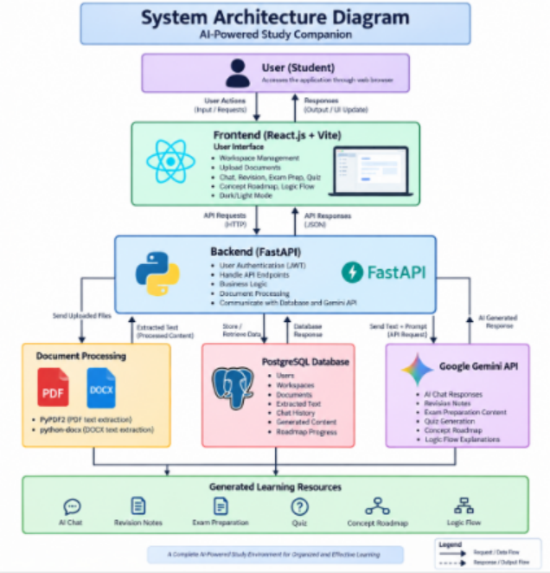
SYSTEM ARCHITECTURE
Frontend (React.js + Vite): workspace management, document upload, chat, revision, exam prep and quiz views, with dark/light mode.
Backend (FastAPI): JWT authentication, API endpoints, business logic, document processing, and all communication with the database and Gemini.
Document processing: PyPDF2 extracts text from PDFs, python-docx from Word files; the cleaned text is passed on to the backend.
PostgreSQL: stores users, workspaces, documents, extracted text, chat history, generated content and roadmap progress.
Google Gemini API: returns chat answers, revision notes or concept roadmaps and logic-flow explanations.
Notes:
Walk top-down: user to frontend, frontend to backend, backend out to processing, database and Gemini.

Slide 10
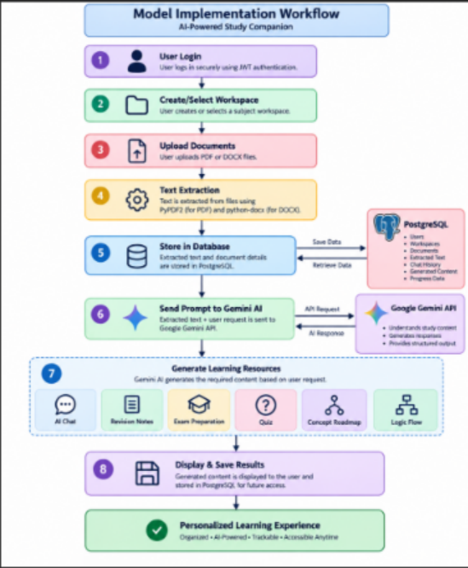
WORKFLOW
1
User Login
Secure sign-in using JWT authentication.
2
Create / Select Workspace
The student opens a subject workspace.
3
Upload Documents
PDF or DOCX study material is uploaded.
4
Text Extraction
PyPDF2 and python-docx pull out the raw text.
5
Store in Database
Text and document details are saved in PostgreSQL.
6
Send Prompt to Gemini
Extracted text plus the user request go to the Gemini API.
7
Generate Resources
Chat, notes, exam prep,or roadmap or logic flow is produced.
8
Display & Save
Output is shown to the user and stored for future access.
Notes:
Trace one document from login through to a saved quiz.

Slide 11
ALGORITHM & METHODOLOGY
A. Document Text Extraction
Prompt anatomy
The uploaded file's type is detected and routed to PyPDF2 (PDF) or python-docx (DOCX).
Each page or paragraph is read in order, and headers, footers and empty runs are stripped.
The cleaned text is stored against the document record in PostgreSQL, so it is extracted once and reused.
ROLE
You are a study assistant for this subject.
MATERIAL
Extracted text from the uploaded document.
TASK
B. Prompt Construction and Generation
Explain / summarise / map concepts.
A task template is selected for the requested resource — chat, notes, roadmap or logic flow.
The stored text and the student's request are combined into a single structured prompt for Gemini.
The model is instructed to answer from the supplied material and to return a fixed output format.
The response is parsed, rendered in the interface, and written back to the workspace.
FORMAT
Headings, numbered points.
CONSTRAINT
Stay within the supplied material.
Notes:
Explain that the same extracted text drives all six resource types — only the task template changes.

Slide 12
MODULES
Authentication Module
Workspace Module
Registration, login and JWT-based session handling, so each student's workspaces and documents stay private.
Creating, listing and opening subject workspaces; scopes all material and generated content to one subject.
Document Processing Module
Gemini Integration Module
Upload handling, file-type detection, and text extraction through PyPDF2 and python-docx.
Builds task-specific prompts, calls the Google Gemini API, and parses the structured response.
Learning Resource Module
Persistence & Progress Module
Produces AI chat, revision notes, concept roadmaps and logic-flow explanations.
Stores documents, extracted text, chat history and generated content in PostgreSQL and tracks roadmap progress.
Notes:
Six modules, each independently testable.

Slide 13

KEY ACHIEVEMENTS
Working end-to-end application — login, workspace, upload, generation and storage.
Reliable text extraction from both PDF and DOCX material using PyPDF2 and python-docx.
Six learning resources generated from one upload: chat, notes, roadmap, logic flow.
Unit-wise concept syllabus panel with progress tracking and PDF export.
Secure JWT authentication with subject-scoped workspaces for each student.
Responsive React + Vite interface with dark/light mode and a built-in focus timer.
Notes:
Quote the three headline numbers and where they were measured.

Slide 14
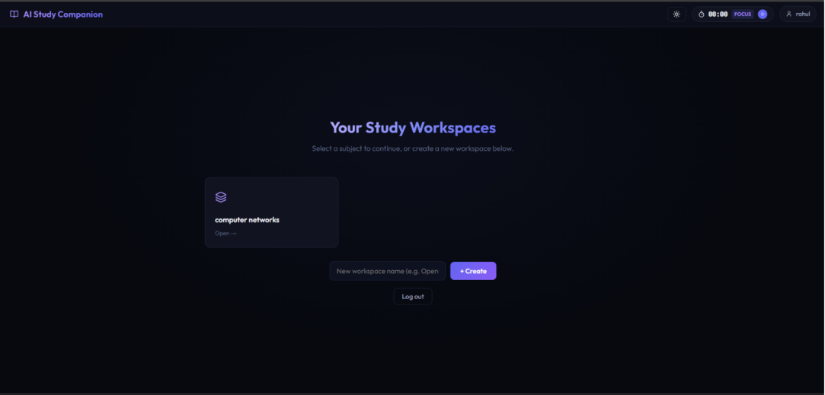
SCREENSHOTS
Workspace selection — the student picks a subject or creates a new one
Notes:
Show the workspace model: everything downstream is scoped to the subject chosen here.

Slide 15
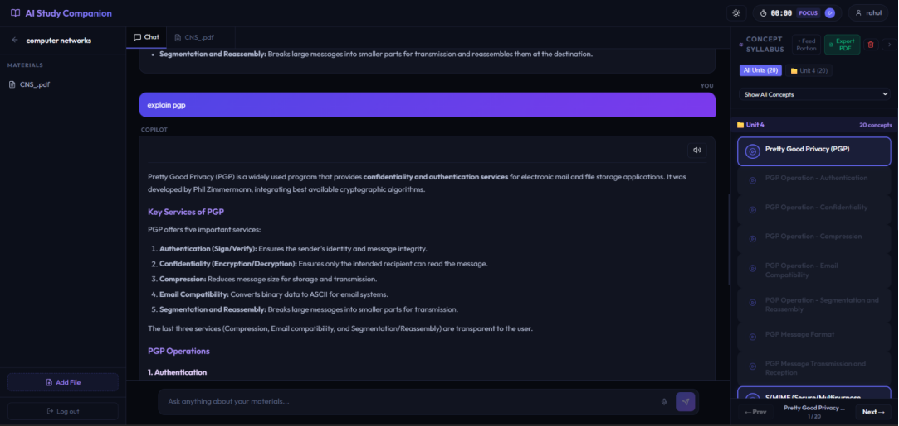
SCREENSHOTS
AI chat grounded in the uploaded material, with the concept syllabus panel alongside
Notes:
Point out the materials list on the left, the answer in the centre, and the unit-wise concept list on the right with PDF export.

Slide 16
RESULTS
Text extraction handled both PDF and DOCX material with only minor formatting loss.
Answers stayed relevant to the uploaded material rather than drifting to general knowledge.
Test users reported faster revision than working from raw documents alone.
Notes:
Explain the evaluation set before quoting the numbers.

Slide 17
FUTURE SCOPE
1
Lecture audio ingestion
2
Multilingual support
Transcribe recorded classes with Whisper so spoken explanations join the same index.
Answer and generate practice in regional languages for the same English source notes.
3
Handwritten notes
4
Collaborative workspaces
OCR support so scanned and handwritten material can be uploaded too.
Shared class libraries so a batch can build one subject workspace together.
5
Mobile application
6
Spaced revision
A companion app with offline access to saved notes and quizzes.
A scheduler that resurfaces weak concepts from the roadmap at increasing intervals.
Notes:
Pick two of these as the honest next steps rather than listing all six as promises.

Slide 18
CONCLUSION
This project set out to close the gap between having study material and actually understanding it. The AI Study Companion demonstrates that a learner's own documents, combined with a large language model through a well-structured prompt, can be turned into the several different forms that revision actually demands — explanation, notes, practice and structure.
Built on React with Vite, FastAPI, PostgreSQL and the Google Gemini API, the system delivers six learning resources from a single upload and keeps every workspace, document and generated output organised per subject. Testing on real course material showed reliable extraction, relevant answers , with users revising faster than from raw documents alone.
Explanations, notes and structure — generated in one place, from the student's own material.
Notes:
Close on the one-line value statement, then invite questions.

Slide 19
THANK YOU
Questions are welcome
Team C17 • Department of CSE (AI & ML) • Geethanjali College of Engineering and Technology
Notes:
Thank the panel and the guide.

