Slide 1



Analyzing YouTube Songs Dataset
This report provides an analysis of the YouTube song data with a focus on key metrics such as views, likes, comments, and the distribution of publishing times. The aim is to uncover insights and trends that can guide content creators and stakeholders in enhancing the performance of YouTube song videos.
By Ashish Riwal

Slide 2
Dataset Description
video_id : Unique identifier for each YouTube video.
channelTitle : Title of the YouTube channel publishing the song.
title : Title of the YouTube song video.
Description : Description provided for the YouTube song video.
tags :Tags associated with the YouTube song video.
publishedAt : Date and time when the YouTube song video was published.
viewCount : Number of views received by the YouTube song video.
likeCount : Number of likes received by the YouTube song video.
favoriteCount : Number of times the YouTube song video has been marked as a favorite.
commentCount : Number of comments posted on the YouTube song video.
duration : Duration of the YouTube song video.
definition : Video definition or quality (e.g., HD, SD).
caption : Availability of captions for the YouTube song video.

Slide 3
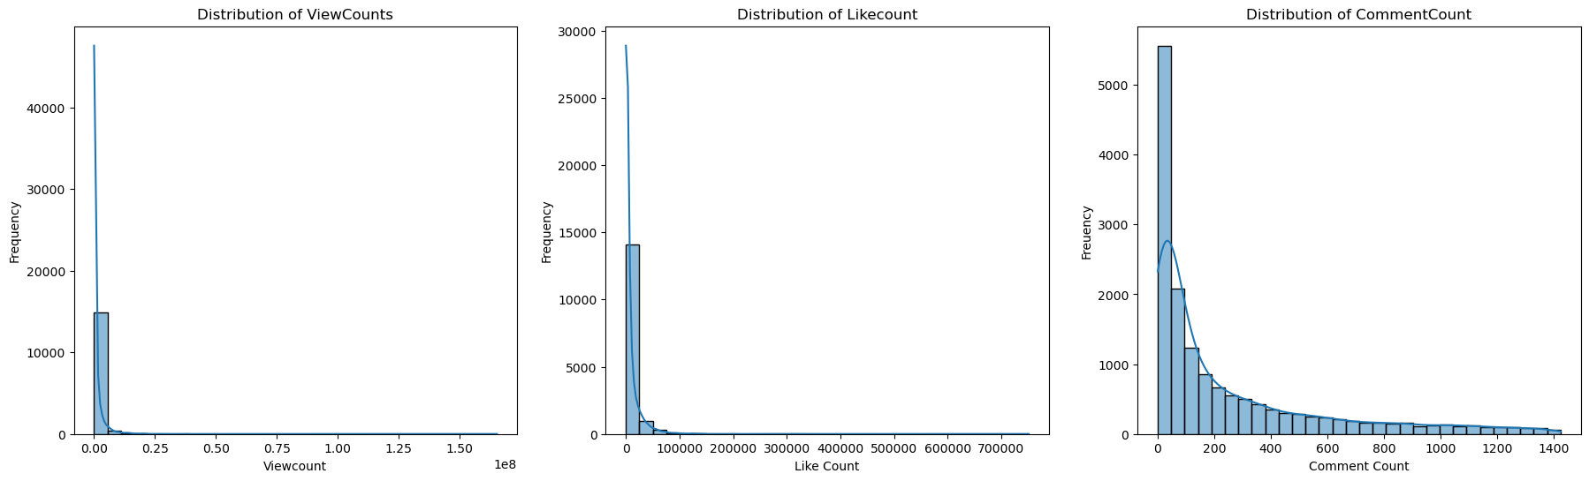
Exploratory Data
Analysis
Key Findings from the Distribution Graphs
of ViewCount, LikeCount, and CommentCount
Distribution of ViewCount
Skewed Distribution: The viewCount distribution is highly right-skewed, indicating that most videos have a relatively low number of views, while a few videos have extremely high view counts.
Concentration: The majority of videos have view counts clustered at the lower end of the scale, with a sharp drop-off as the number of views increases.
Outliers: There are significant outliers with very high view counts, stretching the distribution's tail far to the right.
Insight:
Viral Videos: A small number of videos achieve viral status, garnering an extraordinarily high number of views, while the majority receive modest view counts.

Slide 4
Key Findings from the Distribution Graphs
of ViewCount, LikeCount, and CommentCount
Exploratory Data Analysis
2. Distribution of LikeCount :
Right-Skewed Distribution: Similar to view counts, the likeCount distribution is also highly right-skewed. Most videos receive a low number of likes, with a sharp decline as the number of likes increases.
Low Frequency at Higher Counts: There are very few videos with a likeCount exceeding 100,000.
Concentration: A significant concentration of videos has likeCounts close to zero.
Insight:
Engagement Challenge: While likes are an important measure of engagement, achieving a high number of likes is challenging and uncommon for most videos.
3. Distribution of CommentCount :
Right-Skewed Distribution: The commentCount distribution is right-skewed, with most videos receiving a low number of comments.
Higher Concentration at Low Counts: The majority of videos have fewer than 100 comments.
Steady Decline: The number of videos decreases steadily as the comment count increases, with very few videos receiving more than 1,000 comments.
Insight:
Interaction Level: Commenting is a less frequent form of engagement compared to views and likes. Encouraging viewers to comment can be a valuable strategy for boosting interaction and engagement.

Slide 5
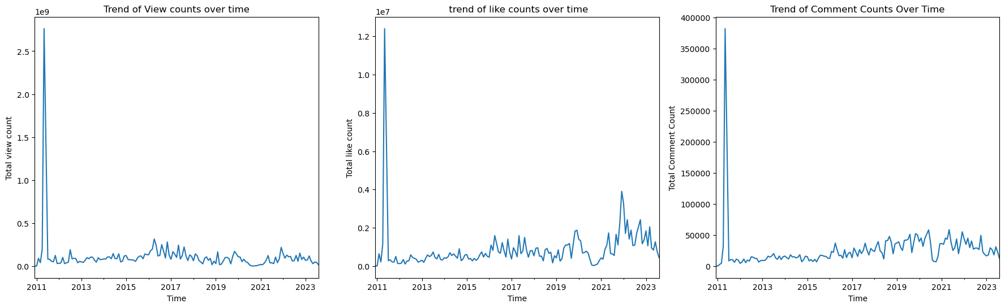
Exploratory Data
Analysis
Key Findings from the Trends over time
Graph of ViewCount, LikeCount,
and CommentCount
1. Trend of ViewCounts Over Time :
Initial Spike: There is a significant spike in view counts around 2011. This indicates a particular video or event that garnered exceptionally high views during this period.
Stable Period: After the spike in 2011, the total view counts stabilize and remain relatively low and consistent from 2012 onwards, with slight fluctuations.
Recent Trends: While the view counts show occasional peaks, they do not reach the levels observed in the initial spike.
Insight:
Viral Content: The initial spike suggests the presence of a viral video around 2011. Analyzing the content and context of this spike can provide insights into what makes videos go viral.
Consistency: Post-2011, the view counts indicate a stable and consistent viewing pattern, suggesting that while new viral hits are rare, the overall engagement remains steady.

Slide 6
Key Findings from the Trends over time Graph of
ViewCount, LikeCount, and CommentCount
Exploratory Data Analysis
2. Trend of LikeCounts Over Time
Initial Peak: Similar to view counts, there is a significant peak in like counts around 2011, which aligns with the viral video observed in the view counts.
Stable Period: After the initial peak, like counts remain relatively stable with moderate fluctuations.
Gradual Increase: There is a gradual increase in like counts from around 2015, indicating a growing trend in user engagement over time.
Insight: User Engagement: The initial peak in like counts mirrors the viral video trend, while the gradual increase post-2015 suggests improving user engagement over time. Encouraging viewers to like videos can further boost engagement metrics.
3. Trend of CommentCounts Over Time
Initial Spike: The comment counts show a significant spike around 2011, similar to the trends observed in view and like counts.
Low but Stable: After the initial spike, comment counts remain low but stable, with occasional increases in engagement.
Recent Trends: There is a noticeable increase in comment counts around 2021, suggesting a rise in user interaction during this period.
Insight: Interactive Content: The spike and subsequent stability in comment counts indicate that while commenting is less frequent than viewing or liking, it remains an important engagement metric. The recent increase in comments suggests that fostering community interaction can enhance engagement.

Slide 7
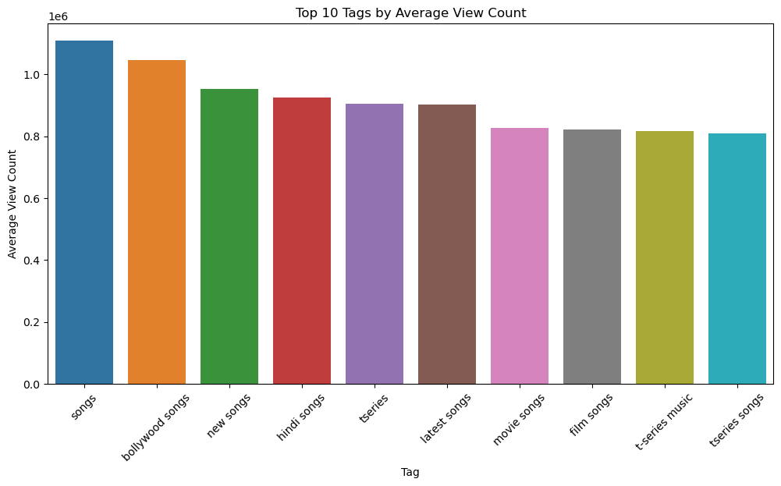
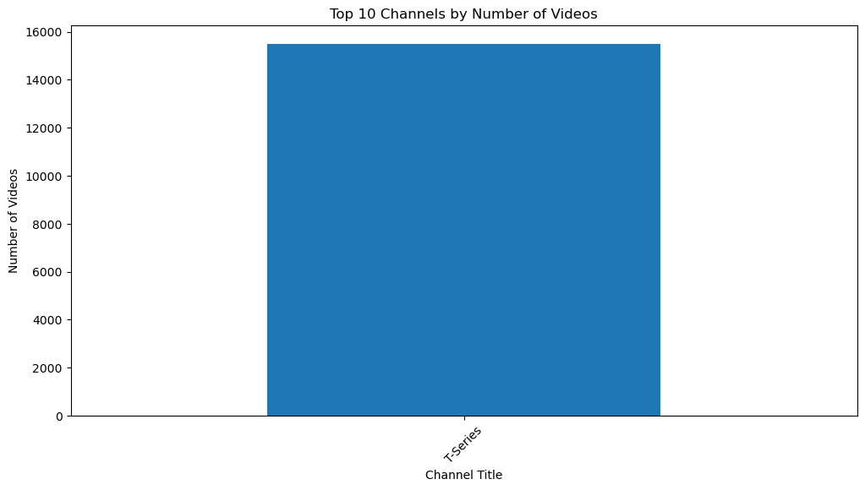
Exploratory Data
Analysis
Key Findings from tags of the songs and Channel
Distribution Graph
Top 10 Tags : From the graph it’s clearly visible that the most common used tag is ‘songs’ tag, most of the songs are published with this tag. Then on the 2nd number ‘Bollywood songs’ tag is the mostly used and we can say most of the published songs is of the Bollywood category and then ‘new songs’ , ‘Hindi songs’ and then after ‘latest songs’ there a constancy can be seen in the tags. Means to get the Viewcounts more the songs tag will be used.
Channel Distribution : The channel distribution shows there is only one channel of publishing music video, i.e., ‘T-Series’

Slide 8
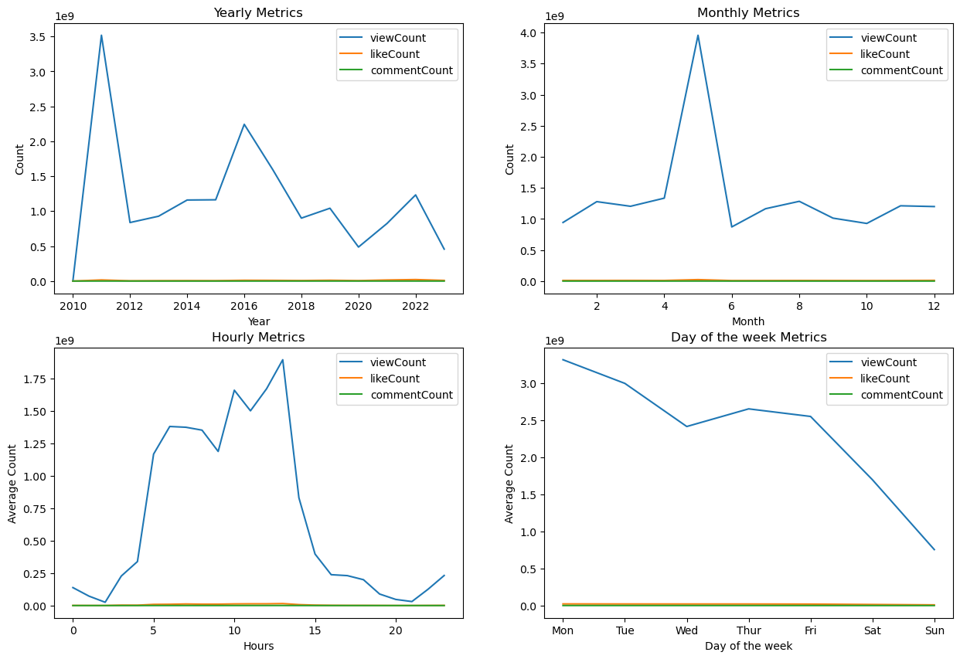
Exploratory Data Analysis
Key Findings from time Metrics of the Songs Data
Yearly Metrics: ViewCount: Peaks around 2010 and fluctuates over the years, with noticeable spikes in 2015 and 2019. The view count generally shows a declining trend after 2010.
LikeCount and CommentCount: These metrics are barely visible, indicating they are significantly lower compared to view counts.
2. Monthly Metrics:
ViewCount: Peaks notably in April, suggesting a surge in views during this month. Other months show varying levels of view counts but are much lower compared to April.
LikeCount and CommentCount: Again, these metrics are almost negligible compared to view counts.
3. Day of the Week Metrics:
ViewCount: The highest on Monday, gradually declining towards the weekend, with the lowest on Sunday. This suggests that viewers are more active during the start of the week.
LikeCount and CommentCount: As seen in other graphs, these counts are significantly lower compared to view counts.
4. Hourly Metrics:
ViewCount: Shows higher activity between 6 AM to 3 PM, with a peak around 2 PM. This indicates that most views occur during daytime hours.
LikeCount and CommentCount: Similar to the other graphs, these counts remain very low compared to view counts.

Slide 9
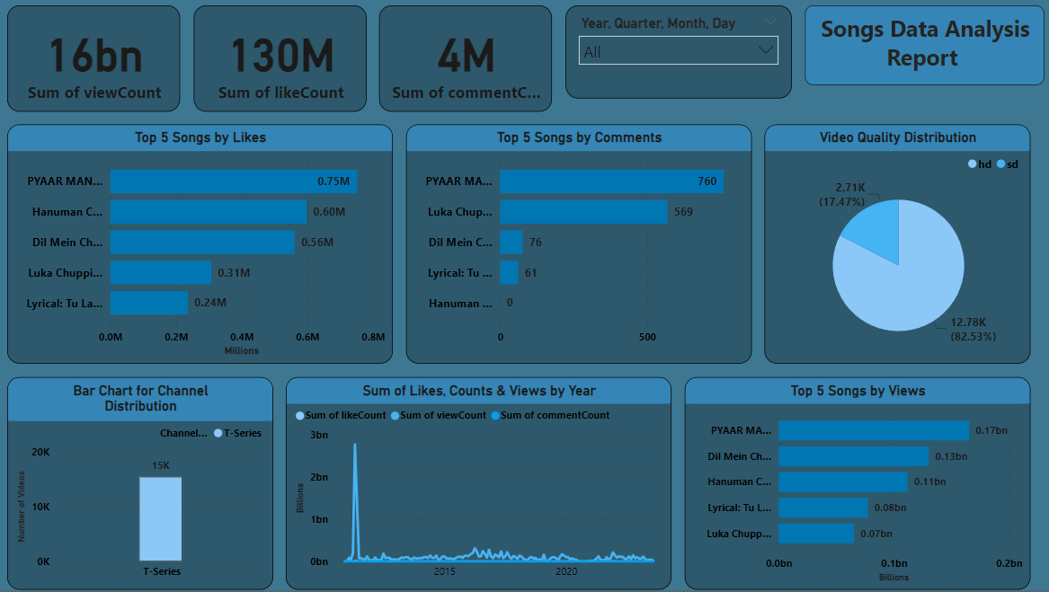
Identifying Trending Songs
﻿Summary from Top 5 Songs by View Chart :
From view chart summary it’s clear that ‘Pyaar Manga hai’ has the highest view count(0.17 Billion) and one the trending songs by views then on 2nd number ‘ Dil mein chupa lunga’ ( 0.13 Billion), 3rd ‘Hanuman Chalisa’(0.11 Billion), 4th ‘Tu long mein Lacchi-Lyrical’(0.08 Billion) and last 5th one is again ‘Tu long mein Lacchi’(0.07 Billion). These are the top 5 trending songs by the viewCounts.
﻿Summary from Top 5 Songs by Like Chart:
From like chart summary it’s clear that ‘Pyaar Manga hai’ song is still on the 1st number with (0.75 Million) like counts and ‘ Hanuman Chalisa’ comes on the 2nd number with (0.60 Million) like counts, ‘ Dil mein Chupa Lunga’ goes on the 3rd number with (0.56 Million) like count, ‘Tu long mein Lacchi-Lyrical’(0.08 Billion) goes on the 5th number with (0.31 Millions) like count and last is ‘Tu long mein Lacchi comes on the 4th number ’ with (0.24 Million) like counts. These are the top 5 trending songs by the likeCounts.
Summary from Top 5 Songs by Comment Chart:
From like chart summary it’s clear that again ‘Pyaar Manga hai’ song is still on the 1st number with 760 comments and ‘ Hanuman Chalisa’ goes on the last number with 0 comments, ‘ Dil mein Chupa Lunga’ still on the 3rd number with 76 comments, ‘Tu long mein Lacchi-Lyrical’ comes on the 4th number with 61 comments and last is ‘Tu long mein Lacchi comes on the 2nd number ’ with 61 comments.

Slide 10
Factors Influencing User Engagement
1
Content Quality
2
Video Titles and Thumbnails
High-quality content that resonates with the audience is likely to receive more views, likes, and comments.
Catchy titles and appealing thumbnails can attract more viewers.
3
Promotion and Social Sharing
4
Audience Interaction
Actively promoting videos on social media and other platforms can drive traffic and engagement.
Engaging with viewers through comments and creating interactive content can foster a loyal community.
Insights
1
Holistic Approach
A combination of high-quality content, effective promotion, and active audience interaction is essential for maximizing engagement.

Slide 11
Recommendations for the content Creators and Stakeholders
Based on the detailed analysis of the YouTube song video dataset, here are some key recommendations for content creators and stakeholders to enhance performance and engagement:
Optimize Publishing Times
Best Times to Publish: The analysis shows that videos published around 1 PM (13:00) have the highest number of uploads, indicating a potential high-traffic period. Experiment with publishing during this time to capture a larger audience.
Avoid Low Traffic Times: Publishing videos during late-night or early morning hours (between 1 AM and 6 AM) generally shows lower engagement. Avoid these times for better visibility and engagement.
2. Enhance Video Titles and Thumbnails
Catchy and Descriptive Titles: Use catchy titles that are concise, clear, and include keywords. Incorporate numbers, questions, and power words to attract clicks. For example, "Top 10 Viral Songs of 2023 You Must Hear”.
Eye-Catching Thumbnails: Invest time in creating attractive and relevant thumbnails. Thumbnails should be visually appealing, have a consistent style, and reflect the content of the video.
3. Leverage High Engagement Metrics
Likes and Comments as Indicators: Videos with higher like and comment counts generally indicate better engagement. Encourage viewers to like, comment, and share the videos to increase interaction.
Respond to Comments: Actively engage with viewers by responding to comments. This fosters a community feeling and can boost engagement.

Slide 12
Recommendations for the content Creators and Stakeholders
Content Quality and Consistency
High-Quality Production: Ensure that the video and audio quality are top-notch. Invest in good equipment and post-production to make videos more appealing.
Consistent Upload Schedule: Maintain a consistent upload schedule to keep the audience engaged and coming back for more.
2. Utilize Social Media and Cross-Promotion
Promote on Social Media: Use social media platforms to promote new videos. Share snippets, behind-the-scenes content, and teasers to create buzz.
Collaborations: Collaborate with other popular creators or influencers to reach a broader audience. Cross-promotions can significantly boost visibility and engagement.
Thank You

