Slide 1



Introduction to Hotel Aggregate Rating Prediction
The objective of our project is to predict restaurant ratings based on several features such as location, cost for two, and cuisines offered. Accurate prediction of ratings can be invaluable for restaurant owners and customers alike, enabling better decision-making and improving customer satisfaction
By Ashish Riwal

Slide 2
The dataset includes 9551 records, providing a comprehensive overview of restaurant data. The dataset contains the following columns:
1. Restaurant ID: Unique identifier for each restaurant.
2. Restaurant Name: Name of the restaurant.
3. Country Code: Numeric code representing the country where the restaurant is located.
4. City: Name of the city where the restaurant is situated.
5. Address: Physical address of the restaurant.
6. Locality: Locality or neighborhood where the restaurant is located.
7. Locality Verbose: Detailed description of the locality.
8. Longitude: Geographical longitude of the restaurant's location.
9. Latitude: Geographical latitude of the restaurant's location.
10. Cuisines: Types of cuisines offered by the restaurant.
11. Average Cost for Two: Average cost for a meal for two people.
12. Currency: Currency used for transactions in the restaurant.
13. Has Table Booking: Indicator of whether the restaurant accepts table bookings.
14. Has Online Delivery: Indicator of whether the restaurant offers online delivery.
15. Is Delivering Now: Indicator of whether the restaurant is currently delivering.
16. Switch to Order Menu: Indicator of whether the restaurant has switched to an order menu.
17. Price Range: Price range category of the restaurant.
18. Aggregate Rating: Overall rating of the restaurant.
19. Rating Color: Color code representing the rating.
20. Rating Text: Text description of the rating.
21. Votes: Number of votes received by the restaurant.

Slide 3
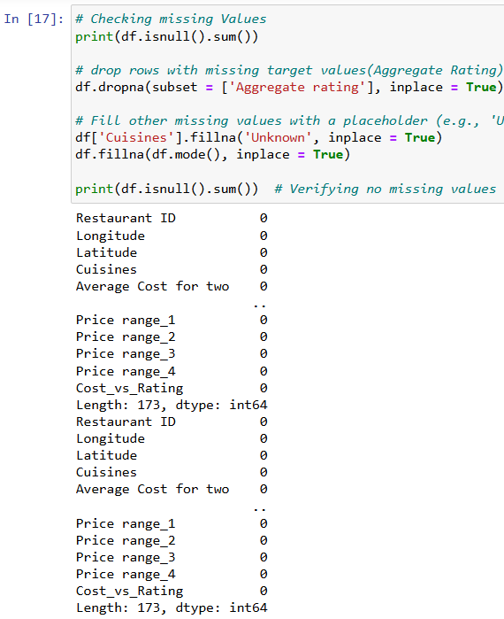
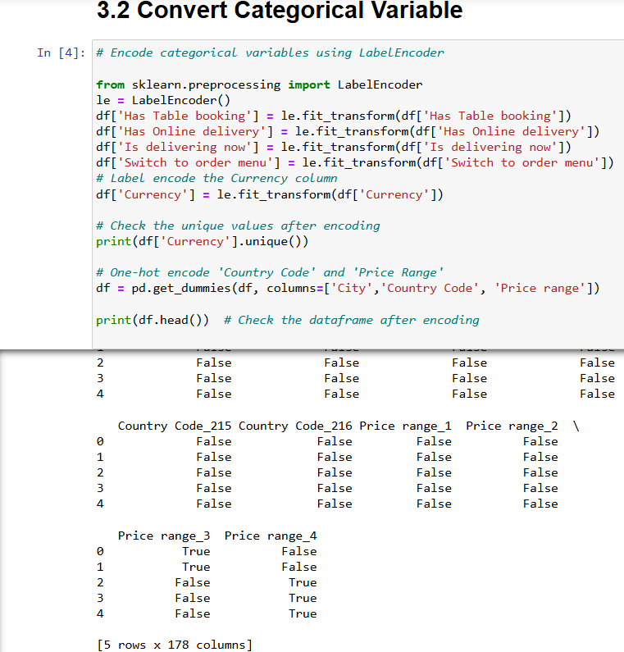
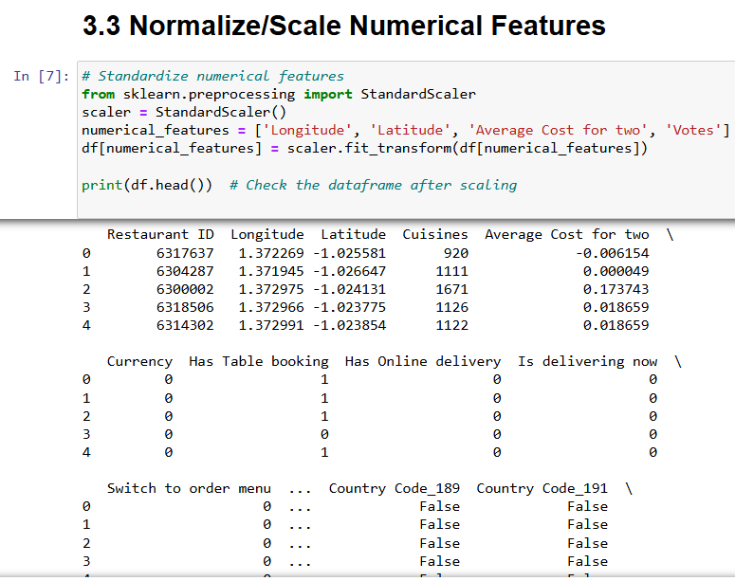
Data Preprocessing: To ensure our model works effectively, we first cleaned and preprocessed the data. This included handling missing values, encoding
categorical variables like city and price range using One-Hot Encoding, and scaling numerical features such as longitude, latitude, and average cost for two
using StandardScaler.

Slide 4
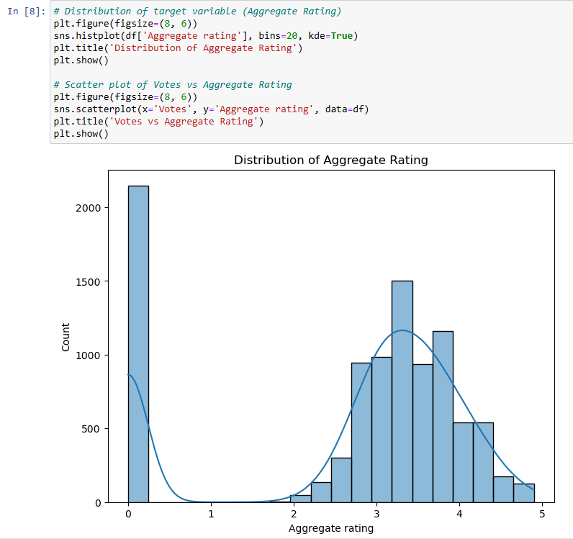
EDA of the Data: The distribution of the "Aggregate Rating" reveals a bimodal pattern, with a significant concentration of ratings at 0, indicating
many instances of unrated or extremely low-rated items. Additionally,
there is another peak in the 3 to 4 rating range, suggesting that a large
portion of the dataset falls within this moderate to high rating category.
The sparse presence of ratings between 1 and 2 indicates that users tend
to either give very low or relatively high ratings, with fewer moderate
evaluations. This polarization in ratings could suggest that users are more
likely to rate items at extremes or that the system might encourage such
rating behavior.

Slide 5
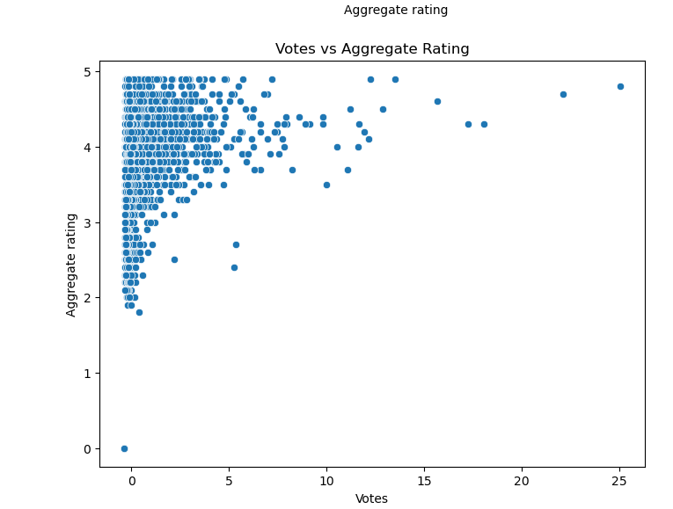
EDA of the Data: The scatter plot reveals that most entities receive a high aggregate rating (above 4) despite having a relatively low number of
votes, suggesting that highly rated items often garner limited attention.
There is a noticeable clustering of data points in the upper left corner,
indicating that while many items are rated favorably, they don't attract a
large voting base. Conversely, as the number of votes increases, the
distribution of ratings becomes more varied, with fewer entities achieving
either very high or very low ratings. This pattern highlights a potential
disparity between popularity and perceived quality, where items with
fewer votes are often highly rated, while those with more votes show a
broader range of ratings. The scatter plot reveals that most entities receive
a high aggregate rating (above 4) despite having a relatively low number
of votes, suggesting that highly rated items often garner limited attention.
There is a noticeable clustering of data points in the upper left corner,
indicating that while many items are rated favorably, they don't attract a
large voting base. Conversely, as the number of votes increases, the
distribution of ratings becomes more varied, with fewer entities achieving
either very high or very low ratings. This pattern highlights a potential
disparity between popularity and perceived quality, where items with fewer votes are often highly rated, while those with more votes show a broader range of
ratings.

Slide 6
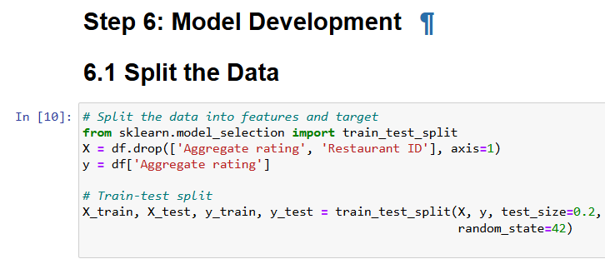
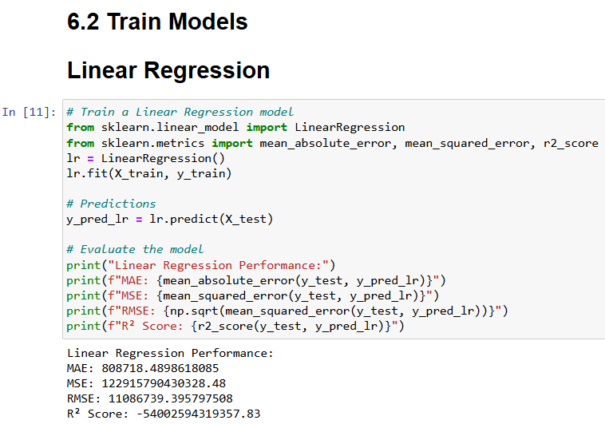
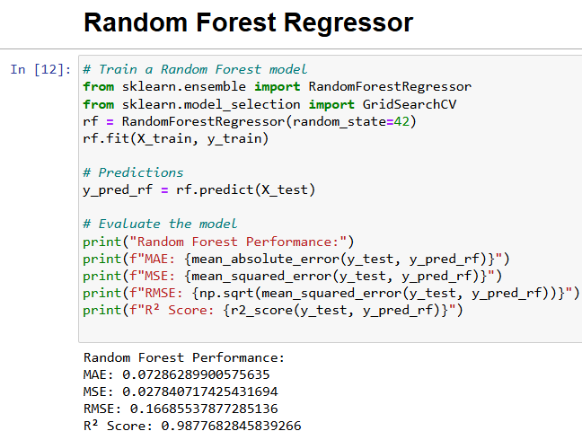
Model Development: We opted for the Random Forest Regressor and Linear Regression as our predictive model. The dataset was split into
training and testing sets in an 80/20 ratio. The model's performance was evaluated using metrics such as Mean Absolute Error (MAE), Mean Squared Error
(MSE), Root Mean Squared Error (RMSE), and
R² Score.

Slide 7
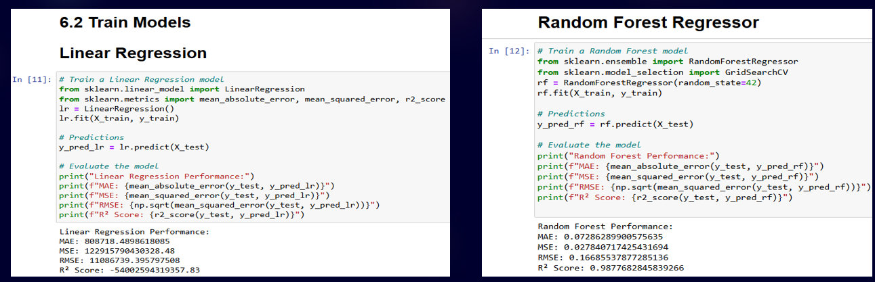
Model Evaluation: The image shows the performance comparison of two regression models: Linear Regression and Random Forest Regressor. Both
models are trained on the same dataset
,with their performance evaluated using
Various metrics, including Mean Absolute
Error (MAE), Mean Squared Error (MSE),
Root Mean Squared Error (RMSE),and R²
Score.
Insights:
Linear Regression:
MAE: 808718.489
MSE: 12291978403632.48
RMSE: 11086879.395797508
R² Score: -54002594319357.83
The negative R² score indicates a poor fit, suggesting that the model fails to capture the relationship between the features and the target variable.
Random Forest Regressor:
MAE: 0.07286289905575635
MSE: 0.027840717425431694
RMSE: 0.16685357877825136
R² Score: 0.9877628248539266
The Random Forest Regressor has significantly better performance, with a near-perfect R² score close to 1, indicating a very strong fit and excellent predictive
power.

Slide 8
Conclusions:
The Random Forest Regressor outperforms the Linear Regression model by a wide margin across all evaluation metrics. The Linear
Regression model’s negative R² score indicates that it fails to model the data effectively, possibly due to the complexity of the relationship
between the input features and the target variable.
The Random Forest Regressor's high R² score and low error metrics suggest that it captures the underlying patterns in the data well,
making it the superior model for this specific dataset.
This comparison highlights the importance of using more complex models like Random Forest for datasets where linear relationships
might not suffice, providing more accurate and reliable predictions.

