Slide 1


Internship Presentation in Python
GitHub: https://github.com/AshishSahani0/CodSoft_Python_Task

Slide 2
Department of Computer
Science and Engineering
Presented By:
Ashish Sahani
CSE-B
2301330100058
Presented To:
Mr. Rupendra Kaushik
Ms. Ankita Sharma

Slide 3
About CodSoft......
It's aim is to help students lacking basic skills by offering hands-on learning through live projects and real-world examples through Internships in different background i.e. Python , Java, C , C++ Programming Language as well it also provide internship in different developing backgrounds such as Web Development, Android Development , Data Science etc.....
https://www.codsoft.in/
contact@codsoft.in

Slide 4
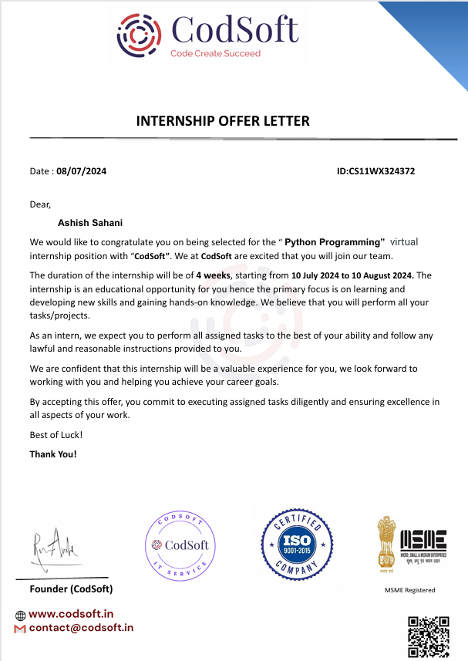
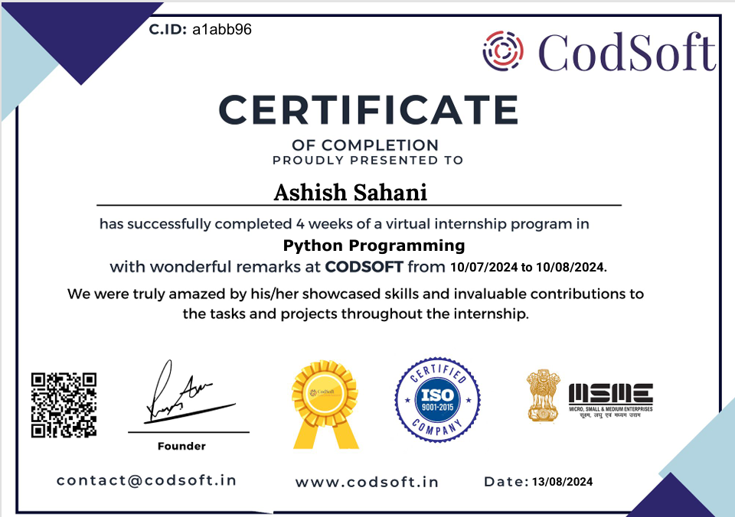

Slide 5
Task 1………. TO-DO LIST
A To-Do List application is a useful project that helps users manage and organize their tasks efficiently. This project aims to create a command-line or GUI-based application using Python, allowing users to create, update, and track their to-do lists

Slide 6
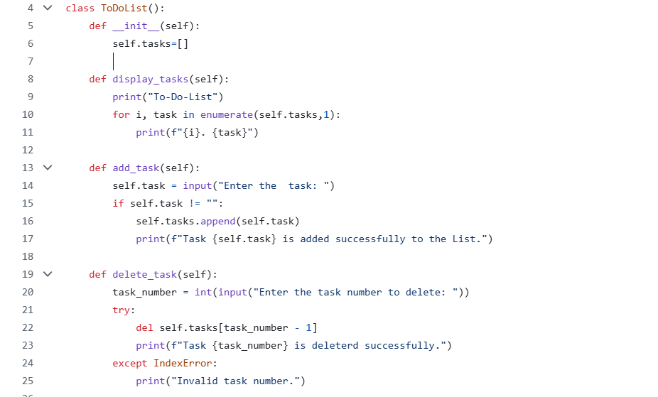

Slide 7
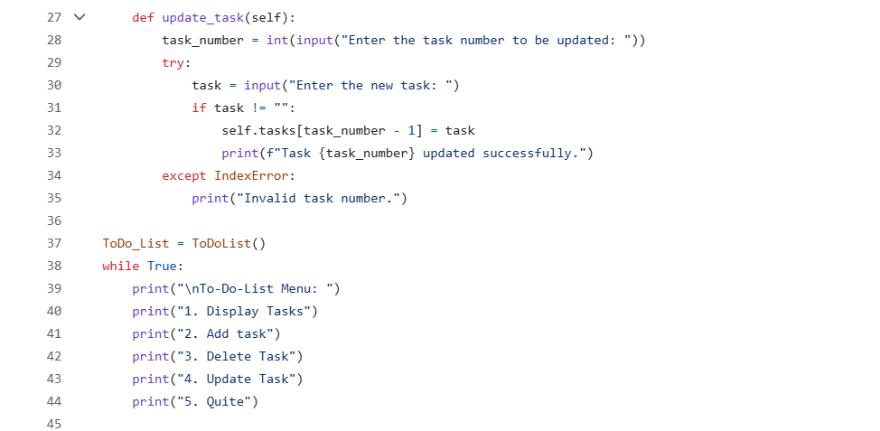

Slide 8
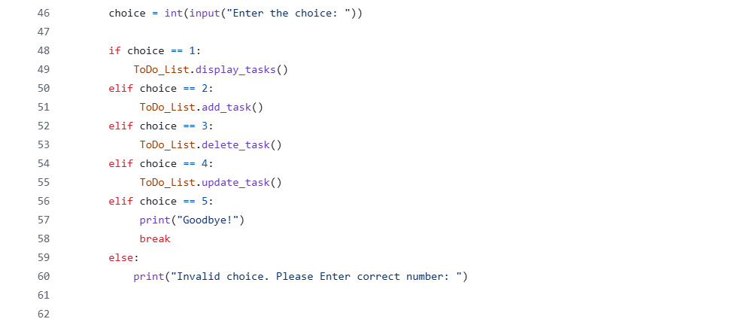

Slide 9
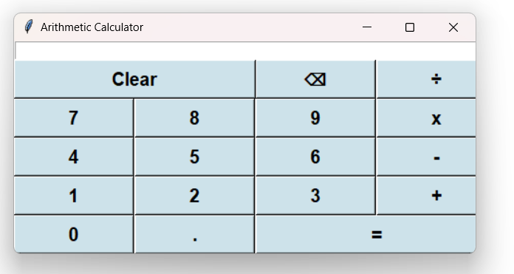
Task 2…. CALCULATOR
Design a simple calculator with basic arithmetic operations using GUI.

Slide 10
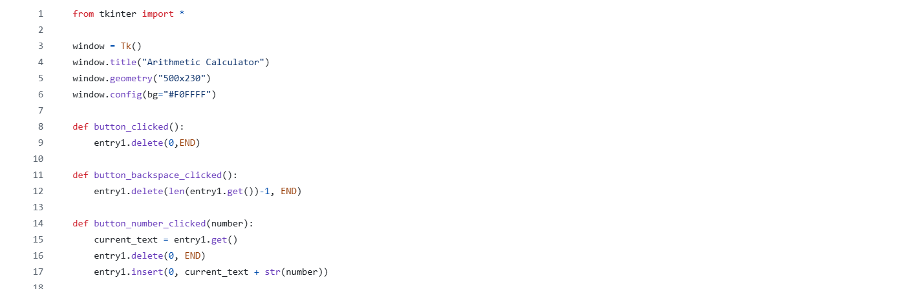
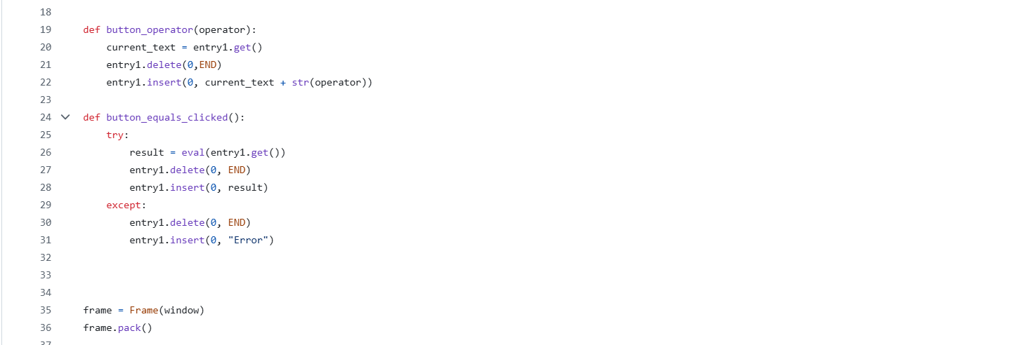

Slide 11
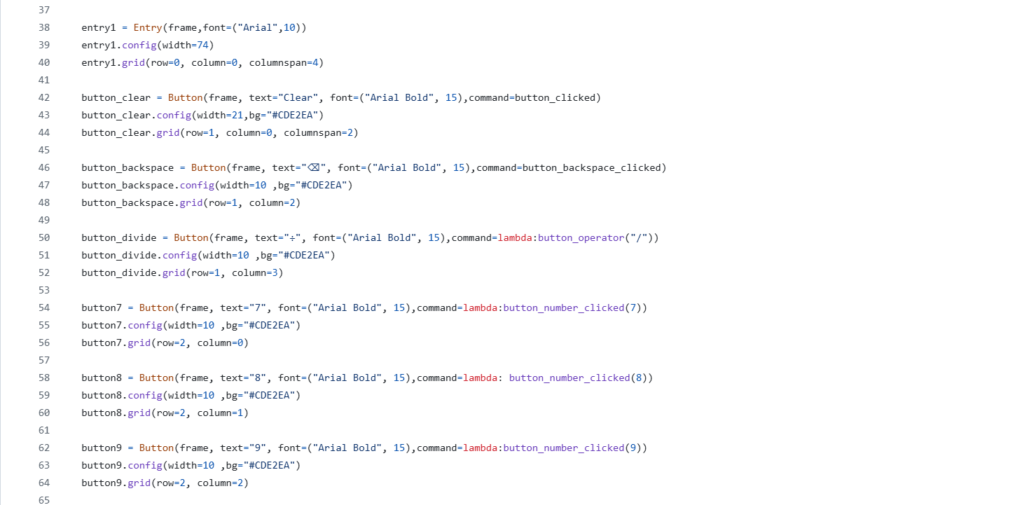

Slide 12
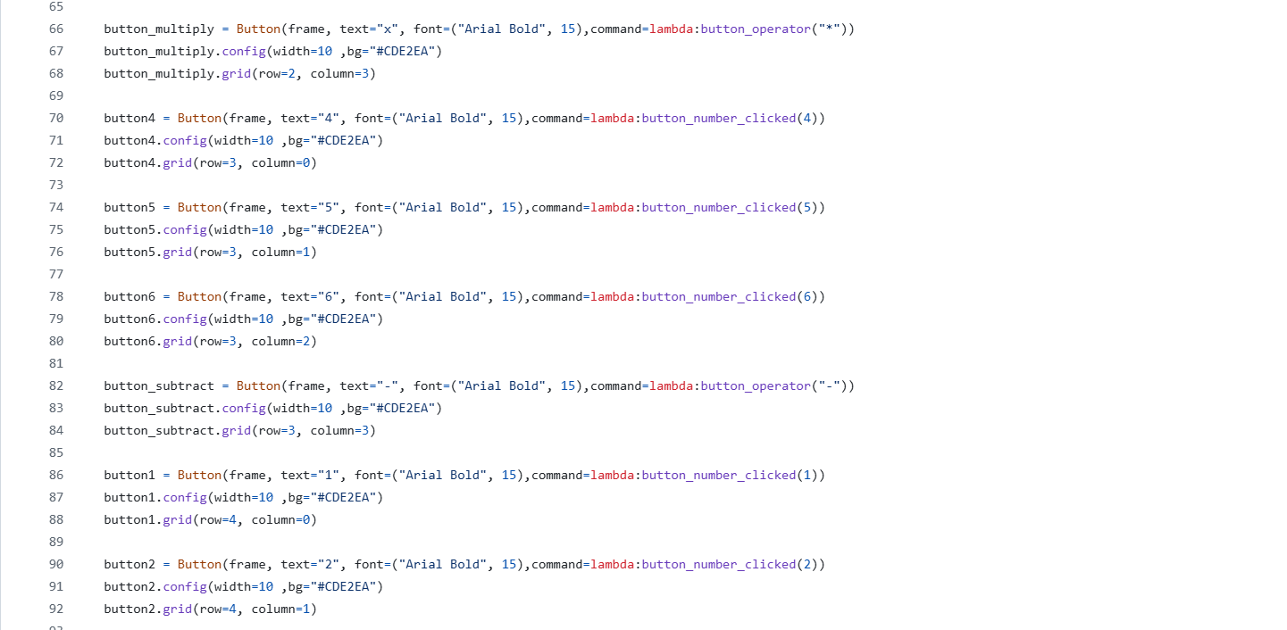

Slide 13
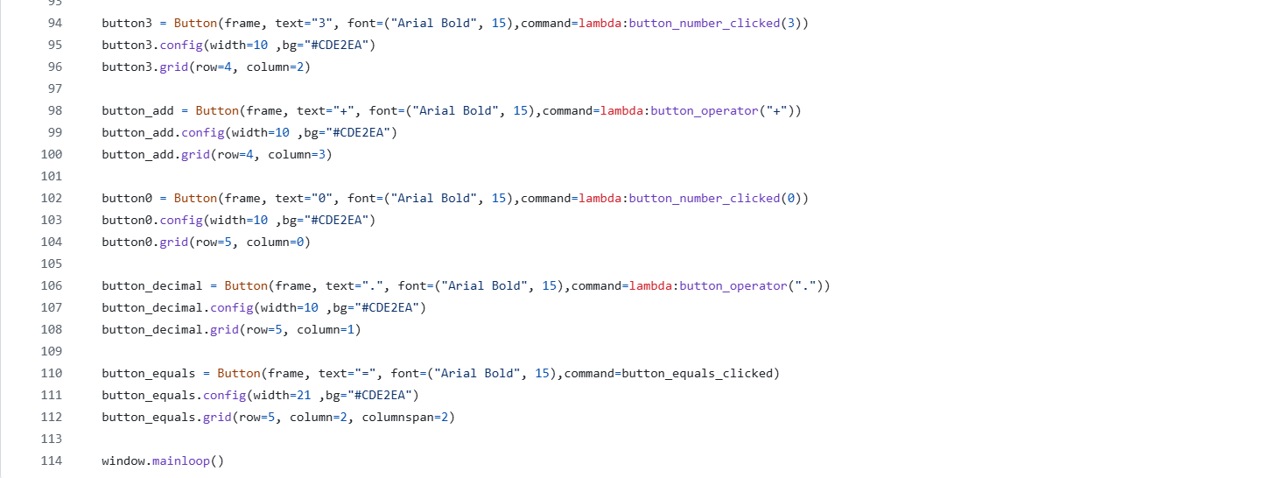

Slide 14
Task 3….. Rock-Paper-Scissors Game
User Input: Prompt the user to choose rock, paper, or scissors.
Computer Selection: Generate a random choice (rock, paper, or scissors) for the computer.
Game Logic: Determine the winner based on the user's choice and the computer's choice. Rock beats scissors, scissors beat paper, and paper beats rock.
Display Result: Show the user's choice and the computer's choice. Display the result, whether the user wins, loses, or it's a tie.
Score Tracking (Optional): Keep track of the user's and computer's scores for multiple rounds.
Play Again: Ask the user if they want to play another round.
User Interface: Design a user-friendly interface with clear instructions and feedback.

Slide 15
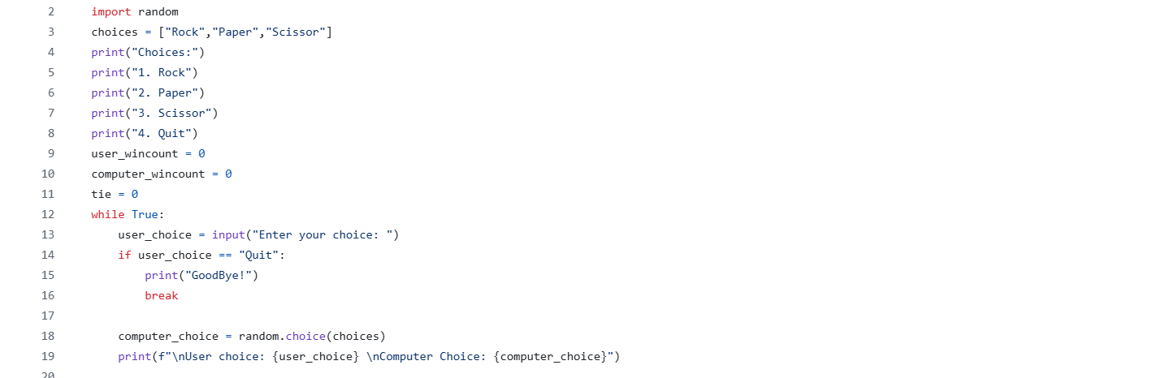

Slide 16
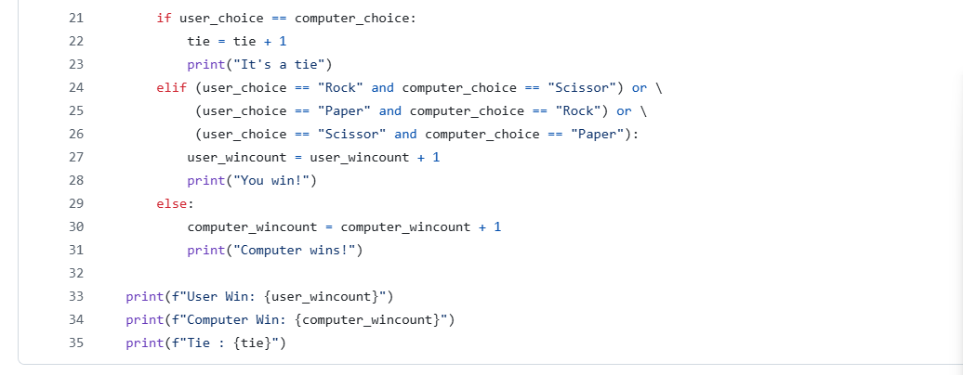

Slide 17
THANK You

