Slide 1

Library Management
OOTs Using JAVA
BCSE0352
Department of Computer Science and Engineering
Submitted to:
Name of Member | Roll Number | Role Number | Department Section
Team Lead Name | ASHISH SAHANI | 2301330100058 | CSE-B
Team Member Name | ASHISH SAHANI | 2301330100058 | CSE-B
Team Member Name | ANURAG PATEL | 2301330100058 | CSE-B
Team Member Name | AMIT RAJ SINGH | 2301330100031 | CSE-A

Slide 2
Introduction…..
Library management is the process of organizing and maintaining a library to ensure it runs smoothly and meets the needs of its users. This includes tasks like managing books and resources, helping people find information, tracking borrowed items, and using technology to keep things efficient. The goal is to make sure the library provides easy access to knowledge and services for the community.

Slide 3

Technologies and concepts are utilized……
Java Programming Language:
The entire application is written in Java, a popular, object-oriented programming language used for developing desktop, mobile, and web applications.
Swing (Java GUI Toolkit):
JFrame: The main window for the application.
JLabel, JTextField: For displaying text and allowing the user to input data .
JButton: Buttons for adding, viewing, editing, and deleting books.
JTable and JScrollPane: Used for displaying the list of books in a table format.
JOptionPane: For displaying dialog boxes to show messages or ask for user input .

Slide 4
Event Handling with ActionListener
The ActionListener interface is implemented to handle user actions, such as button clicks(e.g.. Adding, viewing, editing, or deleting books).
Data Structure (ArrayList)
ArrayList<String[]>: Used to store the books information. Each book is represented as an array of string and all books are stored in an ArrayList.
GitHub: https://github.com/AshishSahani0/JAVA_Project/blob/main/LibraryManagement.java

Slide 5
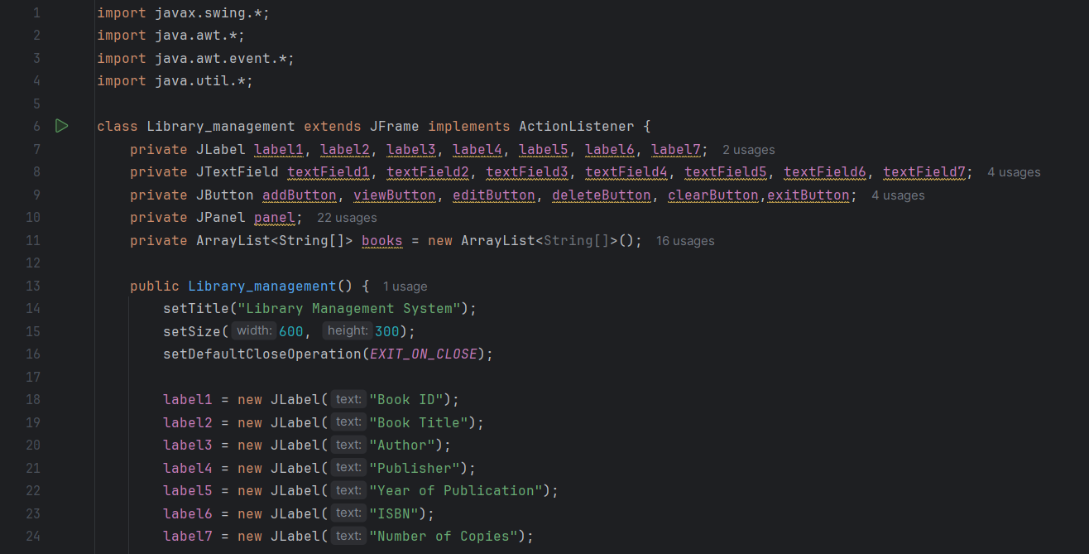

Slide 6
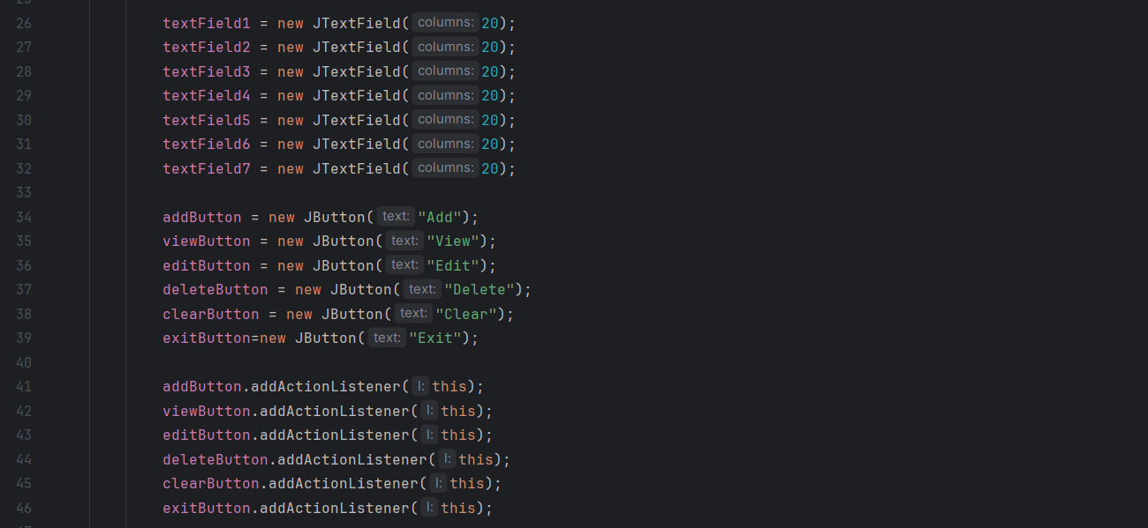

Slide 7
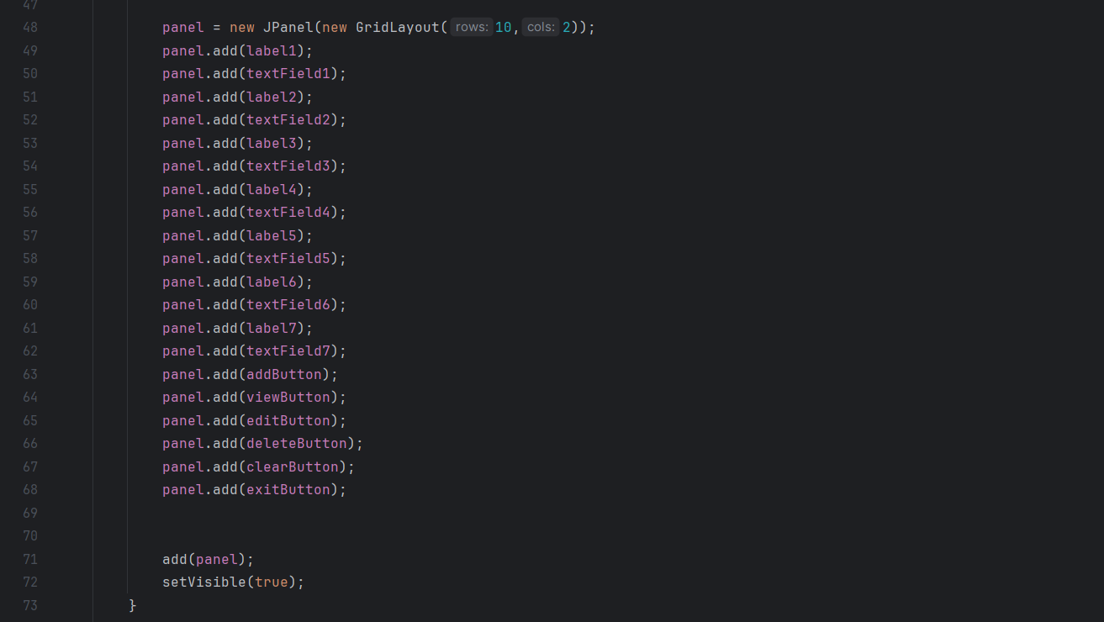

Slide 8
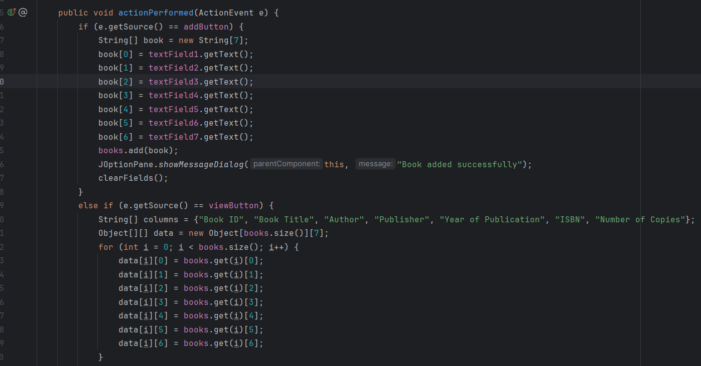

Slide 9
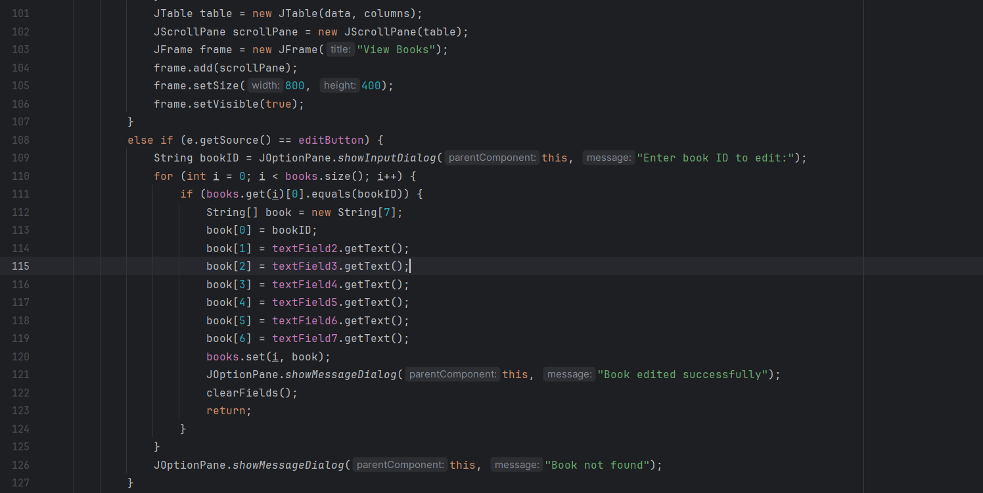

Slide 10
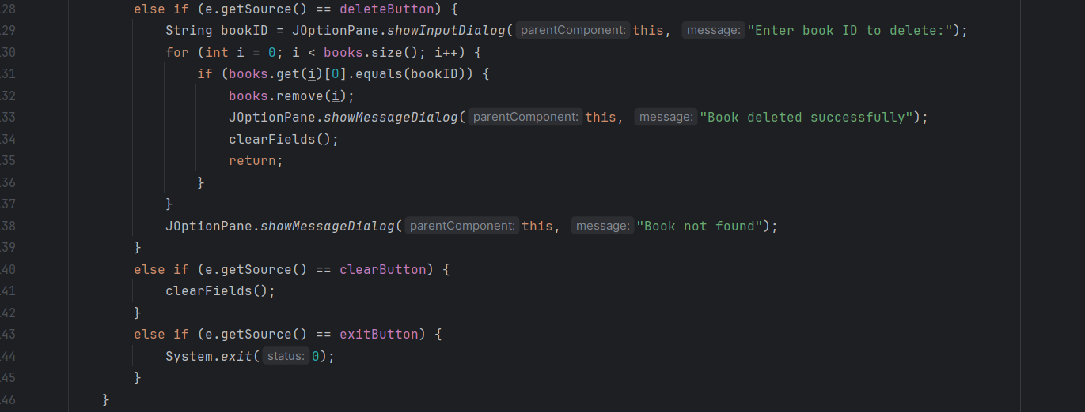

Slide 11
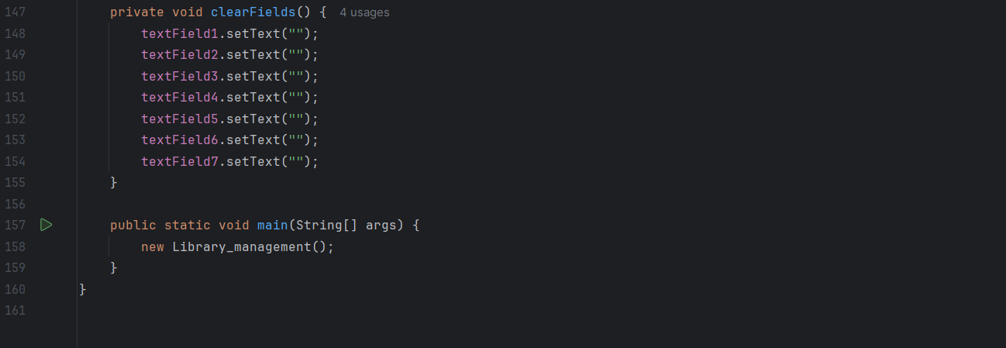

Slide 12
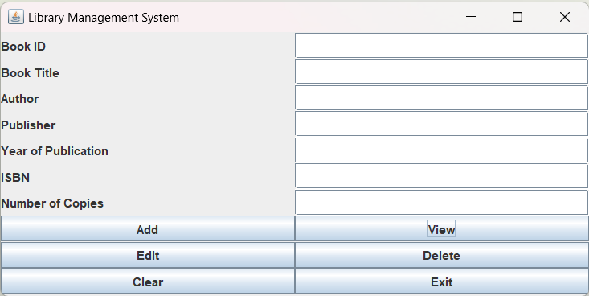

Slide 13
Thank You

