Slide 1
Containers with “ACI”

Slide 2
Secure Deployment
Network Considerations
Network Security Groups can be leveraged on the ACI delegated subnets to restrict inbound and outbound traffic
Azure private DNS zones can be used for internal DNS resolution
Private link can be used to access PaaS services like storage account
VNET injected ACI is supported.
Considerations:
Private endpoint is not supported for ACI.
Reference : https://docs.microsoft.com/en-us/azure/container-instances/container-instances-volume-azure-files
az container create \
--resource-group $ACI_PERS_RESOURCE_GROUP \
--name hellofiles \
--image mcr.microsoft.com/azuredocs/aci-hellofiles \
--dns-name-label aci-demo \
--ports 80 \
--azure-file-volume-account-name $ACI_PERS_STORAGE_ACCOUNT_NAME \
--azure-file-volume-account-key $STORAGE_KEY \
--azure-file-volume-share-name $ACI_PERS_SHARE_NAME \
--azure-file-volume-mount-path /aci/logs/

Slide 3
Secure Deployment
Network Considerations
ACI can be accessed externally through Application Gateway
AppGW can leverage managed identity to fetch listener certificate from Az keyvault
Network virtual appliance can be used if ACI is needed to front end a TCP connection.
Cons:
ACI cannot frontend a connection in ATT env because neither ACI nor appgw support private link at present.

Slide 4
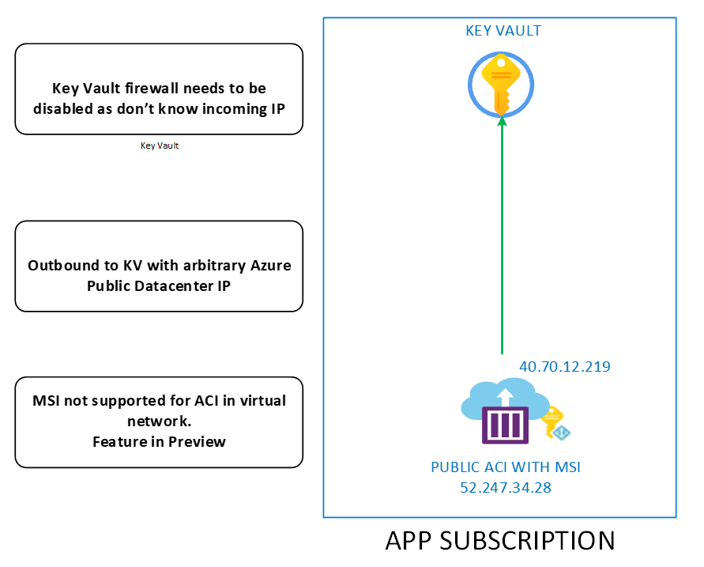
Secure Deployment
KV Integration
Azure Container Instances doesn’t support Azure Key Vault integration Natively
To fetch Application secrets during run time, managed identity is required. MSI is only supported on Public ACI type (Preview)
Azure Key Vault resource Firewall needs to be disabled to be accessed by ACI
Considerations:
As per ATT ASPR guidelines it is not recommended disable KV firewall.
MSI is not supported with VNET injected ACI.

Slide 5
Secure Deployment
Secrets
Private/Public ACI has option for using “secret” mount point
Application secrets can be retrieved from KV using automation and use it while ACI instance creation.
Workaround:
ADO Agent works as middle agent to pull secret from KV and present it to ACI.

Slide 6
Secure Deployment
Secrets
Secure ENV variables can also be used for application secrets.
Saved in container instance ENV variables
Secure ENV variables are not visible via aci properties but can be seen by logging into aci shell
- Secret mount or ENV variables can be used to decouple application code from application secrets.
- Application secrets must be fetched from Key vault as a preliminary step.

Slide 7
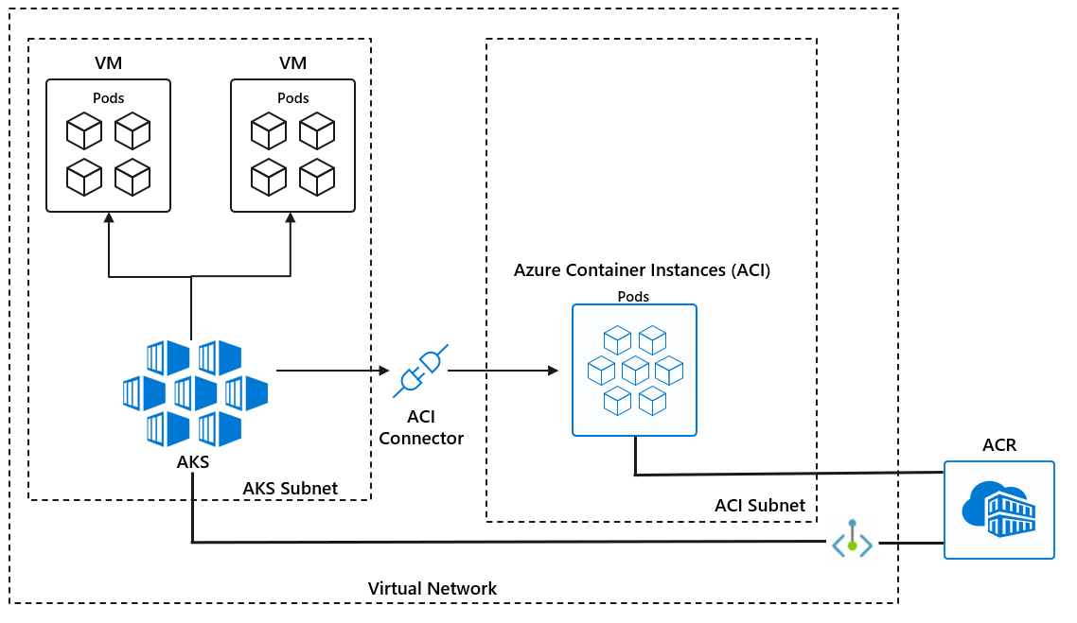

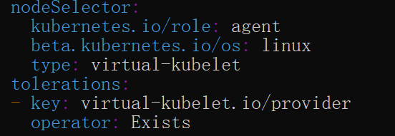
Secure Deployment
Burst with AKS
Virtual nodes can be configured with Delegated subnet, Pods can be deployed, scale and managed from AKS.
It required Secret object (ACR access) to be presented to the Deployment YAML
With NodeSelector definition Pods can be pushed to virtual node
Considerations:
ACI service can not pull secrets or certs from KV though MSI.
Build kubernetes Secret objects in advance to access ACR
Custom logic will be required for Autoscaling burst scenario.

