Slide 1
EDA on Filipino Family Income and Expenditure Dataset
- Anirudh Ayya
-Ashish Shenoy

Slide 2
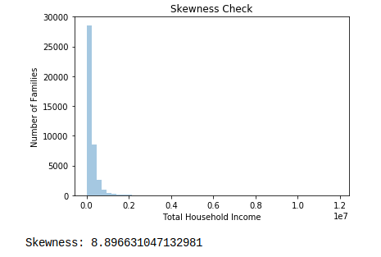
Checking for Skewness

Slide 3
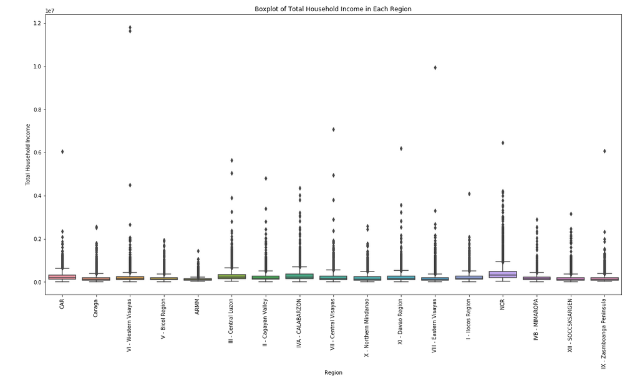
Checking for Presence of Outliers

Slide 4
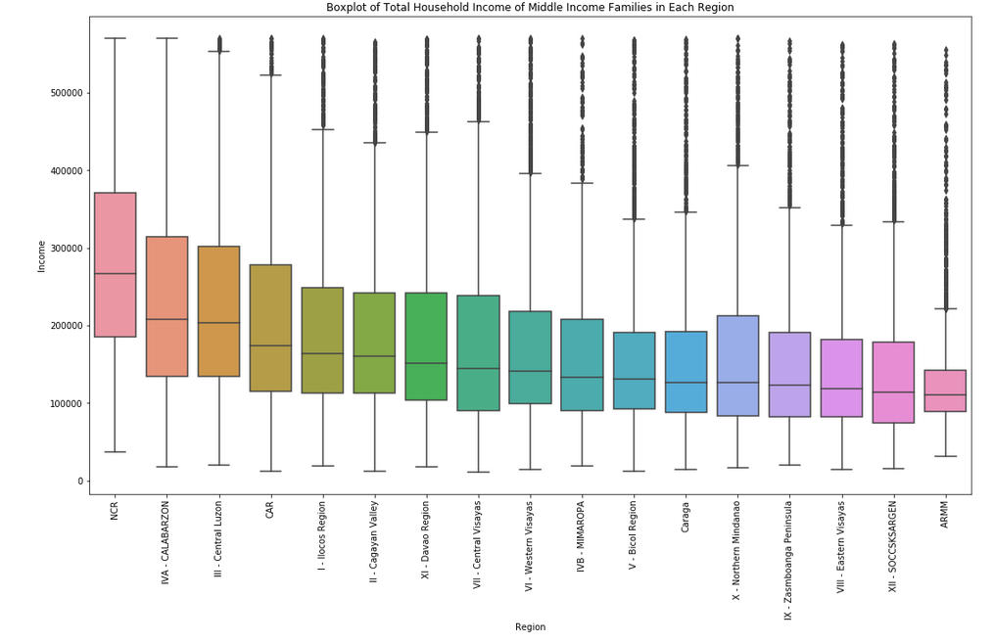
Middle Income Families by Region

Slide 5
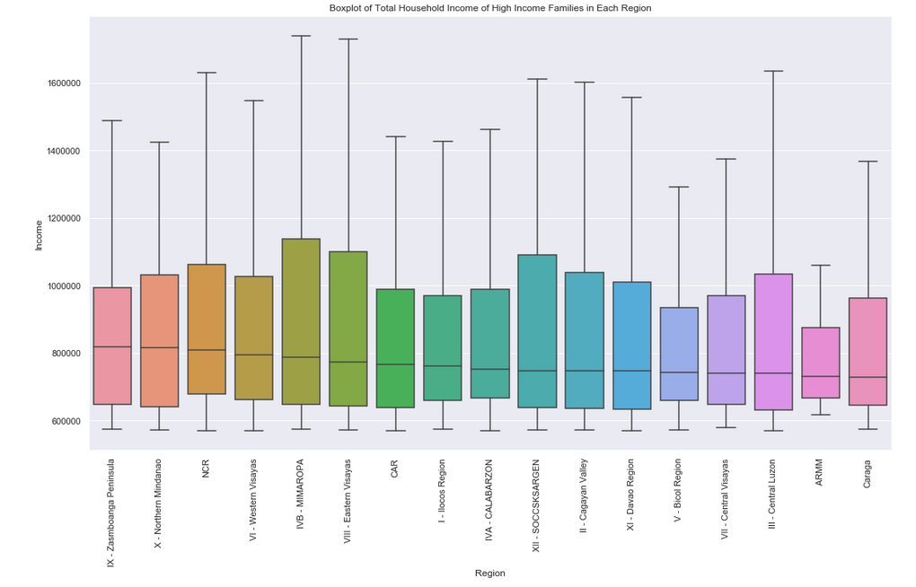
High Income Families by Region

Slide 6
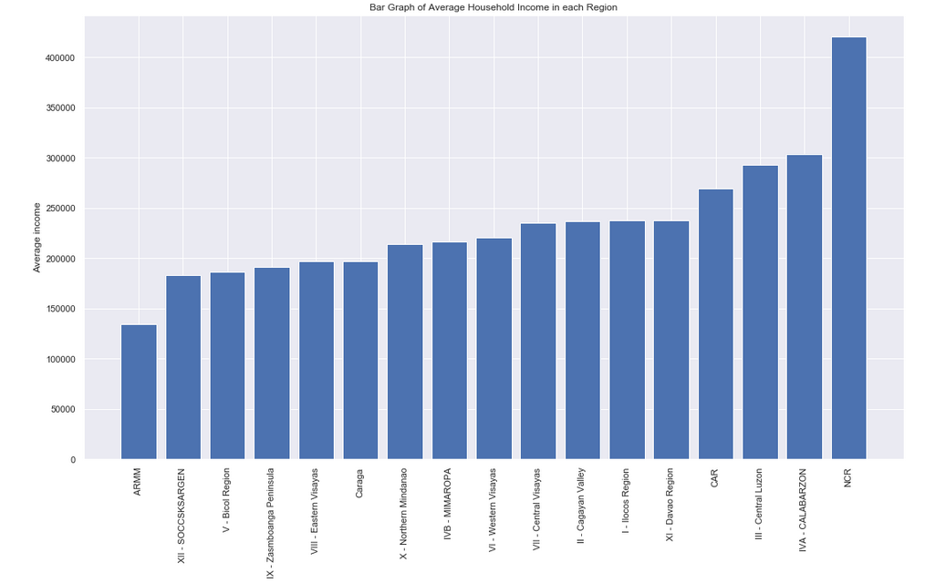
Average Household Income in each Region

Slide 7
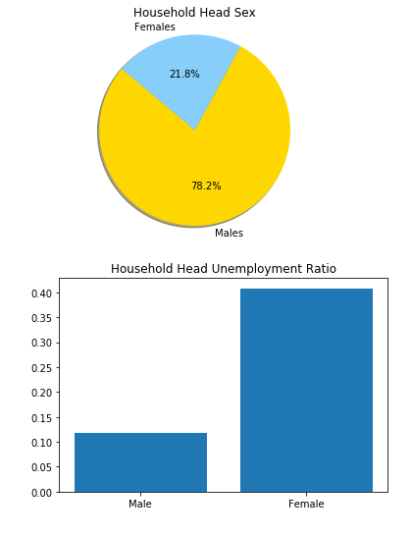
Household Head Sex Unemployment Ratio

Slide 8
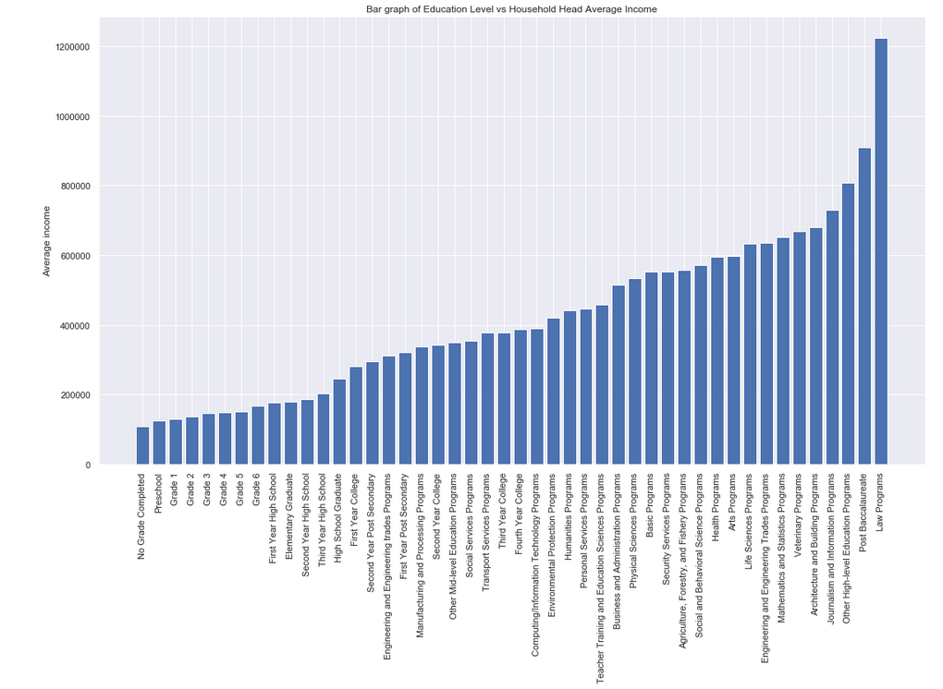
Educational Level vs Average Household Income

Slide 9
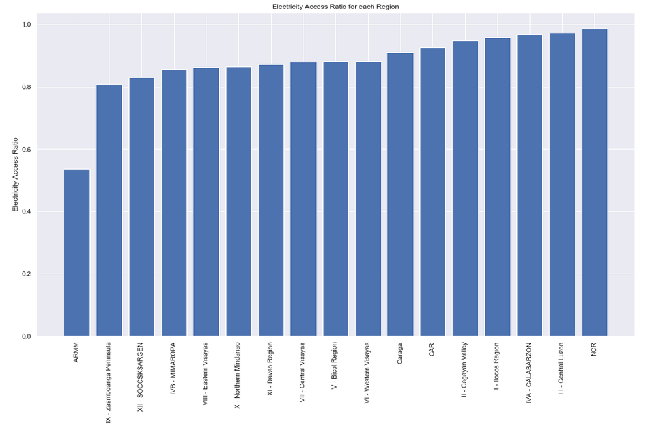
Electricity Access Ratio by Region

Slide 10
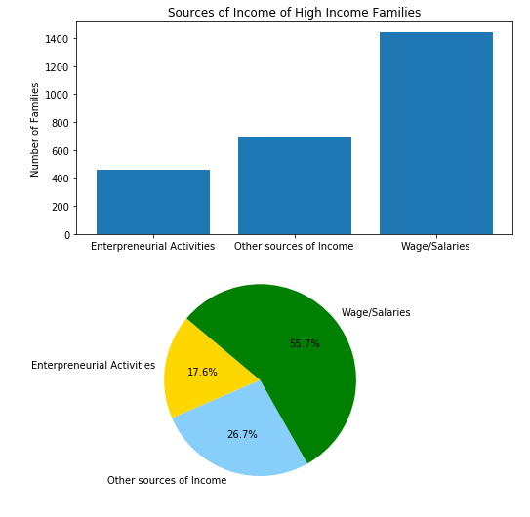
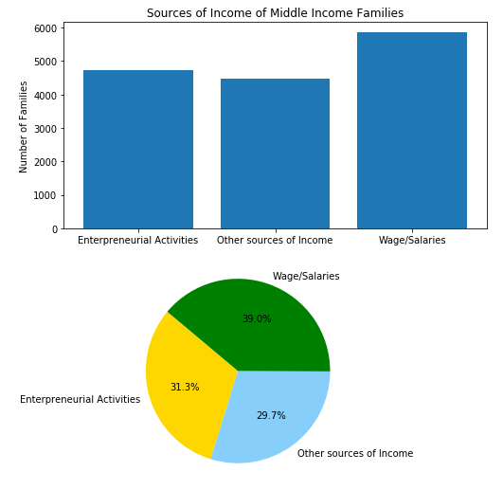
Sources of Income

Slide 11
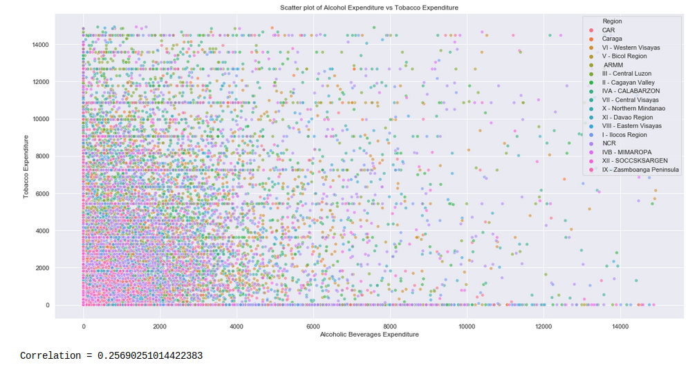
Correlation between Alcohol and Tobacco Expenditure

Slide 12
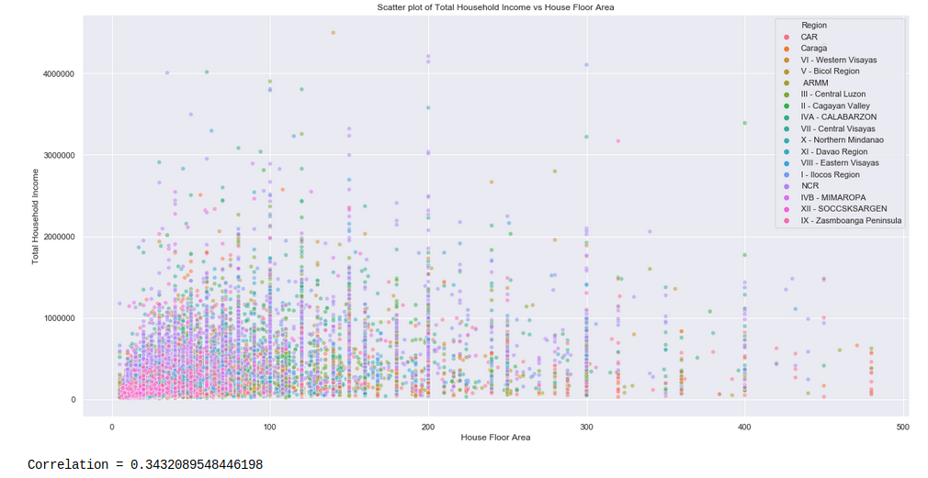
Correlation between Household Income and House Floor Area

Slide 13
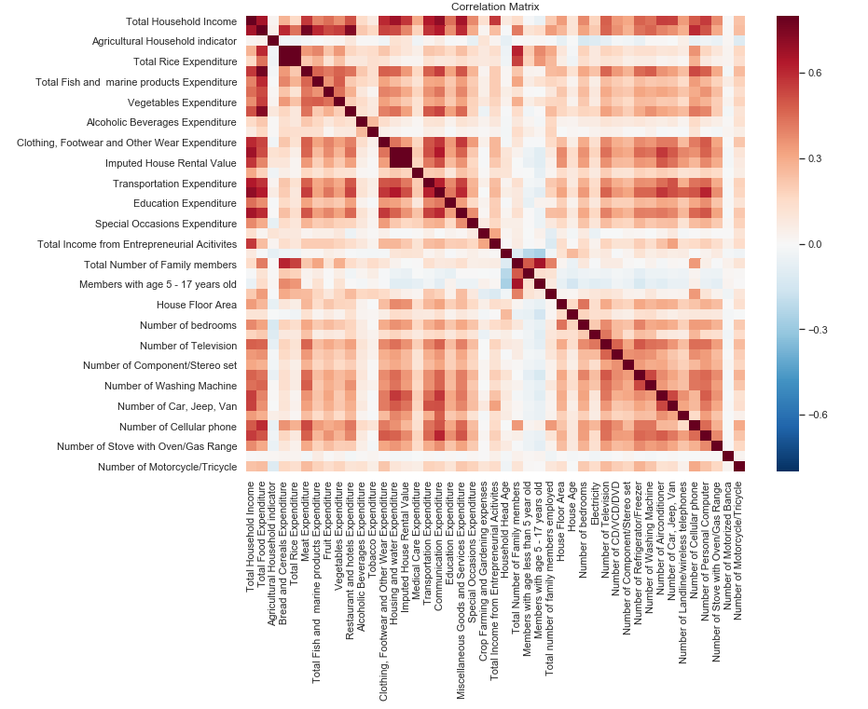
Correlation Matrix

Slide 14
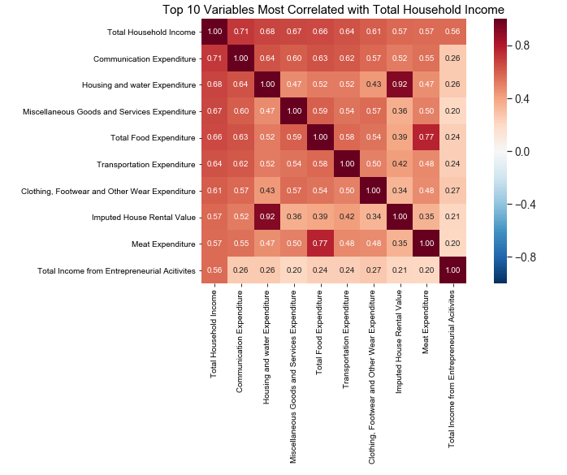
Top 10 Variables Most Correlated with Household Income

Slide 15
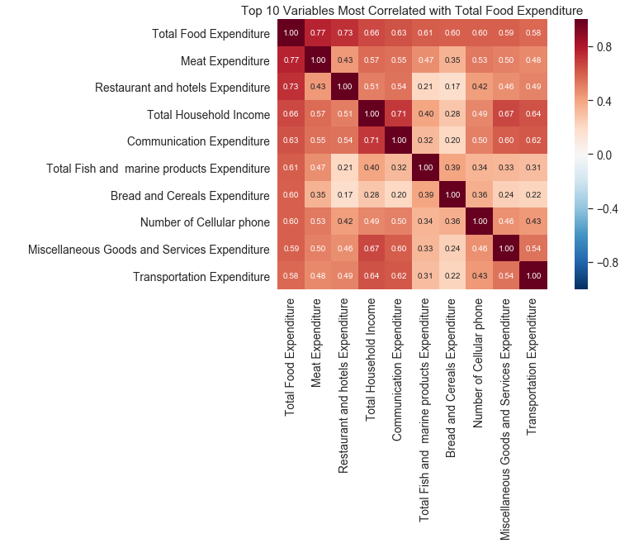
Top 10 Variables Most Correlated with Food Expenditure

Slide 16
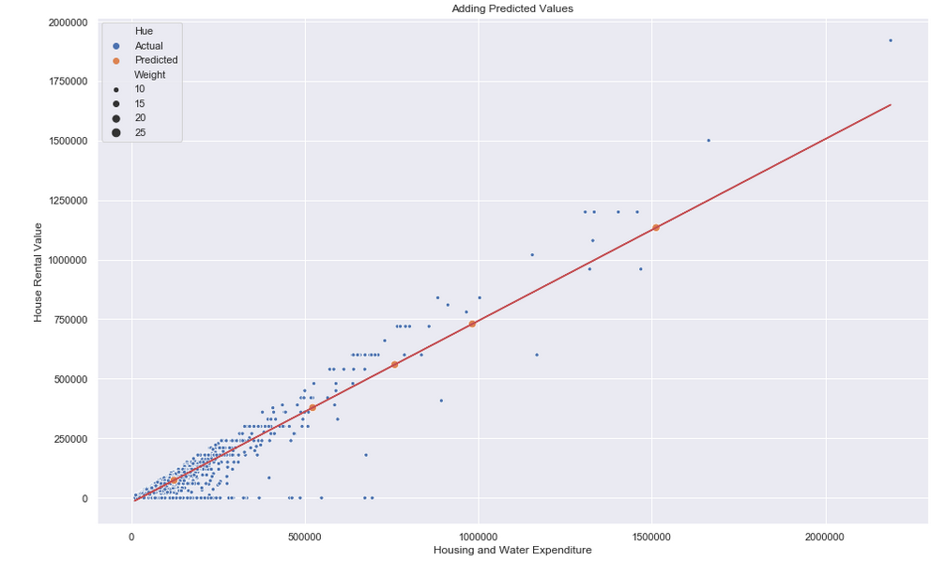
Predicting House Rental Value from Housing and Water Expenditure

Slide 17
Thank You

