Slide 1
HACKERRANK · NEXTGEN
AI Assistant Usage
Q2 2026 Planning
Screen & Interviews | Sep 2025 – Feb 2026
NextGen Q1 2026 · March 2026

Slide 2
Agenda
# | Section | What you'll see
01 | Usage Overview | Screen vs. Interviews — adoption, volume, messages
02 | Question Type: Screen | Code, Database, Fullstack, CodeRepo Task breakdown
03 | Question Type: Interviews | Fullstack, CodeRepo, Untagged breakdown
04 | Top Customers — Screen | Top 15 companies by AI-used attempts + adoption %
05 | Top Customers — Interviews | Top 15 companies by AI-used interviews + adoption %
06 | Ratings & Feedback | Screen vs Interviews — AI-focused themes side by side

Slide 3
Executive Summary · AI Assistant · Sep 2025 – Feb 2026
SCREEN
INTERVIEWS
5,058
98
865
63
Attempts with AI
Companies Using AI
Interviews with AI
Companies Using AI
2%
0.4%
18%
3%
76 attempts · 13 sandbox accounts
19 attempts · 10 testing accounts
156 interviews · 14 sandbox accounts
24 interviews · 16 testing accounts
Top question type: fullstack · 330 tests enabled · Real active accounts: 75
Top question type: fullstack · Candidate avg: 3.91/5 · Interviewer avg: 3.42/5 · Real active accounts: 33

Slide 4
Usage Overview · Screen vs. Interviews
Screen
Interviews
Unique Attempts with AI
5,058
865
Unique Interviews with AI
Unique Companies
98
63
Unique Companies
Unique Tests
330
464,497*
Total AI Messages Sent
Total AI Messages Sent
1,033,969*
KEY INSIGHT
Screen leads AI adoption by 5.8×. Screen: 5,058 attempts across 98 companies. Interviews: 865 sessions across 63 companies.
* Total messages capped at 5,000 per row to exclude known data outliers.

Slide 5
Question Type Breakdown · Screen
Question Type | Unique Attempts (%) | Total AI Msgs | Avg Msgs / Attempt
fullstack | 3,512 (69%) | 906,682 | 258.2
code | 1,048 (21%) | 5,575 | 5.3
database | 613 (12%) | 3,746 | 6.1
coderepo_task | 502 (10%) | 117,946 | 235
approx | 4 (0%) | 20 | 5
Attempts Share by Question Type
fullstack (69%)
DOMINANT: FULLSTACK
3,512
3,512 attempts · 69% of all AI-used screen attempts · avg 258.2 msgs/attempt
code (21%)
1,048
database (12%)
613
coderepo_task (10%)
502
approx (0%)
4

Slide 6
Question Type Breakdown · Interviews
Question Type | Unique Interviews (%) | Total AI Msgs | Avg Msgs / Interview
fullstack | 393 (45%) | 376,412 | 957.8
coderepo | 307 (35%) | 87,160 | 283.9
Untagged | 173 (20%) | 925 | 5.3
Interviews Share by Question Type
fullstack (45%)
DOMINANT: FULLSTACK
393
393 interviews · 45% of all AI-used interviews · avg 957.8 msgs/interview
coderepo (35%)
307
Untagged (20%)
173
"Untagged" = interviews where question_type field is blank in source data.

Slide 7
Top Customers · Screen AI Usage (Top 15 by AI-Used Attempts)
Rank | Company | Attempts with AI | Total Attempts* | Adoption %
1 | Amazon | 1,348 | 1,527 | 79%
2 | Walmart Global Tech Talent Acquisition | 676 | 871 | 76%
3 | Nedbank | 628 | 2,053 | 26%
4 | NPCI | 328 | 600 | 54%
5 | MercadoLibre | 241 | 296 | 77%
6 | Zycus Inc | 134 | 154 | 87%
7 | Accenture | 132 | 195 | 67%
8 | Cognizant Technology Solutions | 112 | 3,324 | 2%
9 | Thoughtworks | 93 | 446 | 21%
10 | New York Life | 91 | 135 | 67%
11 | Optmyzr | 90 | 101 | 89%
12 | Verdi | 90 | 93 | 86%
13 | HCLTech | 72 | 818 | 8%
14 | Garner Health | 72 | 90 | 77%
15 | MoneyLion Inc | 58 | 101 | 57%
* Total attempts = all attempts on the same tests after the date AI assistant was first used on that test. Top 3 rows highlighted in green. "—" = company not in adoption file.

Slide 8
Top Customers · Interview AI Usage (Top 15 by AI-Used Interviews)
Rank | Company | Interviews with AI | Total Interviews* | Adoption %
1 | Uber | 93 | 22,061 | 0%
2 | Adobe Inc. | 69 | 3,198 | 2%
3 | Atlassian | 69 | 20 | — (anomaly)
4 | Paxos | 60 | 89 | 67%
5 | Oracle Corporation | 54 | 23,658 | 0%
6 | DraftKings Inc | 49 | 1,118 | 4%
7 | Indeed | 48 | 124 | 39%
8 | Blue Origin | 47 | 272 | 17%
9 | Wayfair | 47 | 1,968 | 2%
10 | Affirm | 27 | 1,984 | 1%
11 | Palo Alto Networks | 27 | 379 | 7%
12 | Zycus Inc | 21 | 49 | 43%
13 | Snap Inc. | 19 | 4,676 | 0%
14 | Affirm Sandbox | 19 | 4 | — (anomaly)
15 | BNY | 16 | 282 | 6%
* Total interviews = all interviews from the same company after the date AI assistant was first used by that company. Top 3 rows highlighted in blue.

Slide 9
Ratings & Feedback · AI Assistant (Screen vs Interviews)
SCREEN
INTERVIEWS
Avg 4.10/5 · 2404 responses · 64 mention AI keywords
Avg 3.82/5 · 98 responses · Cand. 3.91/5 vs Intvwr. 3.42/5
Helpfulness & Suggestions
Poor Quality / Inaccurate
Poor Quality / Inaccurate
24 responses · avg 4.2★
3 responses · avg 1.3★
3 responses · avg 1.0★
AI hints guided candidates through problems without giving away answers — genuinely useful in practice.
AI responses were wrong, off-topic, or unhelpful — eroded candidate trust in the tool.
—
AI responses were wrong, off-topic, or unhelpful — eroded candidate trust in the tool.
UX / Interface Issues
Performance / Reliability
UX / Interface Issues
Performance / Reliability
6 responses · avg 3.7★
4 responses · avg 2.8★
1 responses · avg 3.0★
2 responses · avg 2.0★
AI autocomplete was intrusive or hard to dismiss — the interface made it difficult to ignore suggestions.
AI tool caused slowdowns, freezes, or disconnections that disrupted the candidate experience.
AI autocomplete was intrusive or hard to dismiss — the interface made it difficult to ignore suggestions.
AI tool caused slowdowns, freezes, or disconnections that disrupted the candidate experience.
Missing / Limited Features
Missing / Limited Features
3 responses · avg 2.7★
1 responses · avg 4.0★
Candidates wanted more model options, context-aware hints, or features the current AI does not offer.
Candidates wanted more model options, context-aware hints, or features the current AI does not offer.

Slide 10
Why Are Interview Ratings Lower When AI Is Used?
4.10 / 5
3.82 / 5
−0.28 pts
21% vs 13%
Avg rating — Screens
Avg rating — Interviews
Gap (interviews rated lower)
Severe ratings (≤ 2★) Interviews vs Screen
To understand why, we asked three questions:
Q1
Q2
Q3
Are interviewers less satisfied than candidates?
Do users who rely heavily on AI rate it worse?
What are interviewers actually frustrated about?
Answered on the next slide →
Answered on the next slide →
Answered on the next slide →
Based on 98 interview feedback responses (79 candidates, 19 interviewers). Screen: 2,404 responses.

Slide 11
What the Data Shows · Three Answers
The answer
What interviewers said
Interviewers are rating the experience
lower than candidates are.
All low-rating comments cite platform failures,
not AI quality.
21% interviews
13% screen
Candidates
Severe (≤ 2★) — same bugs, higher stakes in live sessions.
3.91 / 5 (n=79)
“The candidate struggled to accept diffs. Sometimes when accepting diffs, the file would end up in a …” [1★]
Interviewers
3.42 / 5 (n=19)
“laggy really bad” [1★]
Question 1
Question 2
Question 3
Are interviewers less satisfied than candidates?
Do users who rely heavily on AI rate it worse?
What are interviewers actually frustrated about?
CONFIRMED
INCONCLUSIVE
SAME BUGS, HIGHER STAKES
Yes — interviewers rate 0.49 pts lower than candidates.
Direction is right, but sample too small to confirm.
Both Screen and Interview users complain about identical bugs — but interviews have 62% more severe ratings.
3.42 / 5 (interviewers) vs 3.91 / 5 (candidates). Interviewers are ~20% of respondents but pull the overall interview average below Screen.
Interview: heavy users 3.55 / 5 (n=11) vs light 3.83 / 5 — drops with usage.
Screen feedback mentions the same failures: freezing, lag, keyboard issues, crashes. Screen users recover privately and rate 4.10/5. In interviews, the same bug happens in front of an evaluator — the candidate can't recover gracefully, time is lost, and the evaluator sees the disruption. The live context turns a tolerable bug into a high-stakes failure.
Primary driver of the gap.
Needs more data before acting.
Fix: reliability in live-session context is the priority — async Screen users self-recover.
Analysis based on 98 interview feedback responses (Q1 2026). Msg-count buckets: Low = 1–5 messages, Medium = 6–20, Heavy = 21+.

Slide 12
Test-Level AI Usage · Data Available
Test Name | Company | AI-Used Attempts | AI Share % | Adoption %
The Amazon Coding Challenge | Amazon | 786 | 17% | 78%
Walmart Early Careers SWE Intern Assessment - 2025 | Walmart Global Tech Talent Acquisition | 311 | 7% | 88%
Sample Test for Django | Amazon | 220 | 5% | 79%
Walmart Software Engineering Assessment | Walmart Global Tech Talent Acquisition | 241 | 5% | 68%
Challenge - Backend Developer AI - Seed (SH/CX/FIN) | MercadoLibre | 190 | 4% | 78%
Java Full Stack Developer Test | Zycus Inc | 122 | 3% | 87%
Nedbank SQE_Baseline Assessment | Nedbank | 146 | 3% | 79%
Walmart Software Engineering Assessment (VALIDATION SAMPLE) | Walmart Global Tech Talent Acquisition | 75 | 2% | 93%
NPCI Advance Open Source (Coding - Java) - Basic | NPCI | 127 | 3% | 55%
Sample Test for Spring Boot | Amazon | 80 | 2% | 77%
Garner Intern and L1 Take Home Test | Garner Health | 69 | 2% | 77%
Sample Test for Node.JS | Amazon | 92 | 2% | 72%
Sorted by AI Share % × Adoption % (combo score). AI Share % = test's AI-used attempts ÷ all AI-used attempts across all tests. Adoption % = AI-used ÷ total attempts on that test (from first AI-use date).

Slide 13
NEXT STEPS & PRIORITIES
Turning AI Assistant Data Into Action
01
Drive AI adoption depth — current rates leave room to grow
Screen adoption: 35% of eligible attempts. Interview adoption: 1%. Focus on high-volume tests with low adoption — improve discoverability and in-product AI nudges.
02
Address AI quality & reliability concerns
Top negative signals: AI freezing, unreliable responses, poor autocomplete UX. Screen avg: 4.10/5 · Interviews avg: 3.82/5. These directly suppress ratings.
03
Expand AI coverage to underserved question types
Screen dominant: fullstack (69% of AI attempts). Interviews dominant: fullstack (45%). Drive parity across all types.
04
Investigate Uber interviews — low adoption despite high volume
Uber: 22,061 total interviews vs 93 AI-used. Known issue being resolved — track as leading indicator for large-account AI adoption.
Owner: [TBD] · Q2 2026 · HackerRank NextGen

Slide 14
FEEDBACK ISSUE TRENDS
Issue Buckets — Week on Week
% of feedback rows flagged · Screen & Interviews · Sep 2025 – Feb 2026
01
Weekly trend chart — % of feedback rows flagged per issue bucket
5 buckets: Content · Performance · AI Assistant · UI/UX · Core Functionality
02
Key insights — what is rising, stable, and spiking
Dec W2 incident · content quality trend · UI/UX Feb spike · AI Assistant emergence
Source: Sheet16.csv · 2,502 rows · Q1 2026 · HackerRank NextGen

Slide 15
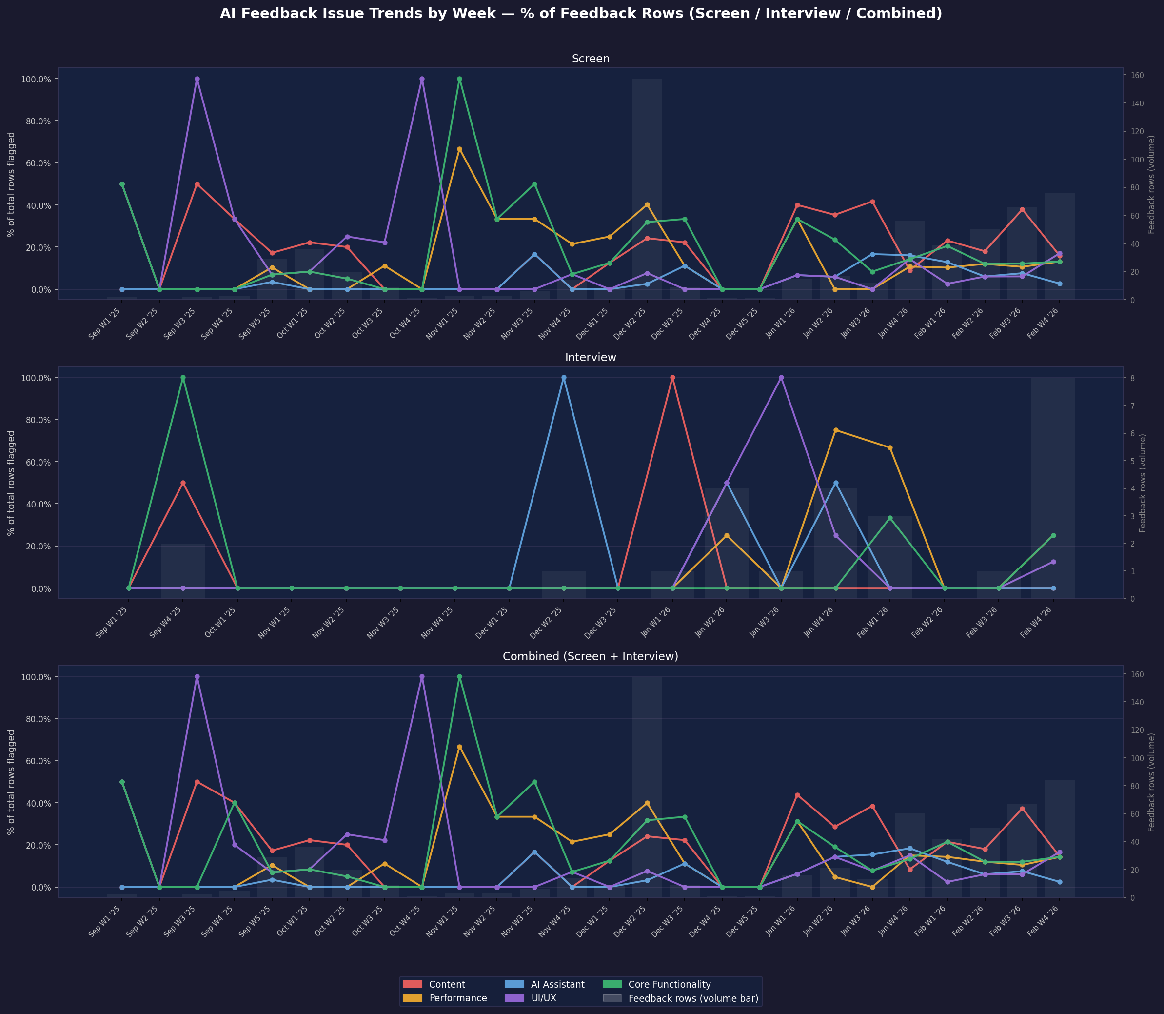
Issue Bucket Trends by Week · % of Feedback Rows Flagged · Screen (top) & Interview (bottom)

Slide 16
FEEDBACK ISSUE TRENDS · KEY INSIGHTS
What the Trend Data Shows · Sep 2025 – Feb 2026
CONTENT
Content quality — sustained #1 concern, ~21% avg last 4 weeks, not recovering
Peaked 42% in Jan W3 and 38% in Feb W3 ’26. Elevated since Dec W2 incident. Top bucket in 3 of last 5 weeks — not improving.
PERF
Dec W2 ’25 spike (40%) resolved — now a stable floor at ~12%, not improving
Platform incident (Dec 8–14 ’25). Same complaints in Screen and Interview — interviews feel it harder due to live-session stakes. 62% more severe ratings in interviews vs screen.
UI/UX
Feb W4 ’26 — 17% of feedback rows, highest rate in dataset. Needs immediate investigation
Most recent week’s top bucket. Sharp end-of-period spike — likely tied to a UI change in late Jan/Feb. Also appearing in interview data (Jan W2, Jan W3).
AI
AI Assistant complaints emerged Jan ’26, peaked 16%, now fading to 3%
Near-zero before Dec 2025. Sharp spike Jan W4 ’26 (16%), declining to 3% by Feb W4. Pattern matches a feature launch or model change. Same timing in interview data.
Screen: 2,404 rows · Interview: 97 rows · Denominator: feedback rows per week · HackerRank NextGen · Q1 2026

