Slide 1
INHERITANCE
By: Ashish Verma

Slide 2
What is Inheritance?
It is the capability of one class to inherit properties from another class.
The technique of building new classes from the existing classes is called inheritance.

Slide 3
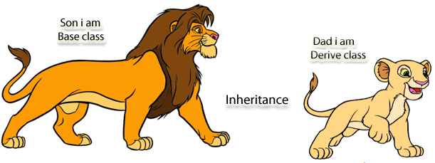
Base and Derived Class
It is the class
whose properties are inherited by
another class.
It is also called
Super Class.
It is the class that
inherit properties
from base class(es).
It is also called Sub Class.
It inherits all the properties of the base class and can add additional features to the derived class.

Slide 4
Types of Inheritance
1. SINGLE INHERITANCE
2. MULTIPLE INHERITANCE
3. HIERARCHICAL INHERITANCE
4. MULTILEVEL INHERITANCE
5. HYBRID INHERITANCE

Slide 5
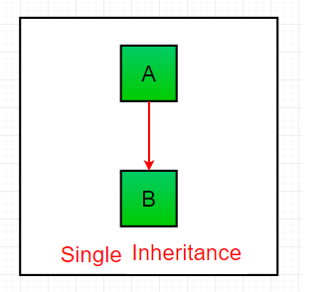
1. SINGLE INHERITANCE
In Single Inheritance, subclasses inherit the features of one superclass.
In image below, the class A serves as a base class for the derived class B.

Slide 6
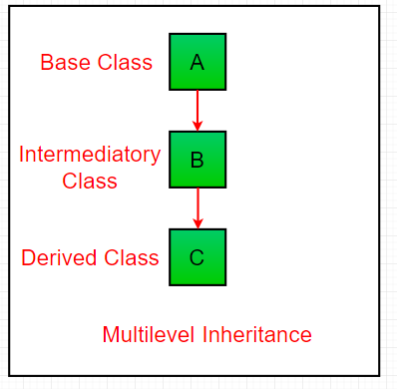
2. MULTIPLE INHERITANCE
In Multilevel Inheritance, a derived class will be inheriting a base class and as well as the derived class also act as the base class to other class.
In below image, the class A serves as a base class for the derived class B, which in turn serves as a base class for the derived class C.
In Java, a class cannot directly access the grandparent’s members.

