Slide 1
Project Udyam Digital
Enterprise Track A, Digital Track
From business needs to digital readiness, in one guided journey.
Team Shankhnad
MMMUT_GORAKHPUR
Notes:
Team Shankhnad from MMMUT Gorakhpur. Project Udyam Digital, Enterprise Track A. In one sentence: we turn a business owner's own words into an eligible, priced plan, a verified KYC and a tracked installation, in one guided journey in Hindi or English. Accel Business is the case's fictional operator and all data is the synthetic case data.

Slide 2
Friction, not demand, loses the customers
368 of 5,000 leads became customers (7.36%); every step loses more than 30% of those who reach it.
Leads reaching each stage
1,113
lost at the quote: price 621, slow or complex quote 385
827
lost because the needs visit never happened
273
accepted a quote, then dropped out at paperwork
220
lost after KYC: slow installs, no fibre, failed payments
What else the data shows
56 of 368
₹24,335
23.0%
bundles sold broke the catalogue's own eligibility rules
CAC via field sales; ₹4,026-6,352 via web, WhatsApp, referral
6-month churn after 4-5 status calls; 11.9% after 1-2
Observed in smb_leads.csv (synthetic, 5,000 leads, Apr-Jun 2026); analysis/01_data_audit.py and 02_business_diagnosis.py
Notes:
Five thousand leads, 368 customers. The losses are not about demand: 1,113 owners dropped at the quote, mostly price and a quote that was too slow or too complex; 827 never got the visit; 273 said yes and then fell out at paperwork. The data shows three more things. 56 of the 368 bundles sold broke the catalogue's own eligibility rules, so a rules engine checks every one. Field sales cost twenty-four thousand rupees per customer, against four to six thousand through the website, WhatsApp, referrals and inbound calls. And customers who had to chase status four or five times churned about twice as often.

Slide 3
Start with professionals and micro shops
Professionals pay back in 1.6 months, micro shops are half the leads; firms with 73% of revenue stay sales-led.
Segment, and who sells | Leads | Activation | CAC | New MRR | Bundle that fits: what its customers bought | Median price, term
Professional practices 1st: digital first, call-back | 1,247 | 11.1% | ₹10,695 | 21% | Fibre, postpaid SIMs, cloud email; many add security, backup | ₹6,575 a month; 12 months
Micro retail & services 2nd: self-serve | 2,709 | 4.1% | ₹20,007 | 6% | Fibre and a postpaid SIM; a third add POS, Wi-Fi or CCTV | ₹2,470 a month; 12 months
Multi-site businesses Field sales, digital KYC | 755 | 11.0% | ₹15,614 | 57% | Fibre and SIMs; about half add 4G/5G failover, POS, CCTV | ₹28,080 a month; 12 months
Small manufacturers Key-account sales | 289 | 12.8% | ₹15,324 | 16% | SIMs, cloud email, leased line (73%); security, firewall | ₹15,910 a month; 24 months
Field sales and partners keep a role
Sales take multi-site and factory deals over ₹25k a month. Partners serve cities not yet online and keep their QR sign-ups. Response: KYC reviewer 4 h, partner 48 h, sales or call-back 24 h.
Pricing
One catalogue-midpoint price per product: 100.2% of historic revenue. A Starter option beside every plan; GST shown apart; the server re-prices at checkout.
Observed in smb_leads.csv: bundles are what activated customers bought, medians (analysis/02b_segment_bundles.py)
Notes:
Which segments first? Professional practices: 11 percent activate, CAC under eleven thousand rupees, paid back in 1.6 months, and their bundle is standard: fibre, SIMs and cloud email at about six and a half thousand a month for twelve months. Then micro shops: half the leads, and only self-serve reaches them profitably, with fibre and a SIM at about two and a half thousand a month. Multi-site businesses and manufacturers bring 73 percent of new revenue; they stay with field and key-account sales, who use the same quote, KYC and tracker. Partners serve cities not yet open online and keep the sign-ups their QR codes bring. Prices are one catalogue-midpoint price per product, revenue-neutral against history.

Slide 4
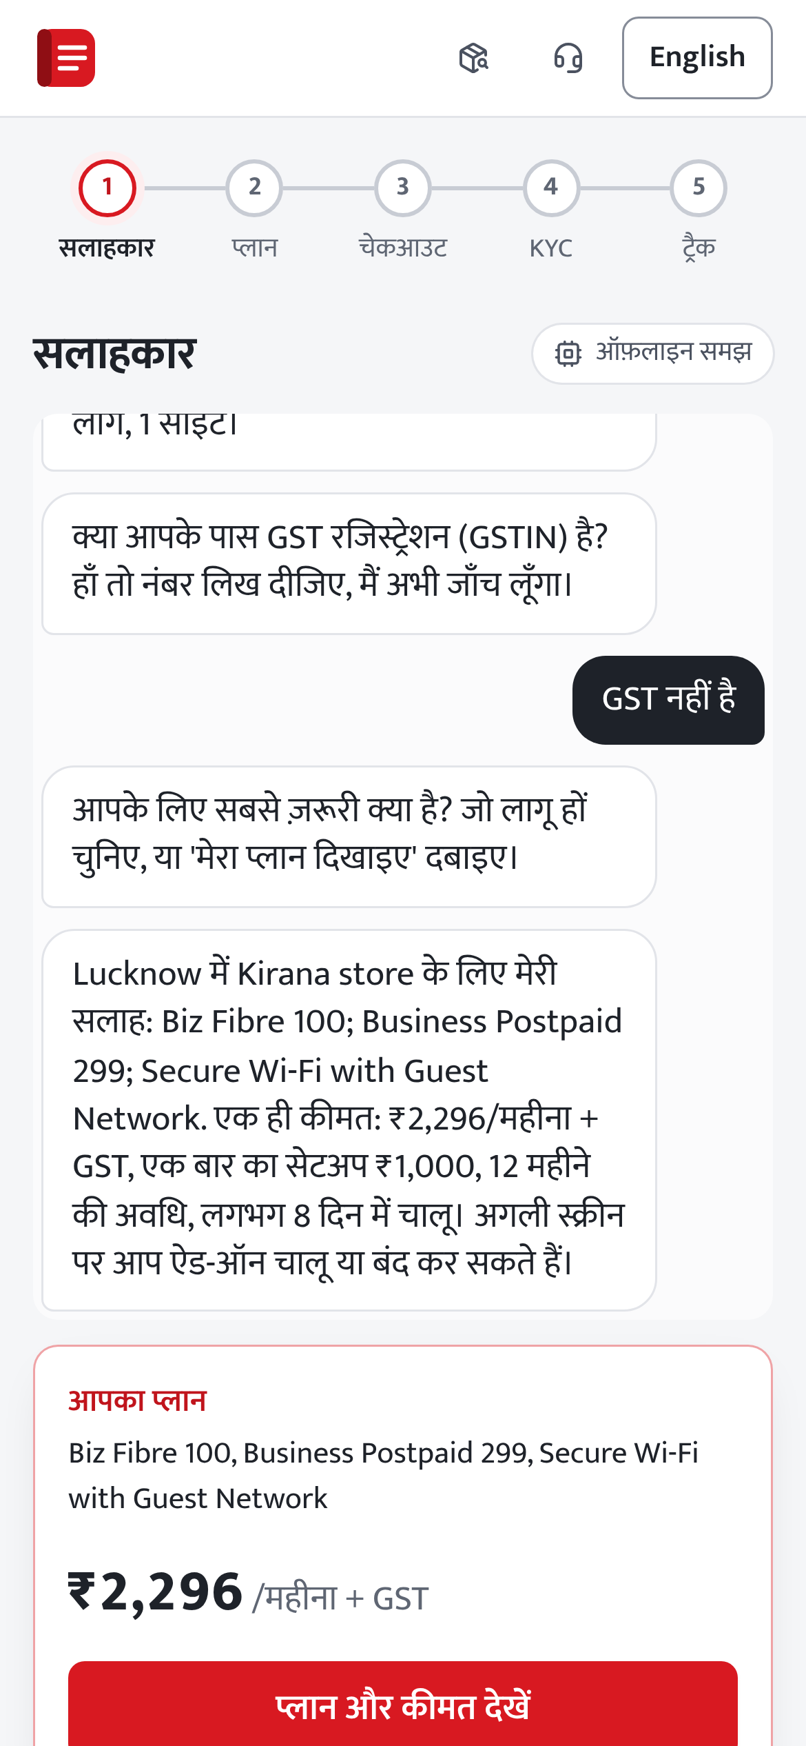
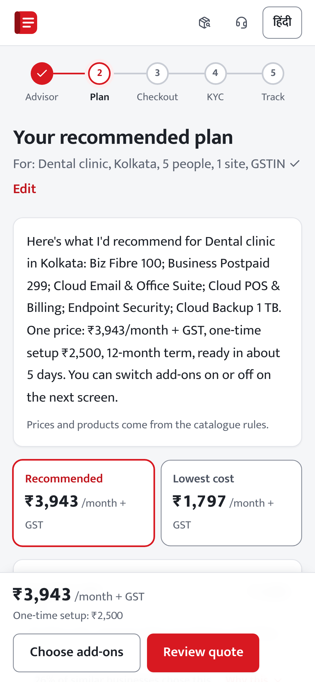
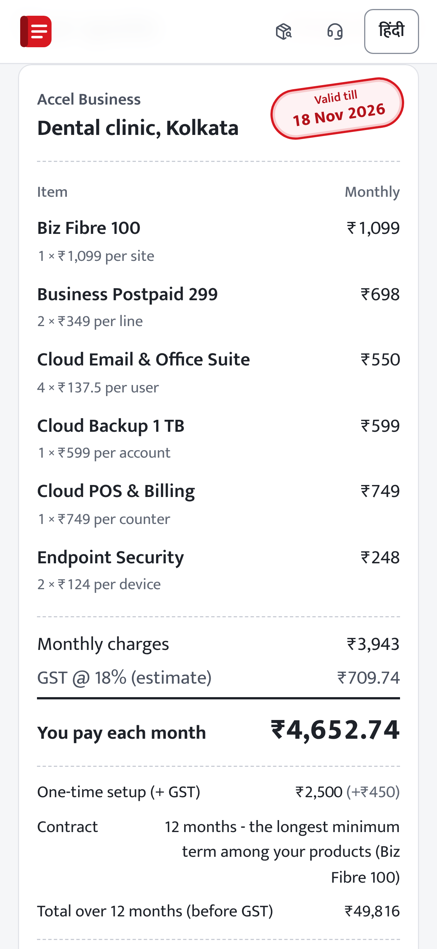
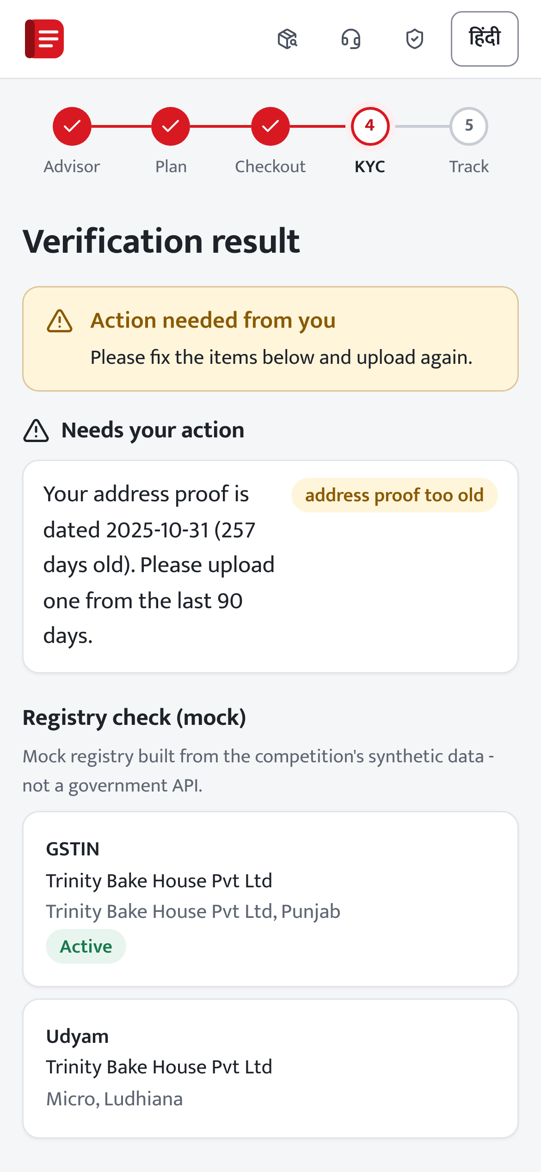
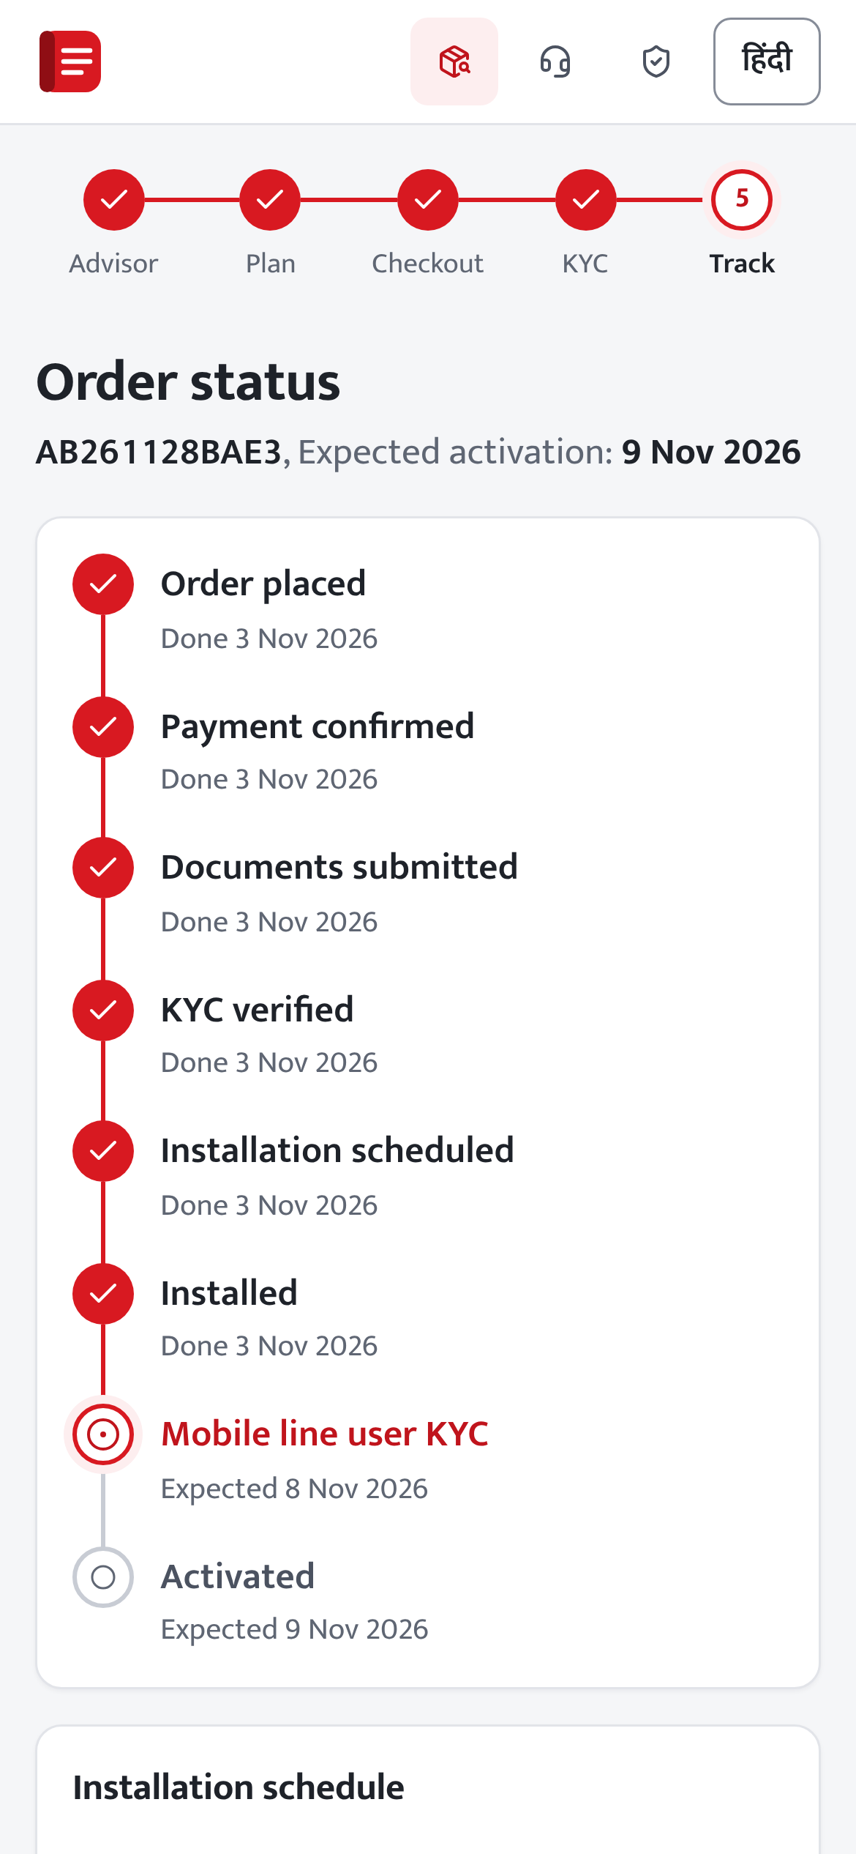
One guided journey, in Hindi or English
Fifteen screens from the first question to activation; a call-back is one tap away on each of them.
GenAI advisor, Hindi or English
Reasons, cheaper option, add-on toggles
One price, GST shown, held 15 days
Fix-it steps instead of a rejection
Every milestone and date, no status calls
Captured from the running prototype with synthetic data (scripts/deck_screens.cjs); Accel Business is the case's fictional operator
Notes:
Here is the journey. The owner types in Hindi or English, or fills a short form, and the GenAI advisor asks only what is missing. The plan explains every product, shows a cheaper option next to it, and add-ons toggle on and off. The quote is one price with GST shown, held for fifteen days. KYC failures come back as fix-it steps, not rejections. And the tracker shows every milestone, including the end-user KYC that DoT requires for business mobile lines, so nobody has to call to ask.

Slide 5
Rivals list packages; we run the journey
Competitive analysis: how small businesses buy from four telcos today, from their public pages and press.
 | Airtel Office Internet | JioBusiness | Tata Tele Business | Vi Business | Udyam Digital (ours)
What is sold | Fibre up to 1 Gbps, calls; one bill | Fibre, voice and digital tools | SmartOffice, Smartflo cloud calling | MSME offers; PayU partner tools | A bundle from 25 products, built for this business
Price before a sales call | Plans from ₹999 | ₹901 to ₹10,001 a month | — | — | Exact quote with GST, held 15 days
How an owner buys | Plan pages, then an enquiry | Register interest; an executive calls | Consultative, partner-led, with demos | Self-check tool; online or in a store | Guided self-serve; a person on request
Guided advice in Hindi or Hinglish | — | — | — | — | Chat or form in English, Hinglish, Hindi
Need to activation in one session | — | — | — | — | Quote, KYC with fix-it steps, and a tracker
Where they lead: networks, brands and partners (Google Cloud, Cisco, PayU). The case notes rivals are starting to sign up single products online.
Our edge: one session from need to an eligible bundle, KYC and tracking, in the owner's language, on the operator's own catalogue.
— = not found on their public pages or in press, Nov 2026; not a claim about internal tools. Sources: docs/research/research_notes.md
Notes:
We read the public pages and press of the four telcos selling to small businesses. Airtel Office Internet and JioBusiness publish packages and prices, then it is an enquiry form or an executive's call. Tata Tele Business is consultative and partner-led. Vi offers a self-check tool and sign-up online or in a store. They lead on networks, brands and partners, and the case notes that rivals are starting to offer instant online sign-up for single products. What we did not find publicly is the whole journey for a bundle: advice in the owner's language, an eligibility-checked quote, KYC that says what to fix, and tracking, in one session. That is the gap, and it sits on the operator's own catalogue.

Slide 6
Rules decide, models assist
One FastAPI service with separate modules; the rules engine and the KYC checks make every decision.
Business owner
phone, Hindi or English
Staff
sales, partner, KYC reviewer, admin
94%
of fields right on 40 held-out messages in English, Hinglish, Hindi; GenAI off
Web app
15 customer screens + back office (React, TypeScript)
2.28x
activation rate in the top-scored 20% of June leads, against the average
Security layer
OTP + JWT, five roles, rate limits, masked logs, audit trail
Advisor
EN, Hinglish, HI
Rules engine
price, eligibility
Smart KYC
OCR, cross-checks
Orders, privacy
consent, tracker
Routing
score, who helps
98.7%
of 149 labelled document fields read correctly
GenAI
optional; reads and explains masked text
Storage
encrypted files, audited views
Integration points, not live yet
Operator CRM, catalogue and billing, orders and provisioning; GSP, Udyam, DigiLocker, eSign, SMS, UPI
0
prices, eligibility rules or KYC decisions set by a language model
Held-out results: analysis/outputs/advisor_eval.md, ml_report.md (trained Apr-May, tested on June), ocr_benchmark.md
Notes:
The architecture is a modular monolith: one service, clear modules. The two dark boxes decide: the rules engine prices and checks eligibility, Smart KYC checks documents. Everything else assists. The advisor reads English, Hinglish and Hindi: GenAI, when a key is set, reads the owner's words and explains the computed plan; with GenAI off, the offline extractor still gets 94 percent of fields right on a held-out set. The lead score lifts the top fifth to 2.3 times the average rate on a month it never saw. And no language model ever sets a price or makes a decision; with no key, it runs offline. Along the bottom are the integration points: the operator's CRM, catalogue and billing, and order and provisioning systems, plus GSP, Udyam, DigiLocker, eSign, SMS and UPI. GSP, Udyam, SMS and payments are mocks today, behind the interface the real service will use; DigiLocker, eSign and the operator's own systems are designed, not built.

Slide 7
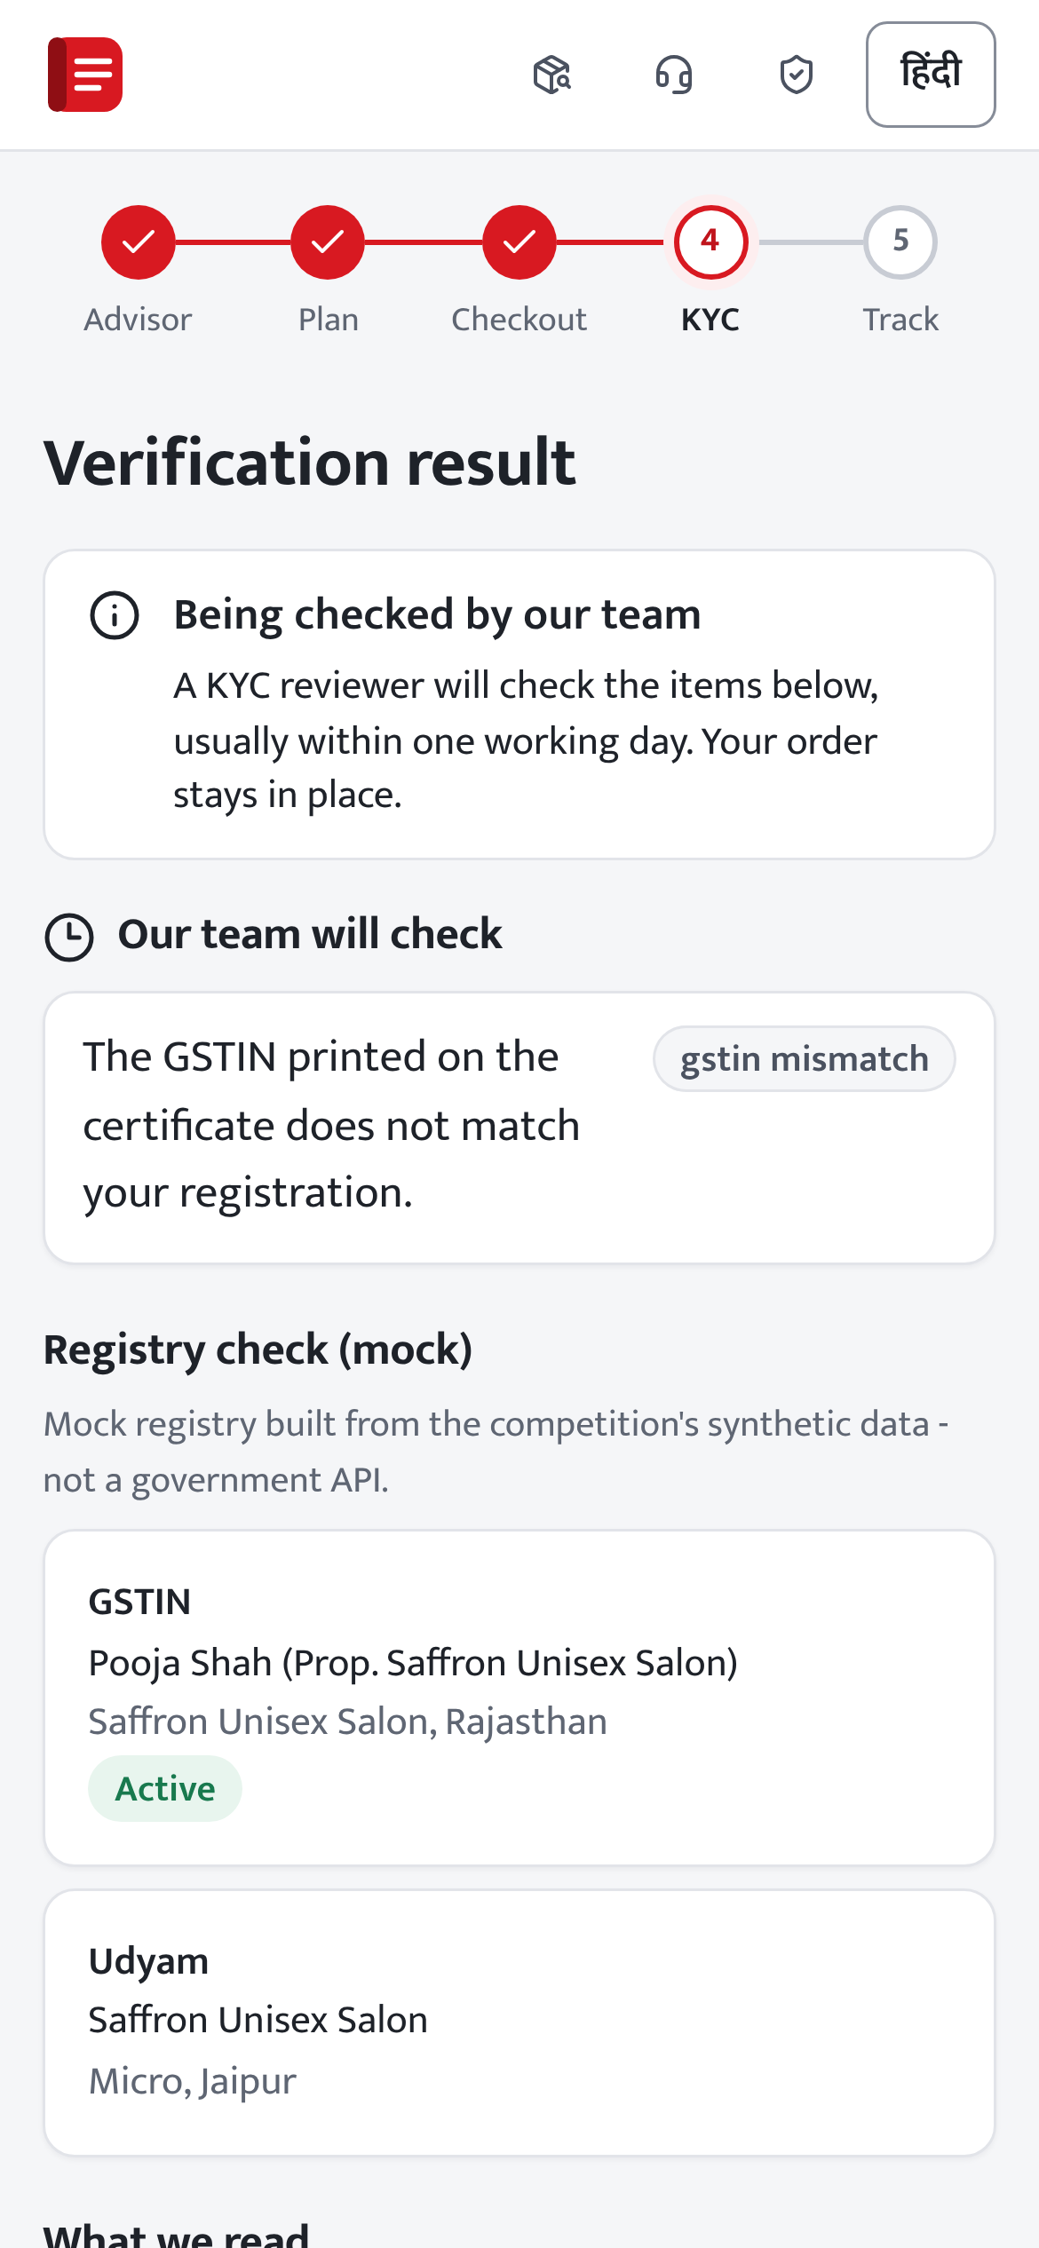
Verify in minutes, ask a person when unsure
Consent first, only the data KYC needs, and a reviewer instead of an automatic rejection.
1
Consent per purpose, before any upload
DPDP Act 2023, by design
Consent: per purpose, before any upload; optional ones start off; withdraw any time.
Purpose limitation: KYC data is used only for KYC; partners see only their own leads.
Data minimisation: lookups send only the GSTIN or Udyam number; GenAI sees masked text, never documents.
Retention: documents deleted on schedule, and at once on withdrawal; encrypted, every view audited.
2
File checks; metadata stripped
3
Deskew, blur check, watermark removal
4
Three OCR passes; GSTIN checksum, formats
5
Mock GSTIN and Udyam lookup; cross-checks
6
Verified, fix-it request, or a reviewer
DPDP Rules 2025: notice, security and retention duties apply from 13-14 May 2027. Built in now; legal review before launch.
12 specimen applicants: 6 verified, 2 asked to fix, 4 to a reviewer
K06 GSTIN fails its checksum; K11 bill is 257 days old
Specimen decisions are our own evaluation (analysis/03), not an answer key; GSTIN and Udyam registries are local mocks.
Notes:
KYC starts only after itemised consent. Each upload is checked, cleaned and read three ways, then looked up in the GSTIN and Udyam registries, which are mocks today, and cross-checked against the declaration. On the twelve specimen applicants: six verified automatically, two were told exactly what to fix, four went to a reviewer - for example K06, whose certificate GSTIN fails its checksum. The DPDP Act's three tests from the case are built in: consent per purpose, data used only for KYC, and only the data needed - lookups send just the GSTIN or Udyam number, and GenAI sees masked text, never documents. Documents are encrypted, every view is audited, and withdrawing consent deletes them.

Slide 8
Five targets, proved in a two-city pilot
At 60% of leads digital: ₹3.1 crore extra revenue in year 1, and the build pays back in 11 months.
Lead to activation
Blended CAC
Days to activate
Quote acceptance
Calls to chase status
10.0%
₹11,761
10.8
49.1%
1.5 or fewer
from 7.36%
from ₹15,053
from 17.6
from 43.6%
from 3.0
Rollout, with a gate before each step
Risks, and how we contain them
1
Foundations weeks 0-8
Risk | How we contain it
AI gives a wrong price or approval | GenAI never prices, decides eligibility or sees documents; offline fallback
Forged or reused documents | Checksum, registry and duplicate checks; a person decides every unclear case
Sales and partners feel bypassed | Routing rules, partner QR attribution; sales keep big and complex deals
Owners not comfortable online | Hindi or English, chat or form, call-back on every screen, partner help
Lead score learnt on synthetic data | It only orders the queue; retrained on pilot outcomes before scaling
GSP, SMS, payments; security review, legal sign-off
2
Pilot in 2 cities months 3-5
A/B; gate: 1.1x activations, 0 KYC false accepts
3
Scale to 10 cities months 6-9
Partner QR codes, DigiLocker, two more languages
4
National months 10-15
Model retrained on real outcomes; eSign; DPDP live
Targets: expected case in analysis/05_business_case.py; the status-call target is an assumption. Privacy note: docs/privacy_security_note.pdf
Code: https://github.com/AshishYadav0704/udyam-digital Demo video: https://youtu.be/M5kciftmRfQ
Notes:
Five numbers decide whether this works, each read weekly or monthly: lead to activation from 7.4 to 10 percent, CAC from fifteen thousand to under twelve, days to activate from 17.6 to under 11, quote acceptance from 44 to 49 percent, and status calls halved. In the expected case that is about three crore rupees of extra revenue in year one, and the build pays back in eleven months. We would not launch nationally on day one: eight weeks of foundations, then a two-city pilot against today's process, gated on 1.1 times the activations and zero KYC false accepts, then ten cities with two more languages, then national. On the right are the risks and how each is contained. The code, the demo video and the privacy note are linked below. From business needs to digital readiness, in one guided journey.

