Slide 1


Slide 2
Who am I ?
In the past
Siemens as a flash developer
IBM as a flex developer
At present
trainer and consultant

Slide 3
What is CSS ?
The Cascading Style Sheets is a language that’s used to write formatting instructions how webpage content should ‘look’— in terms of: Layout & style

Slide 4
Why ?
1apple1402mango803grapes78

Slide 5
Why ?
1 Apple 140
2 Mango 80
3 Grapes 78

Slide 6
Why ?
1 | Apple | 140
2 | Mango | 80
3 | Grapes | 78

Slide 7
Why ?
Sl No | Product | Price
1 | Apple | 140
2 | Mango | 80
3 | Grapes | 78

Slide 8

The benefits of CSS
Separation of content and presentation
  CSS provided in a file that is separate to the (content) HTML. can more easily be updated.

Slide 9
The benefits of CSS
Smaller webpage file sizes
  I personally have seen reduction up to 50%

Slide 10
The benefits of CSS
Improved webpage download speed
  Since it is small it will download faster
  Can be cached for re use
  Save bandwidth
  Improve rendering speed

Slide 11
The benefits of CSS
Streamlined maintenance
  Reduction in errors
  Easy up gradation

Slide 12
The benefits of CSS
Different devices different presentations
  For web
  For print
  For mobile etc…

Slide 13
The benefits of CSS
Table-less layout
  Tables were meant to display data,
  and not to make a layout
  Longer download times, uses more bandwidth
  Table causes accessibility issues

Slide 14
Some XHTML tags that can format
address Allows you to mark up addresses
dl Indicates a definition list (especially for term/definition pairs)
dt Indicates a definition term within a definition list
dd Indicates the definition of a term within a definition list
blockquote Indicates extended quotes
q Indicates inline quotes
label Labels form elements
th Marks headers of columns and rows within a table
thead Marks table headers
tfoot Marks table footers
fieldset Groups form elements
button Creates form buttons
cite Specifies citations or references to other sources
samp Indicates sample output of scripts, programs, etc.
kbd Indicates text to be entered by the user
abbr Specifies abbreviated forms or words or phrases
acronym Indicates acronyms

Slide 15

Where can a CSS be..?
Inline Style
<h1 style="font-family: Arial">Welcome!</h1>

Slide 16
Where can a CSS be..?
Embedded Style
<style>
h1 {
font-family: Arial;
}
</style>
<h1>Welcome!</h1>

Slide 17
Where can a CSS be..?
Linked Style
<link rel=“stylesheet” href="style.css" />
Notes:
<link type="text/css" rel="stylesheet" href="style.css"/>

Slide 18
Where can a CSS be..?
Imported Styles
<style type="text/css">
@import "style.css"; or @import url (“style.css”)
</style>
The import needs to the be the first declaration if there is any embedded style declared in the file…

Slide 19
Few vocabulary as we move on ..
Cascade
  Multiple sheets and types of sheets can be used.
Inheritance
  Style Inheritance relies on the document tree.
Specificity
  The style starts applying from generic to specific

Slide 20
Code Anatomy
Selector {
Property: Value ;
}
e.g.
p {
color: #ff0000;
}

Slide 21
Terminology
h1 {
color : red;
font-size :24px;
}
Rule
Declaration Block
Declaration
Property
Value

Slide 22

Selectors
Element Selectors | Dynamic Pseudo Class Selectors
Class Selectors | Lang Pseudo Class Selectors
ID Selectors | Child Selectors
Descendant Selectors | Adjacent Sibling Selector
Pseudo Class Selectors | General Sibling Selector
Pseudo Element Selectors | Attribute Selectors
Selector Groups | Universal Selector
Notes:
`

Slide 23
Element Selectors
body {
}
h1 {
}
p {
}
ul {
}

Slide 24
Class Selector
.small {
}
<p class="small">Welcome to your life there's no turning back </p>

Slide 25
ID Selector
#selection{
}
<div id="selection ">
This is a division on my page
</div>
Must be unique in the document
Notes:
p#selection

Slide 26
Descendant Selectors
p em{
}
<em> paragraph </em>
<p> this is my
<em>paragraph </em>
</p>

Slide 27
Pseudo class selectors
a:link {
}
a:hover {
}
You can also make a combination of class and pseudo selection if an anchor tag has a class main then for the link property….
a.main:link

Slide 28
Pseudo element selector
:first-line - Applies style to the first line in a given element
:first-letter- Applies style to the first line in a given element
:before- Applies style before a given element
:after- Applies style after a given element
h1:after { content: "header note" }
p:after {content: url(paramark.gif);}

Slide 29
Selector Groups
h1, h2, h3 {
font-family: Arial;
}

Slide 30
Dynamic Pseudo Class Selectors
:focus -Applies the style when focused
:active –Applies style when element is clicked
:hover -Applies the style only when the mouse hovers over the selected element

Slide 31
Language Pseudo Class Selectors
p:lang(es) {
}
<p lang="es"> some Spanish text </p>
Note: The support for this feature is currently limited

Slide 32
Child Selectors
div:first-child{
}
<body>
<div> Hello every one
<em>Good Afternoon</em>
</ div >
</ body >

Slide 33
First Child Selectors
p:first-child{
}
Any rule you write for this selector will be applied to the first paragraph child of every tag.
Note: The support for this feature is currently limited

Slide 34
Adjacent Sibling Selectors
th+td {
}
As a table can contain both th and td in the same level they are siblings within the same table tag…

Slide 35
General Sibling Selectors
ul~p {
}
Any p that comes after the ul as a sibling

Slide 36
Attribute Selectors
input[type="submit"] {
}
<input type=“submit” />
Other flavors available
[att] = Apply the style to a given attribute, no matter the value
[att=val] = Apply the style to a given attribute with a specific value
[att~=val] = Apply style to any attributes with space-separated specified values
e.g. (class=“val" and class="important val“ and class=“val high",
but not class="my-val“ or class=“value")
as they don’t match val (should not have any alphabets before or after it)

Slide 37
Universal Selector
* {
padding: 0;
margin: 0;
}

Slide 38
Advanced Selectors
Child and adjacent sibling selectors

Slide 39
Child and adjacent sibling selectors
#nav > li {font-weight: bold;}
  <ul id="nav">
  <li>Home</li>
  <li>Services
  <ul>
  <li>Design</li>
  <li>Development</li>
  <li>Consultancy</li>
  </ul>
  </li>
  <li>Contact Us </li>
  </ul>

Slide 40

Sources of Style
Browser Styles / User Agent Styles
User Styles
Author Styles
Notes:
C:\Program Files\Mozilla Firefox\res\html.css

Slide 41
Specificity
Style="" 1,0,0,0 1000
#id #id {} 0,2,0,0 200
#id .class {} 0,1,1,0 110
tag #id {} 0,1,0,1 101
#id {} 0,1,0,0 100
tag.class .class {} 0,0,2,1 21
tag.class{} 0,0,1,1 11
tag tag {} 0,0,0,2 2
tag {} 0,0,0,1 1

Slide 42
Specificity
In the order of importance
User styles flagged as !important
Author styles flagged as !important
Author styles
User styles
Styles applied by the browser/user agent

Slide 43
DIV tag <div>
A Block level element
Used to create a block with nested elements
Idea is to group the nested elements and to be able to refer with a name or an id

Slide 44
Span tag <span>
Just like div span creates an inline element
That can be addressed to

Slide 45
color property
color:red color keyword
color:#rrggbb color in hex notation
color:rgb(rrr,ggg,bbb) values from 0-255
color:rgb(rrr%,ggg%,bbb%) values in percentage
color:inherit color of the parent tag
color:#f00 will also be treated as hex

Slide 46
border property
border-width: thin
border-width: medium
border-width: thick
Note : thin, thick, medium sizes are provided by browser
border-width: 5px
border-width: 1em
border-top-width: 1px
border-bottom-width: 1px
border-right-width: 1px
border-left-width: 1px

Slide 47
border-color property
Same as color property
border-style property
border-style: none border-style: solid
border-style: double border-style: groove
border-style: hidden border-style: inset
border-style: dashed border-style: outset
border-style: dotted
border-style: ridge

Slide 48
border-color property
none
solid
double
groove : A three-dimensional effect that gives the impression that the border is carved into the canvas.
hidden : same as none but works when applied to tables
inset
dashed
outset
dotted
Ridge : a 3D effect that has the opposite effect of groove

Slide 49
Border properties shorthand
border: <width> <style> <color>
Eg; border:thick groove #F00;

Slide 50
margins
margin-top
margin-right
margin-bottom
margin-left
Shorthand
margin:<top> <right> <bottom> <left>
margins can also accept negatives

Slide 51
padding
padding-top
padding-right
padding-bottom
padding-left
Shorthand
padding:<top> <right> <bottom> <left>

Slide 52
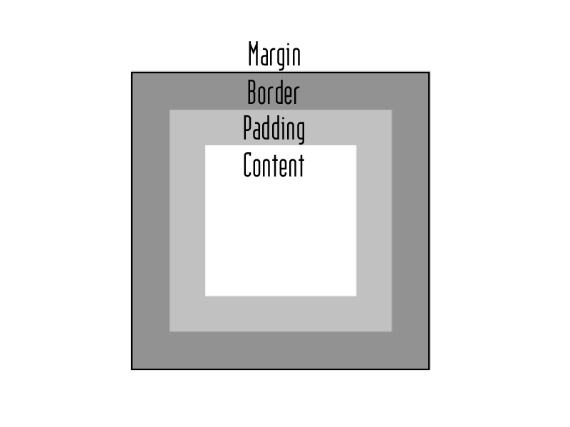
The Box Model

Slide 53
position
position: static the default place
position: relative takes a position relative to the container
position: absolute takes user defined position from a relative parent
position: fixed takes a position irrespective of container
position: inherit takes position property from parent

Slide 54
Float
Arranges the element
float: left
float: right
float: none
float: inherit

Slide 55
Clear
Clears the block contents
clear: none
clear: left
clear: right
clear: both
clear: inherit

Slide 56
Background
background:url()
background:#rrggbb

Slide 57
Background image
background-image:url(“”)
background-image:none
background-image:inherit

Slide 58
Background repetition
background-repeat:repeat
background-repeat:repeat-x
background-repeat:repeat-y
background-repeat:no-repeat
background-repeat:inherit

Slide 59
Background Attachment
background-attachment:scroll
background-attachment:fixed
background-attachment:inherit

Slide 60
Background Position
background-position:<x> <y>
background-position:top
background-position:bottom
background-position:left
background-position:center
background-position:right

Slide 61
Font Families

Slide 62
Font Styles

Slide 63
Font Weight

Slide 64
Font Size
font-size:12pt
font-size:12pt
font-size:medium
font-size:small
font-size:normal
font-size:larger
font-size:50%

Slide 65
Text indenting
text-indent: <length>
text-indent: <percentage> by containing block

Slide 66
Aligning Text
text-align:left
text-align:right
text-align:center
text-align:justify

Slide 67
Text Decoration
text-decoration:none
text-decoration:underline
text-decoration:overline
text-decoration:line-through
text-decoration:sub
text-decoration:super
text-decoration:blink

Slide 68
Types of media
<link rel="stylesheet" type="text/css" href="print.css" media="print" />
<link rel="stylesheet" type="text/css" href="screen.css" media="screen" />
<link rel="stylesheet" type="text/css" href="projection.css" media="projection" />
all : Users for all devices
aural : Used for speech and sound synthesizers
braille : Used for Braille tactile feedback devices
embossed : Used for Braille printers
handheld : Used for handheld or small devices like PDAs and smartphones
print : Used for printers and print preview
projection : Used for projected presentations
screen : Used for color monitors
tty : Used for teletypes, terminals, and portable devices with limited characters
tv : Used for television and WebTV
Notes:
screen, as in a computer screen
print, for things like printouts and print-preview displays
projection, for projected presentations such as slide shows
braille and embossed, for tactile feedback devices and printers
aural, for speech generators
tv, for television-type displays (think WebTV)
tty, for fixed-width character displays
handheld , for palmtop computers
the ubiquitous all

Slide 69
Display common properties
Block elements, such as paragraphs, headings, and lists, sit one above another when displayed in the browser.
Inline elements such as a, span, and img, sit side by side when they are displayed in the browser and only appear on a new line if there is insufficient room on the previous one.

