Slide 1
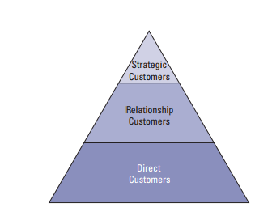
DHL Customer Asset Management
CUSTOMER SEGMENTATION
First, strategic customers are extremely high volume shippers with a full range of logistics solutions and express shipment needs. This segment consists of approximately DHL’s top 250 customers worldwide, mostly large multi-nationals.
Second, the relationship customers segment consists of customers who use DHL to ship their products and documents regularly but with a lower volume than the strategic customers segment, and are also not as sophisticated in terms of supply-chain needs.
Finally, the direct customers segment ships infrequently with DHL.

Slide 2
Customer Churn Analysis
Steps to process the data set
Process the data in Customer-country_data_5-5.xls and evaluate the Customer KPI w.r.t the country.
Data Wrangling on missing , incorrect data available in sheet.
KPI summarize the valuable information such as –
- Gross/Net Profit (If decreasing then mark its customer churn score as 0 else 1)
- On Time Shipping (If its decreasing or less than 95% in trend then mark customer churn score 0 else 1)
- Shipping Accuracy (If its decreasing or less than 95% in trend then mark customer churn score 0 else 1)
- On Time Delivery (If its decreasing or less than 95% in trend then mark customer churn score 0 else 1)
- Lost Time Injury Frequency Rate (If its increasing or less than 10% in trend then mark customer churn score 0)
- Inventory Location Accuracy(If its decreasing or less than 95% in trend then mark customer churn score 0 else 1)
4. Sum the total customer churn score
5. Need to process the GPS navigation data and population rate in state/country where On Time Shipping, On Time Delivery, Lost Time Injury creating issue.

Slide 3
Customer’s Stock Data Analysis
Setting Up The System
- Solution done in R programming language and below are the packages
- Quandl for Data Download
- tidyverse to Use tibble for grouping and perform single operation on multiple groups
- tidyquant for Time Series and Financial functions to perform the analysis
- gglot for Plotting and Visualization
Creating the Dataset - In our analysis, we have selected following DHL’s customers-
PEPSICO
UNILEVER
FORD MOTOR
HEWLETT PACKARD
PROCTER & GAMBLE
Visualization of monthly prices

Slide 4
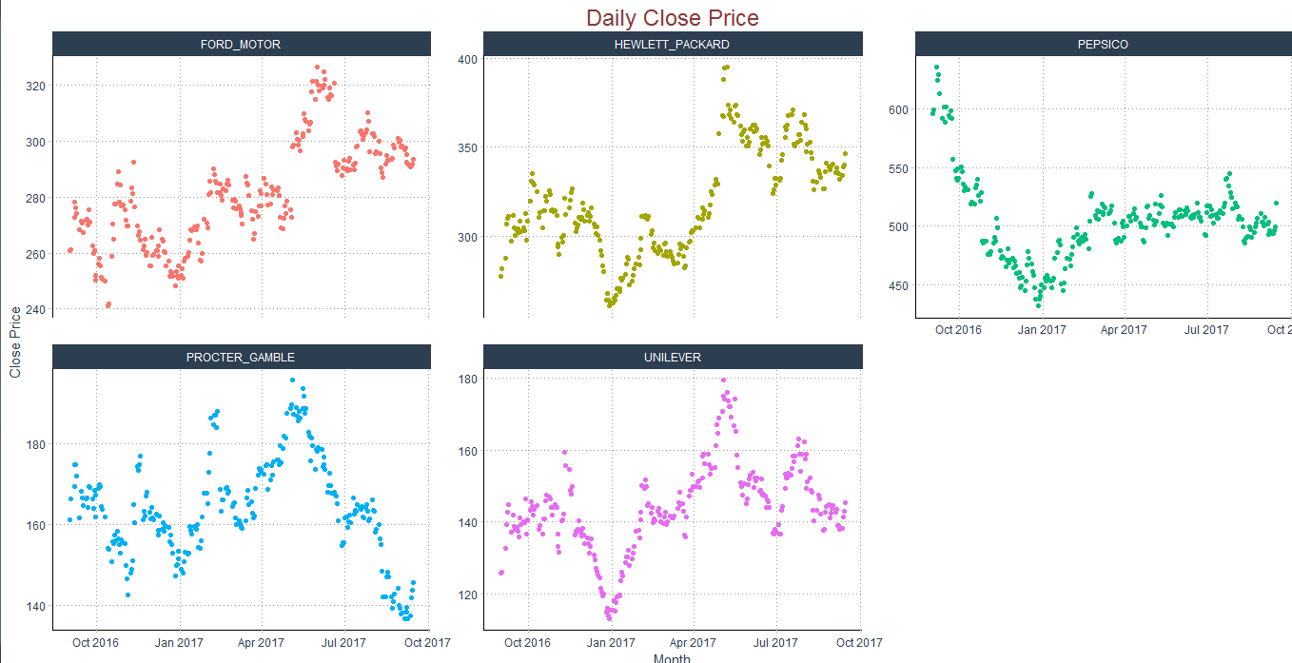
Customer’s Stock Data Analysis

Slide 5
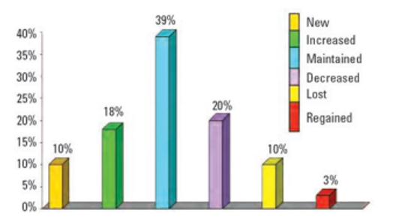
Customer Churn Prediction Analysis
Steps to process the data set
Process the data in Opportunities_examples.xls and evaluate the important columns.
Data Wrangling on missing , incorrect data available in sheet.
Applied Random forest and Logistic Regression machine learning algorithm to predict the customer churn.
If the signal to noise ratio is low (it is a ‘hard’ problem) logistic regression is likely to perform best. Else Random Forest.

Slide 6
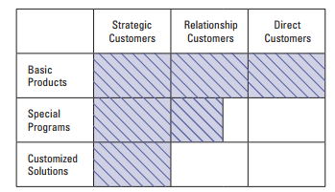
Customer’s Categorization
Customers using DHL’s basic products find it easier to switch because switching costs are low and all its key competitors also offer similar products.
In contrast, the switching costs are significantly higher for customers with special programs, and highest for clients using customized solutions.

Slide 7
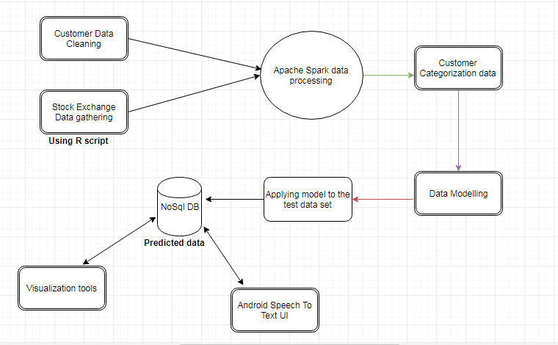
Data Processing Architecture

