Slide 1
Progressive Web Apps with Angular
Ashish, Kriti, Nisheed, Vinci
eXperience Technologies- SapientRazorfish

Slide 2
WTH is a Progressive Web App
“... a new software development methodology for building modern frontend”

Slide 3
Progressive
The is the ‘Key’ Keyword

Slide 4
Web App
Is what it really is …

Slide 5
What Constitutes a PWA
App Shell Model
Instant Loading
Offline Support
60 fps
Add to Home Screen
Push Notifications
Root Component as App Shell
Render Root Component Universally
Service Worker
Web Worker
Web App Manifest
Web Push API

Slide 6
Selling PWAs (.. Your boss, client, PM..)
It’s a set of guides to improve App Performance.
It’s a replacement for your Responsive / Adaptive Web App.
Not every Native App needs to be Native.
Chrome users on desktop & mobile get super enhanced experience.
Offline support is not everything.
There is nothing to lose.

Slide 7





Support for PWAs
Launch from home screen
Service Worker
Launch from home screen
Service Worker
Launch from home screen
Service Worker
Launch from home screen
Service Worker
Launch from home screen
Service Worker
Feature is available
Feature is in development

Slide 8
Twitter lite pwa
65% increase in pages per session
75% increase in Tweets sent
20% decrease in bounce rate

Slide 9
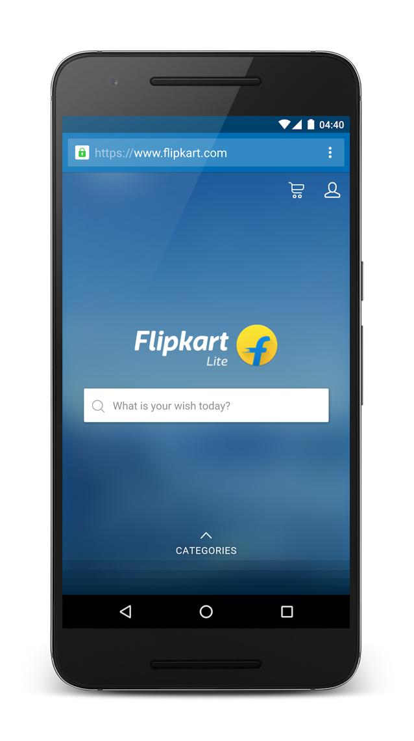
Flipkart lite
3x more time spent on site
40% higher re-engagement rate
70% greater conversion rate via homeScreen
3x lower data usage
Src: https://developers.google.com/web/showcase/2016/flipkart

Slide 10
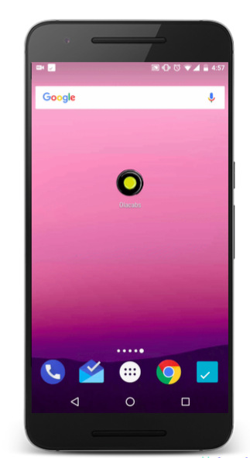
OLA PWA
68% increase in mobile traffic in Tier 2 and 3 cities.
30% higher conversion rates in Tier 3 cities.
200KB PWA application size is, which is 300x smaller than downloading an Android app and more than 500x smaller than the iOS app
20% of users who book in their PWA had prev. uninstalled their app
Src: https://developers.google.com/web/showcase/2017/ola

Slide 11
दो तीन शब्द slides Angular के बारे में

Slide 12


Know your Angular
Angular
Angular 2.x.x
Angular 4.x.x
Angular x.x.x
AngularJS
Angular 1.x

Slide 13
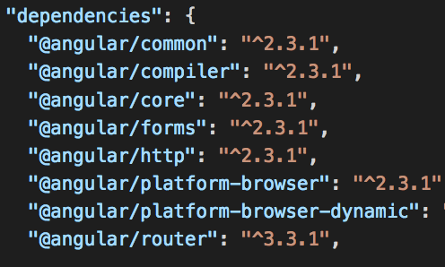
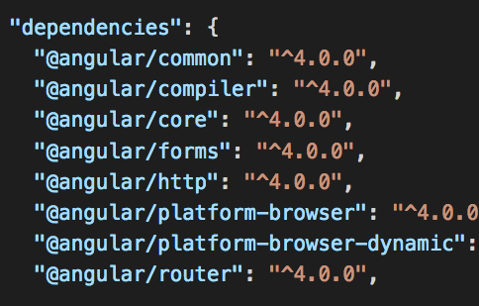
What Happened to Angular3
Angular 2
Angular 4

Slide 14
Migrating from 2 to 5 (super easy*)
Step 1
npm install @angular/ {common,compiler,compiler-cli,core,forms,http,platform-browser,platform-browser-dynamic,platform-server,router,animations} @latest typescript@latest
Step 2
Follow the instructions in the terminal
* in most cases

Slide 15
Minimal Viable PWA
App Shell → AppComponent
Add to Home Screen → Manifest.json
Full Screen → Manifest.json
Offline Support → Service Worker

Slide 16
Manifest.json
Home screen icon
Full screen Mode
App Name
Background and foreground color

Slide 17
Service worker
Register
Install
Activated
Error
Idle
Terminated
Fetch / Message

Slide 18
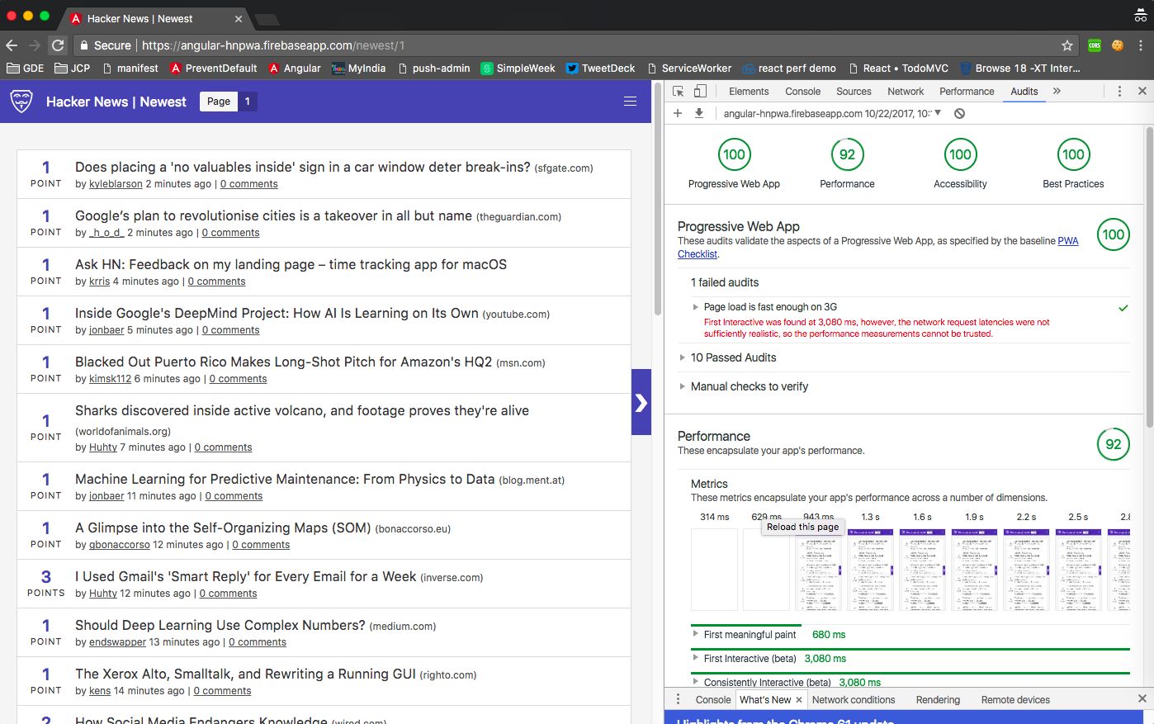
Are you a PWA ?
Lighthouse - https://developers.google.com/web/tools/lighthouse/

Slide 19
Angular CLI
npm install -g @angular/cli
npm install @angular/service-worker –save-dev
Workbox.js
$ npm install workbox-cli --global
$ workbox generate:sw
Ionic 2
npm install -g ionic cordova
ionic start my-pwa-app --v2

Slide 20
Step 0
node –version // >6
yarn add global @angular/cli npm i –g @angular/cli
Yarn add global http-server
Install Angular Essentials for VS Code https://marketplace.visualstudio.com/items?itemName=johnpapa.angular-essentials
Paisa vasool!!!

Slide 21
Step 1
git clone https://github.com/areai51/angular-hn.git jsfoo-pwa
cd jsfoo-pwa
git fetch
git checkout starter-kit
yarn // npm
ng serve

Slide 22
Step 2
npm i @angular/service-worker @angular/platform-server
npm i ng-pwa-tools
cp node_modules/@angular/service-worker/bundles/worker-basic.min.js src/

Slide 23
Step 3
.angular-cli.json
"assets": [
"assets",
"favicon.ico",
"worker-basic.min.js"
],
main.ts
platformBrowserDynamic().bootstrapModule(AppModule)
.then(()=>{
if('serviceWorker' in navigator){
navigator.serviceWorker.register('/worker-basic.min.js')
}
});

Slide 24
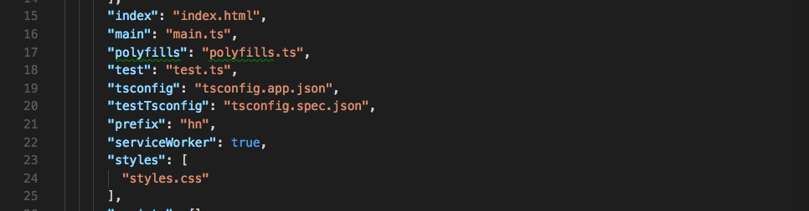
Step 4
ng set apps.0.serviceWorker=true
.angular-cli.json

Slide 25
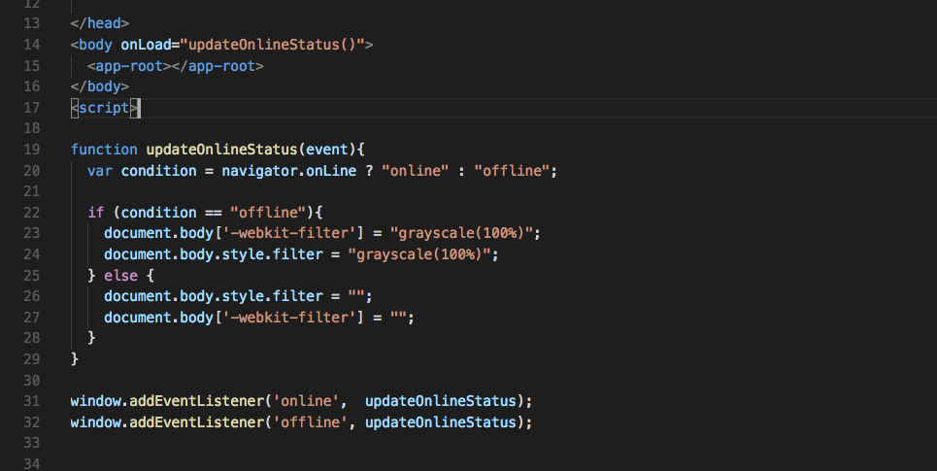
Offline notifications –flipkart style

Slide 26
Native App like Experience
index.html
<link rel="manifest" href="/manifest.json">

Slide 27
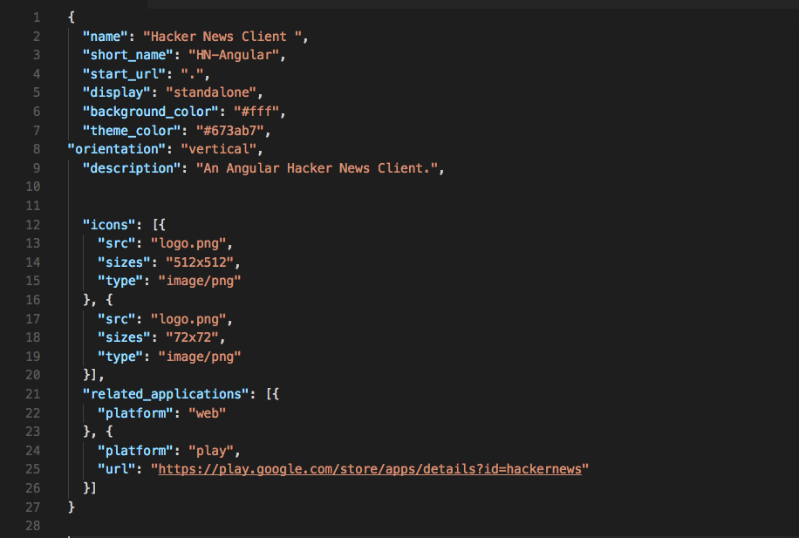
manifest.json

Slide 28
Full-to PWA
Push Notifications → GCM | FCM |Push API
Deeply Integrated PWA → WebAPK
SSR for app Shell → Universal

Slide 29

Examples of PWA
https://github.com/hemanth/awesome-pwa#apps

Slide 30
..and that’s a wrap
@areai51

