Slide 1

RENT-EASE
A Vehicle Rental System

Slide 2

DESCRIPTION
The Vehicle Rental System is a web-based application that simplifies vehicle rentals. Users can browse available vehicles, make reservations, and track their rental history, while administrators manage inventory, bookings, and payments efficiently. The system ensures a seamless rental experience with a responsive interface and robust backend.

Slide 3
OBJECTIVES
The Vehicle Rental System simplifies vehicle rentals by providing an efficient platform for managing vehicles, and reservations.
TECHNOLOGIES USED :
Backend: Spring Boot
Frontend: HTML, CSS, JavaScript
Database: PostgreSQL
Version Control: Git

Slide 4
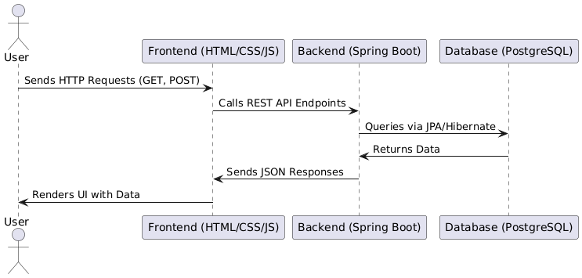
SYSTEM ARCHITECTURE
The system follows a monolithic architecture where the backend, frontend, and database are tightly integrated. It uses a client-server model where the frontend interacts with the backend through REST APIs, and the backend communicates with the PostgreSQL database to store and retrieve data.

Slide 5
DATABASE DESIGN
Key Tables and Their Purpose:
Users Table: Stores admin/user credentials and role-based access.
Vehicles Table: Contains details such as type, availability and description.
Bookings Table: Links users to vehicles with booking dates.
Database Relationships:
One-to-Many: A user can have multiple reservations.
Many-to-One: Multiple reservations can be linked to a single vehicle.

Slide 6
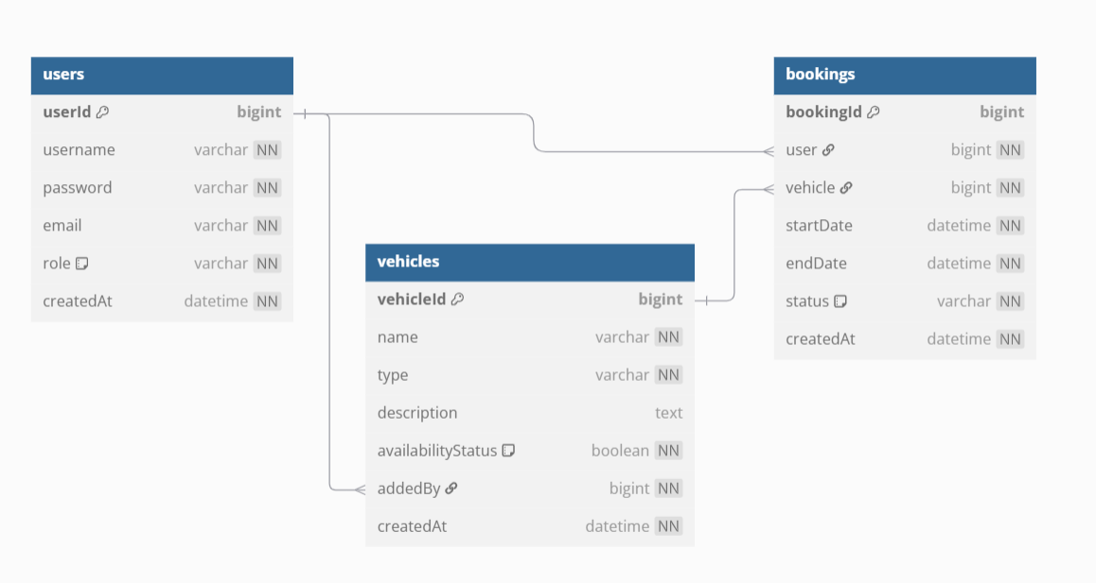
ER DIAGRAM
Users (Admins/User who manage vehicles and reservations).
Vehicles (Details like type, availability, description).
Bookings (Links users to rented vehicles with start/end dates).

Slide 7
KEY FEATURES
Admin/User Login – Secure login system
Vehicle Management: Add, update, and remove vehicles.
Vehicle Availability Check – Ensure vehicles are not double-booked.
Booking Management: View and manage vehicle bookings.
Vehicle Search: Users can browse available vehicles..
Responsive UI: Works smoothly on mobile, tablets, and desktops.

Slide 8
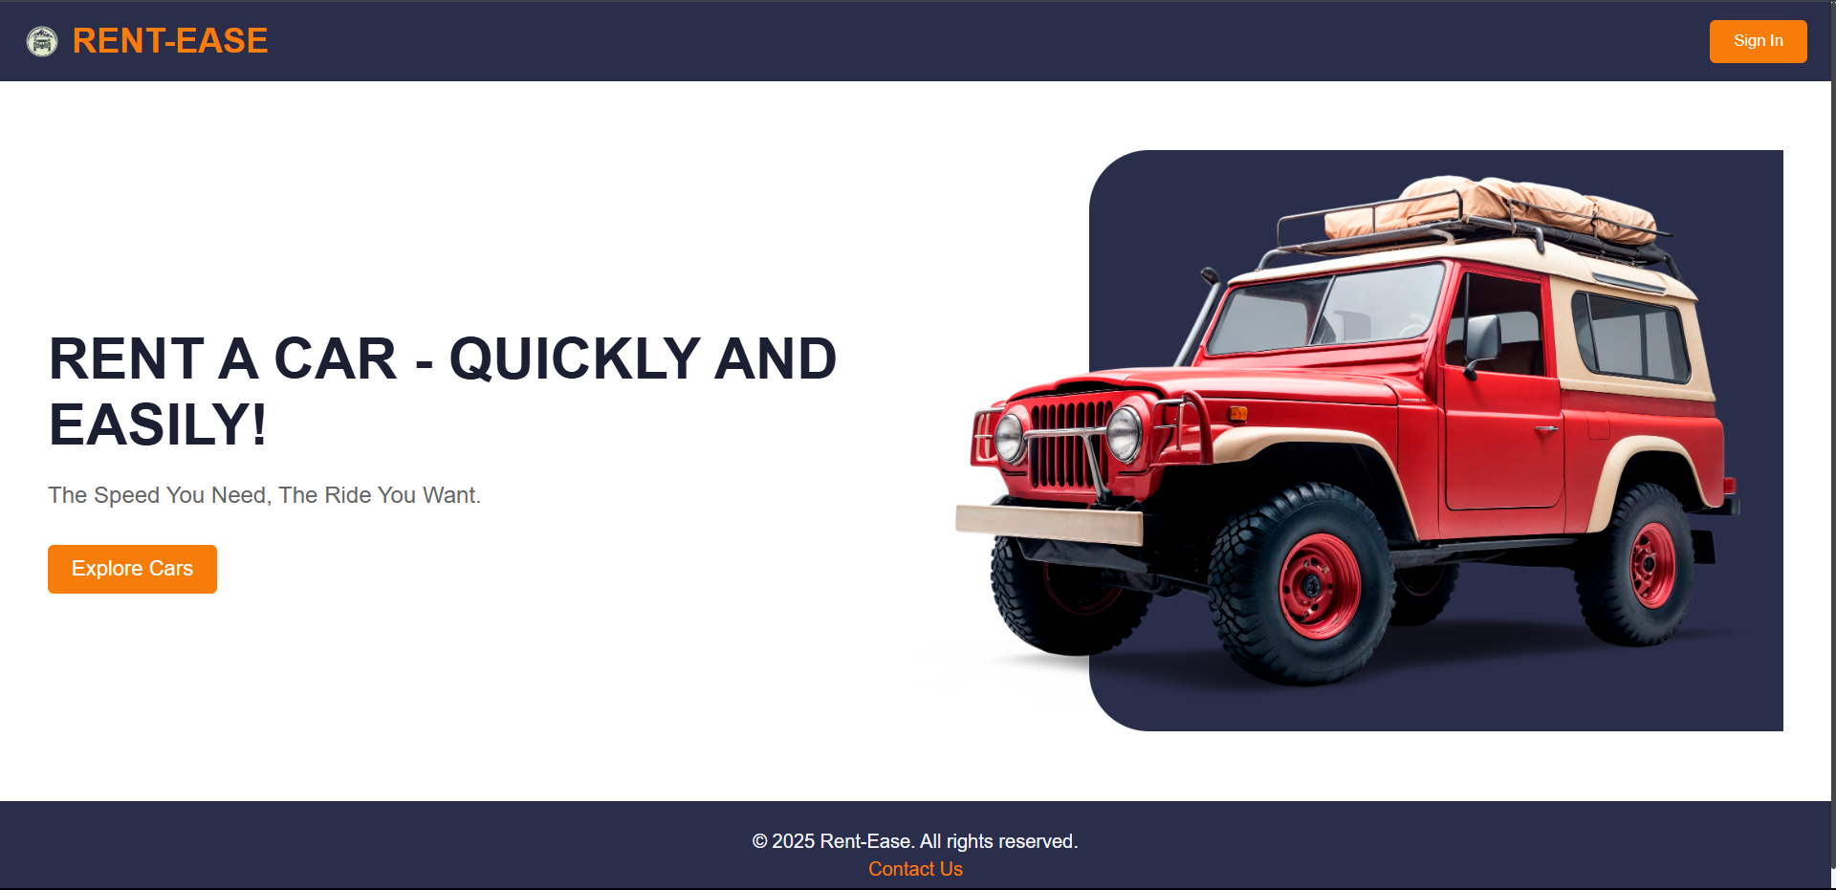
USER INTERFACE

Slide 9
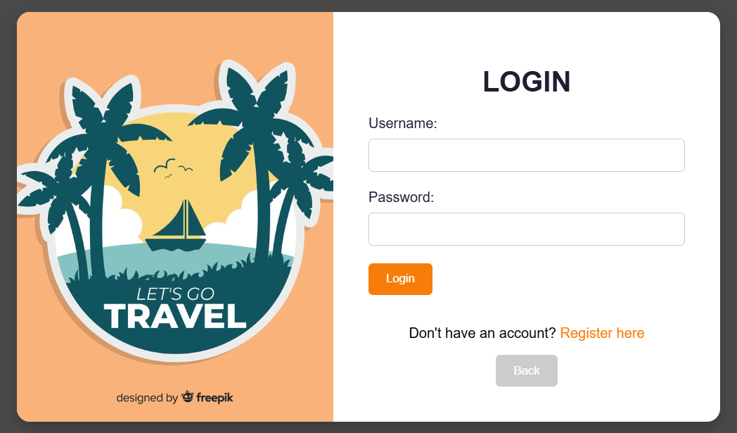
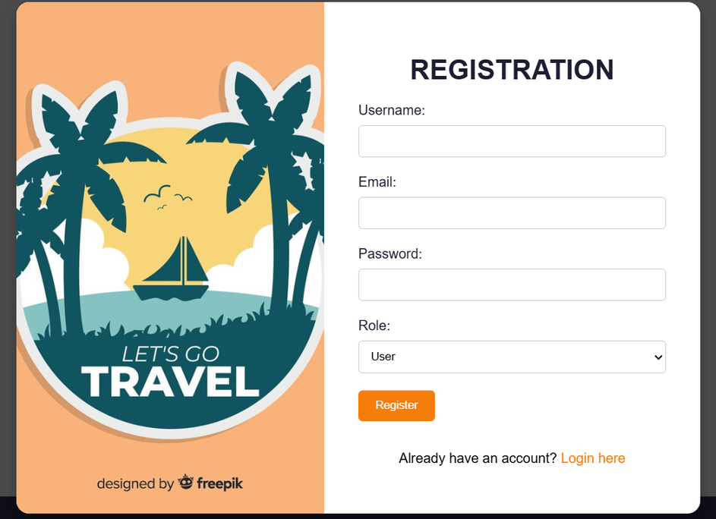
LOGIN/REGISTRATION

Slide 10
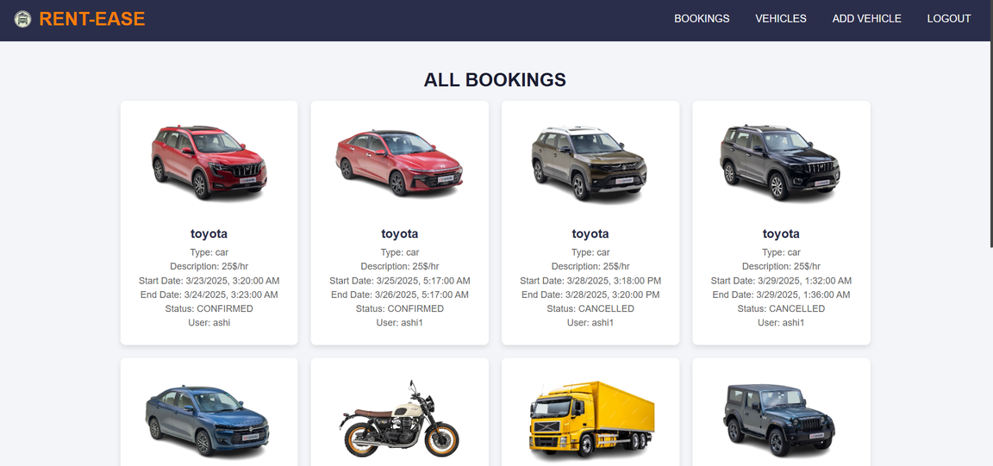
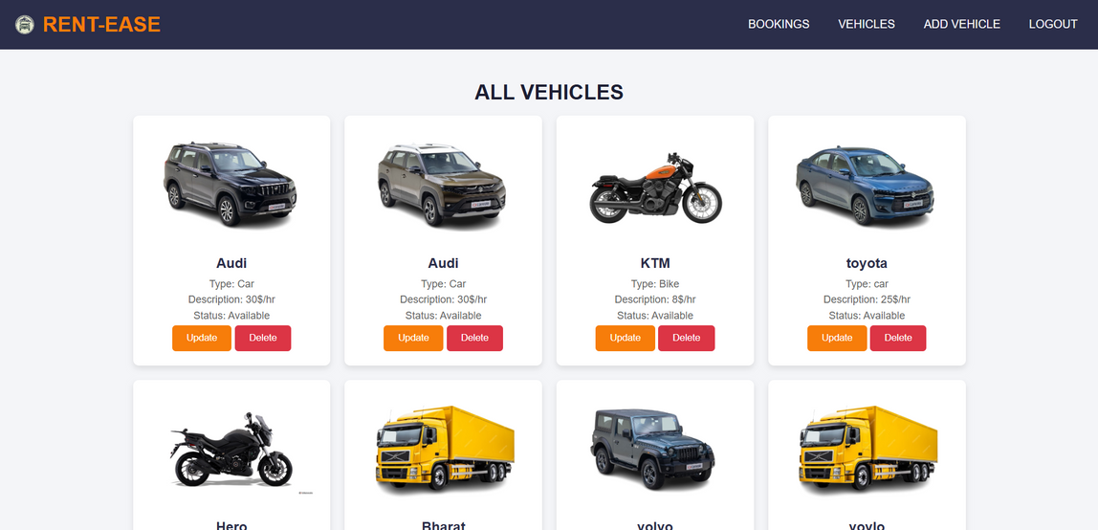
ADMIN DASHBOARD

Slide 11
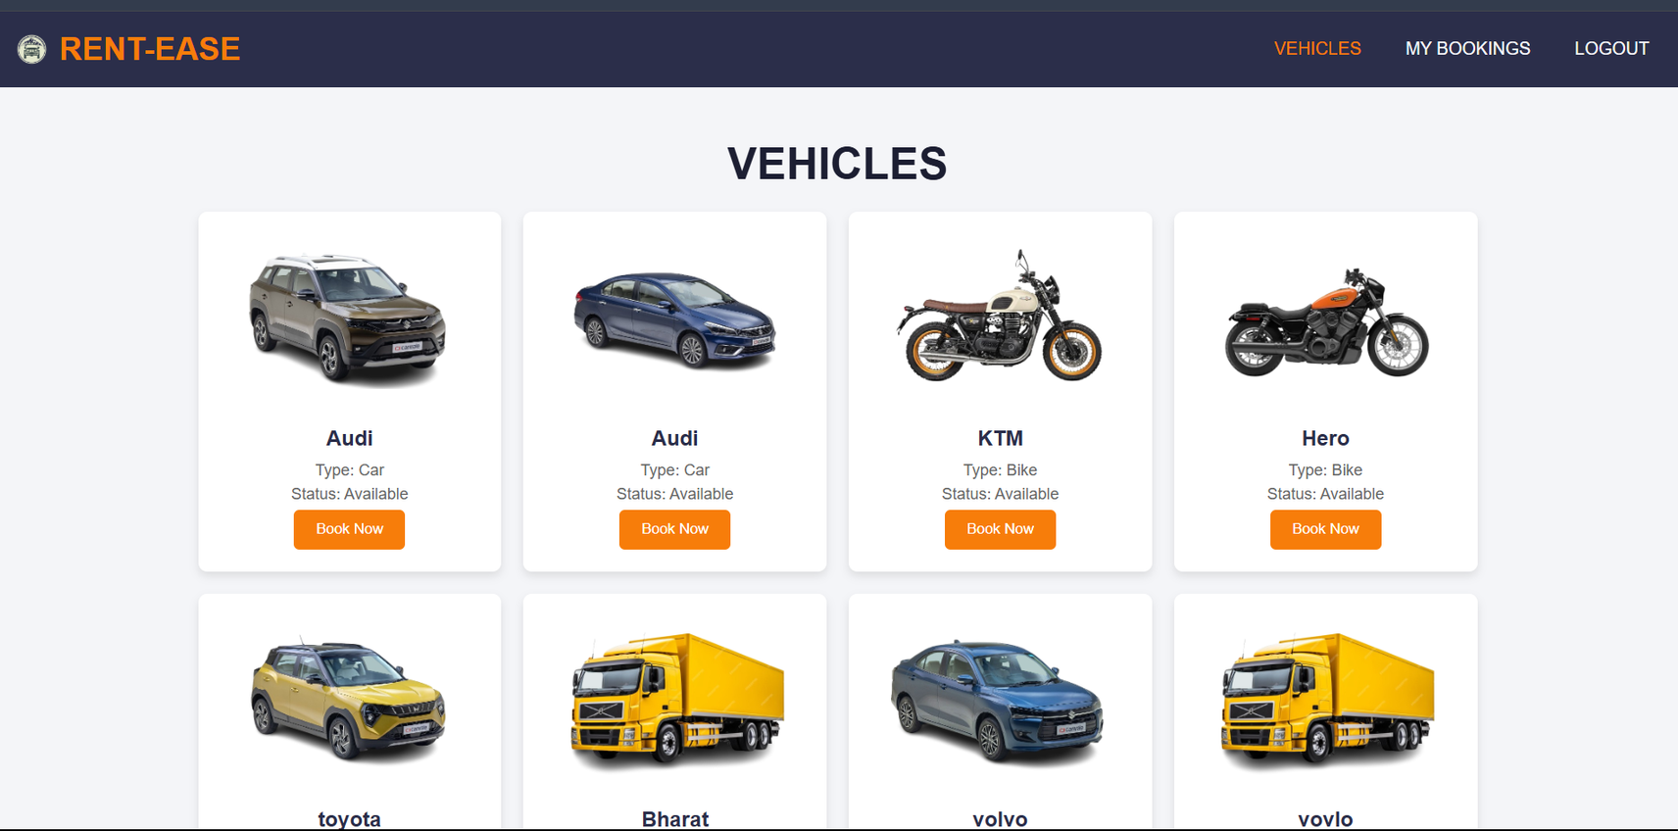
USER DASHBOARD

Slide 12
THANK YOU

