Slide 1
Amrapali University, Haldwani
SUMMER INTERNSHIP PROJECT
ChurnIQ
Customer Churn Prediction & Business Intelligence System
Ashish Dumka
Enrollment 2410302008 | Semester 5
B.Tech CSE (AI&ML)
Internship Organization
Aarsh Ai
Industry Mentor: Swasti Mishra
Faculty Mentor: Mrs. Sonali Mahajan
Department of Computer Science & Engineering • August 2026

Slide 2
Introduction & Problem Statement
Why churn prediction matters for a subscription business
Background
The Problem
Subscription businesses earn revenue on a recurring basis, so a departing customer removes predictable future income. Retaining an existing customer generally costs less than acquiring a new one.
Churn is usually detected only after cancellation. A probability score alone does not tell a retention team who matters most or what action to take.
Project Objectives
Validate, clean and analyse the customer dataset
Convert predictions into risk scores and segments
Build a reusable preprocessing pipeline
Generate a retention action for every customer
Train and compare classification algorithms
Present results through an interactive dashboard
2

Slide 3
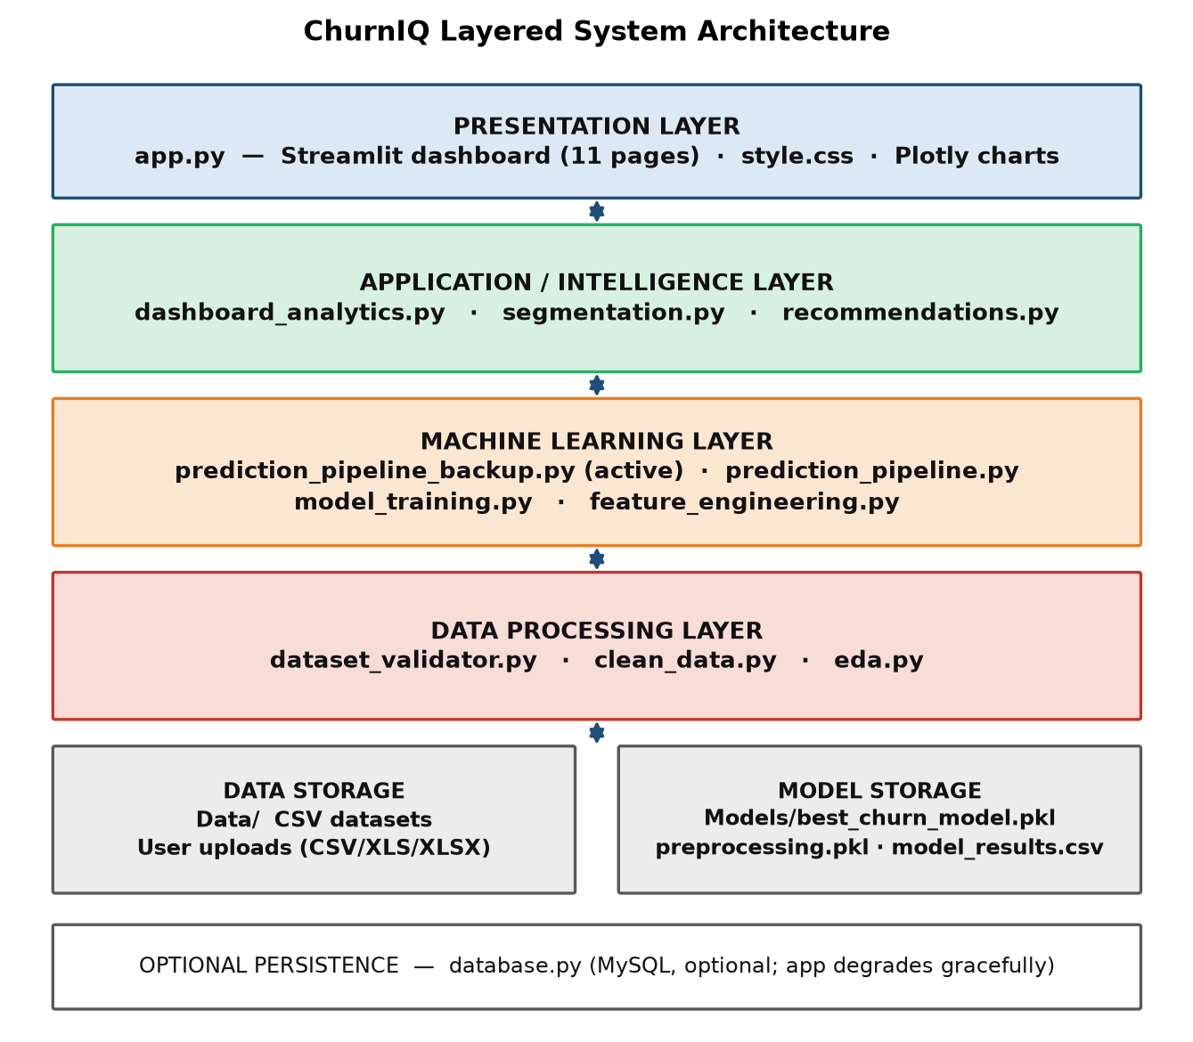
Technologies & System Architecture
Python analytical stack, organised in layers
Python 3
pandas / numpy
scikit-learn
Core language
Data handling
ML pipeline
Streamlit
plotly / matplotlib
joblib
Dashboard
Visualisation
Persistence
Layered Design
Presentation layer — the Streamlit application
Analytical layer — cleaning, modelling, segmentation
Persistence layer — datasets and saved model artefacts
11 modules, approximately 22,000 lines of Python
3

Slide 4
Dataset & Data Preprocessing
Telco Customer Churn dataset, validated and cleaned
7,043
21
1,869
26.54%
Customer records
Attributes
Churned customers
Churn rate
Preprocessing Pipeline
Data Quality & Partitions
Numerical (4): median imputation, then standard scaling
0 duplicate rows, 0 null values
Categorical (15): most-frequent imputation, one-hot encoding
11 blank TotalCharges values, all at tenure 0 — imputed
Built as a scikit-learn ColumnTransformer
Stratified 80 / 20 split: 5,634 train, 1,409 test
Fitted on the training partition only, saved with the model
Fixed random state of 42 for reproducibility
4

Slide 5
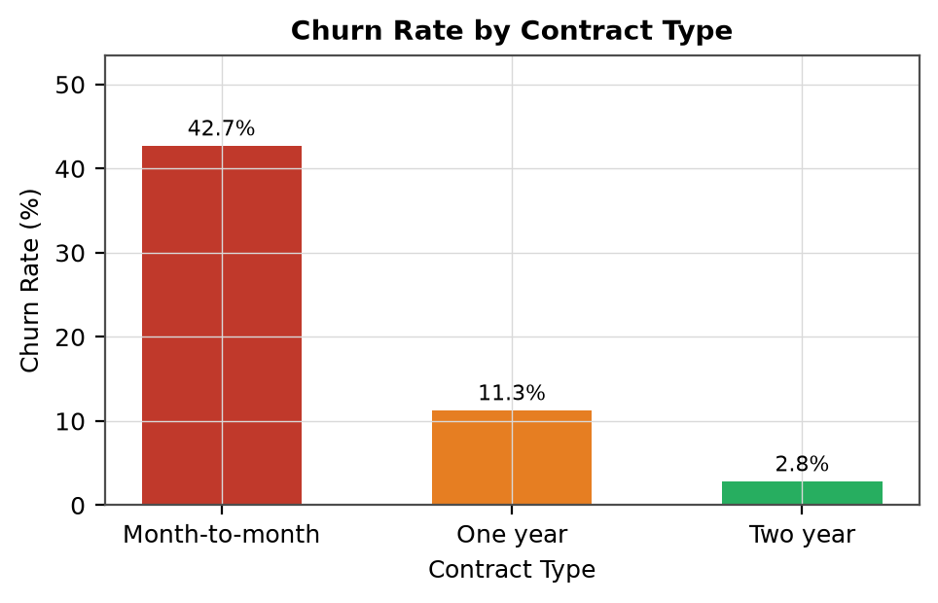
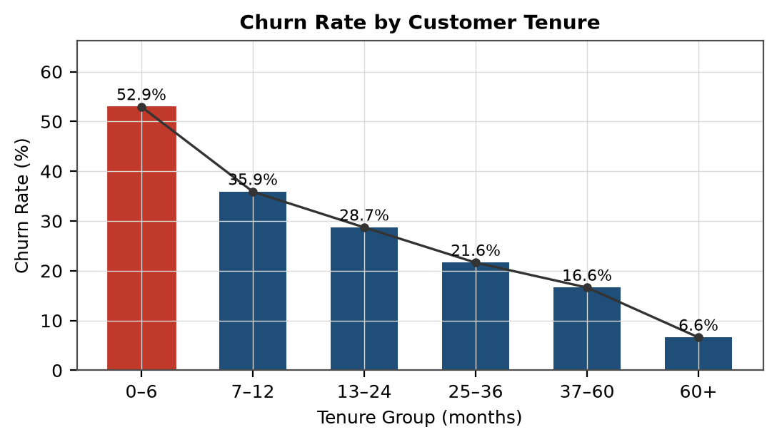
Exploratory Data Analysis
The strongest churn indicators in the dataset
Key Findings
42.71%
45.29%
52.94%
41.64%
6.61%
Month-to-month
Electronic check
First 6 months
No tech support
Over 60 months
5

Slide 6
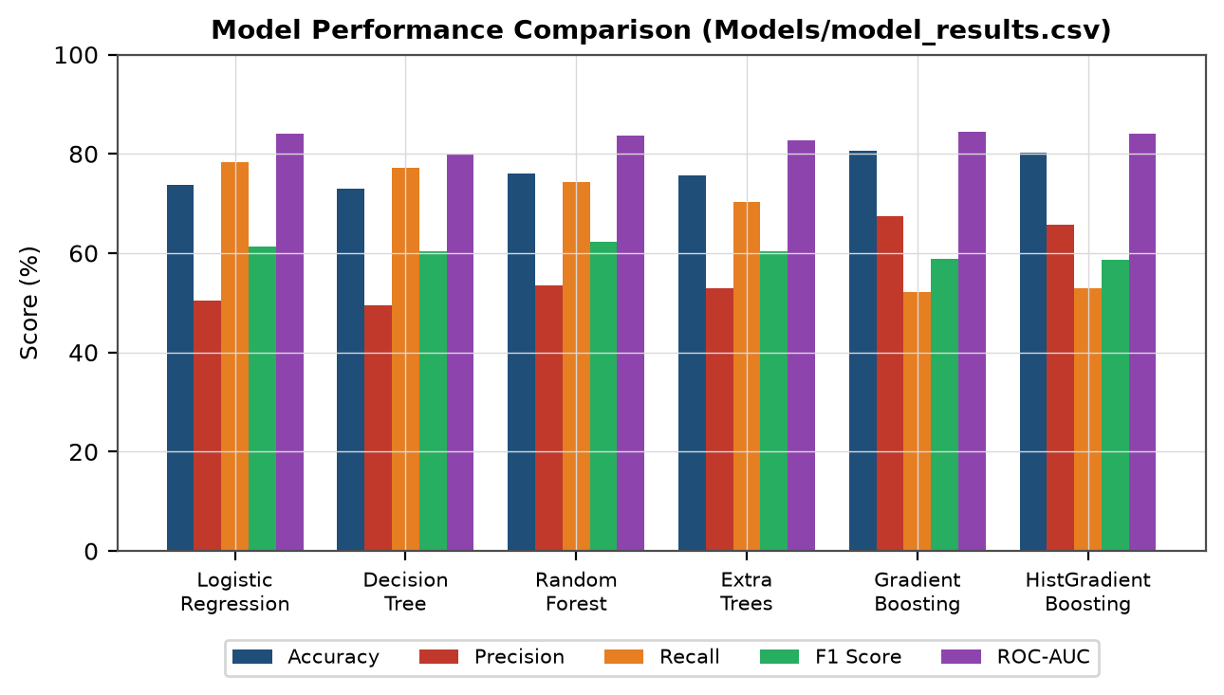
Machine Learning Model
Six algorithms compared on identical partitions
Selected Model
Random Forest
Highest F1 score 0.6226 • CV F1 0.6293
Accuracy
76.08%
Precision
53.56%
Recall
74.33%
F1 Score
62.26%
ROC-AUC
83.69%
Note: the training module ranks by F1 and saves Random Forest, while the dashboard ranks by ROC-AUC and reports Gradient Boosting (0.8437). Both are correct under their own criterion.
6

Slide 7
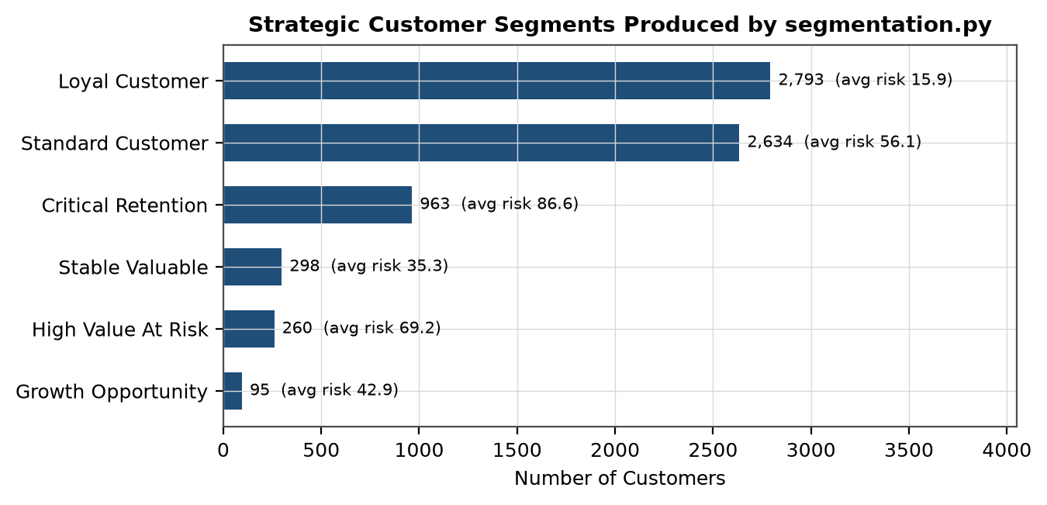
Customer Intelligence & Segmentation
Turning probabilities into prioritised, actionable groups
Risk Score (0-100)
70% predicted probability, adjusted for tenure, charges, contract type, payment method and technical support.
Low
2,794
Medium
1,937
High
1,349
Critical
963
Six strategic segments combine risk with customer value, from Critical Retention through to Loyal.
7

Slide 8
Streamlit Dashboard & Business Insights
Eleven pages, from executive summary to per-customer detail
Executive Overview
Dataset Center
Churn Analysis
Customer Segments
Revenue Exposure
Risk Center
Prediction Center
Model Performance
Customer Explorer
197,382.67
Monthly revenue associated with at-risk customers
Recommendations
Reports
About
From Prediction to Action
Prioritised Action Plan
Recommended retention action per customer
Immediate
963
Personal outreach
Engagement channel by retention priority
High
1,349
Targeted campaign
Six CSV reports available for export
Monitor
1,937
Email / in-app
Immediate outreach for 963 critical customers
Low
2,794
Standard engagement
8

Slide 9
Results, Testing & Future Scope
What the system achieved and where it would develop next
62.26%
84.37%
16
11
Best F1 (Random Forest)
Best ROC-AUC (Gradient Boosting)
Test cases recorded
Modules delivered
Limitations
Future Scope
Evaluated on a single public dataset
Add time-series features from billing history
Static snapshot — no time dimension in the data
Systematic hyperparameter tuning and threshold calibration
Risk weights set from observed patterns, not optimised
Explainability per prediction using SHAP
No campaign-response data, so effectiveness is unmeasured
Record campaign outcomes to measure retention impact
Testing: 11 cases executed against the code and 5 derived from implemented error-handling paths. No failing case was recorded.
9

Slide 10
Conclusion
ChurnIQ covers the full analytical path from a raw data file to an exported retention report — prediction, risk scoring, segmentation and recommendation, presented through an interactive dashboard.
Key Outcome
A ranked, explainable list of customers a retention team can act on — not a column of probabilities.
7,043 customers analysed and scored
6 algorithms trained; Random Forest deployed
4 risk levels and 6 strategic segments generated
11-page dashboard with 6 CSV exports
The system prioritises customers statistically likely to churn; it does not guarantee retention.
Ashish Dumka • 2410302008 • Aarsh Ai • August 2026

