Slide 1


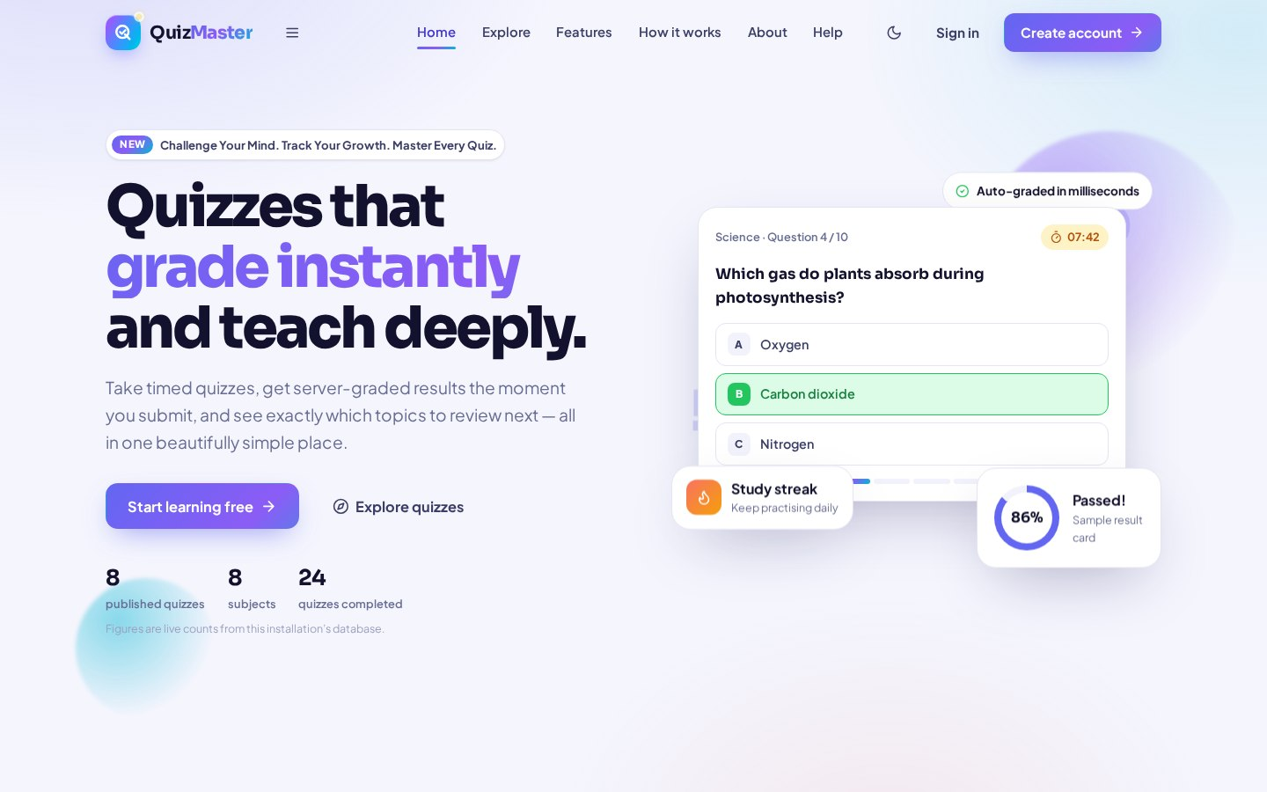
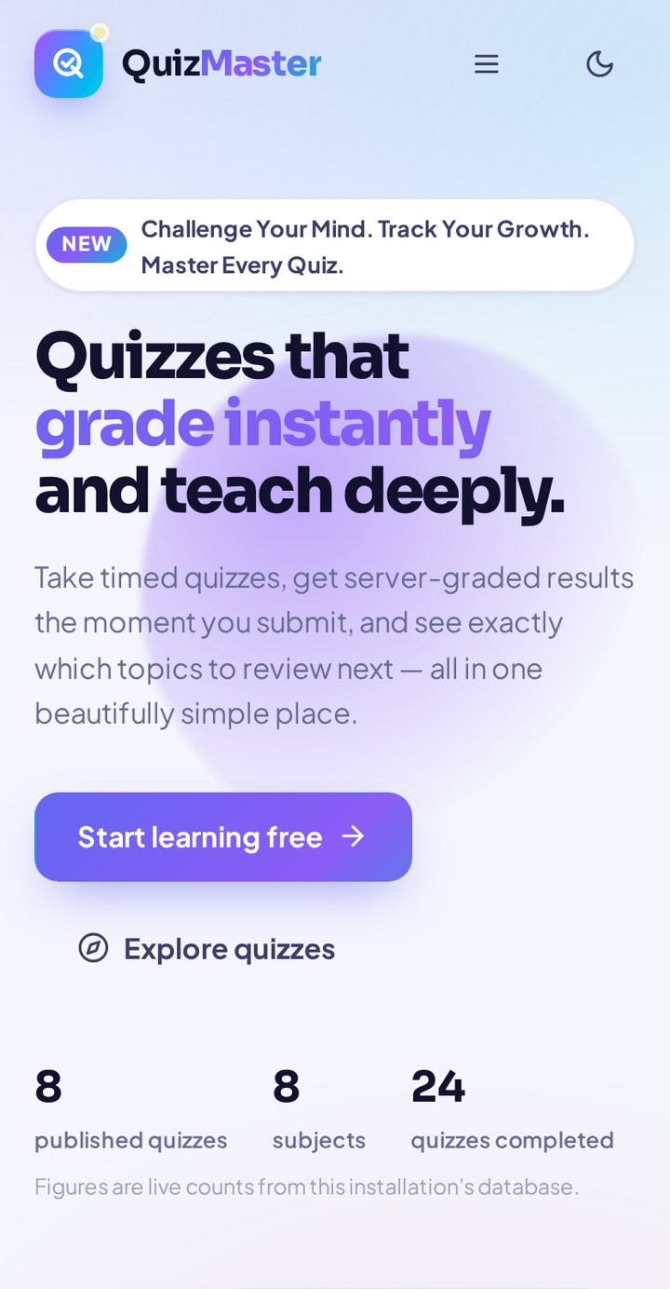
QuizMaster
ONLINE QUIZ · ASSESSMENT · TQM
LEARN SMARTER · ASSESS BETTER · IMPROVE CONTINUOUSLY
quizmaster.app
Quizzes that
grade instantly
and keep improving.
● One platform — students, administrators & quality teams
● Timed quizzes with instant, server-side auto-grading
● Live analytics — scores, trends, leaderboards & reports
● Built-in TQM workspace — Pareto · Fishbone · FMEA · PDCA
22
database tables
110+
application routes
20
quality goals mapped
50+
automated tests
Presented by Ashish · Fundamentals of TQM (BBAT104) — Project Presentation
github.com/Ashishdumka24/QuizMaster
Notes:
Welcome everyone. This is QuizMaster - my online quiz, assessment and Total Quality Management platform. In one line: students take timed quizzes that are graded the instant they submit, administrators manage everything from one console, and a built-in TQM workspace keeps improving the system using real data. It runs in any browser, on phone or desktop, and everything I will show today is a real, working application.

Slide 2

WHY QUIZMASTER · PROBLEM STATEMENT
Assessment today is slow, manual & blind
The baseline — how quizzes still run in most classrooms, and what it costs.
BASELINE — THE MANUAL WAY
WITH QUIZMASTER
✗ Hours of checking — every paper copy marked by hand
✗ Results take days — feedback arrives too late to act on
✗ No attempt history — weak topics stay invisible
✗ Errors & duplicates — totalling mistakes, repeat entries
✗ Nothing measured — so teaching quality can't improve
✓ Graded in milliseconds — automatically, on the server
✓ Instant feedback — score, solutions & weak-topic insight
✓ Complete history — every attempt, trend & leaderboard
✓ Validated, duplicate-safe data with a full audit trail
✓ Quality tools built in — defects, Pareto, FMEA, PDCA
→
From days of manual checking → results in milliseconds, with data you can actually improve on.
QuizMaster · Learn Smarter · Assess Better · Improve Continuously
02 / 11
Notes:
Start with the baseline. In a typical classroom a quiz means paper, manual checking that takes hours, and results that reach students days later - too late to fix weak topics. There is no record of past attempts, marking errors and duplicate entries creep in, and with nothing measured, nothing can improve. QuizMaster removes each of these pain points one-to-one: instant grading, instant feedback, complete history, validated data and built-in quality tools.

Slide 3
QUALITY OBJECTIVES · SRS SNAPSHOT
Built around 20 measurable quality goals
Every guideline goal (Q01–Q20) maps to a working, verifiable feature.
Reliability & Accuracy
Performance & Speed
SRS SNAPSHOT what the system must do
Q01 · Q06 · Q07
Q02 · Q05 · Q13 · Q17
FUNCTIONAL
Auto-backups, audit log, strict validation, duplicate-entry guards.
Indexed search, cached dashboards, pagination, compressed assets.
● Secure registration, login & role-based access
● Quiz & question-bank management (CRUD + import)
● Timed attempts with server-side auto-grading
● Results, history, analytics & report exports
● TQM tools, defect log & PDCA tracking
● Notifications, feedback & announcements
Usability & Accessibility
Security
Q03 · Q08 · Q12 · Q14
Q04
Themes & palettes, dashboards, keyboard navigation, high contrast.
Role-based portals, hashed passwords & OTPs, CSRF, rate limiting.
NON-FUNCTIONAL
Reporting & Insight
Continuous Improvement
● Responsive — mobile, tablet & desktop
● Fast — indexed queries, caching, pagination
● Safe — hashing, validation, backups, recovery
Q15 · Q20
Q09 · Q10 · Q11 · Q16 · Q18 · Q19
PDF / Excel / CSV exports, charts, date-range & printable reports.
Defect log, PDCA tracker, automated tests, docs & version log.
Full traceability: each Q-goal is mapped to its feature in code and reported live in the TQM centre.
QuizMaster · Learn Smarter · Assess Better · Improve Continuously
03 / 11
Notes:
Quality was planned, not added later. We defined twenty quality goals - reliability, performance, usability, security, reporting and continuous improvement - and every single one maps to a feature that actually works in the app. On the right is the SRS in brief: what the system must do, and how well it must do it. Because the mapping lives in the code itself, an examiner can open the TQM centre and verify each goal live.

Slide 4
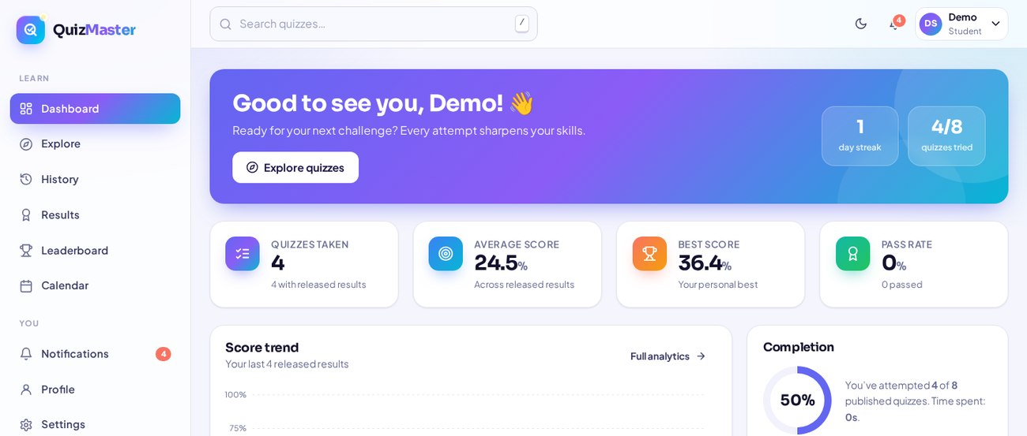
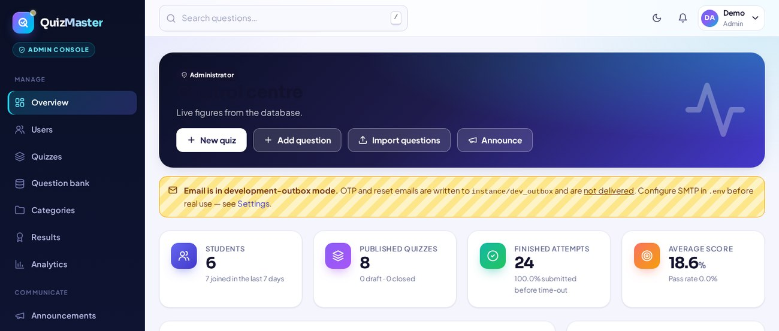
SCOPE & USER ROLES
Two portals, one platform
Built for institutes, coaching centres & self-learners — separate experiences for learning and managing.
Student Portal
LEARN
Administrator Portal
MANAGE
● OTP-verified sign-up & secure login
● Explore by subject, difficulty & search
● Timed attempts with autosave protection
● Instant results, streaks & recommendations
● Themes, profile & accessibility settings
● User, role & account-status management
● Quiz builder & question bank (CSV import)
● Results, analytics, audit & error logs
● Announcements, feedback & support inbox
● Backups, maintenance & system settings
One shared database, strict role-based access — students never see admin tools, admins never break a student's flow.
QuizMaster · Learn Smarter · Assess Better · Improve Continuously
04 / 11
Notes:
There are exactly two user roles. Students get a learning-focused portal: sign up with email OTP verification, explore quizzes, attempt them under a timer with autosave protection, and track their growth. Administrators get a complete management console: users, quizzes, the question bank, analytics, audit logs and system maintenance. Both portals share one database, but access is strictly separated by role - that separation is itself one of our security quality goals.

Slide 5

MODULES & FEATURES
Seven modules. One seamless system.
Each module is a self-contained unit with its own routes and services — easy to test, easy to extend.
01
Auth & Security
02
Student Portal
03
Quiz Engine
04
Question Bank
Email-OTP verification, password reset, role-based access, CSRF & rate limiting.
Personal dashboard, explore, calendar, leaderboard, streaks & recommendations.
Timed player with shuffled questions, autosave, auto-submit & instant grading.
Categories & difficulty levels, CSV / JSON bulk import, live duplicate warning.
05
Admin Portal
06
Analytics & Reports
07
TQM Workspace
Users & quizzes, announcements, audit trail, error log, backups & settings.
Score trends & charts, per-quiz analysis, one-click PDF / Excel / CSV exports.
Defect log, Pareto, Fishbone, FMEA, PDCA, SIPOC–CTQ & statistical control charts.
TECH STACK Python · Flask · SQLAlchemy · SQLite · Jinja2 · Matplotlib · fpdf2 · openpyxl · pytest
QuizMaster · Learn Smarter · Assess Better · Improve Continuously
05 / 11
Notes:
Functionally the system is seven modules. Security first: OTP verification and role-based access. Then the learning side - student portal and the quiz engine with its timer, autosave and instant grading. The question bank lets admins build content quickly, including bulk import. Analytics turns attempts into insight and exportable reports. And the seventh module, the TQM workspace, is what makes this project different - quality tools running inside the product itself.

Slide 6
SYSTEM & DATABASE DESIGN
Clean, modular architecture
Routes, services, models and templates each live in their own layer — nothing is tangled.
LAYERED DESIGN
DATABASE · 22 TABLES
MODULAR FOLDERS
Presentation
Users & Access
QuizMaster/
├─ backend/
│ ├─ blueprints/ (7)
│ ├─ models/ (4)
│ └─ services/ (12)
├─ frontend/
│ ├─ templates/ (79)
│ └─ static/ css·js
├─ database/
│ └─ migrations/
├─ tests/ (pytest)
├─ docs/ · tqm/
└─ app.py · wsgi.py
79 Jinja2 templates · responsive CSS · vanilla JS
User · EmailOTP · PasswordResetToken
Routing
Quiz Core
7 Flask blueprints · 110+ routes
Quiz · Question · AnswerOption · Category · QuizAttempt · AttemptAnswer
Business Services
Quality (TQM)
12 services — grading, attempts, exports, charts, email, backup
Defect · FMEAItem · PDCAAction · ChangelogEntry
Data Layer
System
AuditLog · Notification · Feedback · Announcement · ErrorLog · Setting
New feature = new blueprint + service. Nothing else changes.
SQLAlchemy ORM · SQLite · Alembic migrations
QuizMaster · Learn Smarter · Assess Better · Improve Continuously
06 / 11
Notes:
Architecturally, requests flow through four clean layers: templates render the pages, seven blueprints route requests, twelve services hold the business logic like grading and exports, and SQLAlchemy models talk to the database. The 22 tables fall into four domains - users, quiz core, quality and system. And the folder structure mirrors the architecture exactly, so any developer can find any feature in seconds. This modularity is our maintainability quality goal, Q11, in practice.

Slide 7
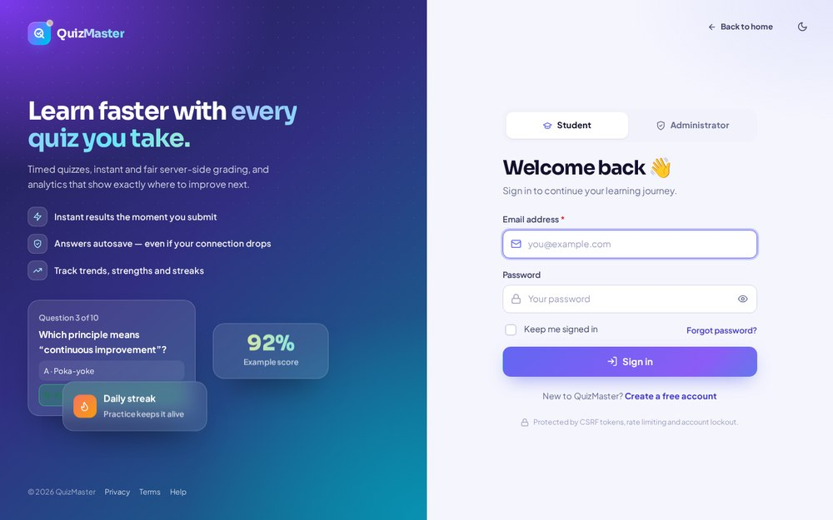
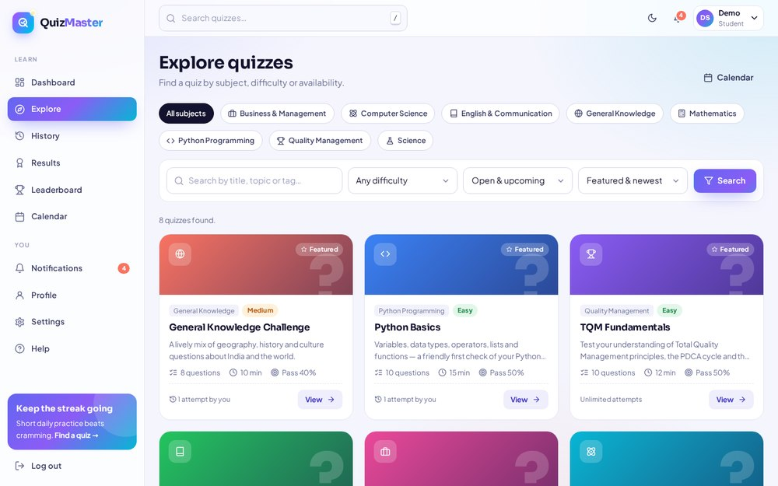
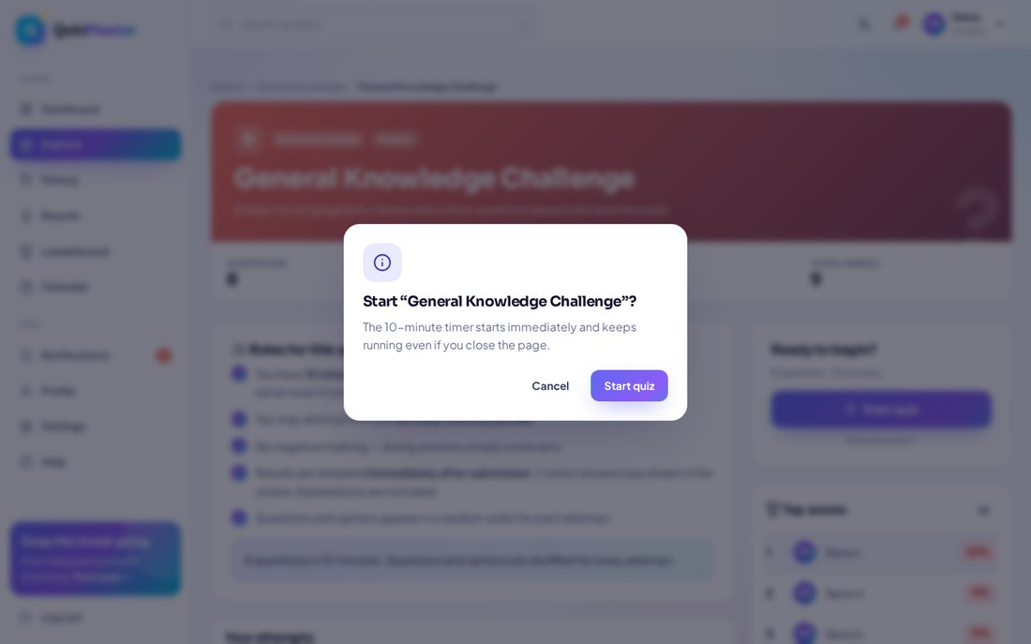
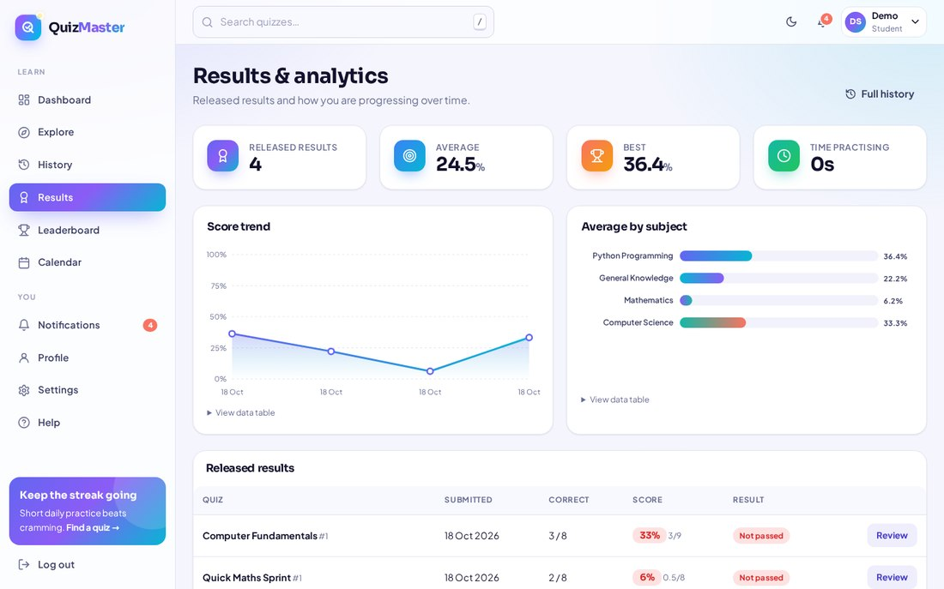
MAIN SYSTEM WORKFLOW
From sign-up to insight in six steps
Designed so answers are never lost — and results need zero manual work.
1 · Register
email OTP verified
2 · Explore
pick a quiz
3 · Attempt
timer + autosave
4 · Submit
instant grading
5 · Review
results & history
6 · Improve
analytics → PDCA
Step 6 feeds improvements back into better quizzes — a continuous PDCA loop.
quizmaster.app
quizmaster.app
quizmaster.app
quizmaster.app
Secure sign-in
Explore quizzes
Focused quiz player
Instant results
✓ Answers autosave as you type
✓ Auto-submits when time runs out
✓ Refresh or disconnect? Resume safely
QuizMaster · Learn Smarter · Assess Better · Improve Continuously
07 / 11
Notes:
Here is the main workflow end to end. A student registers and verifies an email OTP, explores and picks a quiz, attempts it under a timer, and submits. Grading happens on the server immediately - no teacher action needed. The student reviews the result, and the data flows into admin analytics, which feeds the PDCA improvement cycle. Notice the three safety nets: answers autosave continuously, the quiz auto-submits at the deadline, and even a refresh or disconnect cannot lose an attempt. That is reliability, goal Q01, in action.

Slide 8
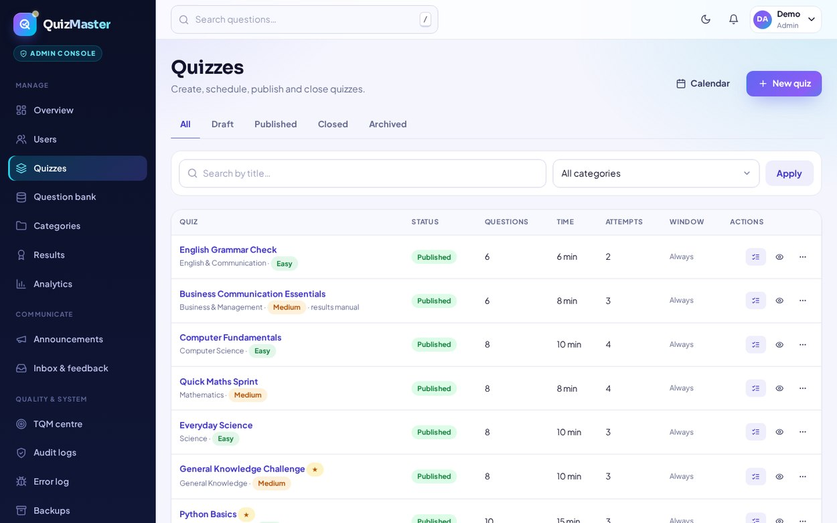
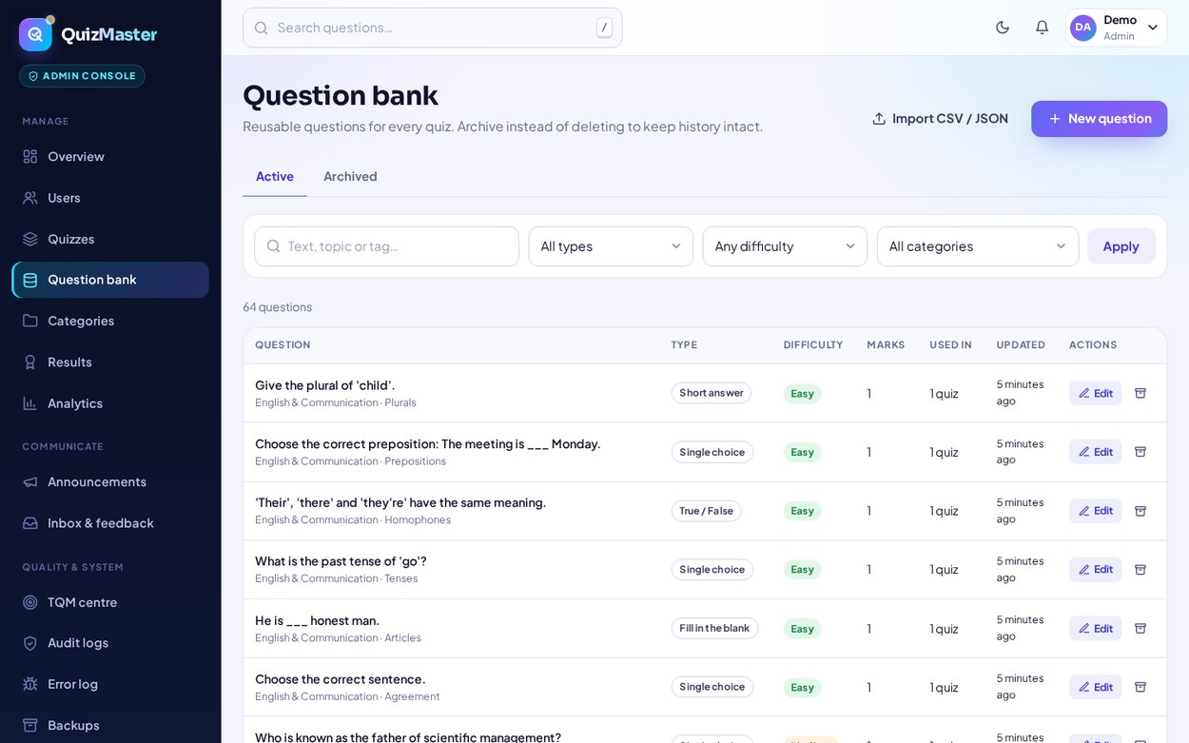
CRUD OPERATIONS · DATABASE INTEGRATION
Full CRUD, fully integrated
Every record is created, read, updated and deleted through validated, audited workflows.
C
Create
quizmaster.app/admin/quizzes
Quizzes, questions, users, categories, announcements — plus bulk CSV / JSON import.
R
Read
Live search, filters, sorting & pagination on every list and dashboard.
quizmaster.app/admin/questions
U
Update
Edit content, toggle publish state, manage roles & account status.
D
Delete
Confirmation dialog first — every deletion is written to the audit log.
SQLAlchemy ORM · Alembic migrations · unique constraints block duplicates · append-only audit log · automatic backups
QuizMaster · Learn Smarter · Assess Better · Improve Continuously
08 / 11
Notes:
All data operations are proper CRUD, integrated end to end with the database. Admins create quizzes and questions - or import them in bulk from CSV or JSON. Every list supports search, filters, sorting and pagination. Updates cover everything from editing a question to changing a user's account status. Deletes always ask for confirmation and are written to an append-only audit log. Under the hood, SQLAlchemy ORM prevents SQL injection, and unique constraints make duplicate entries - quality goal Q06 - impossible at the database level.

Slide 9
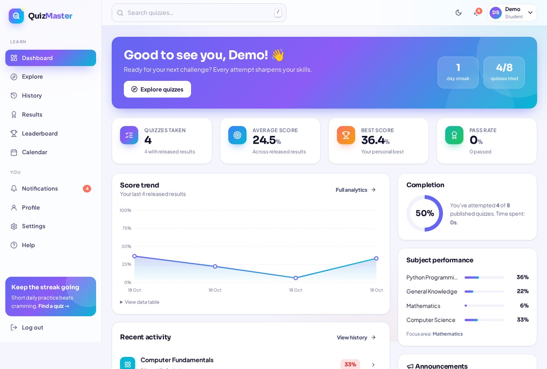
PRODUCT TOUR · STUDENT SIDE
A dashboard that coaches every student
The working application — real screens from the live system.
quizmaster.app/dashboard
● Personal dashboard — streaks, score trend, subject strengths
● Focused quiz player — live timer, progress, keyboard control
● Instant review — correct answers with explanations
● Smart recommendations target your weakest subjects
● Made personal — light/dark themes, 4 palettes, accessibility
quizmaster.app
quizmaster.app
Timed quiz player
Result & answer review
Student dashboard — live scores, trends & recommendations
QuizMaster · Learn Smarter · Assess Better · Improve Continuously
09 / 11
Notes:
This is the live student experience. The dashboard acts like a coach: it shows the study streak, a score-trend graph, subject-wise performance, and it recommends quizzes in the student's weakest subjects - here, Mathematics. During a quiz the player shows the timer and progress and supports keyboard answering. The moment a quiz is submitted, the student sees the score and can review every answer with explanations. Themes, colour palettes and accessibility settings make it personal - quality goals Q03, Q08 and Q12.

Slide 10
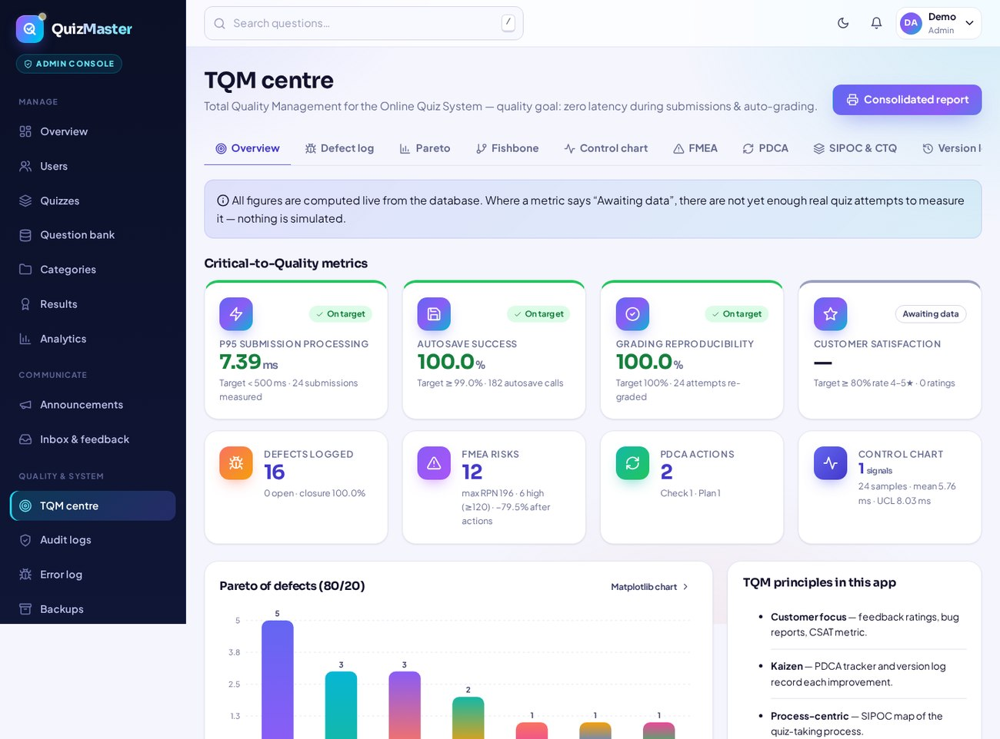
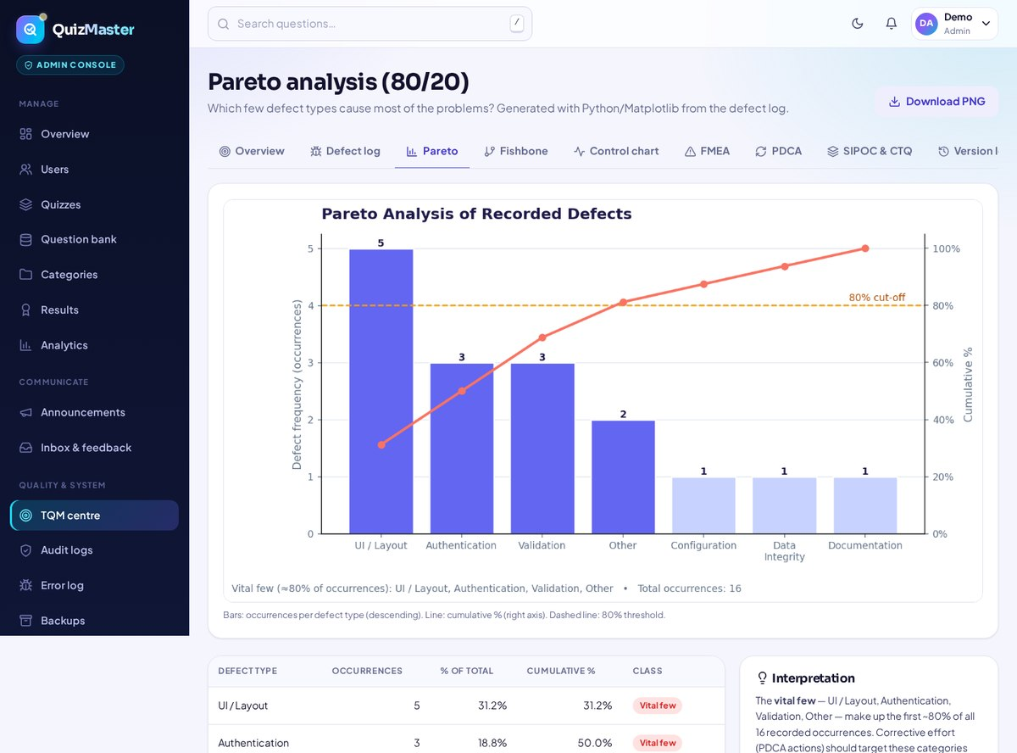
TQM QUALITY WORKSPACE
Quality isn't a chapter — it's built in
A complete Total Quality Management centre, running on this project's own real defect data.
● Defect log — 16 real development defects, 100% closed
● Pareto analysis — the vital few causes behind ~80% of defects
● Fishbone diagram — root causes across six categories
● FMEA — 12 risks scored by RPN, re-scored after action
● PDCA · SIPOC · CTQ — the quiz process, mapped end-to-end
● Control charts — submission latency under statistical control
quizmaster.app/admin/tqm
quizmaster.app/admin/tqm/pareto
7.39 ms
100%
P95 submission processing
(target < 500 ms)
autosave success &
grading reproducibility
Nothing is simulated — every figure is computed live.
QuizMaster · Learn Smarter · Assess Better · Improve Continuously
10 / 11
Notes:
This is the heart of the project. The TQM centre applies the classic quality tools to QuizMaster itself. Sixteen genuine defects found during development are logged and root-caused - all closed. Pareto analysis shows UI/layout, authentication and validation are the vital-few categories. FMEA scores twelve risks by RPN and re-scores them after corrective action. PDCA, SIPOC-CTQ and control charts complete the cycle. And look at the live CTQ metrics: submissions process in about 7 milliseconds against a 500-millisecond target, with 100 percent autosave success and perfectly reproducible grading.

Slide 11
OUTCOMES · TESTING · ROADMAP
Results that speak for themselves
13,000+
110+
22
50+
16 → 0
lines of code
routes · 7 blueprints
database tables
automated tests
defects logged → open
QUALITY, VERIFIED
THE ROAD AHEAD
● pytest suite — auth, quiz flow, grading security, TQM tools
● Render checks catch template errors before users do
● Every real defect logged, root-caused & fixed (100% closure)
● Security by design — scrypt hashing, CSRF, rate limiting
● Richer assessments — more question types & formats
● Deeper analytics — more detailed quality reporting
● CI / CD pipeline with broader automated test coverage
● Scales further — database optimisation & monitoring
Thank you! Questions & a live demo are most welcome.
Ashish
github.com/Ashishdumka24/QuizMaster
QuizMaster · Learn Smarter · Assess Better · Improve Continuously
11 / 11
Notes:
To close: QuizMaster is a complete, tested, working system - over thirteen thousand lines of code, more than a hundred routes, twenty-two tables, and a pytest suite covering authentication, the quiz flow, grading security and the quality tools. All sixteen real defects we found are fixed and documented. Next steps are richer question types, deeper analytics, CI/CD and further scaling. Thank you for your time - I am happy to take questions, and even happier to give a live demo.

