Slide 1
Summary
In this capstone, we will predict if the Falcon 9 first stage will land successfully. SpaceX advertises Falcon 9 rocket launches on its website with a cost of 62 million dollars; other providers cost upward of 165 million dollars each, much of the savings is because SpaceX can reuse the first stage. Therefore if we can determine if the first stage will land, we can determine the cost of a launch. This information can be used if an alternate company wants to bid against SpaceX for a rocket launch. In this lab, you will collect and make sure the data is in the correct format from an API. The following is an example of a successful and launch.
Several examples of an unsuccessful landing are shown here:
Most unsuccessful landings are planned. Space X performs a controlled landing in the oceans.
Objectives
In this lab, you will make a get request to the SpaceX API. You will also do some basic data wrangling and formating.
Request to the SpaceX API
Clean the requested data

Slide 2
Introduction
we will predict if the Falcon 9 first stage will land successfully. SpaceX advertises Falcon 9 rocket launches on its website with a cost of 62 million dollars; other providers cost upward of 165 million dollars each, much of the savings is because SpaceX can reuse the first stage. Therefore if we can determine if the first stage will land, we can determine the cost of a launch. This information can be used if an alternate company wants to bid against SpaceX for a rocket launch. In this lab, you will collect and make sure the data is in the correct format from an API. The following is an example of a successful and launch.

Slide 3
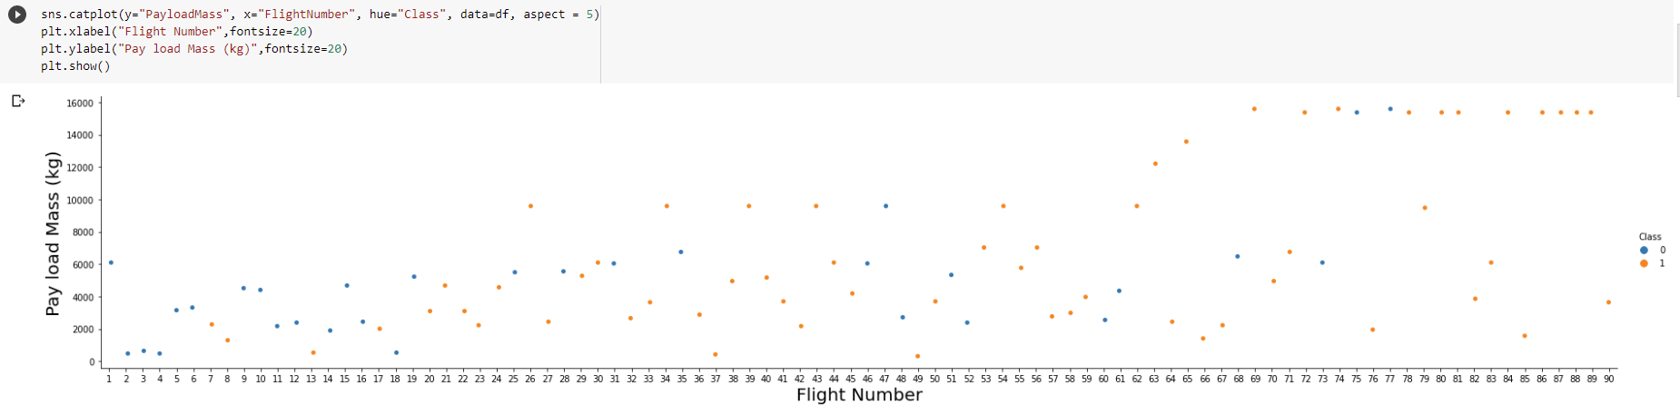
EDA
We see that different launch sites have different success rates. CCAFS LC-40, has a success rate of 60 %, while KSC LC-39A and VAFB SLC 4E has a success rate of 77%.
Next, let's drill down to each site visualize its detailed launch records.

Slide 4
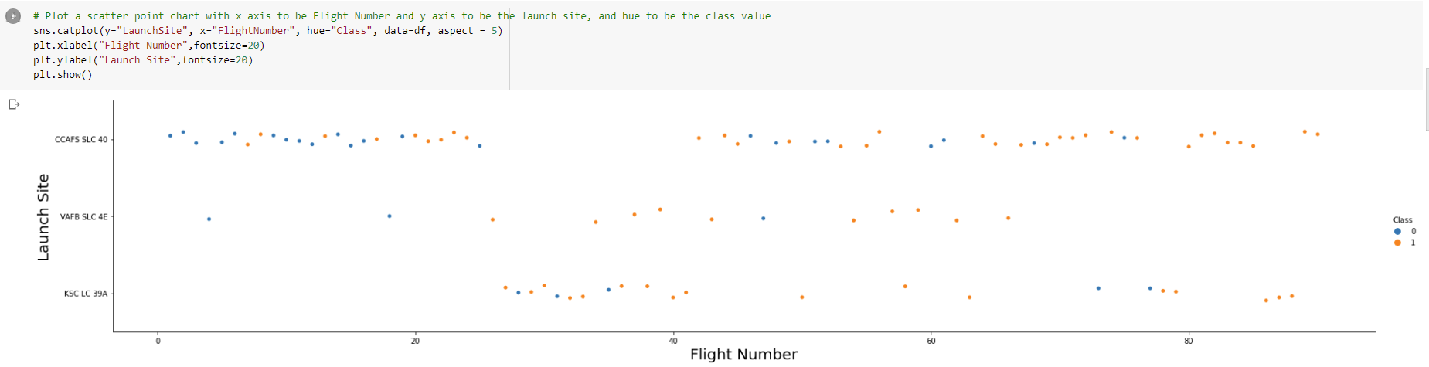
EDA
Now try to explain the patterns you found in the Flight Number vs. Launch Site scatter point plots.

Slide 5
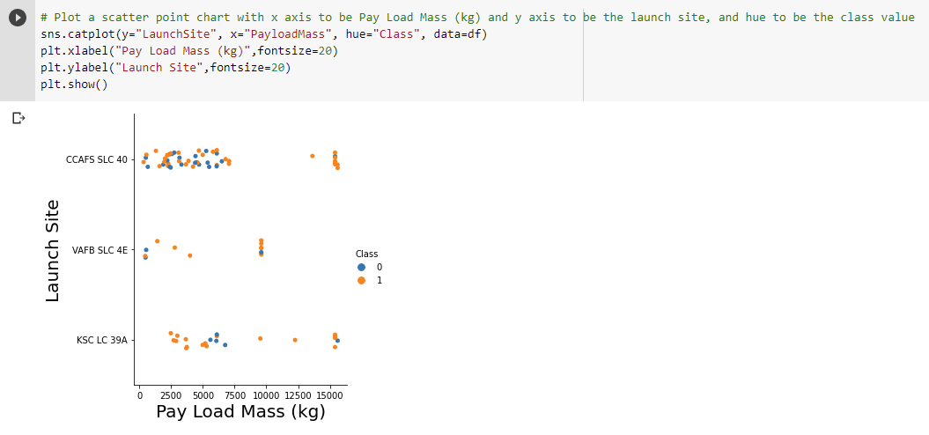
EDA
Now try to explain any patterns you found in the Payload Vs. Launch Site scatter point chart.
We can infer that Launch Site-CCAFS SLC 40 is suitable for launching rockets with payload mass varying from low to very high. Launch Site VAFB SLC 4E is preferred for medium payload mass.

Slide 6
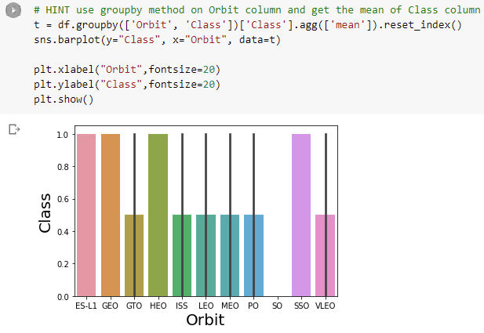
EDA
Analyze the ploted bar chart try to find which orbits have high sucess rate.

Slide 7
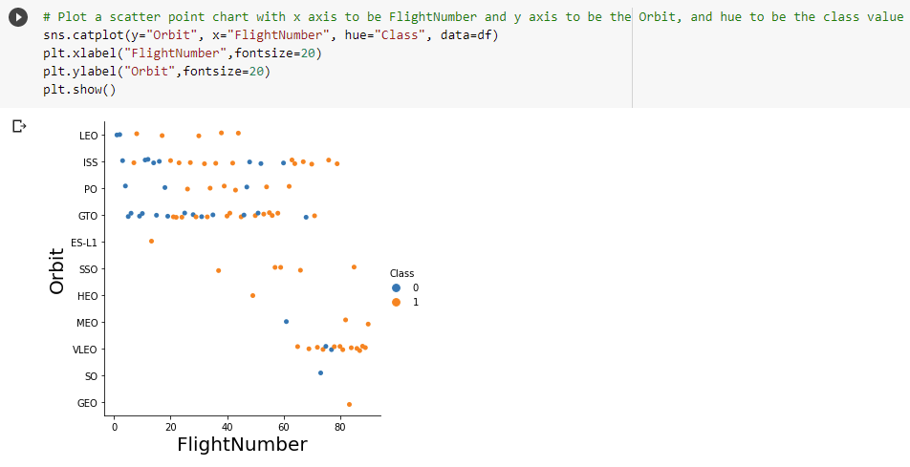
EDA
You should see that in the LEO orbit the Success appears related to the number of flights; on the other hand, there seems to be no relationship between flight number when in GTO orbit.

Slide 8
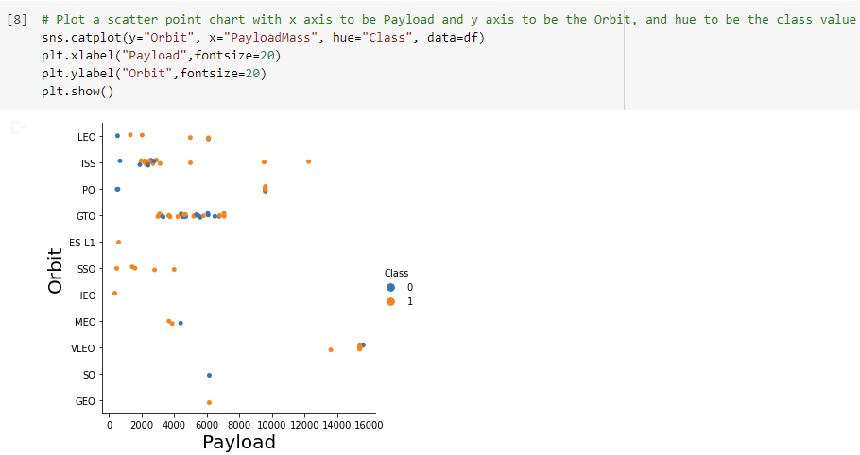
EDA
You should observe that Heavy payloads have a negative influence on GTO orbits and positive on GTO and Polar LEO (ISS) orbits.

Slide 9
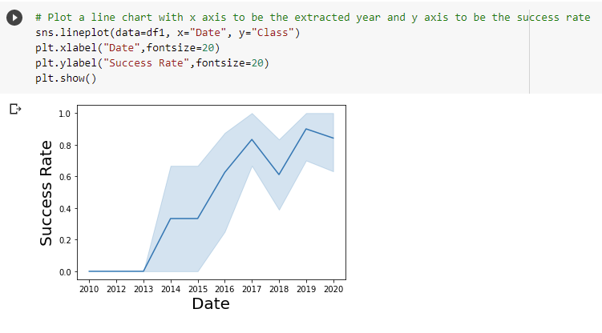
Forecasting
you can observe that the sucess rate since 2013 kept increasing till 2020

Slide 10
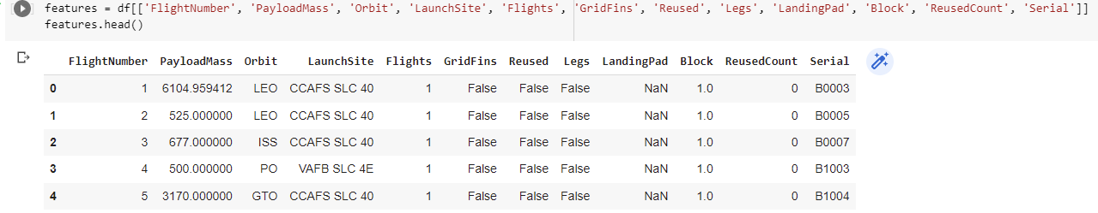
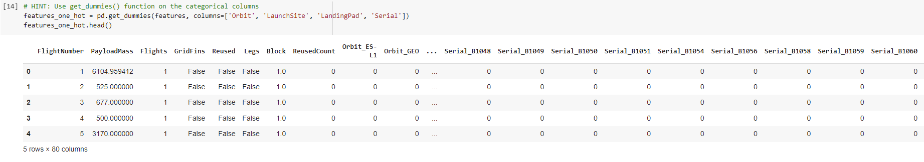
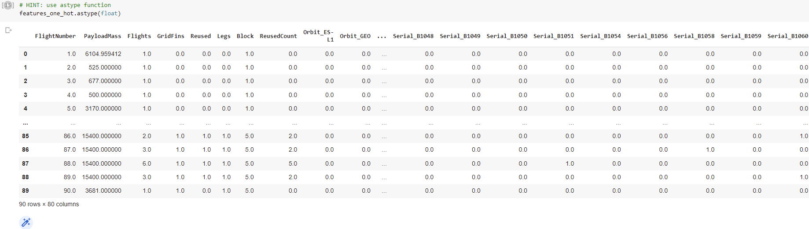
Feature Engineering

Slide 11
Conclusion
different launch sites have different success rates. CCAFS LC-40, has a success rate of 60 %, while KSC LC-39A and VAFB SLC 4E has a success rate of 77%.
Launch Site-CCAFS SLC 40 is suitable for launching rockets with payload mass varying from low to very high. Launch Site VAFB SLC 4E is preferred for medium payload mass.
The LEO orbit the Success appears related to the number of flights; on the other hand, there seems to be no relationship between flight number when in GTO orbit.
Heavy payloads have a negative influence on GTO orbits and positive on GTO and Polar LEO (ISS) orbits.
The success rate since 2013 kept increasing till 2020

