Slide 1
Video Game Sales Dashboard
Analysis using Tableau
Ashish Shabolu
May 2025

Slide 2
Objective of the Dashboard
Analyze global video game sales data across years, genres, platforms, and publishers.
Identify top-performing names, platforms, and publishers.
Understand trends in the gaming industry from 1980 to 2016.
Provide insights for stakeholders to make data-driven decisions.

Slide 3
Dataset Overview
Source: Video game sales dataset
Timeframe: 1980 – 2016
Total Records: 11,493 games
Fields Used: Name, Genre, Platform, Publisher, Sales, Year

Slide 4
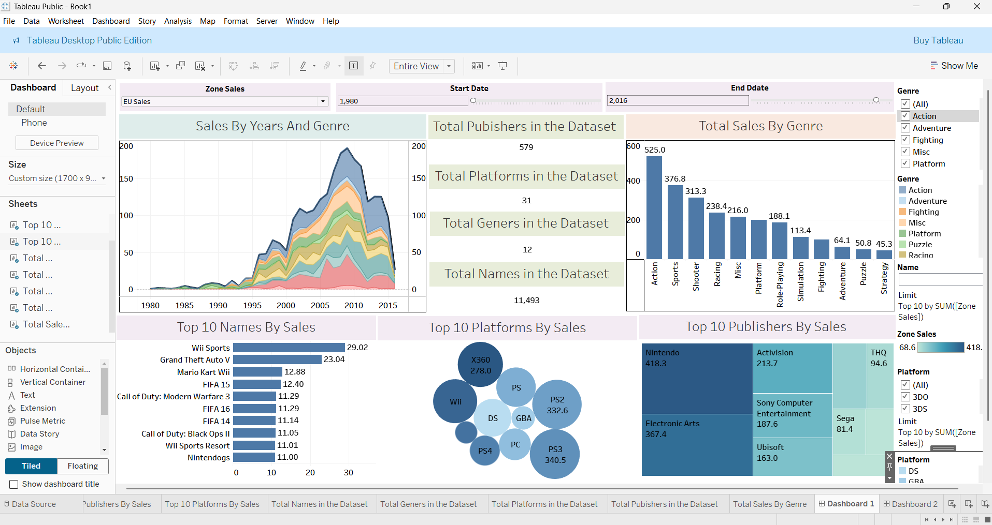
Dashboard Layout

Slide 5
Sales by Years and Genre
Area chart shows growth from 1980 to 2016.
Sales peaked around 2008–2010, then declined.
Action and Sports games dominate later years.
Identifies evolution of genre popularity.

Slide 6
Top 10 Games by Sales
Wii Sports leads with 29.02M units sold.
Other top titles: GTA V, Mario Kart, FIFA series.
Franchises and exclusives drive large sales.

Slide 7
Top Platforms by Sales
PS3, PS2, and Wii are top-selling platforms.
X360 and DS also significant contributors.
Bubble chart shows relative performance.

Slide 8
Top Publishers by Sales
Nintendo leads with 418.3M units.
Followed by Electronic Arts and Activision.
Few large publishers dominate the market.

Slide 9
Total Sales by Genre
Action: 525M+ units – highest performing genre.
Followed by Sports, Shooter, and Racing.
Helps publishers prioritize development.

Slide 10
Interactivity and Filtering
Users can filter by Region, Genre, and Date.
Improves usability and custom exploration.
Supports decision-making based on segments.

Slide 11
Summary of Insights
Action and Sports dominate game sales.
Nintendo and Sony are top contributors.
Game sales peaked around 2010.
Franchise-based games perform best.

Slide 12
Conclusion and Next Steps
Dashboard provides actionable insights.
Supports strategic planning for game devs.
Next steps: add regional insights, forecast trends, integrate reviews.

Slide 13
Thank you !
Ashish Shabolu
shaboluashish@gmail.com

