Slide 1
Tableau Dashboard Analysis
Sales Overview : Region, Category & Monthly Trend
Ashish Shabolu
June 2025

Slide 2
Dashboard Explanation
• Bar Chart – Sales by Region :
Displays total sales in Central, East, South, and West regions.
• Donut Chart – Sales by Category :
Shows distribution among Furniture, Office Supplies, and Technology.

Slide 3
Dashboard Explanation
• Line Chart – Sales Over Months :
Highlights monthly trends from January to December.
• Filters – Category, Region, and Month :
Enables drill-down into specific data subsets.

Slide 4
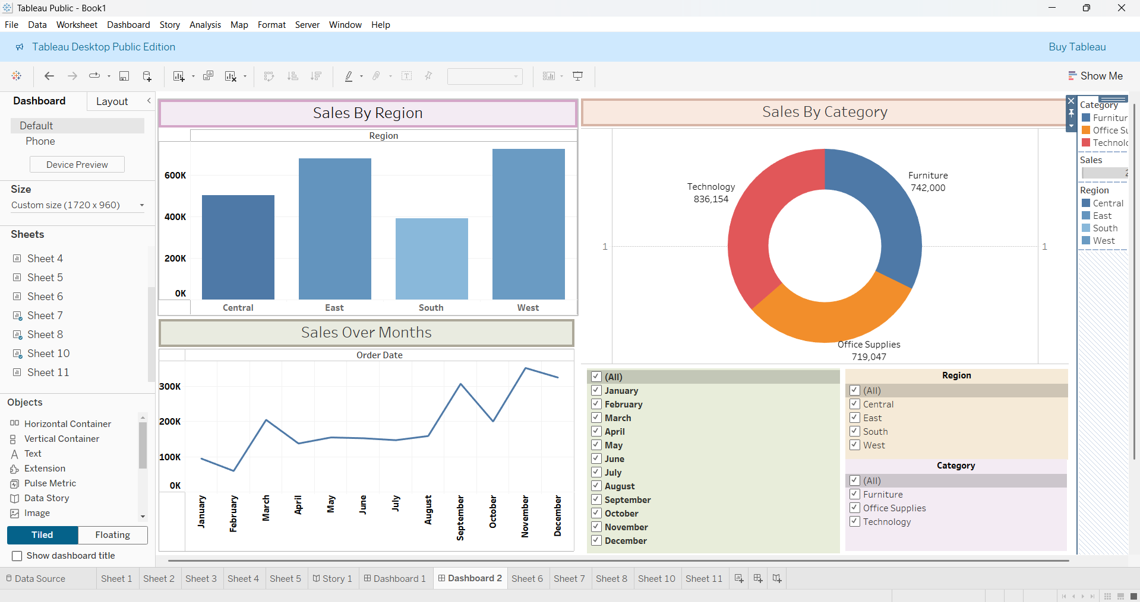

Slide 5
Key Insights
• Region-wise Performance :
East and West regions lead with over ₹600K in sales.
• Top Product Category :
Technology dominates with approximately ₹836K in sales.

Slide 6
Key Insights
• Seasonal Trends :
Peak sales occur between October and December.
• Interactive Filters :
Allow users to slice data by month, region, or category.

Slide 7
Thank you !
Ashish Shabolu
shaboluashish@gmail.com

