Slide 1
Flashcard Quiz
Name - Ashish Karakoti
Roll No. -2210990186

Slide 2
Introduction
Welcome to my presentation on the Flashcard Quiz Python project! In this solo project, I've developed an interactive quiz application that engages users in learning through randomized questions and answers. Leveraging Python's versatility and the random module, I've created a dynamic experience that's both fun and educational.

Slide 3
Objective
Develop a Python-based Flashcard Quiz application to provide a hands-on learning experience for beginners. The project aims to reinforce knowledge through randomized questions, immediate feedback, and user-friendly design, fostering an interactive learning environment while promoting creativity and customization.

Slide 4
Tools and Working
Tools : The Flashcard Quiz project is developed using Python, utilizing its core functionalities along with the random module for randomized question selection.
Working :
Input : The Flashcard Quiz requires a predefined set of flashcards, each consisting of a question and its corresponding answer.
Question Selection : Utilizing the random module, the program selects a random question from the predefined set of flashcards to present to the user.
User Interaction : The selected question is displayed to the user, who provides their answer.
Feedback : Upon receiving the user's answer, the program checks it against the correct answer associated with the question.
Immediate feedback is provided to the user, indicating whether their response was correct or incorrect.
Repeat Process : The process repeats, presenting a new random question to the user after each interaction.
Exit Option : The user has the option to quit the quiz at any time, providing flexibility and convenience.

Slide 5
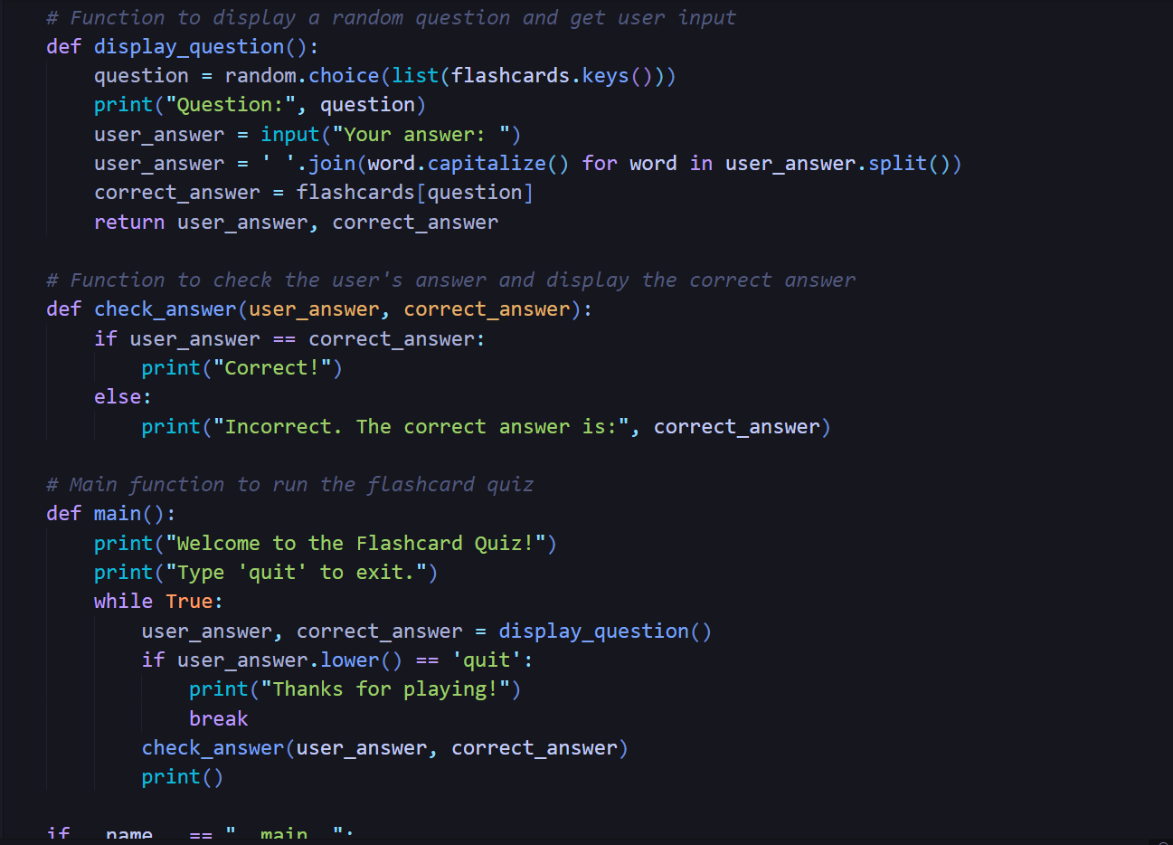
Code Snippet

Slide 6
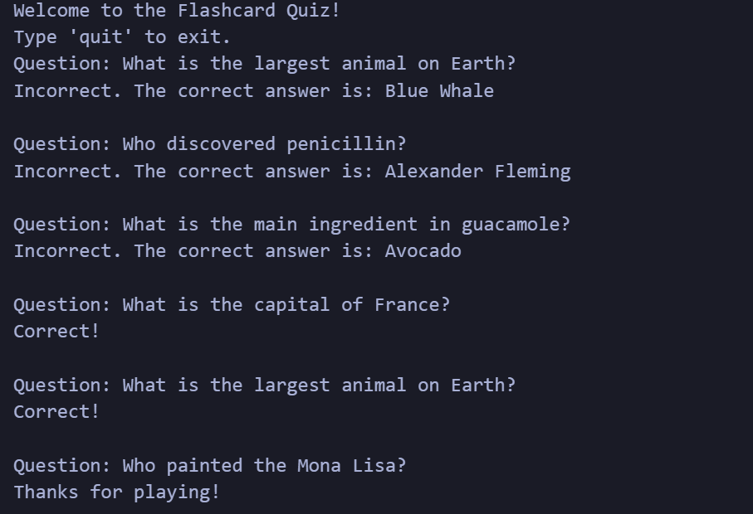
Output

Slide 7
Conclusion
The Flashcard Quiz project provides an engaging and interactive way for beginners to learn Python programming. By combining randomized questions, immediate feedback, and user-friendly design, it offers an effective learning experience. This project fosters active participation and knowledge retention, making it a valuable tool for both learners and educators.

