Slide 1
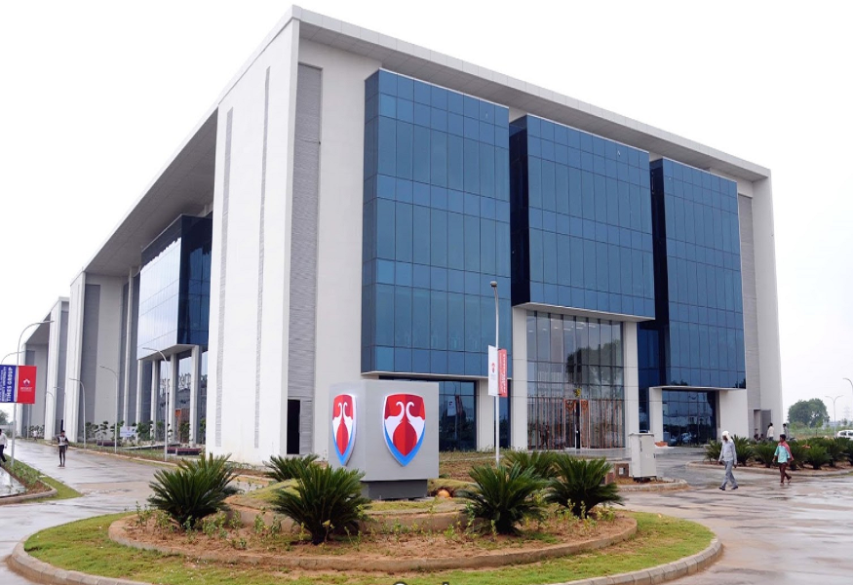


DYNAMIC PROGRAMMING

Slide 2
Topics to be discussed
Importance Of Data Structures And Algorithms
Course outcome
Introduction Of Recursion And Its Complexity
Optimize the Solution Of Problem.
Dynamic Programming Concepts And Problems

Slide 3
Data Structures And Algorithms(DSA)
Why DSA
" I don't like DSA but I want to be a SDE in product based company."
Consider a scenario where you want to make a pizza for yourself.
Can you make your pizza without base?
Answer is No, because without base no one can make pizza.

Slide 4
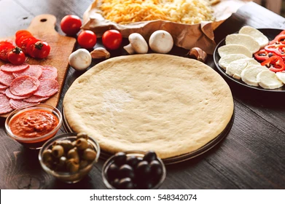
Contd…

Slide 5






Contd…

Slide 6
Contd…
If base of pizza is not good then there is no meaning of toppings.
Same thing happens with our Professional and Personal Life.

Slide 7
Problem Solving Steps
Problem Statement(Given either in technical form or In story form)
Example-N Queen Problem
Problem Statement -
The N Queen is the problem of placing N chess queens on a N×N chessboard so that no two queens attack each other. For example, following is a solution for 4 Queen problem.
 | Q
 |  |  | Q
Q
 |  | Q

Slide 8
Problem Solving Steps
Step1-Identifying Problem Statement(problem reframing stage)
in this problem reframed in technical and simple words
Example-N Queen Problem
Problem Statement -
The N Queen is the problem of placing N chess queens on a N×N chessboard(4 by 4 array) so that no two queens attack each other. For example, following is a solution for 4 Queen problem.
 | Q
 |  |  | Q
Q
 |  | Q

Slide 9
Problem Solving Steps
Step2-Identifying Constraints-
In the above problem the constraints are-
1-no two queens in same row
2-no two queens in same column
3-no two queens in same diagonal

Slide 10
Problem Solving Steps
Step-3-Design Logic-(may be more than one design logic (approach) used)(Algorithm or pseudo code in this section also mentioned) (logic building)
Depends on the characteristics of the problem we can choose any one of the following design strategy for design logic.(In above use backtracking)
a)Devide & Conquer For Solving or implement these algorithms
b)Greedy Method we can use Recursion or Iteration
c)Dynamic Programming
d)Branch & Bound
e)Backtracking
f) Memoization

Slide 11
Problem Solving Steps
Step-4-Validation-(not necessary in every problem)
Most of the algorithm validated by mathematical induction.
Step-5-Analysis-(important step)
Process of comparing two algorithms with respect to time,space,number of register,network bandwidth etc is called analysis.
Step-6- Implementation-(user choice)
Based on students choice (C / C++ / Java / Python)
Step7-Testing And Debugging(test cases provided like boundary value at least)

Slide 12
Dynamic Programming
“Energy Of Nation Is Like A Sap Of Tree, Its Rises Bottom Up”
Wikipedia Defines Dynamic Programming as-
1-Dynamic programming is a method of solving problem in computer science, Mathematics and Economics.
2-Using this method, a complex problem is split into simpler problems, which are then solved just once and store their solution into any of the data structure like an array.
3-At the end, the solutions of the simpler problems are used to find the solution of the original complex problem.
4-From the above definition it is clear that there is no meaning of dynamic or even Programming in Dynamic Programming just like there is no meaning of Apple in Apple Ink because Apple is fruit.

Slide 13
Dynamic Programming
Steps To Learn Dynamic Programming
1-Memory
2-Recursion
3-Optimal Substructure
4-Overlapping Sub-problems
5-Top Down And Bottom Up Approach
6-Memoization
7-Dynamic Programming

Slide 14
Recursion
Recursion-
As we know that maximum computer concept(programming concept) comes from mathematics, Recursion is also one of them.
int main()
{
printf("can not stop programming till i die");
main();
return 0;
}
When a function call itself either directly or indirectly then it is called recursive function and process is called recursion
Points To Remember-
1- Recursion is problem solving technique where solution of larger problems defined in terms of smaller instances of itself.
2- Recursion always have terminating condition otherwise infinite recursion.
3- Recursive function performs some part of task and deligate rest of it to recursive call.

Slide 15
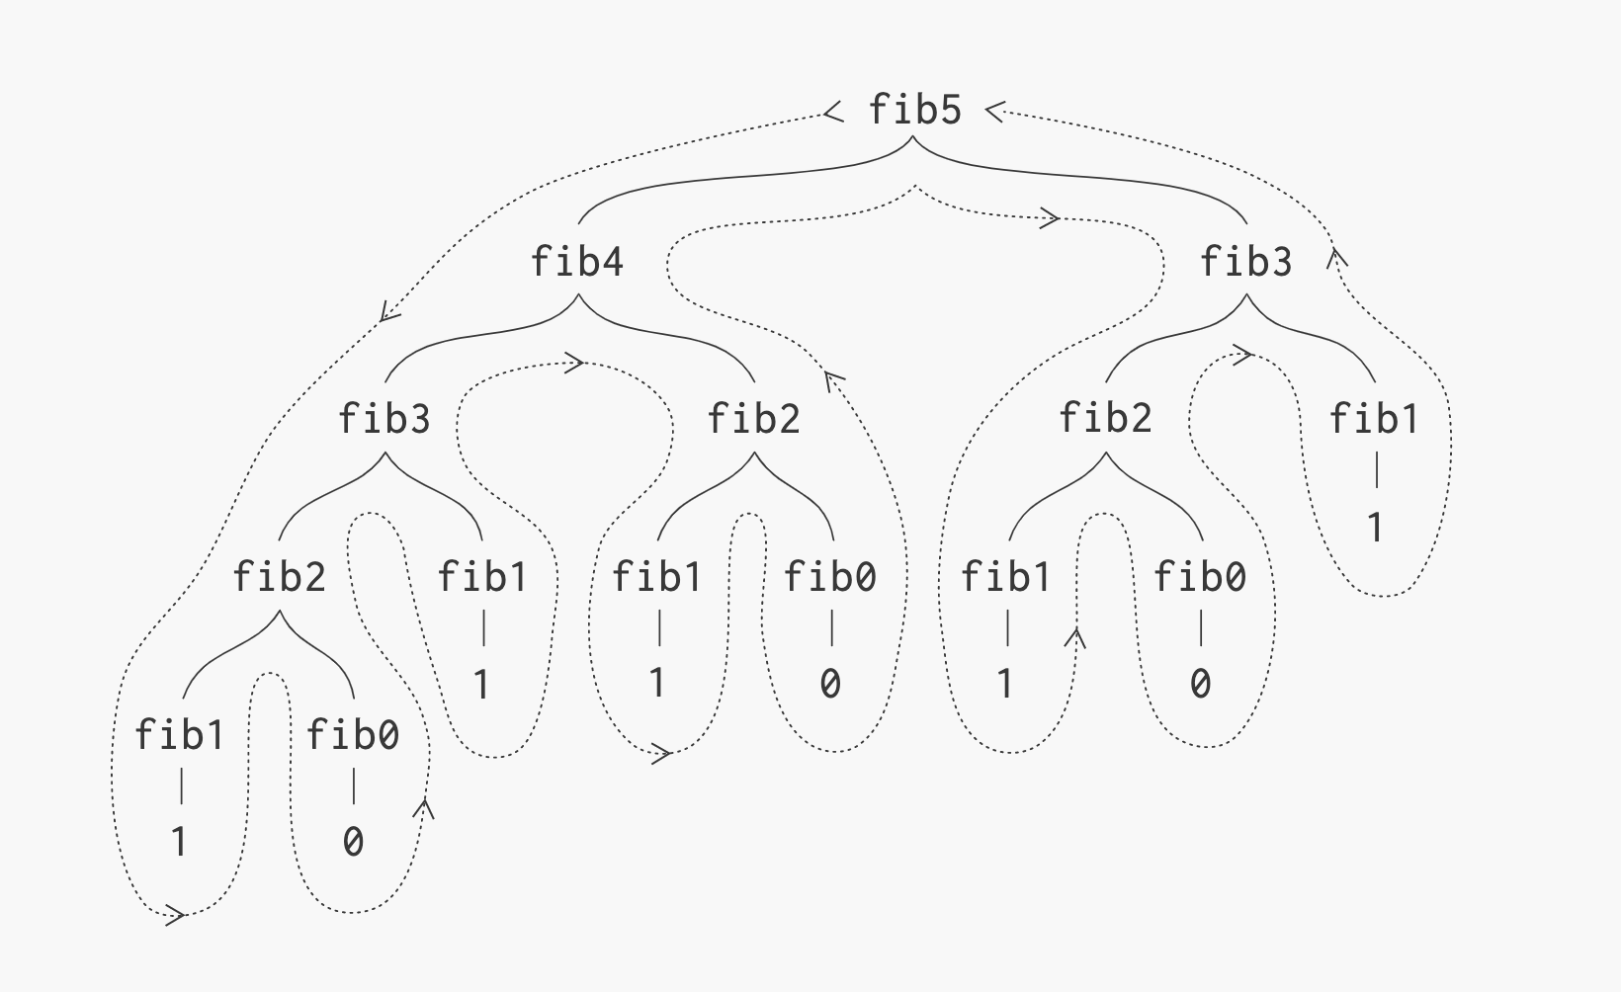
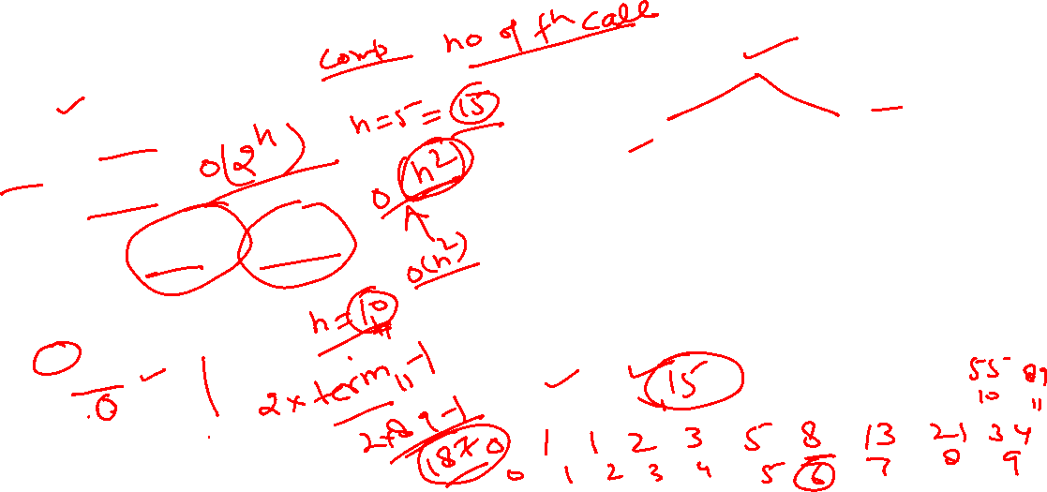
Recursion
Program
int fib(int n)
{
if(n==0)
return 0;
if(n==1)
return 1;
else
return fib(n-1)+fib(n-2);
}
For n=5
total function call=15
=16-1
=2*8-1
=2*term(6)-1
In general total function call for size n=2*term(n+1)-1

Slide 16


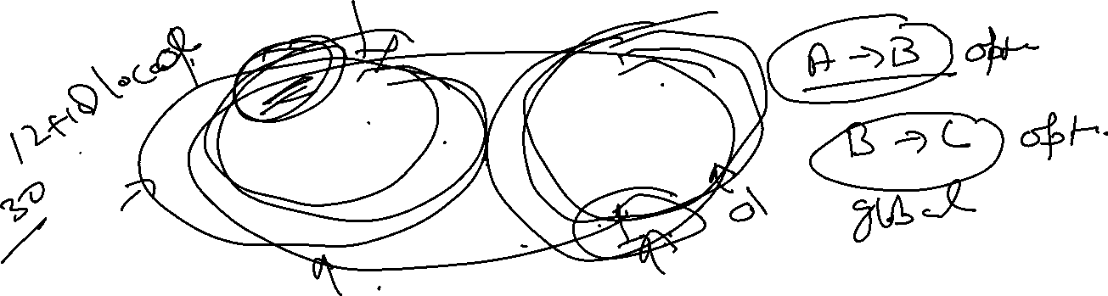








Optimal Substructure
Optimal Substructure (Am I Just Recursion)
Optimal substructure means optimal solution to a problem size of n is based on optimal solution to the same problem but in smaller size ie while building a solution of the problem of size n, define it in terms of similar problem of smaller size (say k<n). Find optimal solution of less elements and combined it to get final optimal solution.

Slide 17

Overlapping Sub Problem
Recursive Solution
int fib(int n)
{
if(n==0)
return 0;
if(n==1)
return 1;
else
return fib(n-1)+fib(n-2);
}

Slide 18
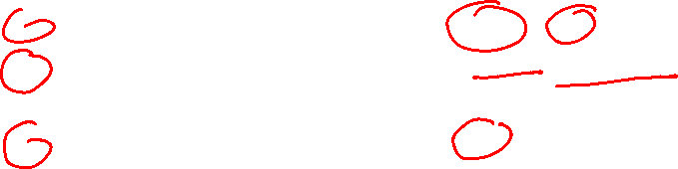
Overlapping Sub Problem
Iterative solution
int fib(int n)
{
int a = 0, b = 1, c, i;
if( n == 0)
return a;
for (i = 2; i <= n; i++)
{
c = a + b;
a = b;
b = c;
}
return b;
}
n | 2 | 3 | 4 | 5 | 20 | 40
Recursive | 1 | 3 | 5 | 9 | 13529 | 204668309
Iterative | 1 | 1 | 1 | 1 | 1 | 1

Slide 19

Overlapping Sub Problem
If we Call fib(20)
Then Fib(3) called 2584 times and fib(10) called 89 times.
For n=20
Recursive solution takes 65.218 micro second
Iterative solution takes 0.109 microsecond
Fib(80)
Recursive solution takes an hour or may be hang
Iterative solution takes approx. 1 second.
The main culprit is overlapping subproblems.

Slide 20



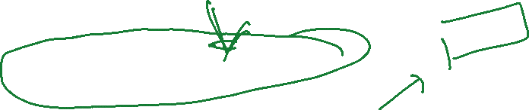

Top Down Approach (Memoization)
Memoization
I wish we could choose which memory to remember
Memoization = Recursion + Cache - Recomputing Overlapping Subproblems
Works on top down fashion and also called top down dynamic programming or memorized dynamic programming.
n | 2 | 3 | 4 | 5 | 20 | 40
recursive | 1 | 3 | 5 | 9 | 13529 | 204668309
iterative | 1 | 1 | 1 | 1 | 1 | 1
memo | 1 | 3 | 5 | 7 | 37 | 77

Slide 21
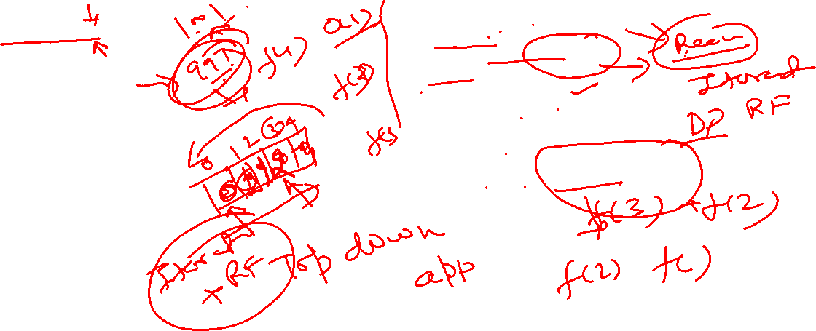
Top Down Approach (Memoization)
#include <stdio.h>
int fib(int n);
#define N 20
int memo[N]={0};
int main(void)
{
int n=75,x;
x=fib(n);
printf("%d",x);
return 0;
}
int fib(int n)
{
int a = 0, b = 1, c, i;
if( memo[n]!= 0)
return memo[n];
if(n==0)
memo[n]=0;
if (n==1 || n==2)
memo[n]=1;
else
memo[n]=fib(n-1)+fib(n-2);
return memo[n];
}

Slide 22

Bottom Up Approach (DP)
1-Dynamic programming unroll the recursion and move to the opposite direction of memorization.
2-Both memoization and dynamic programming solve the problem only once.
3-Memoization uses recursion and works in top down manner where as dynamic programming moves in opposite direction solving the problem bottom up.
4-Dynamic programming use the concept of recursive formula and uses iteration.

Slide 23
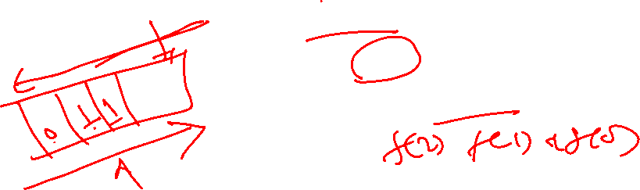
Bottom Up Approach (DP)
int fib(int n)
{
int f[n+1];
int i;
f[0] = 0;
f[1] = 1;
for (i = 2; i <= n; i++)
{
f[i] = f[i-1] + f[i-2];
}
return f[n];
}
#include<stdio.h>
int main ()
{
int n = 75;
printf("%d", fib(n));
return 0;
}

Slide 24
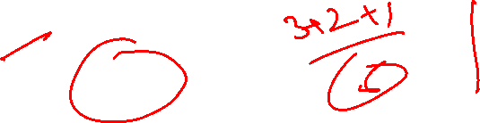
Subset Sum Problem
Given a set of non negative integers and a positive number X, determine if there exist a subset of elements of an array with sum equal to X.
Input {3,2,7,1}
X=6
Output true

Slide 25
Subset Sum Problem(Recursive)
#include<stdio.h>
#define true 1
#define false 0
int issubset(int *arr,int n,int x)
{
if(x==0)
return true;
if(n==0)
return false;
if(arr[0]>x)
return issubset(arr+1,n-1,x);
else
return issubset(arr+1,n-1,x) ||issubset(arr+1,n-1,x-arr[0]);
}

Slide 26
Subset Sum Problem
int main()
{
int arr[4]={3,2,7,1},x=6,n=4,res;
res=issubset(arr,n,x);
if(res==true)
printf("subset exist");
else
printf("not exist");
return 0;
}

Slide 27
Subset Sum Problem(DP)
#include<stdio.h>
int subset(int arr[],int n, int sum);
int main()
{
int arr[]={3,2,7,1};
int x;
x=subset(arr,4,6);
if(x==1)
printf("sum is possible");
if(x==0)
printf("sum is not possible");
return(0);
}

Slide 28
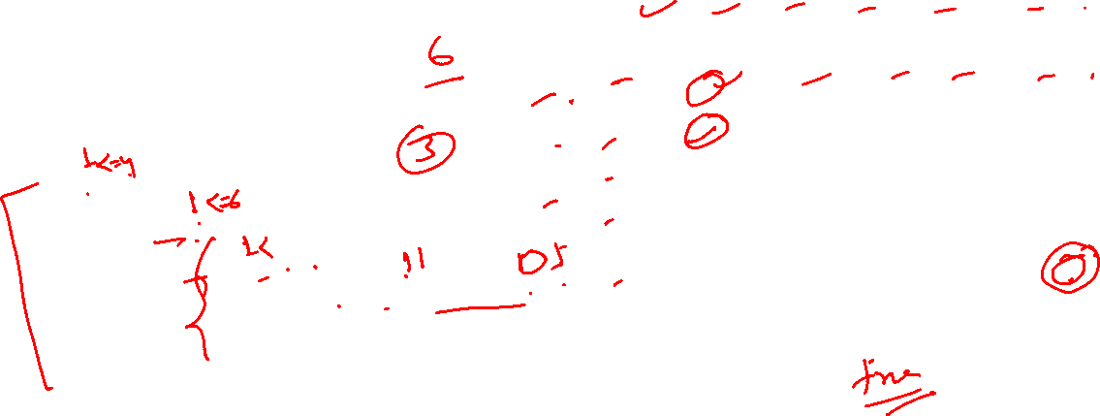
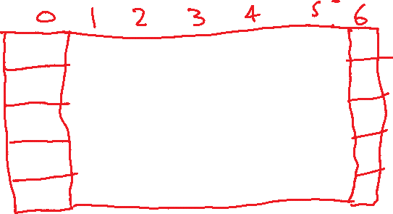

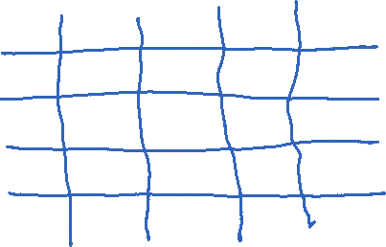


Subset Sum Problem
int subset(int *arr,int n,int sum)
{
int subsetsum[n+1][sum+1],i,j;
for(i=0;i<=n;i++)
subsetsum[i][0]=1;
for(i=1;i<=sum;i++)
subsetsum[0][i]=0;
for(i=1;i<=n;i++)
{
for(j=1;j<=sum;j++)
{
if(j<arr[i-1])
subsetsum[i][j]=subsetsum[i-1][j];
if(j>=arr[i-1])
subsetsum[i][j]=subsetsum[i-1][j] || subsetsum[i-1][j-arr[i-1]];
}
}
return(subsetsum[n][sum]);
}

Slide 29
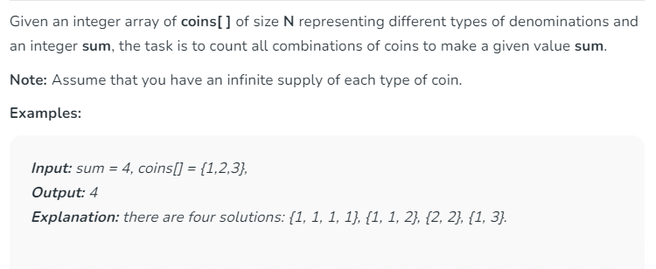
Coin Change Problem

Slide 30
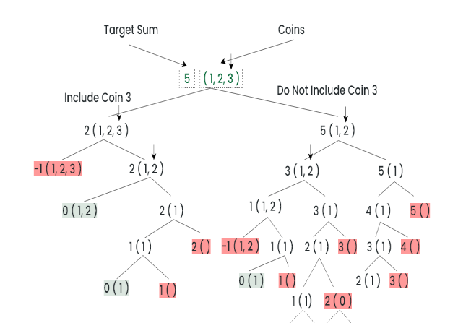
Coin Change Problem

Slide 31
Coin Change Problem (Recursion)
int count(int coins[], int n, int sum)
{
if (sum == 0)
return 1;
if (sum < 0)
return 0;
if (n <= 0)
return 0;
return count(coins, n - 1, sum)
+ count(coins, n, sum - coins[n - 1]);
} int main()
{
int i, j;
int coins[] = { 1, 2, 3 };
printf("%d ", count(coins, n, 5));
return 0;
}

Slide 32
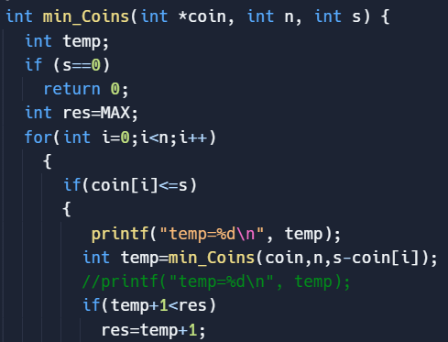
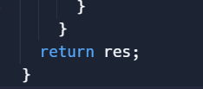
Coin Change Problem (Recursion)

Slide 33
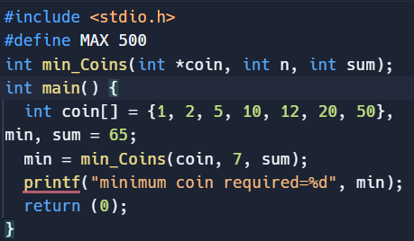
Coin Change Problem (DP)

Slide 34
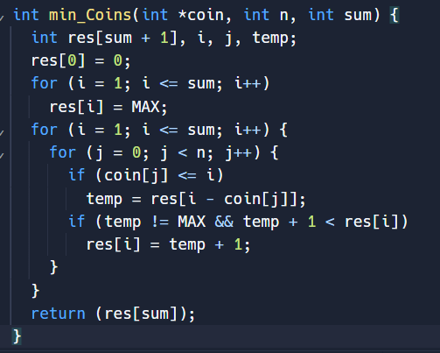
Coin Change Problem

Slide 35
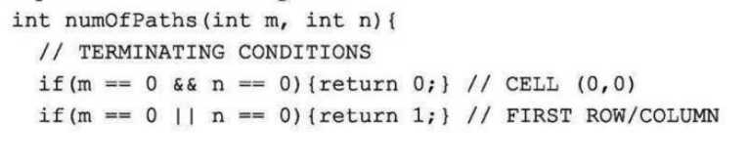

Total Path Count

Slide 36
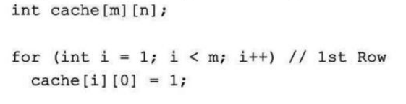
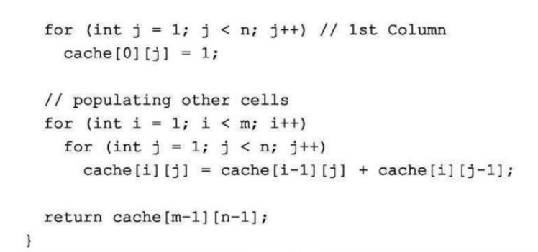
Total Path Count

Slide 37
Technical Training

Slide 38
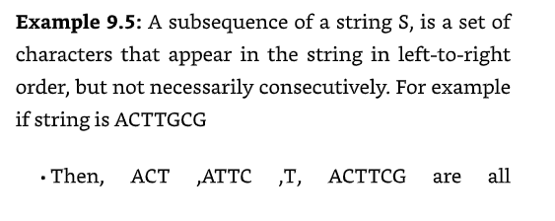
Technical Training

Slide 39
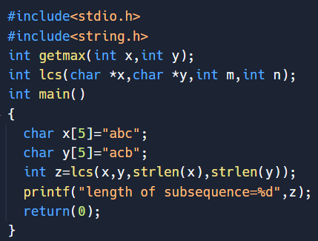
Technical Training

Slide 40
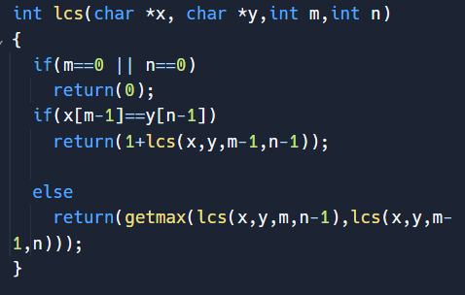
Technical Training

Slide 41
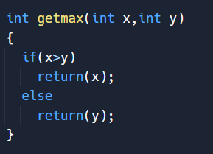
Technical Training

Slide 42
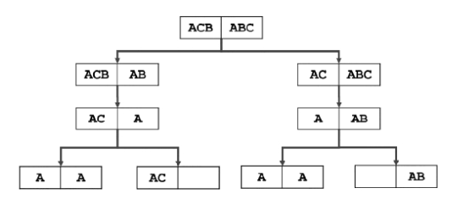
Technical Training

Slide 43
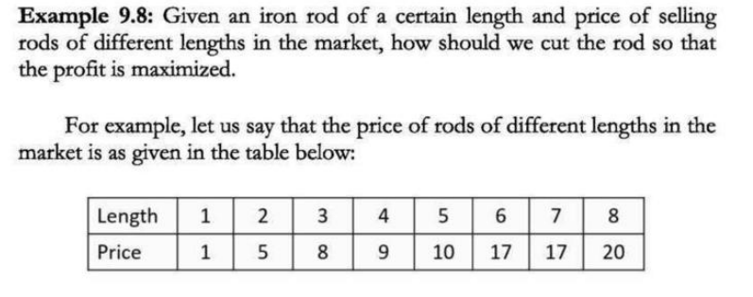
Coin Change Problem

Slide 44
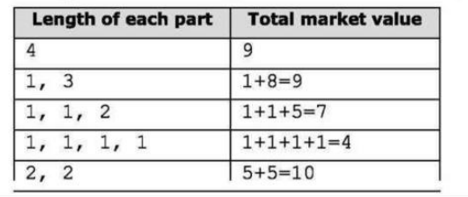
Coin Change Problem

Slide 45
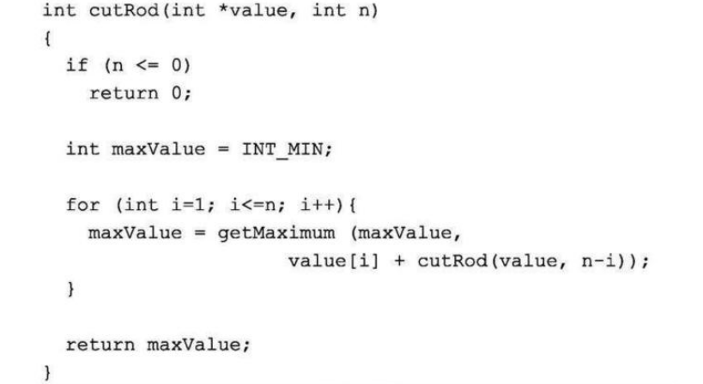
Coin Change Problem

Slide 46
Coin Change Problem

Slide 47
Coin Change Problem

Slide 48
KnapSack(DP)
#include<stdio.h>
int knapsack(int ,int*,int*,int);
int max(int x,int y);
int main()
{
int weight[]={2,3,4,5},value[]={3,4,5,6},profit,capacity=5;
profit=knapsack(capacity,weight,value,4);
printf("total profit=%d",profit);
return(0);
}

Slide 49
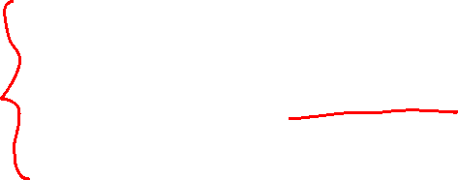
KnapSack(DP)
int knapsack(int capacity,int *weight,int *value,int n)
{
int arr[n+1][capacity+1],i,j,x;
for(i=0;i<=n;i++)
arr[i][0]=0;
for(j=1;j<=capacity;j++)
arr[0][j]=0;
for(i=1;i<=n;i++)
{
for(j=1;j<=capacity;j++)
{
if(weight[i-1]<=j)
{
x=j-weight[i-1];
arr[i][j]=max(value[i-1]+arr[i-1][x],arr[i-1][j]);
}
else
arr[i][j]=arr[i-1][j];
}
}
return(arr[n][capacity]);
}

Slide 50
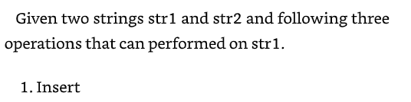
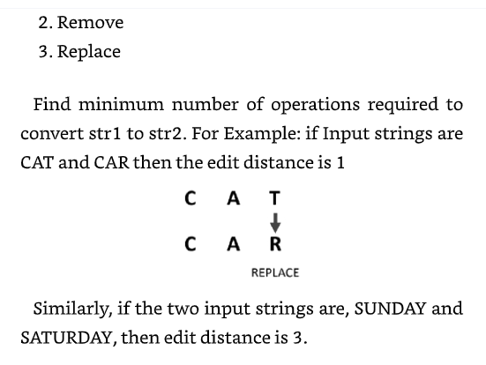
Edit Distance Problem

Slide 51
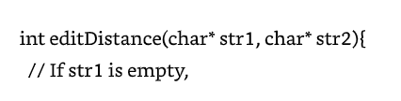
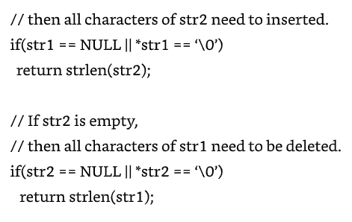
Edit Distance Problem

Slide 52
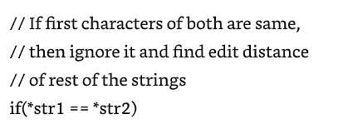
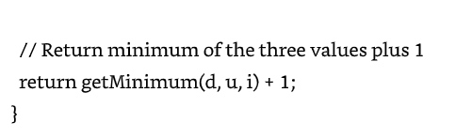
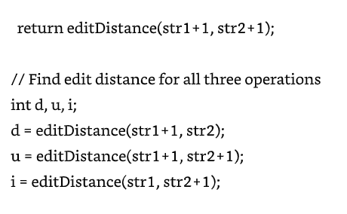
Edit Distance Problem

Slide 53
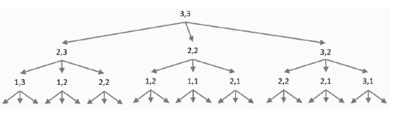
Edit Distance Problem

Slide 54
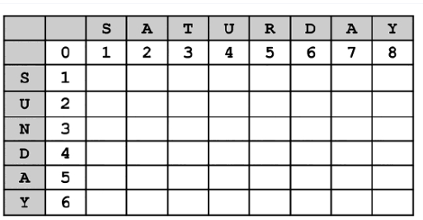
Edit Distance Problem

Slide 55
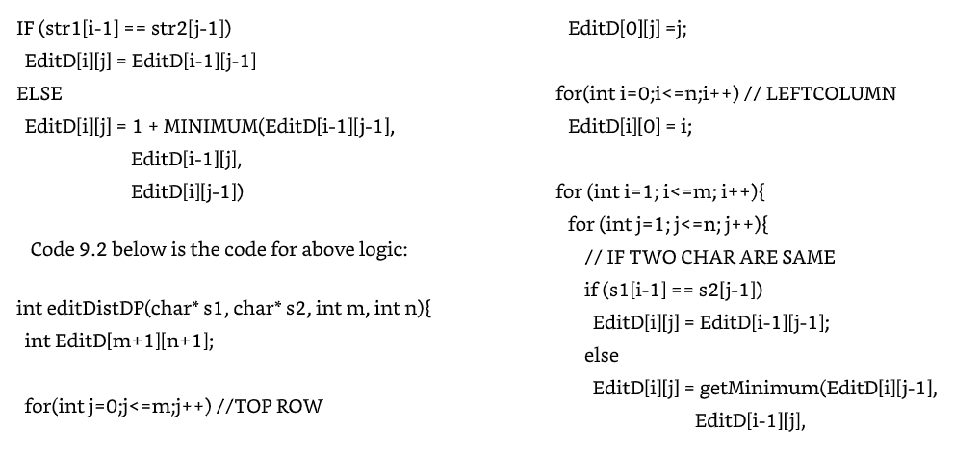
Edit Distance Problem

Slide 56
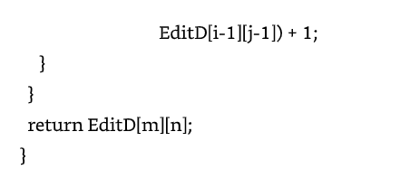
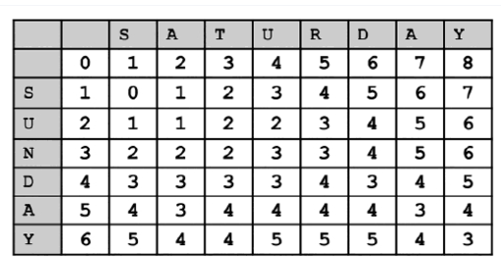
Edit Distance Problem

Slide 57
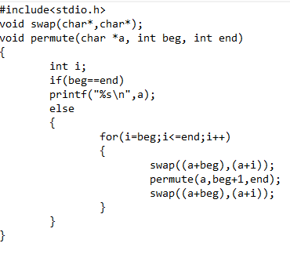
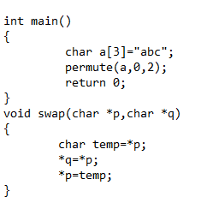
Permutation Problem

Slide 58
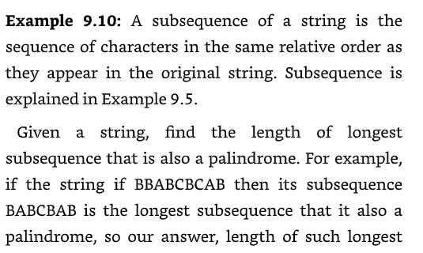
LPS Problem

Slide 59
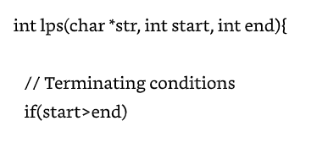
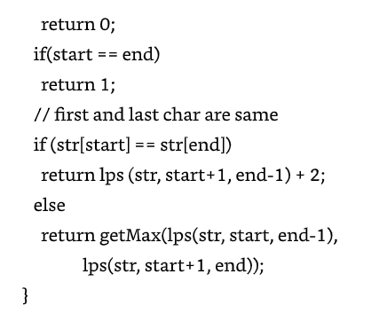
Permutation Problem

Slide 60
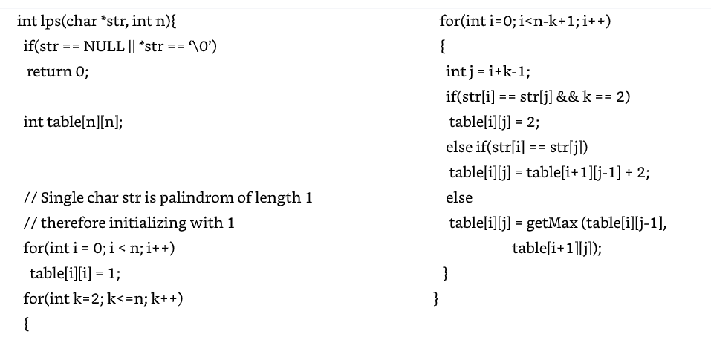
Permutation Problem

Slide 61

Share your thoughts
Questions ?
Answer

Slide 62
