Slide 1

Data Structure Training
Algorithm & Complexity
Department of CSE, CS & IT
ABES Engineering College, Ghaziabad

Slide 2
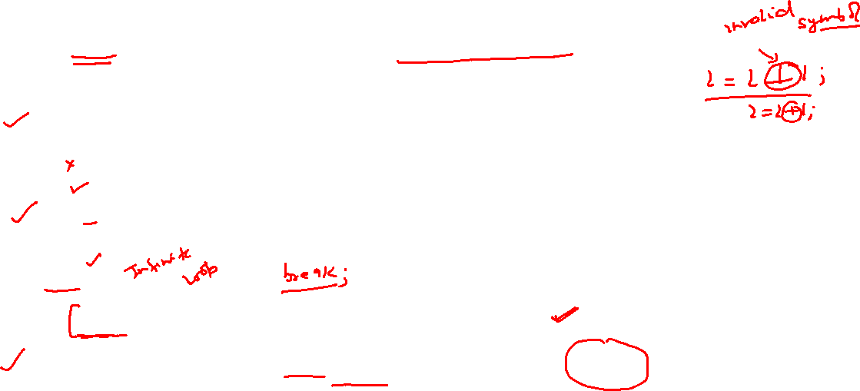
Data Structure Training(Algo&Complexity)
Algorithm-
1-Finite set of steps to solve a problem is called algorithm.
2-Here steps means instruction which contain fundamental operators.
Characteristics Of fundamental Instruction-
1-Definiteness-
Every fundamental instruction must be definite without any ambiguity.
i=i 1
i=i+1;
2-Finiteness-
Every instruction must be terminate within finite amount of time.
i=1;
while(1)
{
i=i+1;//not allowed in algorithm since executing infinitely.
}
3- Every instruction must accept atleast 0 input and provides atmost 1 output.

Slide 3
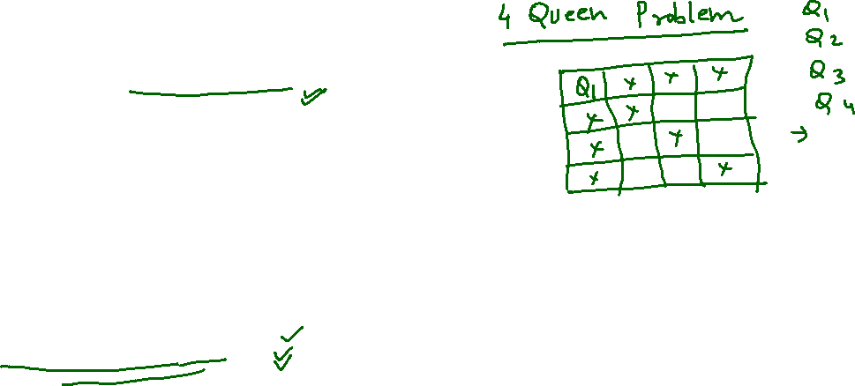
Data Structure Training(Algo&Complexity)
Steps For Solving Any Problem-
1-Identifying Problem Statement
2-Identifying Constraints

Slide 4
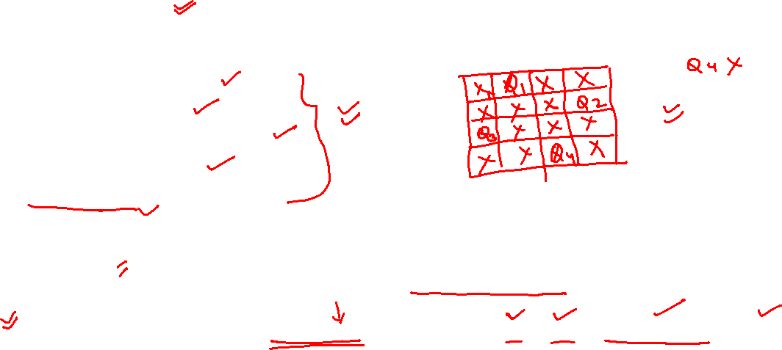
Data Structure Training(Algo&Complexity)
Steps For Solving Any Problem-
3-Design Logic-
Depends on the characteristics of the problem we can choose any one of the following design strategy for design logic.
a)Devide & Conquer
b)Greedy Method
c)Dynamic Programming
d)Branch & Bound
e)Backtracking etc……..
4-Validation-
Most of the algorithm validated by mathematical induction.
5-Analysis-
Process of comparing two algorithms with respect to time,space,number of register,network bandwidth etc is called analysis.

Slide 5
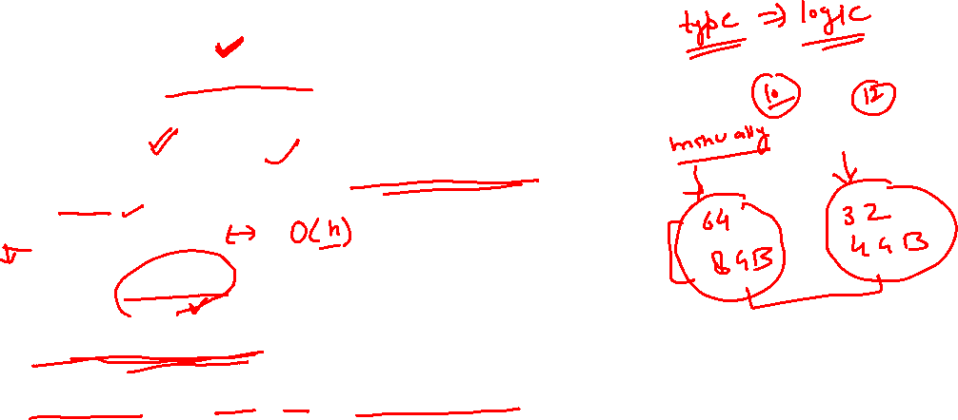
Data Structure Training(Algo&Complexity)
Types Of Analysis-
Priory Analysis-
1-Analysis done before executing
X=x+1;
2-Principle-
Frequency count of fundamental instruction.
Since x=x+1 being carried out only one time so its complexity os
O(1) order of 1
3-It provides estimated values.
4-It provides uniform values.
5-It is independent of CPU,O/S & system architecture

Slide 6
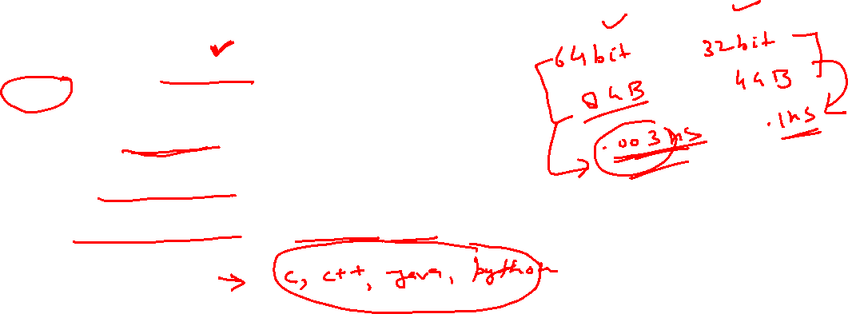
Data Structure Training(Algo&Complexity)
Types Of Analysis-
Posterior Analysis-
1-Analysis done after executing
X=x+1;
3-It provides exact values.
4-It provides non uniform values.
5-It is dependent of CPU,O/S & system architecture
6- Implementation
7-Testing And Debugging

Slide 7

Data Structure Training(Algo&Complexity)
Time Complexity
1-Simple for loop
2-Nested for loop
3-if-else
4-Recursive Algorithm

Slide 8
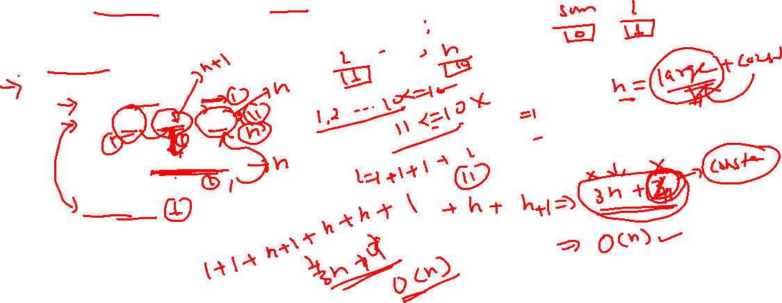
Data Structure Training(Algo&Complexity)
Simple for loop
Find total comparison and time complexity of following code
#include <stdio.h>
int main(void)
{
int sum=0,i;
for(i=1;i<=n;i++)
{
sum=sum+i;
}
return 0;
}

Slide 9
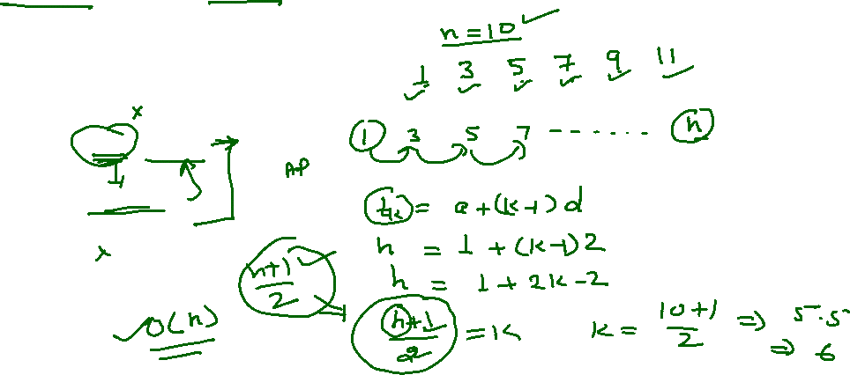
Data Structure Training(Algo&Complexity)
Simple for loop
Find total comparison and time complexity of following code
#include <stdio.h>
int main(void)
{
int sum=0,i;
for(i=1;i<=n;i=i+2)
{
sum=sum+i;
}
return 0;
}

Slide 10
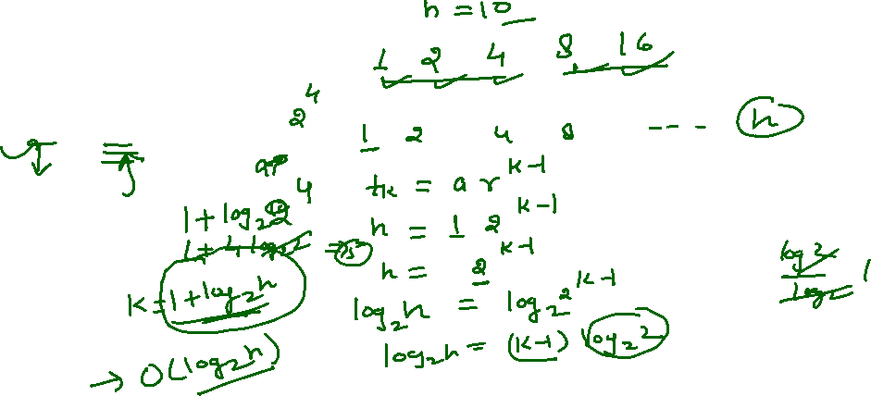
Data Structure Training(Algo&Complexity)
Simple for loop
Find total comparison and time complexity of following code
#include <stdio.h>
int main(void)
{
int sum=0,i;
for(i=1;i<=n;i=i*2)
{
sum=sum+i;
}
return 0;
}

Slide 11
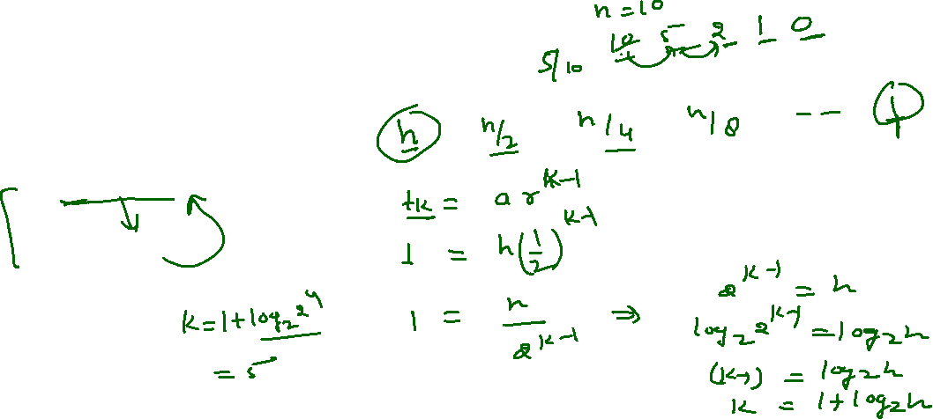
Data Structure Training(Algo&Complexity)
Simple for loop
Find total comparison and time complexity of following code
#include <stdio.h>
int main(void)
{
int sum=0,i;
for(i=n;i>0;i=i/2)
{
sum=sum+i;
}
return 0;
}

Slide 12
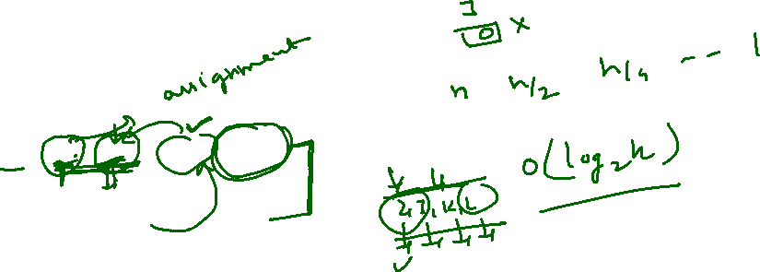
Data Structure Training(Algo&Complexity)
Simple for loop
Find total comparison and time complexity of following code and let val(j) denote value stored in variable j.after termination of loop what is the value of val(j)
#include <stdio.h>
int main(void)
{
int sum=0,i,j;
for(i=n;j=0,i>0;i=i/2,j=j+i)
{
sum=sum+i;
}
return 0;
}

Slide 13
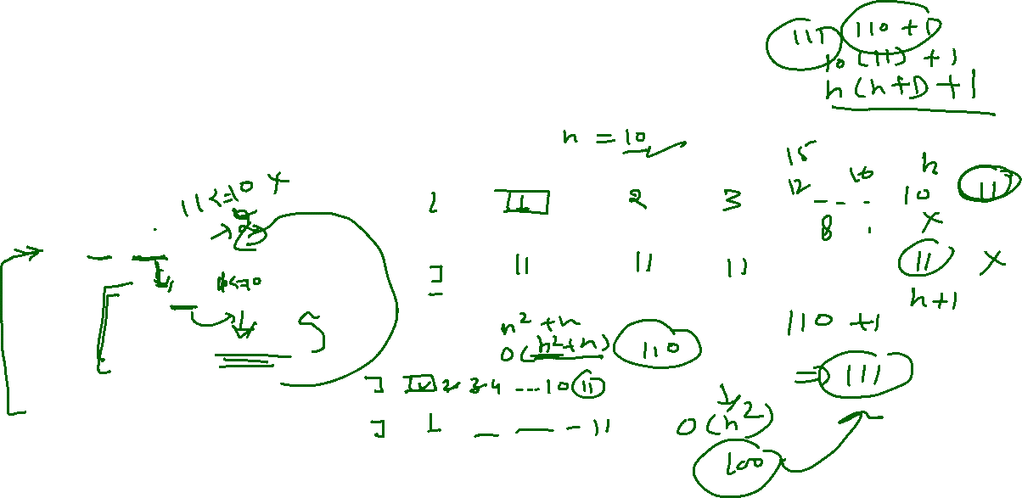
Data Structure Training(Algo&Complexity)
Nested for loop
Find total comparison and time complexity of following code
#include <stdio.h>
int main(void)
{
int sum=0,i,j;
for(i=1;i<=n;i++)
{
for(j=1;j<=n;j++)
{
sum=sum+j;
}
}
return 0;
}

Slide 14
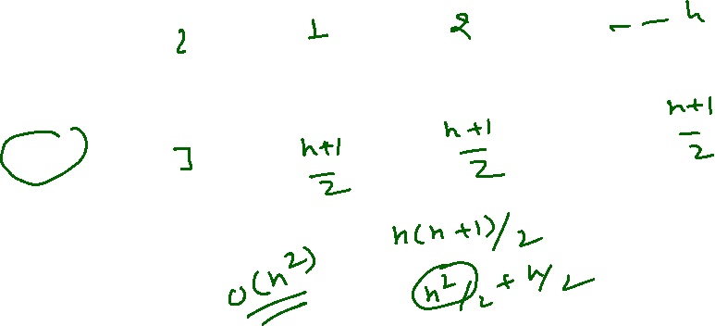
Data Structure Training(Algo&Complexity)
Nested for loop
Find total comparison and time complexity of following code
#include <stdio.h>
int main(void)
{
int sum=0,i,j;
for(i=1;i<=n;i++)
{
for(j=1;j<=n;j=j+2)
{
sum=sum+j;
}
}
return 0;
}

Slide 15
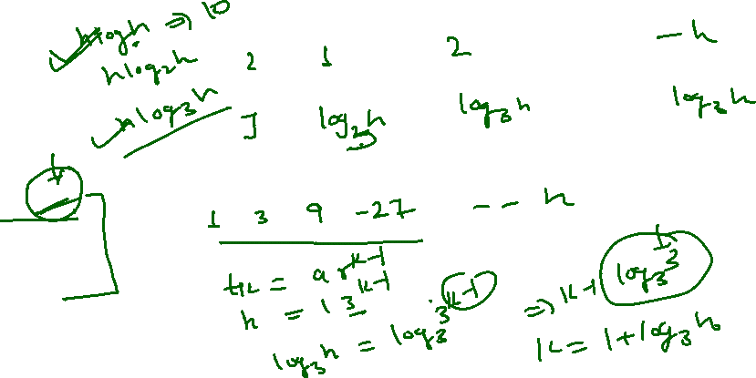
Data Structure Training(Algo&Complexity)
Nested for loop
Find total comparison and time complexity of following code
#include <stdio.h>
int main(void)
{
int sum=0,i,j;
for(i=1;i<=n;i++)
{
for(j=1;j<=n;j=j*3)
{
sum=sum+j;
}
}
return 0;
}

Slide 16
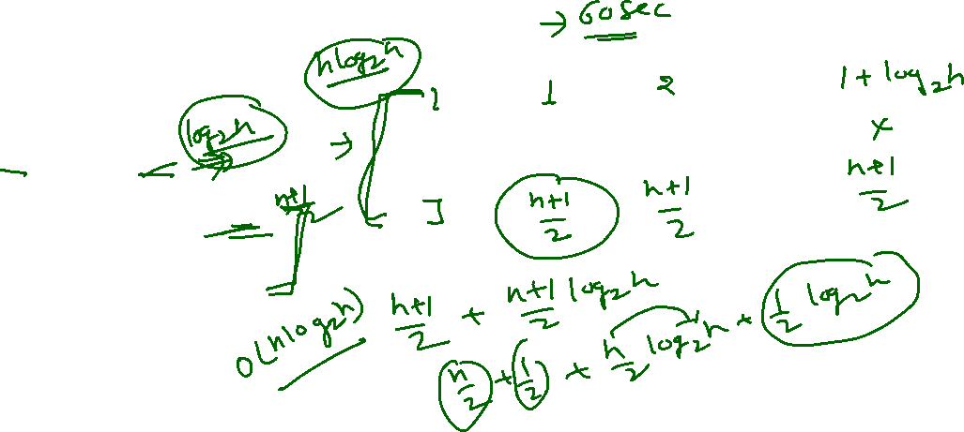
Data Structure Training(Algo&Complexity)
Nested for loop
Find total comparison and time complexity of following code
#include <stdio.h>
int main(void)
{
int sum=0,i,j;
for(i=1;i<=n;i=i*2)
{
for(j=1;j<=n;j=j+2)
{
sum=sum+j;
}
}
return 0;
}

Slide 17
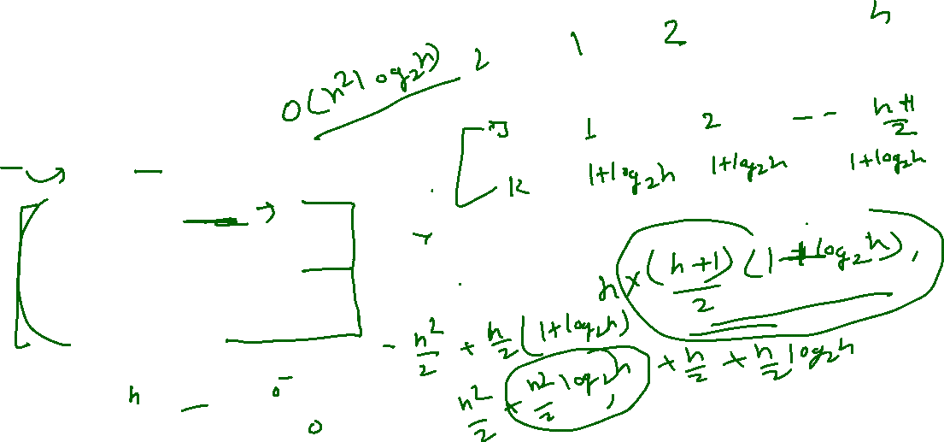
Data Structure Training(Algo&Complexity)
Nested for loop
Find total comparison and time complexity of following code
#include <stdio.h>
int main(void)
{
int sum=0,i,j;
for(i=1;i<=n;i=i+1)
{
for(j=1;j<=i;j=j+2)
{
for(k=1;k<=n;k=k*2)
{
sum=sum+k;
}
}
}
return 0;
}

Slide 18
Data Structure Training(Algo&Complexity)
Nested for loop
Find total comparison and time complexity of following code
#include <stdio.h>
int main(void)
{
int sum=0,i,j;
for(i=0;i<=n;i=i+1)
{
for(j=1;j<=i;j=j+1)
{
if(j%i==0)
{
for(k=1;k<=n;k=k+1)
{
sum=sum+k;
}
}
}
}
return 0;
}

Slide 19
Data Structure Training(Algo&Complexity)
Recursive Algorithm-
Find total comparison and time complexity of following code
int fact(int n)
{
if(n==0 || n==1)
return 1;
else
return n*fact(n-1);
}

Slide 20
Data Structure Training(Algo&Complexity)
Recursive Algorithm-
Find total comparison and time complexity of following code
int fib(int n)
{
if(n==0)
return 0;
if(n==1)
return 1;
else
return fib(n-1) +fib(n-2);
}

Slide 21
Data Structure Training(Algo&Complexity)
Asymptotic Notation-
to compare two algorithms rate of growth with respect to time and space, need asymptotic notation.
Big-Oh (O)
f(n) is O(g(n)) iff there exist some constants c>0 and k>=0 such that f(n) <= c.g(n) for every n>=k

