Slide 1

Technical Training
Problem Solving-1
DR. APJ ABDUL KALAM TECHNICAL UNIVERSITY
By
Amit Pandey
Assistant Professor
Department of Computer Application
ABES Engineering College, Ghaziabad

Slide 2
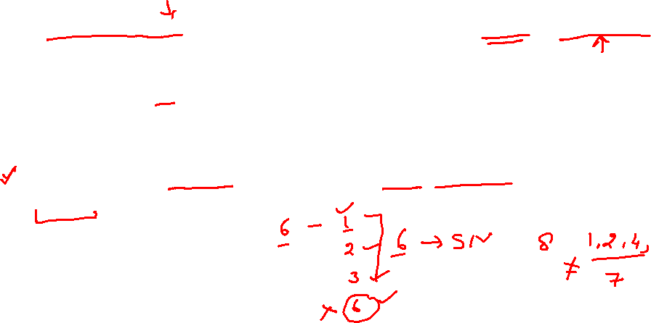
Technical Training (Problem Solving)
Problem 1 –Super Number
A positive integer (>1) is said to be super number if sum of its divisors (excluding itself) is equal to the number itself.
Example1: 6 is a super number. Because its divisors are: 1,2,3 and 1+2+3=6
Example2: 8 is not a super number. Because its divisors are: 1,2,4 and 1+2+4 ≠ 8.
Write a complete C program that will find and output all the super numbers in the range [2,1000].

Slide 3
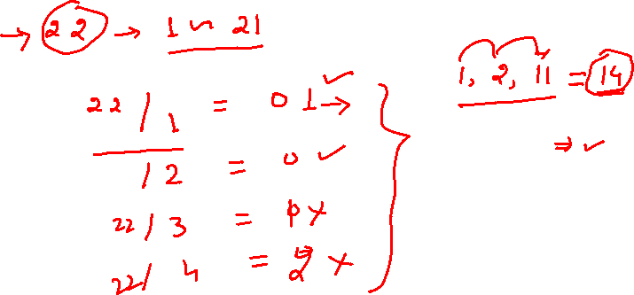
Technical Training (Problem Solving)
Logic Building-

Slide 4
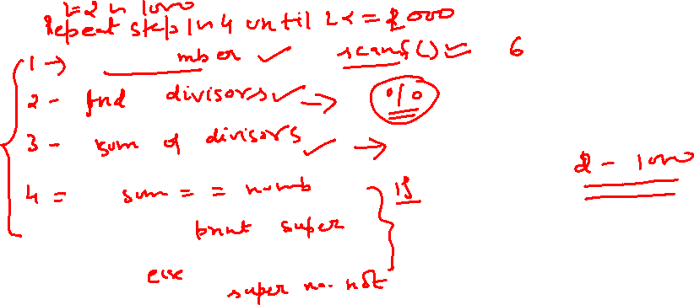
Technical Training (Problem Solving)
Algorithm-

Slide 5
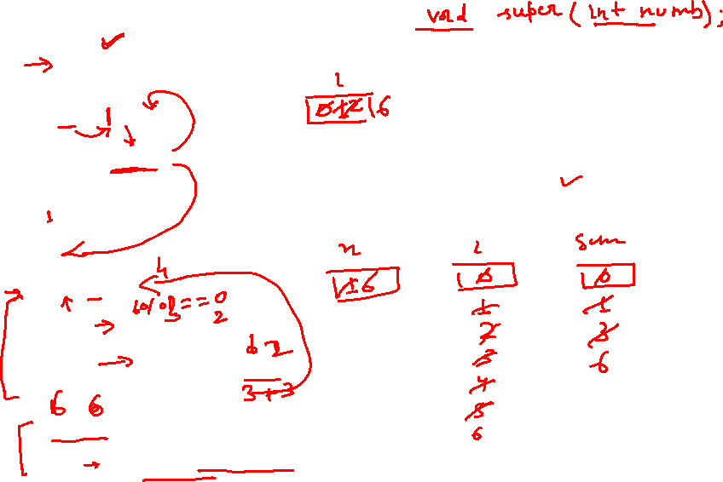
Technical Training (Problem Solving)
Program-
#include <stdio.h>
void super(int numb);
int main()
{
int i=0;
for(i=1;i<=2000;i++)
{
super(i);
}
return(0);
}
void super(int x)
{
int i=0,sum=0;
for(i=1;i<x;i++)
{
if(x%i==0)
{
sum=sum+i;
}
}
if(x==sum)
{
printf("\n%d is super number",x);
}
}

Slide 6
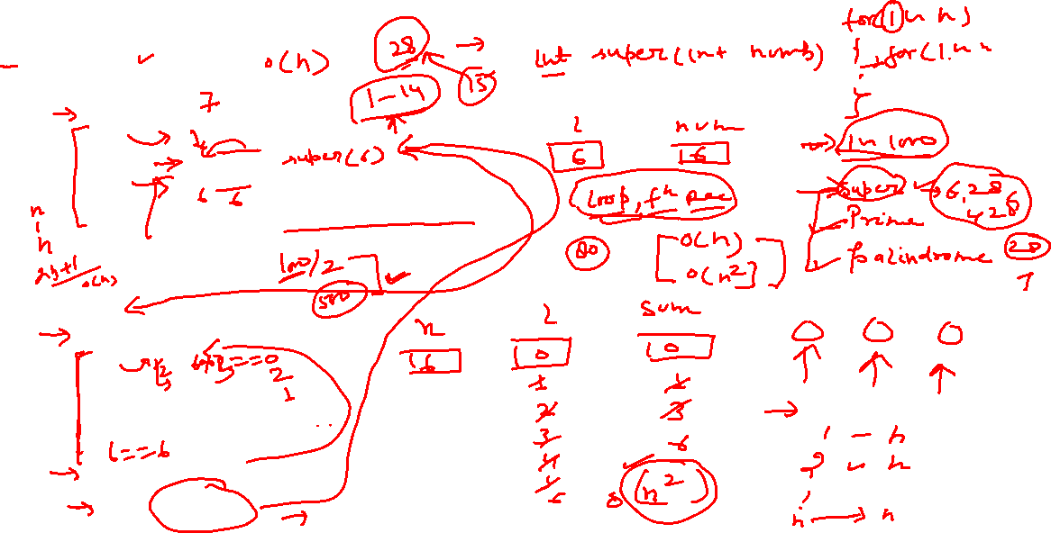
Technical Training (Problem Solving)
Program-
#include <stdio.h>
int super(int numb);
int main()
{
int i=0,num;
for(i=1;i<=2000;i++)
{
num=super(i);
if(i==num)
{
printf("\n%d is super number",num);
}
}
return(0);
}
int super(int x)
{
int i=0,sum=0;
for(i=1;i<x;i++)
{
if(x%i==0)
{
sum=sum+i;
}
}
If(x==sum)
{
return(x);
}
}

Slide 7

Technical Training (Problem Solving)
Problem 2 –Prime Number
A prime number is a positive integer that is divisible only by itself and the integer 1. It is not exactly divisible by any other integer between 2 and N-1. You are required to write a complete C program that takes as input a positive integer N and displays all the prime numbers up to N.
In performing this task, you may want to consider writing and using a function that takes as input an integer, checks if this integer is a prime number or not, and returns a BOOLEAN value indicating whether it is a prime number or not.

Slide 8
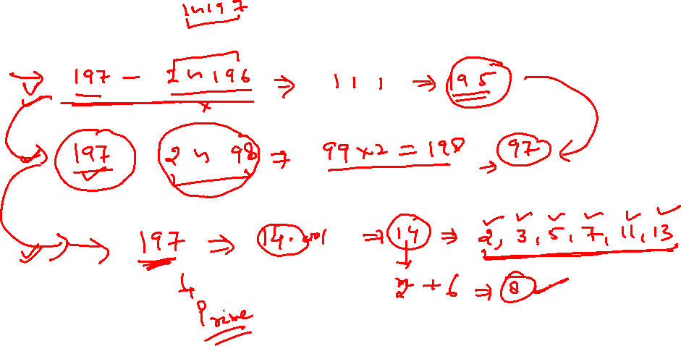
Technical Training (Problem Solving)
Logic Building-

Slide 9
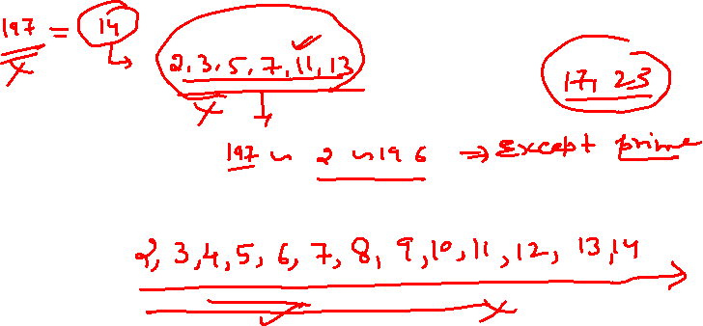
Technical Training (Problem Solving)
Algorithm-

Slide 10
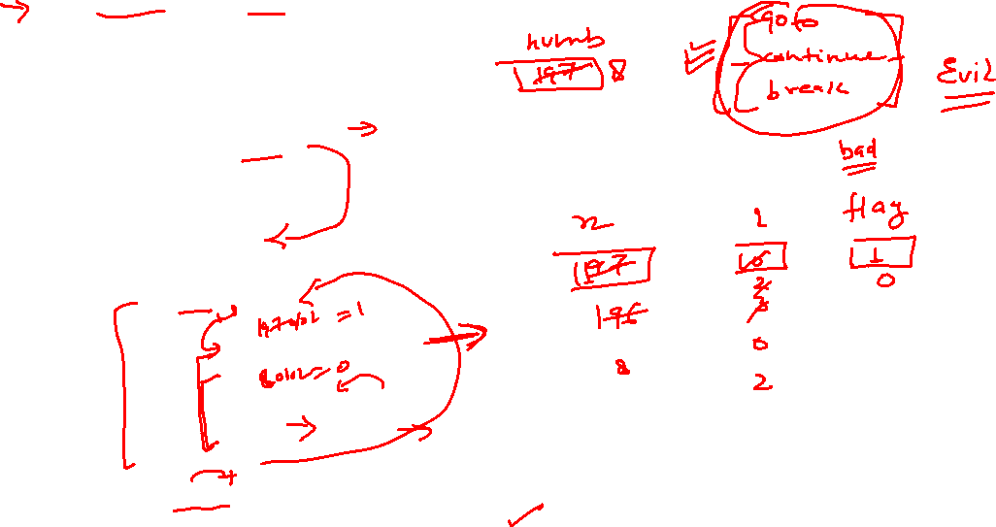
Technical Training (Problem Solving)
#include <stdio.h>
void is_Prime(int numb);
int main()
{
int numb;
printf("enter number");
scanf("%d",&numb);
is_Prime(numb);
return 0;
}
void is_Prime(int x)
{
int i=0,flag=1;
for(i=2;i<x;i++)
{
if(x%i==0)
{
flag=0;
break;
}
}
if(flag==1)
printf("%d is prime",x);
else
printf("%d is not prime",x);
}

Slide 11
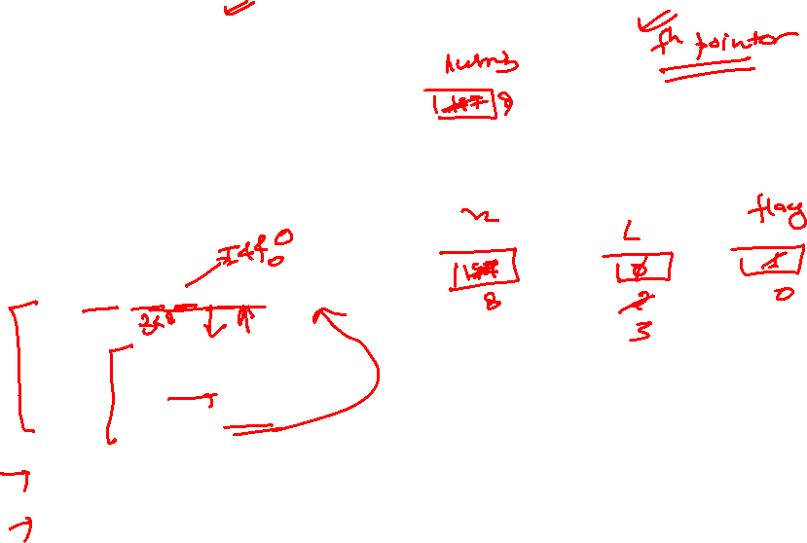
Technical Training (Problem Solving)
#include <stdio.h>
void is_Prime(int numb);
int main()
{
int numb;
printf("enter number");
scanf("%d",&numb);
is_Prime(numb);
return 0;
}
void is_Prime(int x)
{
int i=0,flag=1;
for(i=2;i<x&& flag==1;i++)
{
if(x%i==0)
{
flag=0;
}
}
if(flag==1)
printf("%d is prime",x);
else
printf("%d is not prime",x);
}

Slide 12
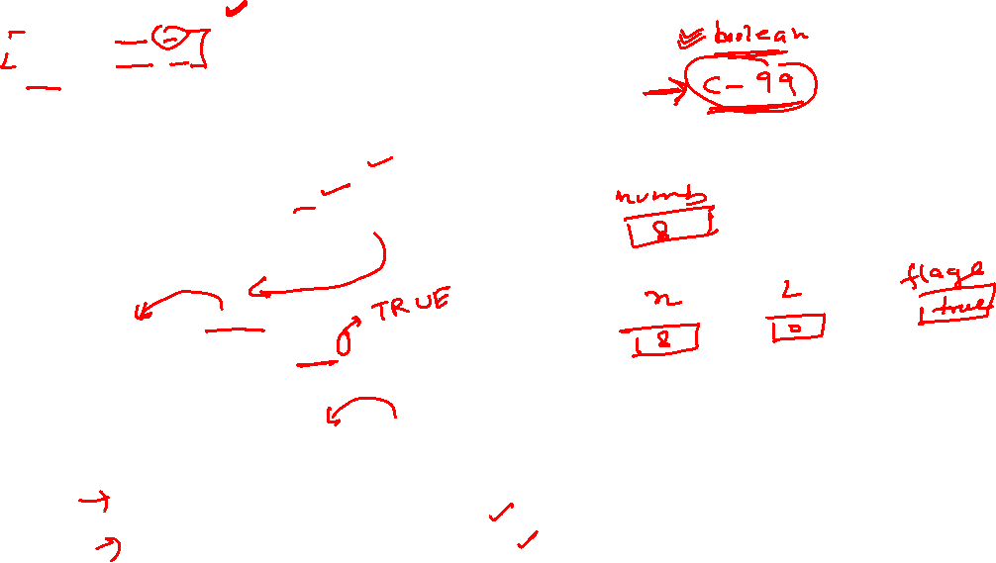
Technical Training (Problem Solving)
#include <stdio.h>
#include<stdbool.h>
#define TRUE 1
#define FALSE 0
void is_Prime(int numb);
int main()
{
int numb;
printf("enter number");
scanf("%d",&numb);
is_Prime(numb);
return 0;
}
void is_Prime(int x)
{
int i=0,flag=TRUE;
for(i=2;i<x && flag==1;i++)
{
if(x%i==0)
{
flag=FALSE;
}
}
if(flag==TRUE)
printf("%d is prime",x);
else
printf("%d is not prime",x);
}

Slide 13
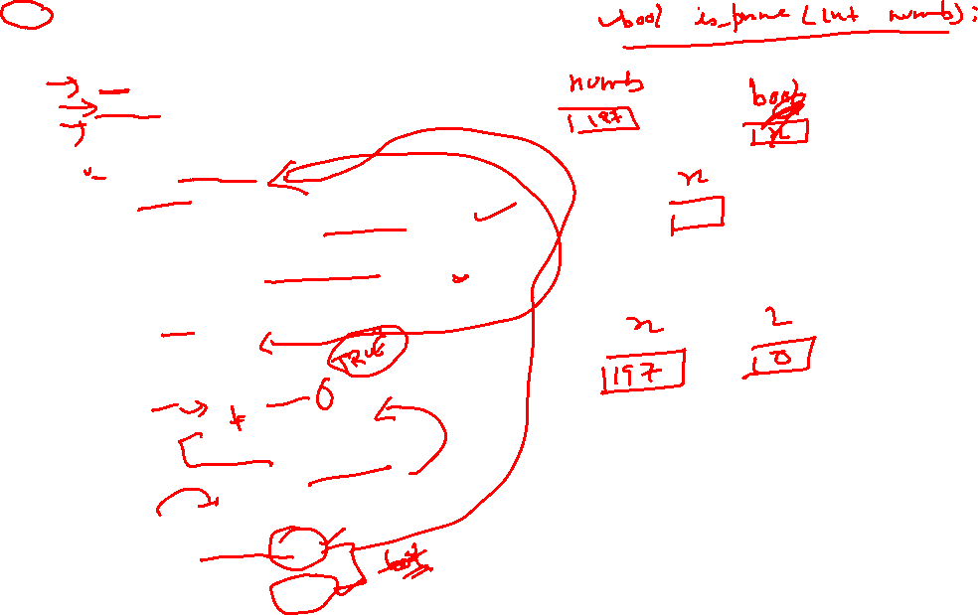
Technical Training (Problem Solving)
#include <stdio.h>
bool is_Prime(int numb);
int main()
{
int numb;
bool x;
printf("enter number");
scanf("%d",&numb);
x=is_Prime(numb);
if(x==TRUE)
printf("%d is prime",numb);
else
printf("%d is not prime",numb);
return 0;
}
bool is_Prime(int x)
{
int i=0,flag=TRUE;
for(i=2;i<x && flag==1;i++)
{
if(x%i==0)
flag=FALSE;
}
if(flag==TRUE)
return TRUE;
else
return FALSE;
}

