Slide 1

Technical Training
Problem Solving-2
DR. APJ ABDUL KALAM TECHNICAL UNIVERSITY
By
Amit Pandey
Assistant Professor
Department of Computer Application
ABES Engineering College, Ghaziabad

Slide 2
Technical Training (Problem Solving)
Problem 1 –Super Number
A positive integer (>1) is said to be super number if sum of its divisors (excluding itself) is equal to the number itself.
Example1: 6 is a super number. Because its divisors are: 1,2,3 and 1+2+3=6
Example2: 8 is not a super number. Because its divisors are: 1,2,4 and 1+2+4 ≠ 8.
Write a complete C program that will find and output all the super numbers in the range [2,1000].

Slide 3
Technical Training (Problem Solving)
Logic Building-

Slide 4
Technical Training (Problem Solving)
Algorithm-

Slide 5
Technical Training (Problem Solving)
Program-
#include <stdio.h>
void super(int numb);
int main()
{
int i=0;
for(i=1;i<=2000;i++)
{
super(i);
}
return(0);
}
void super(int x)
{
int i=0,sum=0;
for(i=1;i<x;i++)
{
if(x%i==0)
{
sum=sum+i;
}
}
if(x==sum)
{
printf("\n%d is super number",x);
}
}

Slide 6
Technical Training (Problem Solving)
Program-
#include <stdio.h>
int super(int numb);
int main()
{
int i=0,num;
for(i=1;i<=2000;i++)
{
num=super(i);
if(i==num)
{
printf("\n%d is super number",num);
}
}
return(0);
}
int super(int x)
{
int i=0,sum=0;
for(i=1;i<x;i++)
{
if(x%i==0)
{
sum=sum+i;
}
}
If(x==sum)
{
return(x);
}
}

Slide 7
Technical Training (Problem Solving)
Problem 2 –Prime Number
A prime number is a positive integer that is divisible only by itself and the integer 1. It is not exactly divisible by any other integer between 2 and N-1. You are required to write a complete C program that takes as input a positive integer N and displays all the prime numbers up to N.
In performing this task, you may want to consider writing and using a function that takes as input an integer, checks if this integer is a prime number or not, and returns a BOOLEAN value indicating whether it is a prime number or not.

Slide 8
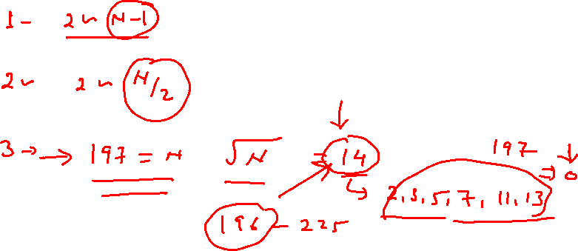
Technical Training (Problem Solving)
Logic Building-

Slide 9
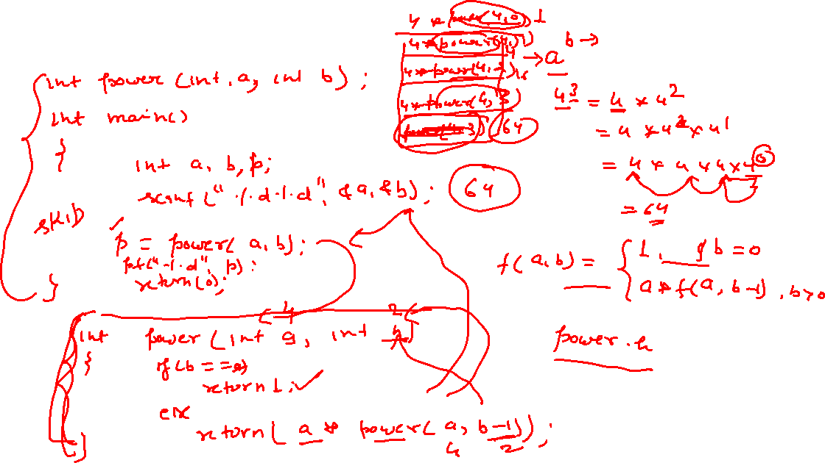
Technical Training (Problem Solving)
Algorithm-

Slide 10
Technical Training (Problem Solving)
#include <stdio.h>
void is_Prime(int numb);
int main()
{
int numb;
printf("enter number");
scanf("%d",&numb);
is_Prime(numb);
return 0;
}
void is_Prime(int x)
{
int i=0,flag=1;
for(i=2;i<x;i++)
{
if(x%i==0)
{
flag=0;
break;
}
}
if(flag==1)
printf("%d is prime",x);
else
printf("%d is not prime",x);
}

Slide 11
Technical Training (Problem Solving)
#include <stdio.h>
void is_Prime(int numb);
int main()
{
int numb;
printf("enter number");
scanf("%d",&numb);
is_Prime(numb);
return 0;
}
void is_Prime(int x)
{
int i=0,flag=1;
for(i=2;i<x&& flag==1;i++)
{
if(x%i==0)
{
flag=0;
}
}
if(flag==1)
printf("%d is prime",x);
else
printf("%d is not prime",x);
}

Slide 12
Technical Training (Problem Solving)
#include <stdio.h>
#include<stdbool.h>
#define TRUE 1
#define FALSE 0
void is_Prime(int numb);
int main()
{
int numb;
printf("enter number");
scanf("%d",&numb);
is_Prime(numb);
return 0;
}
void is_Prime(int x)
{
int i=0,flag=TRUE;
for(i=2;i<x && flag==1;i++)
{
if(x%i==0)
{
flag=FALSE;
}
}
if(flag==TRUE)
printf("%d is prime",x);
else
printf("%d is not prime",x);
}

Slide 13
Technical Training (Problem Solving)
#include <stdio.h>
bool is_Prime(int numb);
int main()
{
int numb;
bool x;
printf("enter number");
scanf("%d",&numb);
x=is_Prime(numb);
if(x==TRUE)
printf("%d is prime",numb);
else
printf("%d is not prime",numb);
return 0;
}
bool is_Prime(int x)
{
int i=0,flag=TRUE;
for(i=2;i<x && flag==1;i++)
{
if(x%i==0)
flag=FALSE;
}
if(flag==TRUE)
return TRUE;
else
return FALSE;
}

Slide 14
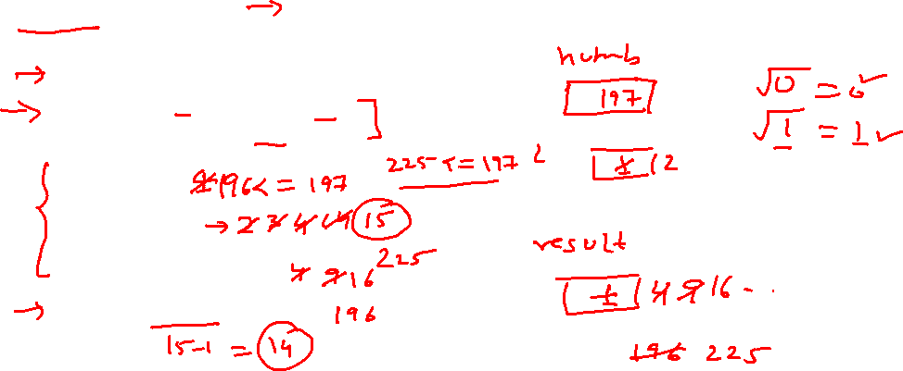
Technical Training (Problem Solving)
int mysqrt(int numb)
{
int i=1,result=1;
if(numb==0 || numb==1)
return numb;
while (result <= numb)
{
i++;
result = i * i;
}
return i - 1;
}

Slide 15
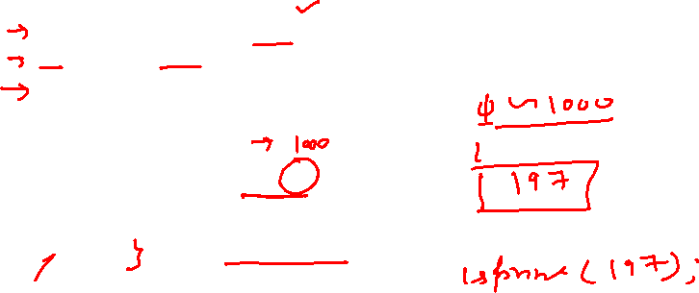
Technical Training (Problem Solving)
void is_Prime(int x);
int fun(int x);
int main()
{
int i=0;
for(i=2;i<=50;i++)
{
is_Prime(i);
}
return 0;
}

Slide 16
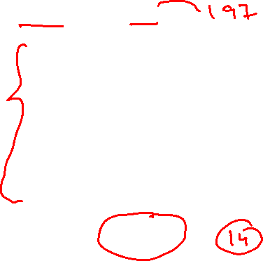
Technical Training (Problem Solving)
int mysqrt(int numb)
{
int i=1,result=1;
if(numb==0 || numb==1)
return numb;
while (result <= numb)
{
i++;
result = i * i;
}
return i - 1;
}

Slide 17
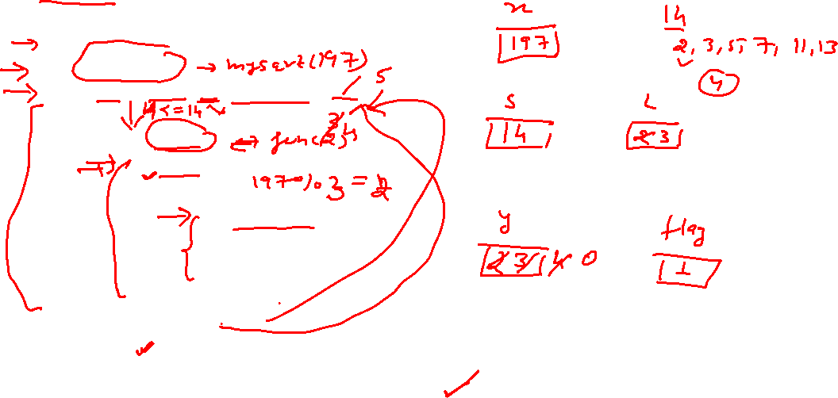
Technical Training (Problem Solving)
void is_Prime(int x)
{
int s,i,y,flag=1;
s=mysqrt(x);
for(i=2;i<=s && flag==1;i++)
{
y=fun(i);
if(y!=0)
{
if(x%y==0)
{
flag=0;
}
}
}
if(flag==1)
printf("%d is prime\n",x);
else
printf("%d is not prime",x);
}

Slide 18
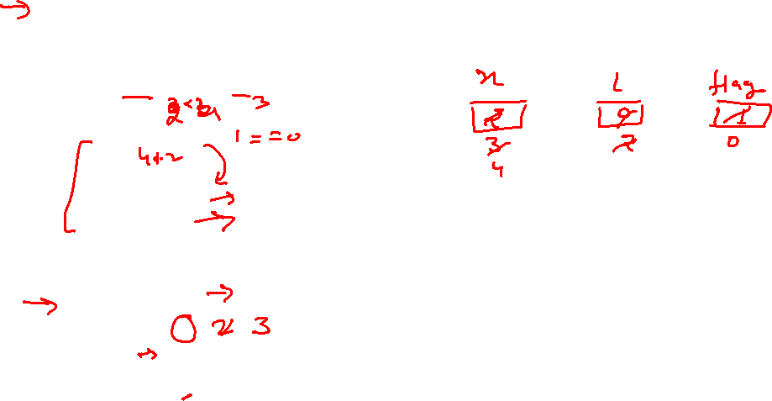
Technical Training (Problem Solving)
int fun(int x)
{
int i=0,flag=1;
for(i=2;i<x;i++)
{
if(x%i==0)
{
flag=0;
break;
}
}
if(flag==1)
return x;
else
return 0;
}

Slide 19

Technical Training (Problem Solving)
Prime and Palindrome
A prime number can also be a palindrome at the same time. A integer that is a palindrome is one in which the digits of the integer reads the same from left to right or right to left. Indeed, a palindrome is one in which the original number and the number in which its digits are reversed are the same.
You are required to write a complete C program that takes as input a positive integer N and display all the numbers up to N that are prime as well as palindrome.
Note that while solving Problem A2.1, you have written and used a function that takes as input an integer, checks if this integer is a prime number or not, and returns a BOOLEAN value indicating whether it is a prime number or not. In a similar manner, you may want to consider writing and using a function that checks if an integer is a palindrome or not. This would make your program elegant.

Slide 20
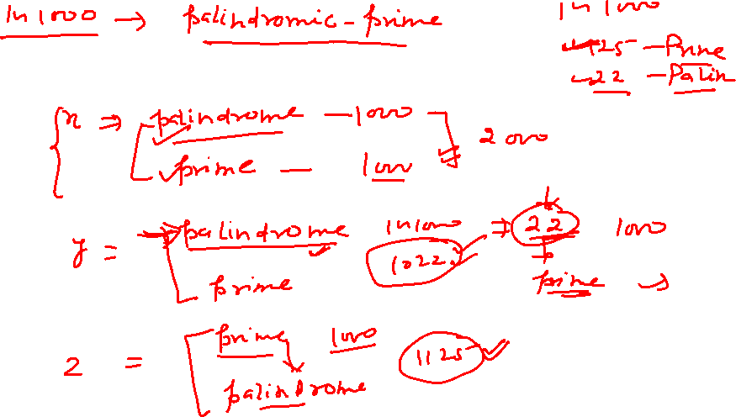
Technical Training (Problem Solving)

Slide 21
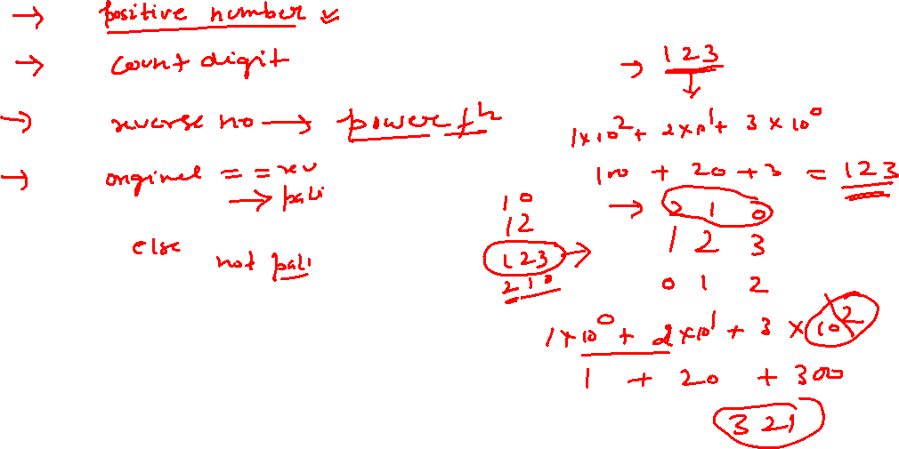
Technical Training (Problem Solving)

Slide 22
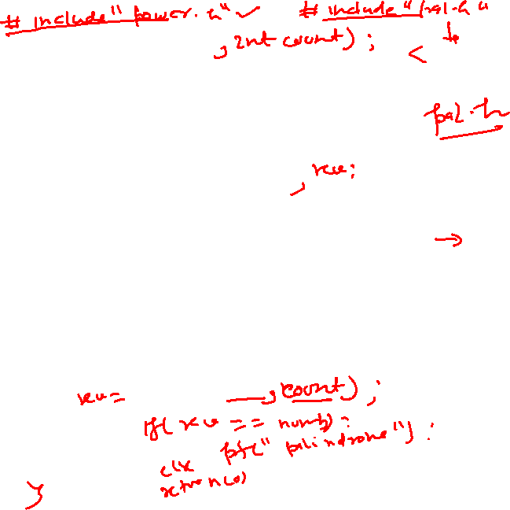
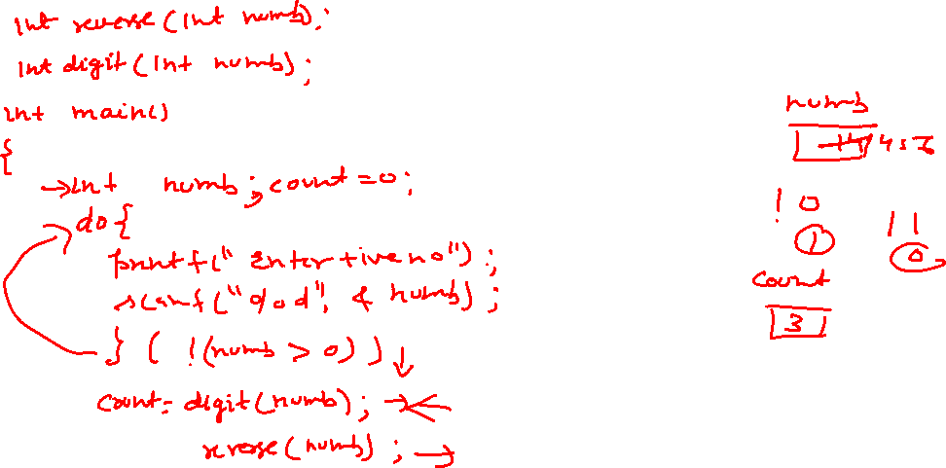
Technical Training (Problem Solving)

Slide 23



Slide 26
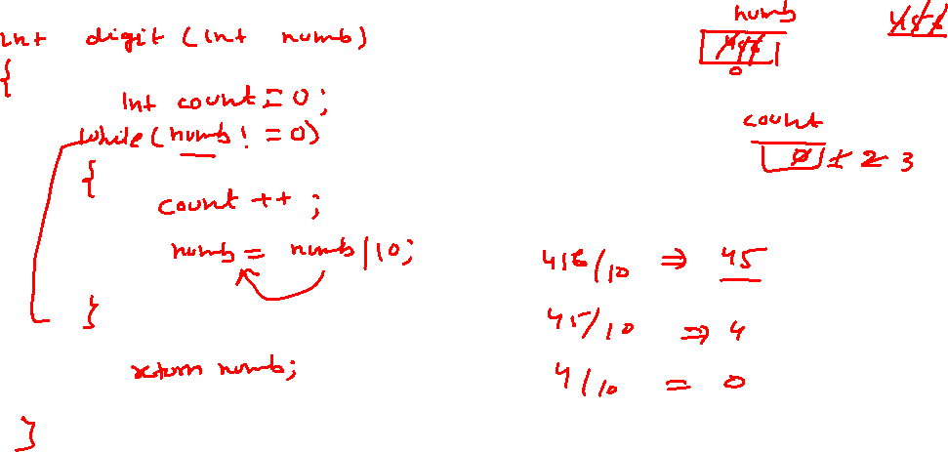
Technical Training (Problem Solving)

Slide 27
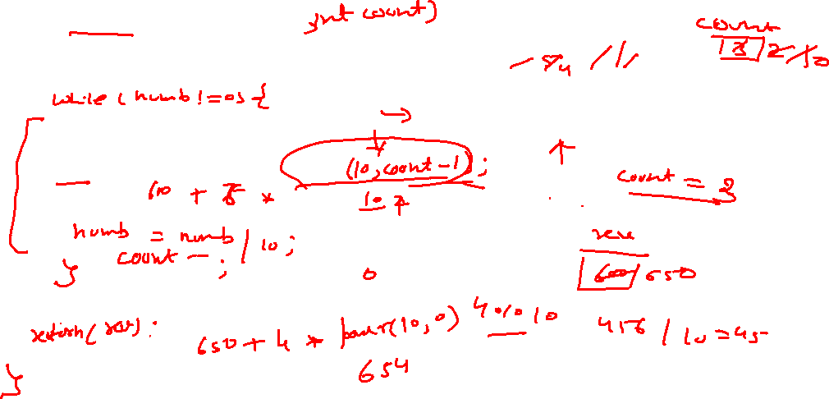
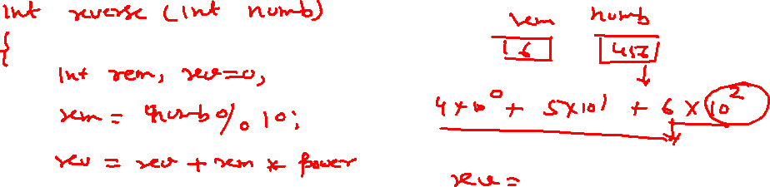
Technical Training (Problem Solving)

Slide 28
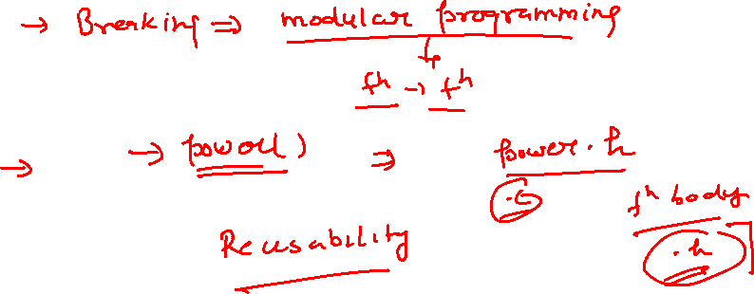
Technical Training (Problem Solving)

