Slide 1

Data Structure Training
Stack
Department of CSE, CS & IT
ABES Engineering College, Ghaziabad

Slide 2

Data Structure Training(Stack)
Implement Stack Using Array(Push)
#define MAX 5
int push(char x)
{
if(top==MAX-1)
{
printf("stack overflow");
exit(1);
}
else
{
top++;//increment then store
stack[top]=x;
}
return top;
}

Slide 3

Data Structure Training(Stack)
Implement Stack Using Array(pop)
#define MAX 5
char pop()
{
char x;
if(top==-1)
{
printf("stack underflow");
exit(1);
}
else
{
x=stack[top];//store and then decrement
top--;
}
return x;
}

Slide 4
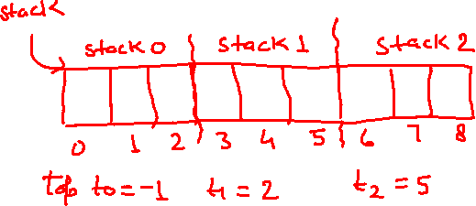
Data Structure Training(Stack)
Implement Multiple Stack In Single Array
A single array will store multiple stacks. For each stack in that array,there will be a top variable.
let array size N=9
number of stack M=3
stack size=N/M=9/3=3
if N=8
Then stack size=2.6
that is 3,3,2

Slide 5
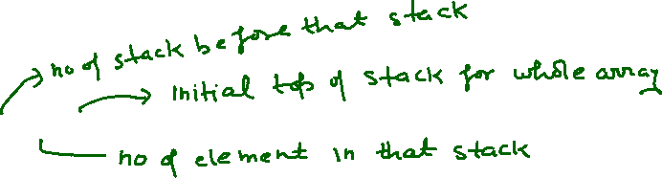
Data Structure Training(Stack)
Calculate Initial top of any Stack
Initially for the whole array it is -1
For 0th stack, initial top of stack= 0 * 3 -1 =-1
For 1th stack, initial top of stack= 1 * 3 -1 = 2
For 2th stack, initial top of stack= 2 * 3 -1 = 5
For i^{th} stack, initial top of stack= i * N/M -1

Slide 6
Data Structure Training(Stack)
Multiple Stack(Push)
#define MAX 5
void push(Ti,x)//insertion to stack i
{
char x;
if(Ti== (i+1)*N/M -1)
{
printf("stack overflow");
exit(1);
}
else
{
Ti++;
stack[Ti]=x;
}
}

Slide 7
Data Structure Training(Stack)
Multiple Stack(pop)
#define MAX 5
char pop(Ti)//deletion from stack i
{
char x;
if(Ti== i*N/M -1)
{
printf("stack underflow");
exit(1);
}
else
{
x=stack[Ti];//store and then decrement
Ti--;
}
return x;
}

Slide 8
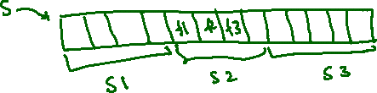
Data Structure Training(Stack)
Advantage of Multiple Stack single array(MSSA)
If There is a single stack only in a single array, you can not run two recursive program at a time.
By using MSSA concept ,you can run two recursive program at a time
Drawback of Multiple Stack single array(MSSA)
In above stack we can easily say that it is not efficient as a lot of space is empty(stack1 and stack3) but still get a message stack is full in case of stack2

Slide 9
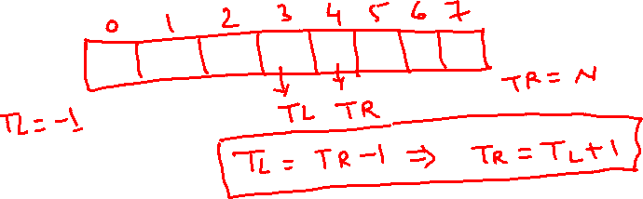
Data Structure Training(Stack)
Implement Multiple Stack in single array efficiently-
1-Here memory is shared between two different stacks , which lead to the synchronization problem and that memory must be considered as critical section which must be handled by semaphore.
2-An array is full when TL=TR-1
Stack empty when TL=-1 and TR=N
3-In this strategy one stack will start from left and other will start from right.
4-For insertion left will increment and right will decrement

Slide 10
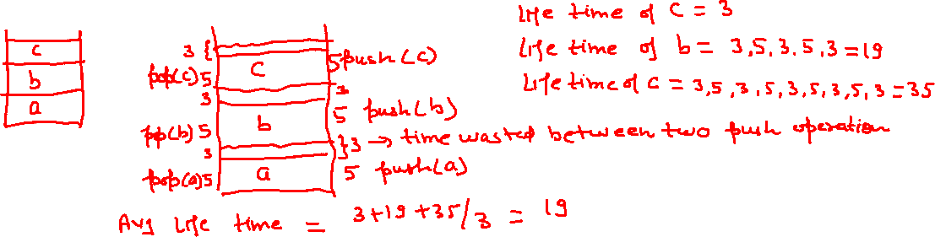
Data Structure Training(Stack)
Stack Life Time Of an Element-
life time of an element in stack is time after push operation of that element before pop operation of that element.
Example1-
Let us suppose that three elements continuously pushed followed by pop.
Let us assume that push() and pop() operation takes 5 min time.and also assume time wasted between any two operation is 3.

Slide 11
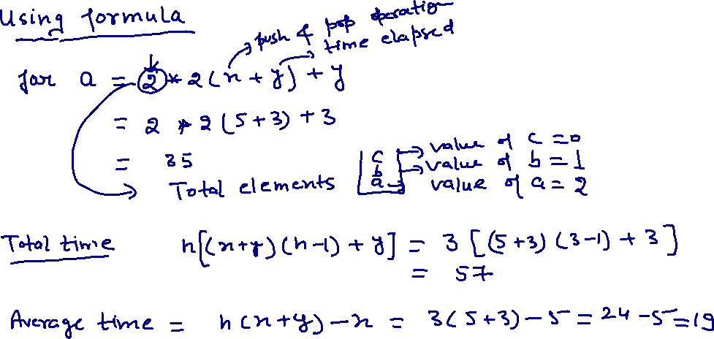
Data Structure Training(Stack)

Slide 12
Data Structure Training(Stack)
These topics based on linklist so will discuss after linklist.
1-Implement Stack Using Linklist-
2-Print next greater element for each element in given array of numbers.if a greater number does not exist on right side print -1.
Input= {5,9,1,15}
Output={9,15,15,-1}
Input={20,17,15,1}
Output={-1,-1,-1,-1}
3-Design a stack with one extra operation called getminimum().this function should return minimum element in the stack at that time without deleting any element.
4-Mergable stack
5-Reverse a linklist and string using stack

