Slide 1

Technical Training
‘C’ Basics
DR. APJ ABDUL KALAM TECHNICAL UNIVERSITY
By
AMIT PANDEY
Assistant Professor
Department of Computer Application
ABES Engineering College, Ghaziabad

Slide 2
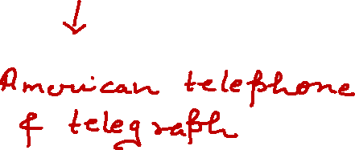

What is C?
C is one of the most popular computer language developed at AT&T’S Bell laboratories of USA in 1972 .
It was developed by Dennis Ritchie.
C is a procedural programming language.

Slide 3
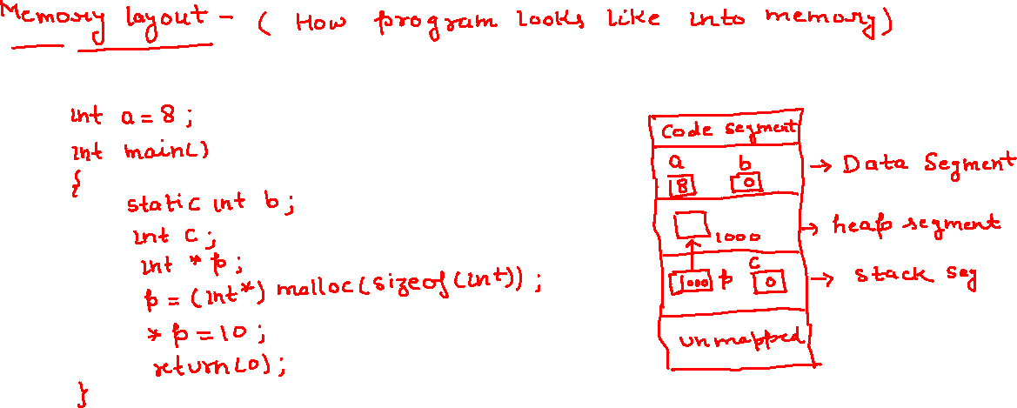

Slide 4
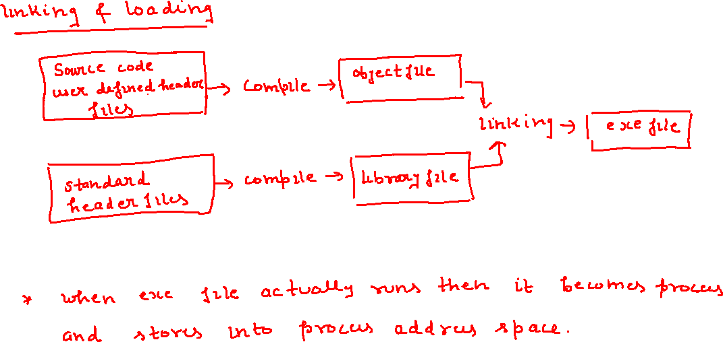

Slide 5
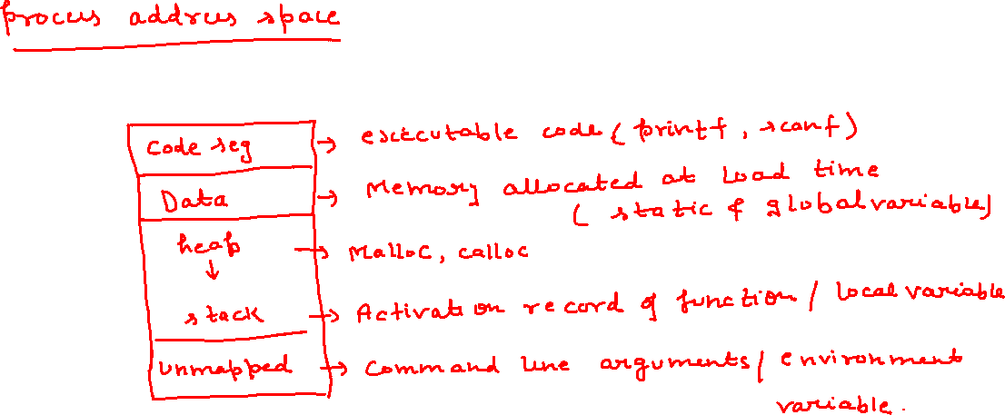

Slide 6
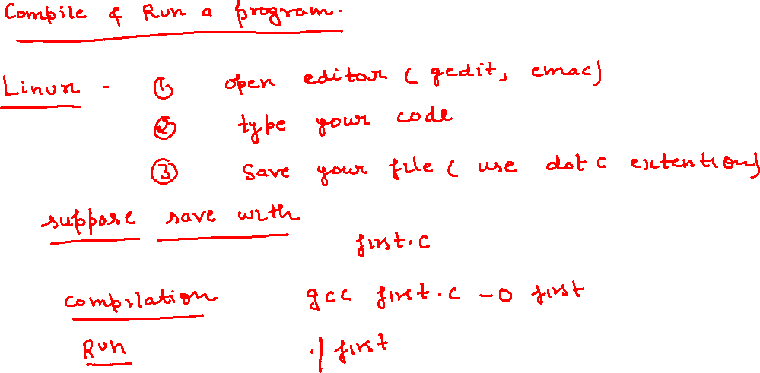

Slide 7
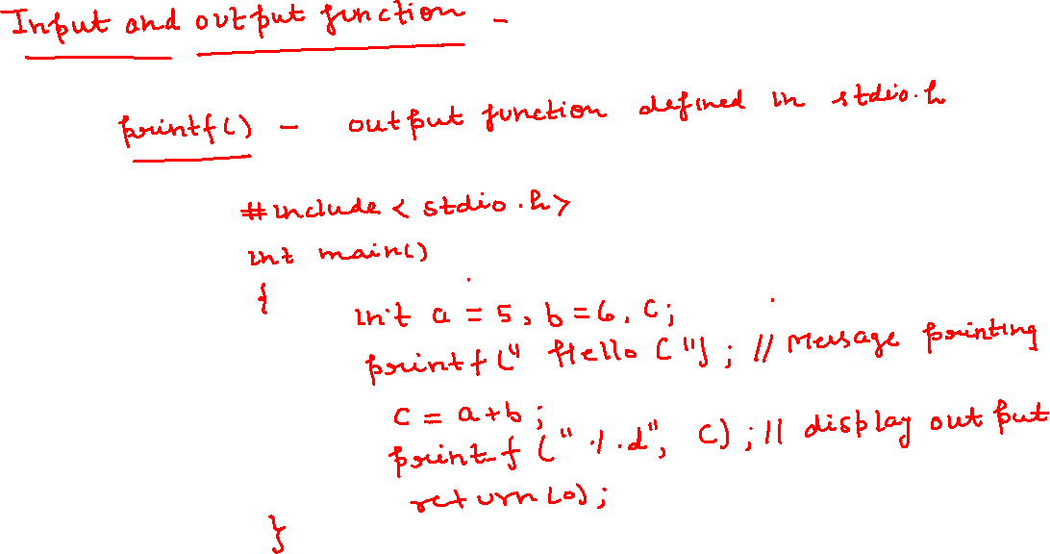

Slide 8
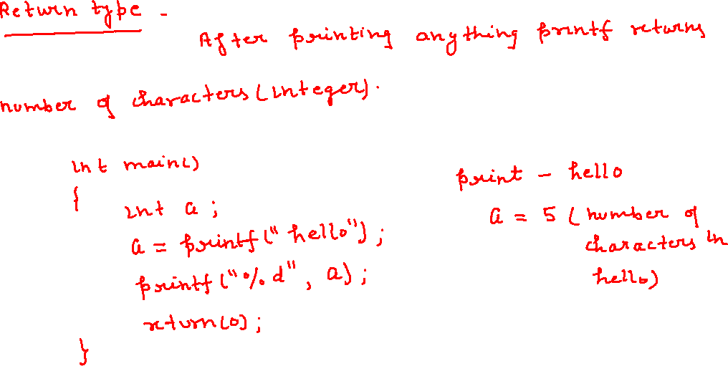

Slide 9
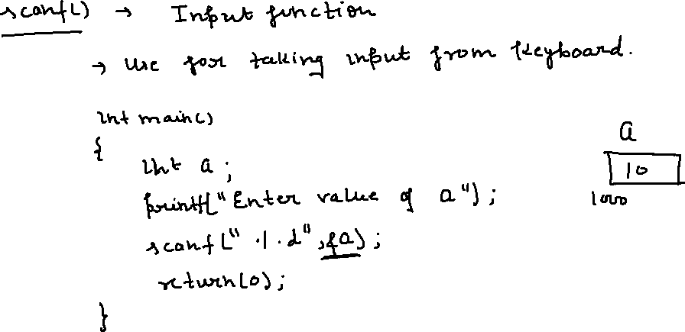

Slide 10
PROBLEM 1
#include <stdio.h>
int main()
{
char arr[100];
printf("%d", scanf("%s", arr));
return 1;
}
PROBLEM 2
#include <stdio.h>
int main()
{
printf(5 + "hello1234");
return 0;
}

Slide 11
PROBLEM 3
#include <stdio.h>
int main()
{
printf("%c ", 7["hello1234"]);
return 0;
}
PROBLEM 4
#include <stdio.h>
int main()
{
printf("%c ", "hello1234“[7]]);
return 0;
}

Slide 12
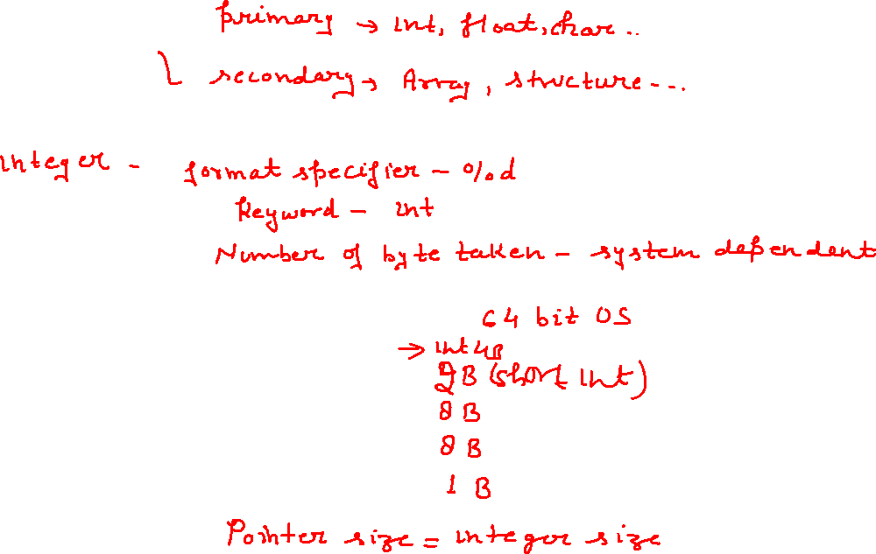
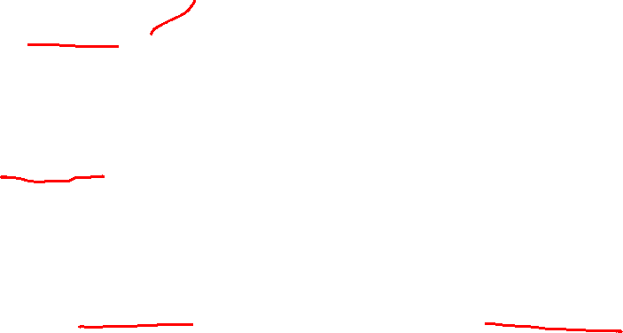

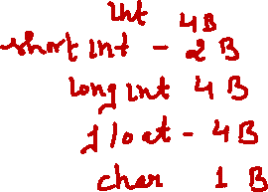


Slide 13
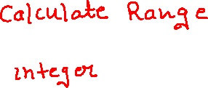
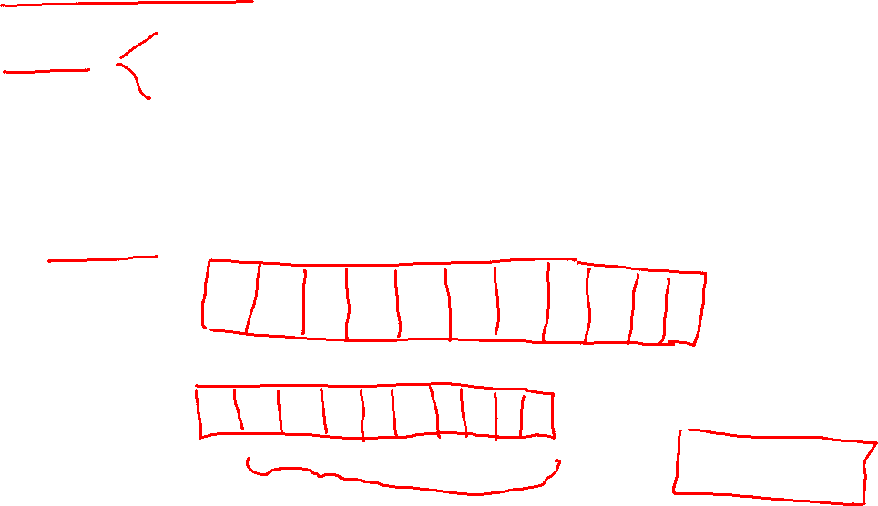
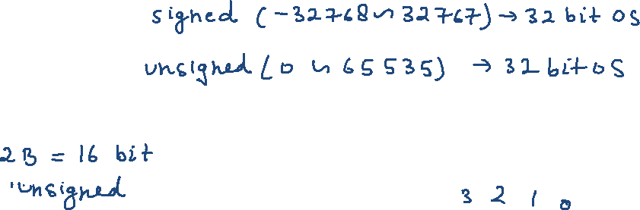



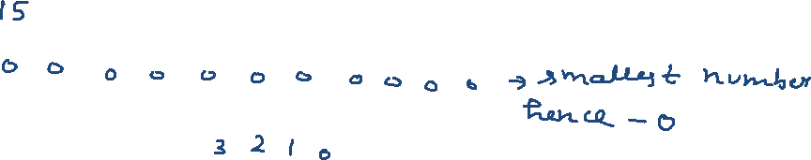
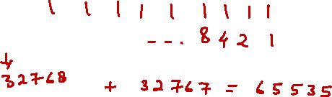


Slide 14
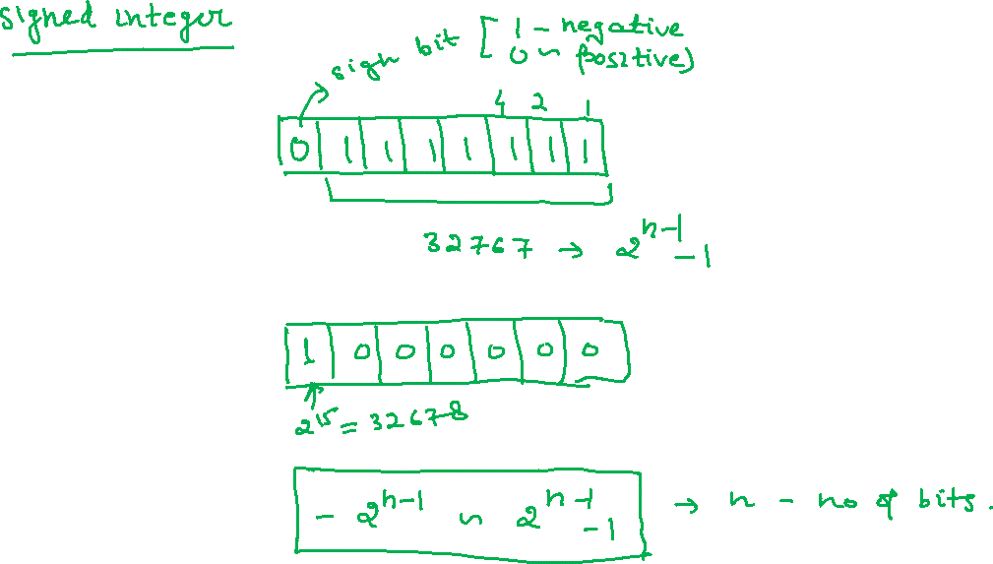

Slide 15
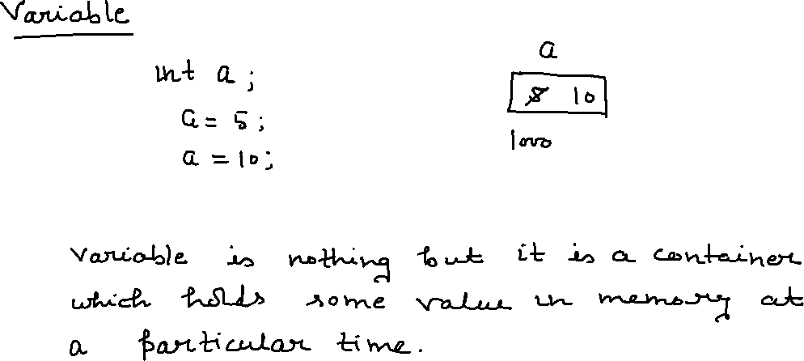

Slide 16
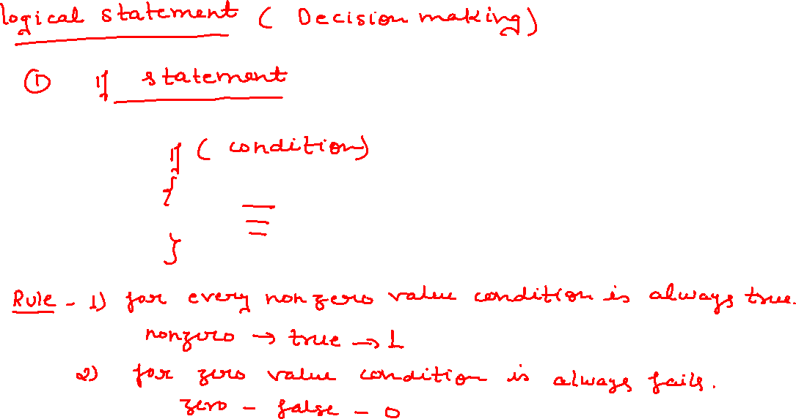

Slide 17
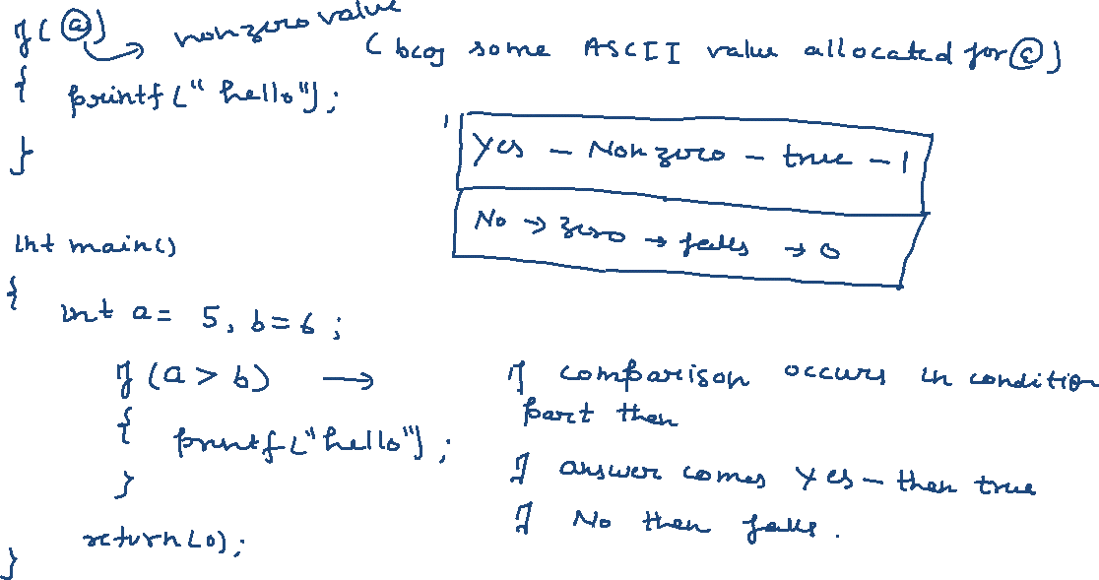

Slide 18
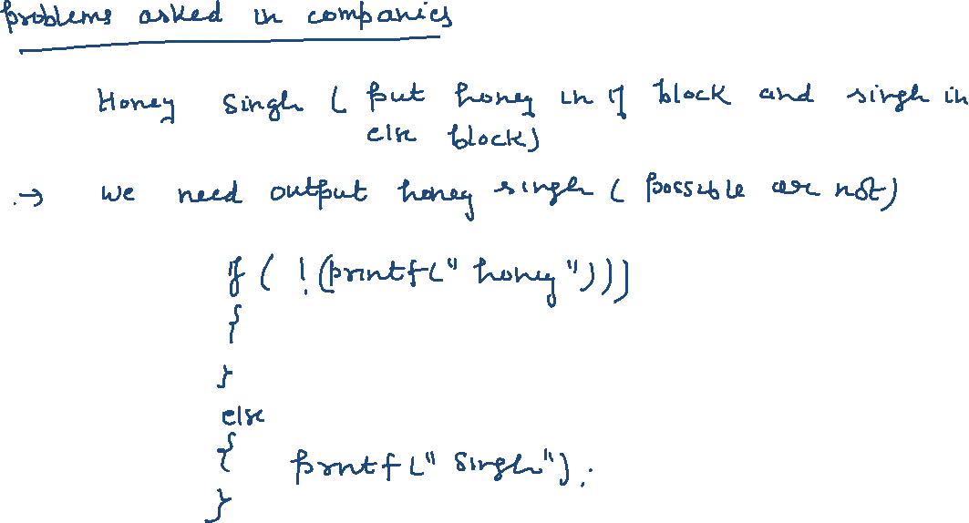

Slide 19
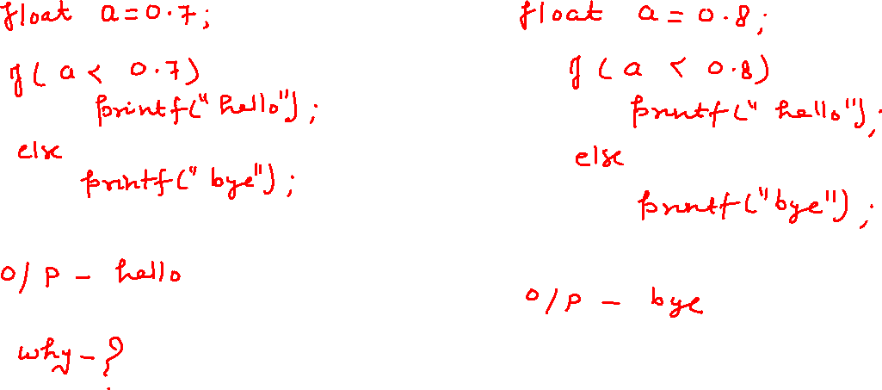

Slide 20
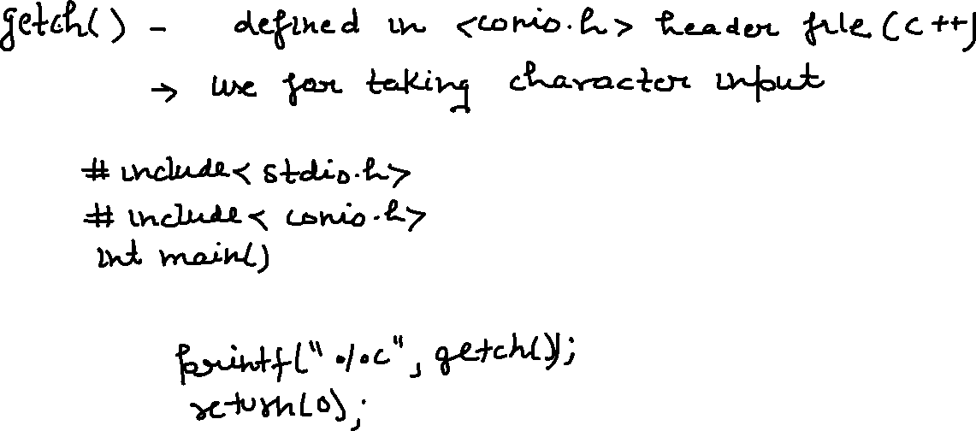
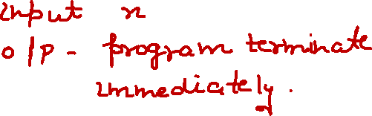

Slide 21
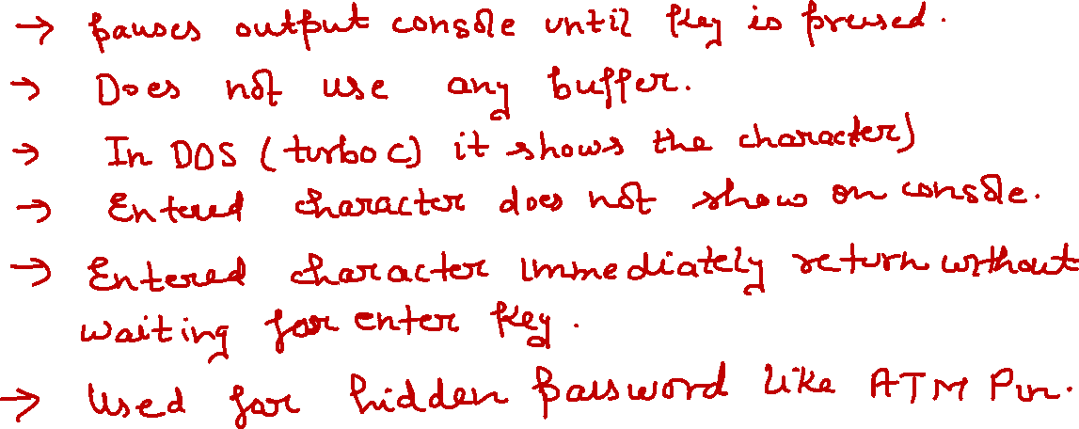

Slide 22
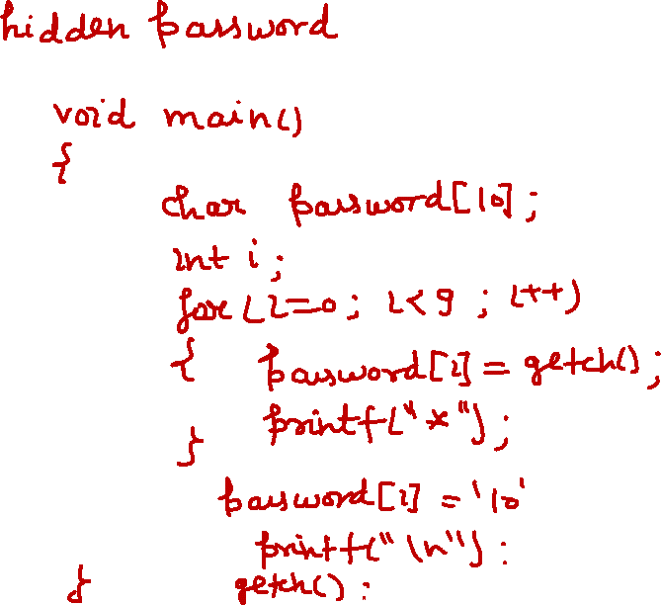

Slide 23
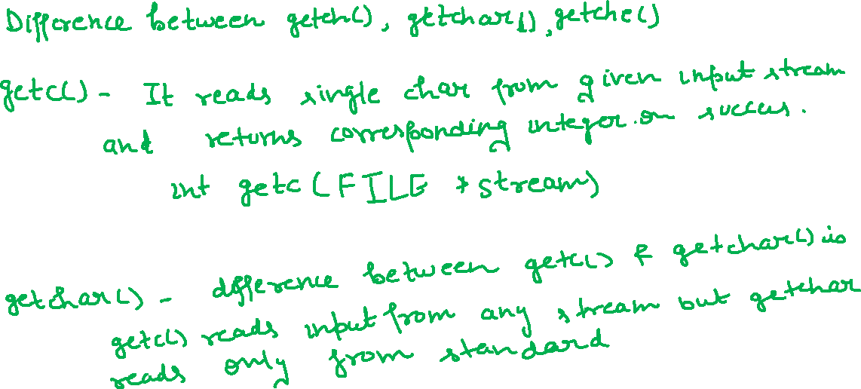

Slide 24

Getc()
#include <stdio.h>
int main()
{
printf("%c", getc(stdin));
return(0);
}
Getchar()
#include <stdio.h>
int main()
{
printf("%c", getchar());
return 0;
}

Slide 25


Getche()
#include <stdio.h>
#include <conio.h>
int main()
{
printf("%c", getche());
return 0;
}
Getch()
#include <stdio.h>
#include <conio.h>
int main()
{
printf("%c", getch());
return 0;
}

Slide 26
PROBLEMS ASKED IN COMPANIES

Slide 27
Technical Training (C BASICS)
#include<stdio.h>
int main()
{
char arr[10000];
printf("%d", scanf("%s", arr));
return 1;
}
What would be the output If input is hello?
A. 5 | B. 1
C. hello | D. Compiler error

Slide 28
Technical Training (C BASICS)
#include<stdio.h>
int main()
{
char arr[10000];
printf("%d", scanf("%s", arr));
return 1;
}
What would be the output if input is hello?
A. 5 | B. 1
C. hello | D. Compiler error

Slide 29
Technical Training (STRING)
#include <stdio.h>
int main()
{
printf("\number system\by");
printf("\rHELLO");
getchar();
return 0;
}
What would be the output ?
A. EVERYONE | B. DEPENDS ON TERMINAL
C. hello | D. Compiler error

Slide 30
Technical Training (STRING)
#include <stdio.h>
int main()
{
printf("\number system\by");
printf("\rHELLO");
getchar();
return 0;
}
What would be the output ?
A. EVERYONE | B. DEPENDS ON TERMINAL
C. hello | D. Compiler error

Slide 31
Technical Training (STRING)
#include <stdio.h>
int main()
{
printf("%%%%");
getchar();
return 0;
}
What would be the output of the above code ? Choose the correct option.
A. %% | B. %
C. %%%% | D. %%%

Slide 32
Technical Training (STRING)
#include <stdio.h>
int main()
{
printf("%%%%");
getchar();
return 0;
}
What would be the output of the above code ? Choose the correct option.
A. %% | B. %
C. %%%% | D. %%%

Slide 33
Technical Training (STRING)
#include <stdio.h>
int main()
{
printf(5 + “hello1234");
return 0;
}
What would be the output of the above code ? Choose the correct option.
A. 1234 | B. hello1234
C. hello | D. error

Slide 34
Technical Training (STRING)
#include <stdio.h>
int main()
{
printf(5 + “hello1234");
return 0;
}
What would be the output of the above code ? Choose the correct option.
A. 1234 | B. hello1234
C. hello | D. error

Slide 35
Technical Training (STRING)
#include <stdio.h>
int main()
{
char str[10];
scanf("%5s",str);
printf("%s",str);
return 0;
}
What would be the output of the above code If input is hello1234
A. hello | B. hello1234
C. 1234 | D. error

Slide 36
Technical Training (STRING)
#include <stdio.h>
int main()
{
char str[10];
scanf("%5s",str);
printf("%s",str);
return 0;
}
What would be the output of the above code If input is hello1234
A. hello | B. hello1234
C. 1234 | D. error

Slide 37
Technical Training (STRING)
#include<stdio.h>
int main()
{
printf("%d", printf("%d", 1234));
return 0;
}
What would be the output of the above code If input is hello1234
A. 12344 | B. 4
C. 1234 | D. error

Slide 38
Technical Training (STRING)
#include<stdio.h>
int main()
{
printf("%d", printf("%d", 1234));
return 0;
}
What would be the output of the above code If input is hello1234
A. 12344 | B. 4
C. 1234 | D. error

Slide 39
Technical Training (STRING)
#include<stdio.h>
int main()
{
printf("%d", printf("%d",printf("hello")));
return 0;
}
What would be the output of the above code If input is hello1234
A. hello51 | B. hello
C. hello5 | D. error

Slide 40
Technical Training (STRING)
#include<stdio.h>
int main()
{
printf("%d", printf("%d",printf("hello")));
return 0;
}
What would be the output of the above code If input is hello1234
A. hello51 | B. hello
C. hello5 | D. error

Slide 41
21. Left most bit 0 in Singed representation indicates.? Choose the correct option.
A. A Positive number | B. A Negative Number
C. A & B | D. None of the above
21. Left most bit 0 in Singed representation indicates.? Choose the correct option.
A. A Positive number | B. A Negative Number
C. A & B | D. None of the above

