Slide 1


INTERNSHIP PRESENTATION
AI Data Analytics Internship
• Student: ASHISH KUMAR
• Enrollment No.: 25SCS1003002697
• B.Tech CSE | 3rd Semester | Section 2CSE1
• Session: 2025–29
• Organization: InAmigos Foundation
• Internship Period: 05 September 2026 – 21 September 2026
1

Slide 2
Internship Overview
AI-assisted research, data organization and social-impact analysis
Internship Focus
Applied AI and data analytics concepts to NGO, volunteering, fundraising and education-related topics.
Learning Approach
Research → organize data → AI assistance → verify → communicate findings.
Duration
05 September 2026 to 21 September 2026
InAmigos Foundation
• Four structured tasks were completed.
• The work emphasized research and analysis rather than production software development.
• AI supported summarization, ideation and recommendation generation.
• Human review and source verification remained important.
2

Slide 3
Organization Profile
InAmigos Foundation
• Nonprofit / Section 8 organization based in Bilaspur, Chhattisgarh, India.
• Founded on 23 September 2020.
• Focus areas include education, community support, animal welfare, women empowerment, environment and skill development.
• The internship connected social-impact activities with AI-assisted research and data-oriented thinking.
Selected initiatives
Project Seva • Project BachpanShala • Project Jeev • Project Udaan • Project Prakriti • Project Vikas
3

Slide 4
Objectives
Research
Collect and organize NGO and social-impact information.
AI Analysis
Use AI tools to summarize information and generate insights.
Opportunity Mapping
Compile student volunteer, internship and fellowship opportunities.
Strategy
Identify practical AI ideas for NGO growth.
Professional Skills
Improve documentation, analysis and communication.
4

Slide 5
Task 1 – NGO Research & Data Collection
10 NGOs researched across multiple social sectors
• Collected NGO name, website, area of work, headquarters and key initiatives.
• Examples: Smile Foundation, CRY, Goonj, Akshaya Patra, Teach For India, WWF-India, SEWA and others.
• Main learning: comparable data fields make NGO research easier to analyze.
5

Slide 6
Task 1 – Sample Data Table
NGO | Primary Area | Headquarters / Base | Key Focus
Smile Foundation | Education & Healthcare | New Delhi, India | Education and healthcare outreach
CRY | Child Rights | Mumbai, India | Child education and protection
Goonj | Community Development | New Delhi, India | Community-led development
Akshaya Patra Foundation | Education & Nutrition | Bengaluru, India | School meal programs
Teach For India | Education | Mumbai, India | Fellowship and educational leadership
6

Slide 7
Task 2 – AI-Powered Data Analysis
Topic: How AI can support NGOs and social-impact initiatives
Data Analysis
Find trends in surveys, project records and structured data.
Fundraising
Support campaign analysis and targeted communication.
Volunteer Management
Match skills and interests with suitable opportunities.
Education
Support personalized learning resources and content.
Healthcare
Assist with outreach planning and pattern identification.
Key insight
AI can accelerate analysis, but human review and responsible data use remain essential.
7

Slide 8
Task 3 – Volunteer Opportunity Compilation
Student-focused opportunity mapping
• Compiled at least 15 opportunities for students in India.
• Fields included organization, opportunity type, eligibility, application link and deadline where available.
• Examples included volunteering, internships, fellowships and student social initiatives.
• Deadlines and eligibility should always be checked on the current official page.
8

Slide 9
Task 4 – AI Insights for NGO Growth
Five practical recommendations
1. AI Chatbot
Handle common questions and guide website visitors.
2. Volunteer Matching
Match skills, interests and availability to opportunities.
3. Fundraising Analytics
Use historical campaign patterns to improve planning.
4. Social-Media Planning
Generate content ideas, drafts and performance insights.
5. Impact Dashboard
Track project, volunteer and donation indicators visually.
9

Slide 10
Methodology
AI-assisted social-impact research workflow
1
2
3
4
5
6
7
Understand Task
Select Sources
Collect Data
Organize Data
AI-Assisted Analysis
Verify & Refine
Document & Present
• AI supported summarization, brainstorming and recommendation drafting.
• Final outputs were reviewed and refined rather than copied directly from AI.
• Source links were retained for traceability and verification.
10

Slide 11
Tools Used & Learning Outcomes
Tools / Platforms
• ChatGPT / AI assistant – research and ideation
• Web & official websites – source collection
• Word – report preparation
• Excel / Google Sheets – structured data
• Google Drive – storage and submission
• LinkedIn – professional sharing
Skills Developed
• Research and information retrieval
• Data collection and organization
• AI-assisted analysis
• Summarization and report writing
• Critical review of AI outputs
• Professional documentation
• Presentation and communication
11

Slide 12
Challenges & How I Addressed Them
• Scattered information → used fixed fields and structured tables.
• Changing deadlines → recommended checking current official opportunity pages.
• AI may generate errors → cross-checked important factual claims.
• Broad social topics → used objectives and categories to structure analysis.
• Limited production exposure → focused on realistic use cases without claiming deployment.
Key Learning
Good analytics depends not only on AI, but also on clear questions, organized data, verification and human judgement.
12

Slide 13
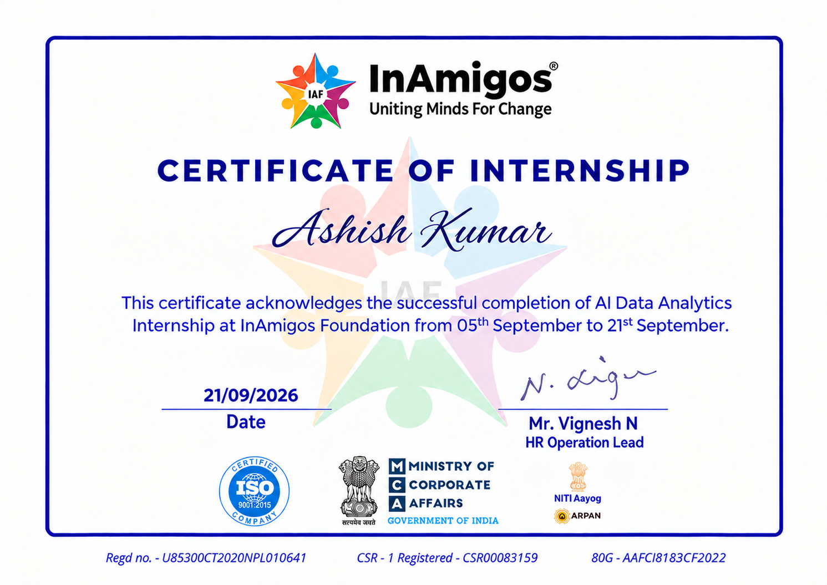
Internship Completion Certificate
13

Slide 14
Conclusion
• Completed an AI Data Analytics Internship at InAmigos Foundation.
• Researched 10 NGOs and organized social-impact information.
• Prepared an AI-powered analysis of AI applications in the NGO sector.
• Compiled 15+ student-oriented volunteer, internship and fellowship opportunities.
• Generated five practical AI strategies for NGO growth.
• Developed stronger research, data organization, AI literacy and communication skills.
Thank You
Questions & Answers
14

