Slide 1

Vehicle Insurance Prediction Model
A prediction model to predict, whether the customer would be interested in Vehicle insurance.

Slide 2

Dataset
We do not have the data so for building a model we require data to train the model. For that, we have taken data from Kaggle(https://www.kaggle.com) with columns like
'Gender’
'Age’
'Driving_License’
'Region_Code’
'Previously_Insured’
'Annual_Premium’
'Policy_Sales_Channel’
'Vintage’
'Response'

Slide 3
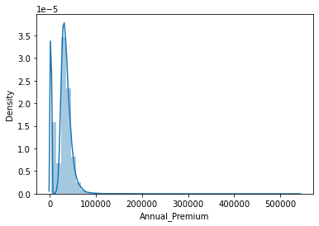
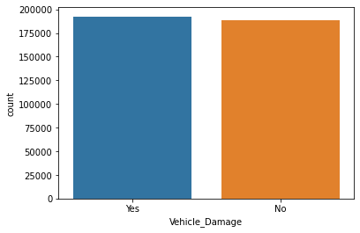
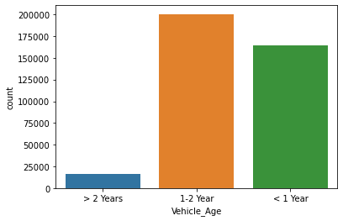
Data Exploration some visualization for more explores the dataset.

Slide 4
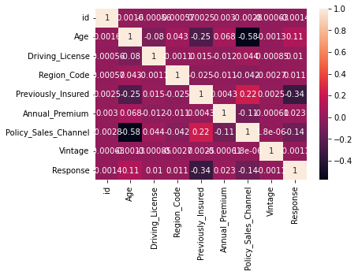
PCA Analysis
PCA Analysis: Perform PCA analysis on the scaled dataset to identify the principal components that explain the most variance in the data. Plot the scree plot to visualize the amount of variance explained by each principal component.

Slide 5
Model Selection
Use the principal components identified in the PCA analysis as input features to build a predictive model to classify whether a customer is interested in Vehicle Insurance.
So, among the many models like – linear regression, logistic regression, decision tree, random forest, and many more we have selected random forest because
High accuracy: Random forest has been shown to have higher accuracy than other models, especially when dealing with large and complex datasets.
Robustness: Random forest is a robust algorithm that can handle missing values and noisy data without requiring pre-processing.
Non-linear relationships: Random forest can capture non-linear relationships between input variables and the target variable, making it suitable for complex problems that involve interactions between multiple variables.
Feature importance: Random forest provides a measure of feature importance, which can be used to identify the most important variables in the dataset.
Outlier detection: Random forest can detect outliers in the data, which can be useful for identifying anomalous data points that may be indicative of errors or fraud.

Slide 6
Model building
Data splitting: The first step is to split the dataset into two parts: a training set and a test set. The training set is used to train the model, while the test set is used to evaluate its performance.
Model development: The next step is to develop the model using the training set. In this case, a random forest was chosen as the modeling algorithm. The hyperparameters of the model were tuned using cross-validation to optimize its performance.
Model evaluation: Once the model is developed, it is evaluated using the test set. The performance metrics used to evaluate the model include accuracy, precision, recall, and F1 score. These metrics provide information on how well the model can predict customer interest in vehicle insurance.
Model interpretation: The final step is to interpret the results of the model. This involves analyzing the importance of the different features in predicting customer interest in vehicle insurance. This information can be used to optimize the company's communication strategy to reach out to those customers and optimize its business model and revenue.

Slide 7
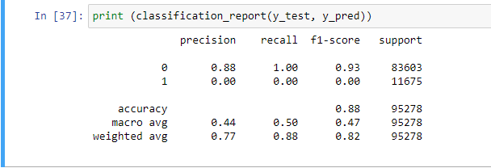
Model evaluation

Slide 8
Conclusion
Business impact: Discuss how the model can help the company to optimize its business model and revenue. For example, by identifying the customers who are most likely to be interested in vehicle insurance, the company can target its marketing efforts more effectively.
Future work: Discuss potential future work that could be done to improve the model or expand its scope. For example, the model could be applied to different datasets to see if it can be generalized to different populations. The model could also be expanded to include additional features that may be relevant to predicting customer interest in vehicle insurance.

Slide 9
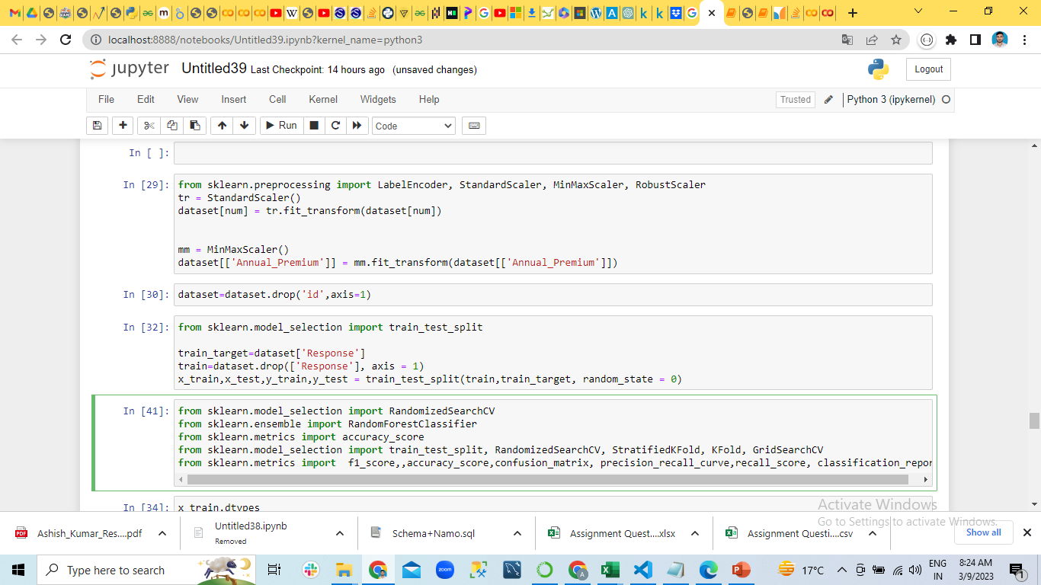
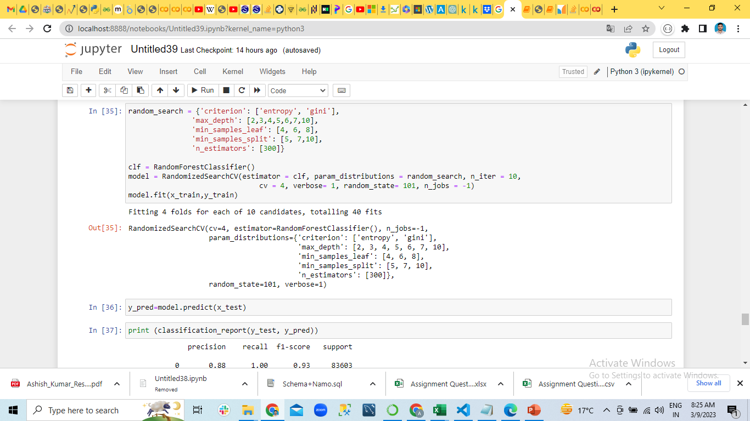
Code file
Here is the link to the code file: click here

Slide 10
Thank you

