Slide 1
Understanding of Career Aspirations of Gen-Z
Data Analytics Report
Presented by:
Ashish Kumar

Slide 2
Project Roadmap
Share insights effectively with stakeholders.
P
Create visual representation for presentation.
P
Use graphs, charts for clear communication..
P
Understand patterns, trends, and relationships.
P
Remove errors, handle missing values..
P
Gather relevant information systematically.
P
Define the issue or challenge clearly..
P

Slide 3

Problem Statement
In the rapidly growing modern workplace, The different needs and expectations of Gen-Z, desiring for bigger paychecks, flexible work arrangements, social and environmental responsibility, becomes a complex issue for employers, department heads, managers, and HR professionals. This becomes hurdles for organizational growth but also leads to critical consequences such as layoffs, a lack of essential skills in the workforce, and diminished customer satisfaction. This data analytics project aims to analyze the impact of the misalignment between Gen-Z's career aspirations and workplace dynamics on various stakeholders, providing actionable insights for employers, HR professionals, and decision-makers to foster a more inclusive and productive work environment.
References: https://www.linkedin.com/pulse/understanding-career-aspiration-gen-z-vishal-mehta/

Slide 4
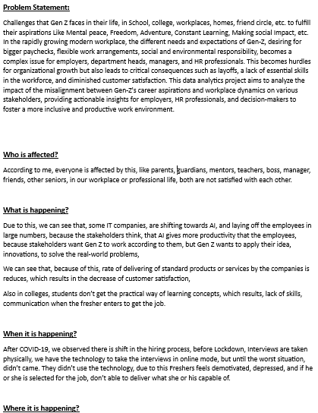
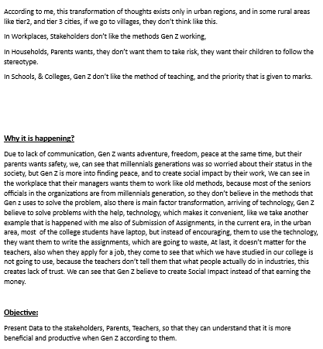
Document

Slide 5
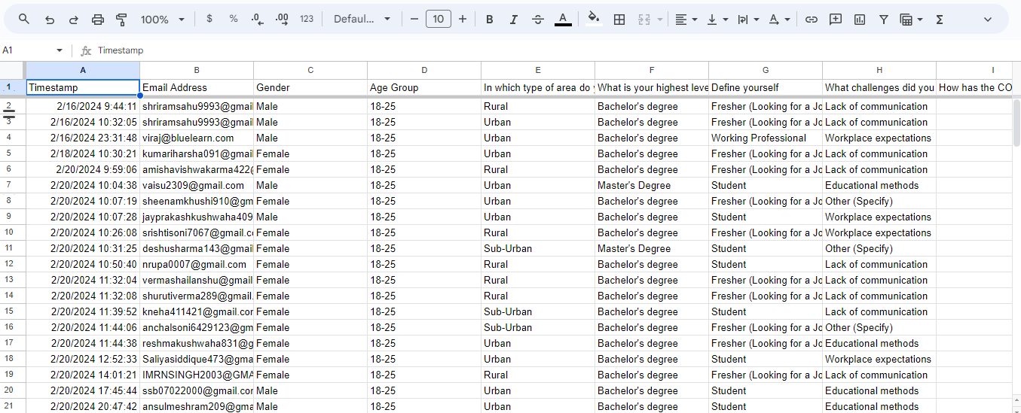
Data Collection

Slide 6
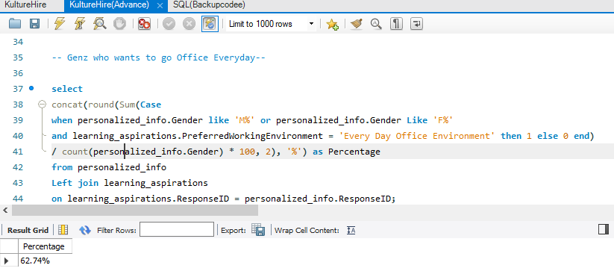
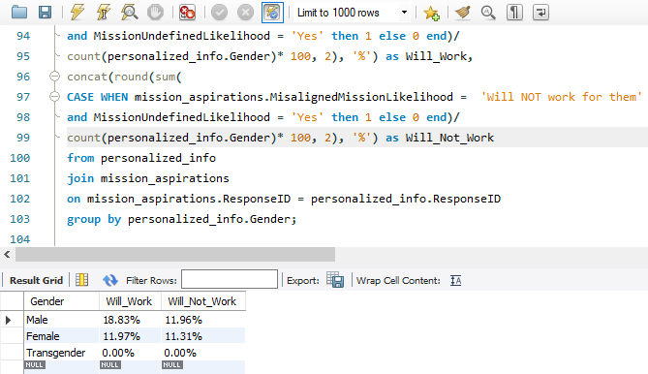
Data Cleaning

Slide 7

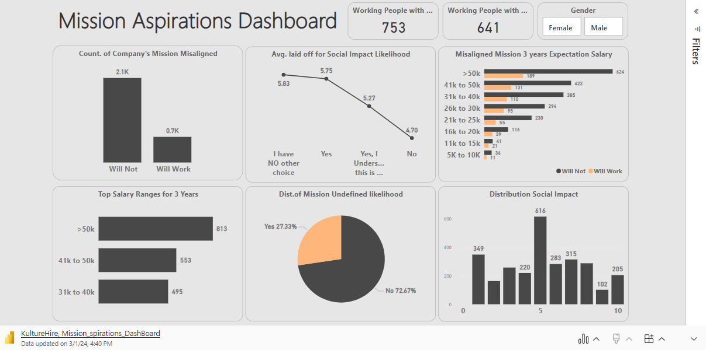
Microsoft Power BI Interaction Dashboard 1

Slide 8
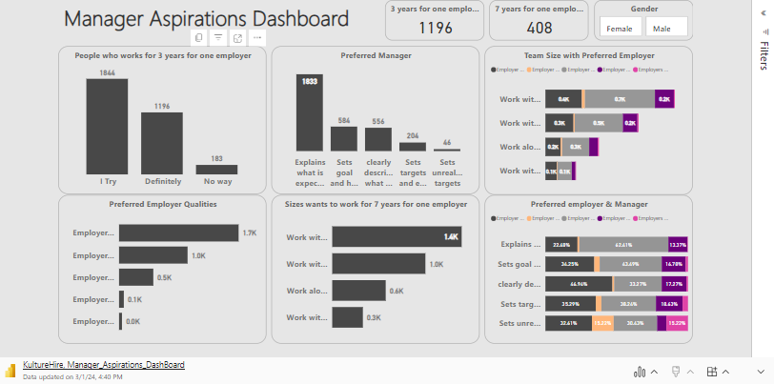
Microsoft Power BI Interaction Dashboard 2

Slide 9
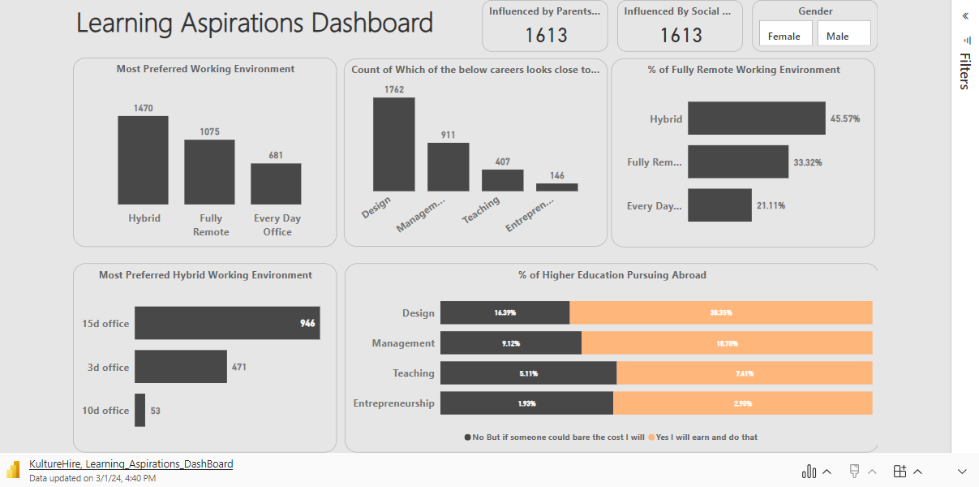
Microsoft Power BI Interaction Dashboard 3

Slide 10

Genpact is a global professional services firm delivering business outcomes that transform industries and shape the future. They partner with the world's most innovative companies to turn their biggest challenges into opportunities, resilience, and growth – from creating hyper-connected supply chains to transforming experiences for their customers and employees.

Slide 11
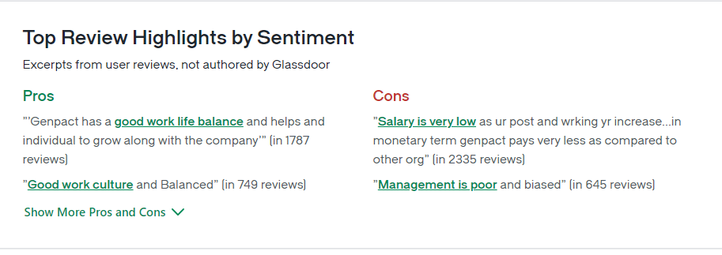
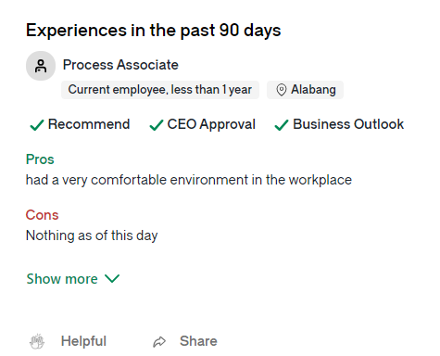
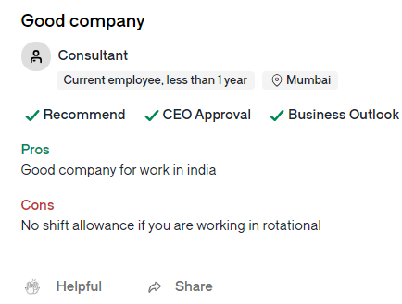

Slide 12
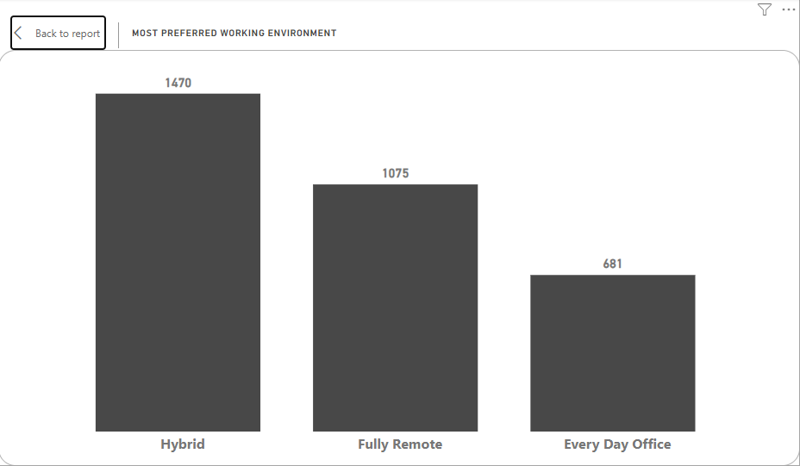
Insight No 1
More than 21% Wants Every Office
More than 46% wants to work for Hybrid Environment
Company prioritize their Employees Mental peace.

Slide 13
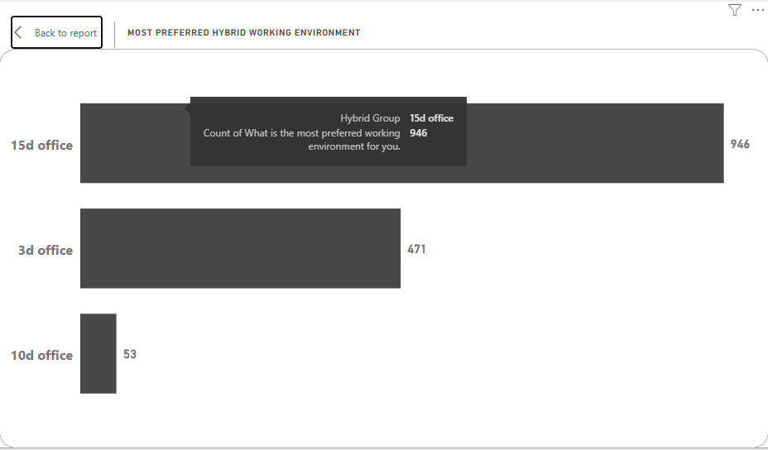
Insight No 2
About 65% wants to come Office for more than 15 Days in Hybrid Environment
Gen Z definitely may consider Genpact Because of the Work Culture is Good according Glassdoor Ratings

Slide 14
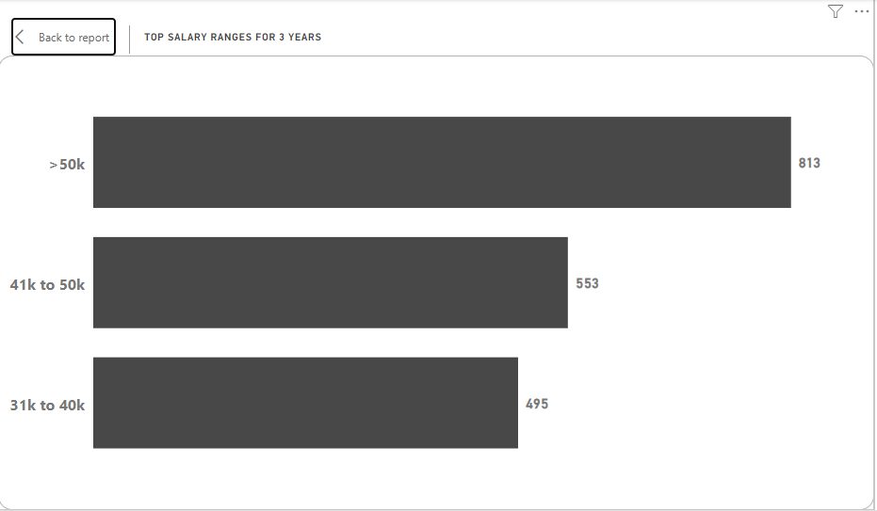
Insight No 2
43% Wants above 50K Salary
29% wants above 40K
That makes about 72% Employees want Above 40K salary
That’s Makes Tough for the retain its employees for long period
Company can offer Bonuses or make hike to Salaries of Employees

Slide 15
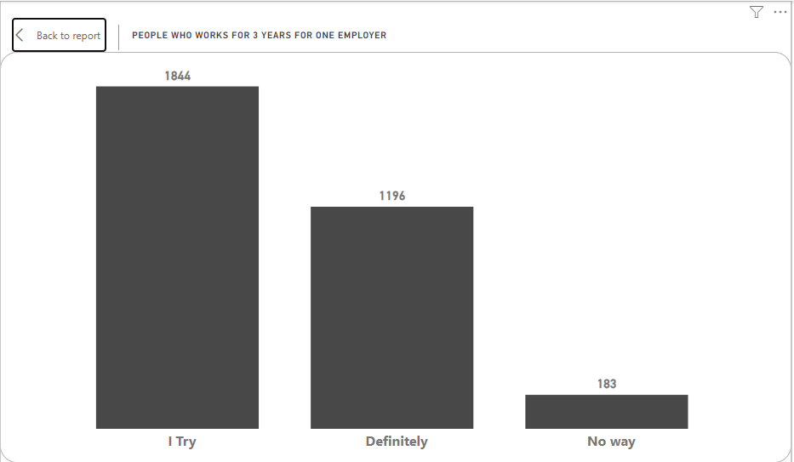
Insight No 4
Majority of the Employees are Okay or Try to work for more than 3 years
I f the company’s doesn’t offer salary it is difficult to retain the employees which results extra capital required for Hiring people again & which is also waste of time and efforts that are put by the employees.

Slide 16
THANK YOU

