Slide 1

CLIP
FRESH
WILD
DEEP
Learning Transferable Visual Models from
Language

Slide 2
Introduction
This presentation summarizes the OpenAI CLIP paper, which investigates how visual models can be trained using natural language supervision. We cover the important concepts, the model architecture, and the effect of CLIP's zero-shot learning on computer vision tasks, describing its strengths, limitations, and the possible future direction.

Slide 3
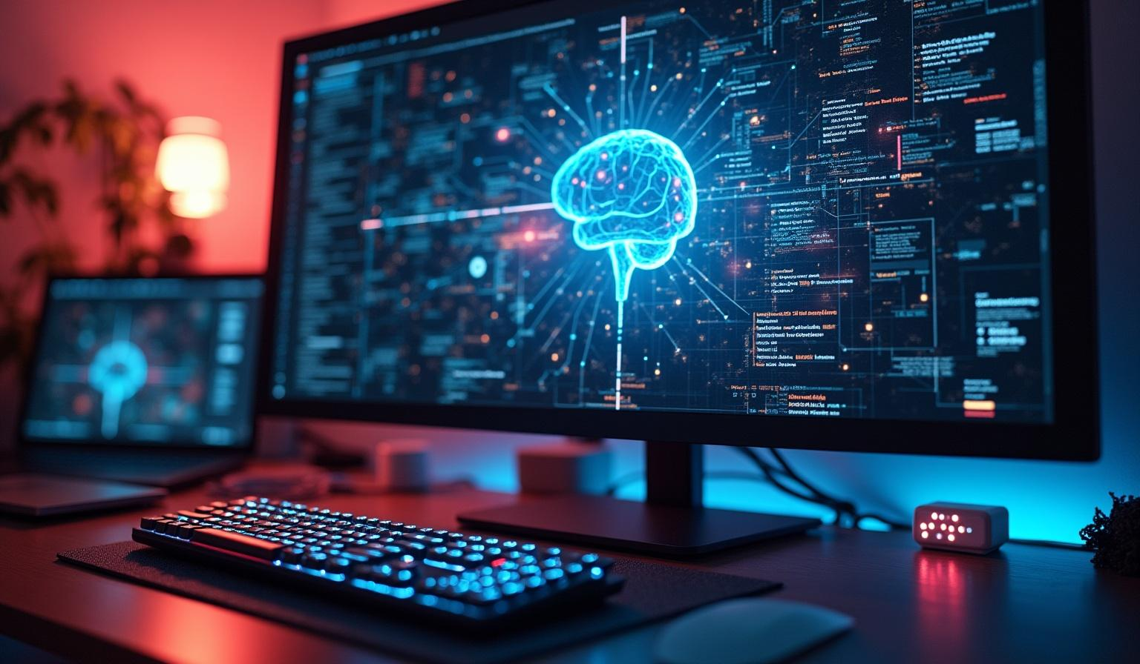
CLIP Overview
01

Slide 4

Problem Statement &
Motivation
Conventional approaches to vision tasks involve fixed labeled datasets that have low adaptation capabilities. The concept of CLIP is based on learning visual concepts using natural language text available on the internet to address this limitation of adaptation capabilities. It eliminates manual labeled datasets for models to understand a wide range of concepts.

Slide 5
Core Idea and Model Architecture
CLIP uses a contrastive learning approach on 400 million image-text pairs to map images and texts into a shared embedding space. It employs two encoders: a ResNet or Vision Transformer for images and a Transformer for text. These encoders enable the model to predict whether a given image and text are related without relying on fixed class labels.

Slide 6
Zero-Shot Transfer and Key Results
CLIP enables zero-shot classification by embedding images and text labels into a shared space, selecting the label with the highest similarity. It achieves competitive performance on over 30 datasets without fine-tuning, outperforming prior models like Visual N-Grams. CLIP also shows superior robustness to distribution shifts and scales effectively with increased compute resources.

Slide 7
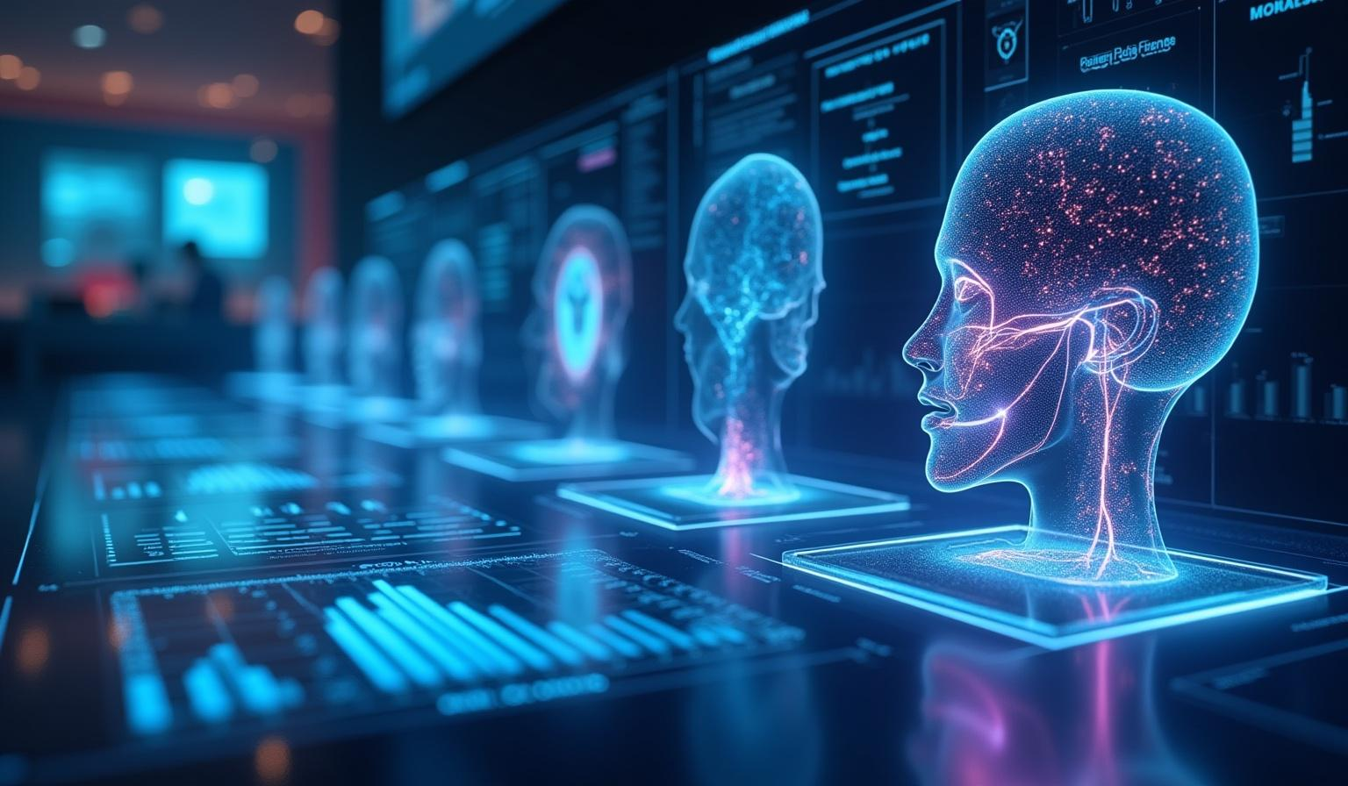
Analysis and Future Work
02

Slide 8
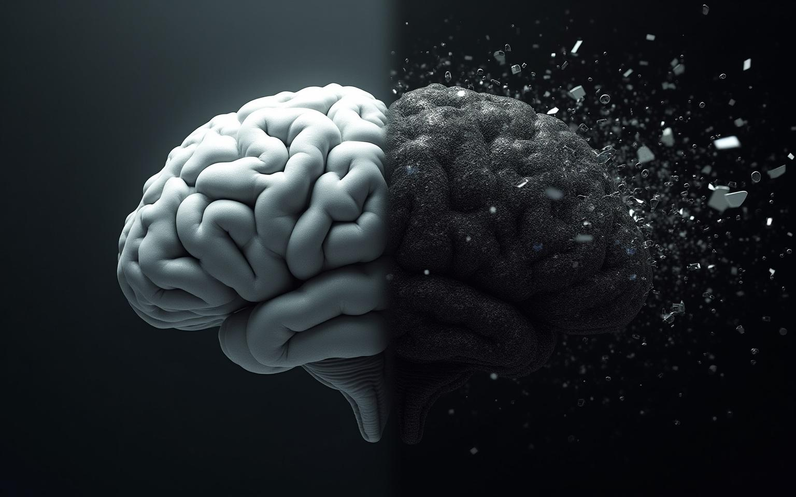
Strengths and
Weaknesses
CLIP’s key strengths include its flexibility, scalability using web data, and strong zero-shot performance across diverse tasks. However, it struggles with fine-grained distinctions and abstract reasoning tasks. It is brittle to out-of-distribution data and requires massive datasets. Additionally, it inherits social biases present in its training data.

Slide 9
Broader Impacts and Ethical Considerations
CLIP’s capabilities raise ethical concerns such as dual-use potential for surveillance and facial recognition. It can amplify social biases, impacting fairness and representation. While lowering barriers for custom classifiers, it also risks misuse. Responsible auditing and deployment guidelines are essential to mitigate these challenges.

Slide 10
Future Directions and Conclusion
Future work includes integrating few-shot learning to improve sample efficiency and incorporating reasoning modules for complex tasks. Debiasing techniques are critical to address social biases. Expanding CLIP to multimodal data and improving computational efficiency are promising avenues to enhance its impact and applicability.

Slide 11

Conclusions
CLIP demonstrates that natural language supervision is a powerful alternative to traditional fixed-label training in vision models. It offers flexible zero-shot transfer capabilities but also exposes challenges in generalization, bias, and robustness. Addressing these issues is vital for advancing responsible and effective AI vision systems.

Slide 12
THANK YOU
DO YOU HAVE ANY QUESTIONS?
youremail@freepik.com
+00 000 000 000
yourwebsite.com
Please keep this slide for attribution

