Slide 1
ATTENDANCE MANAGEMENT
Submitted to:- DR.sarbjeet singh
Submitted by:- Ashishraj Kalkhandey (CO19318)

Slide 2
Objective
Our project name Attendance Management. This project manages attendance of students .Admin can register students and create username & password for student. Student can login, mark attendance of same day & also can see history of attendance
Please note Admin username is : "admin" , password is "admin@2"The main purpose for opting this as our project is its very innovative and interesting in itself and we get to learn a lot of new methods and different styles of coding.

Slide 3
Overview of the
This project manages attendance of students this will record the everyone details everyone have to login there and than teacher marked you attendance you are able to read your attendance this project take input of Y and N. we can also get list of all students with all attendance details.
Y means YES (Present)
N means NO (Absent)

Slide 4
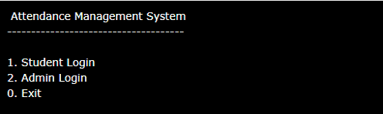
OUTPUT OF ATTENDANCE MANAGEMENT PROJECT
This is directly the output of the project or you can say when we run this project we get this output in first.

Slide 5
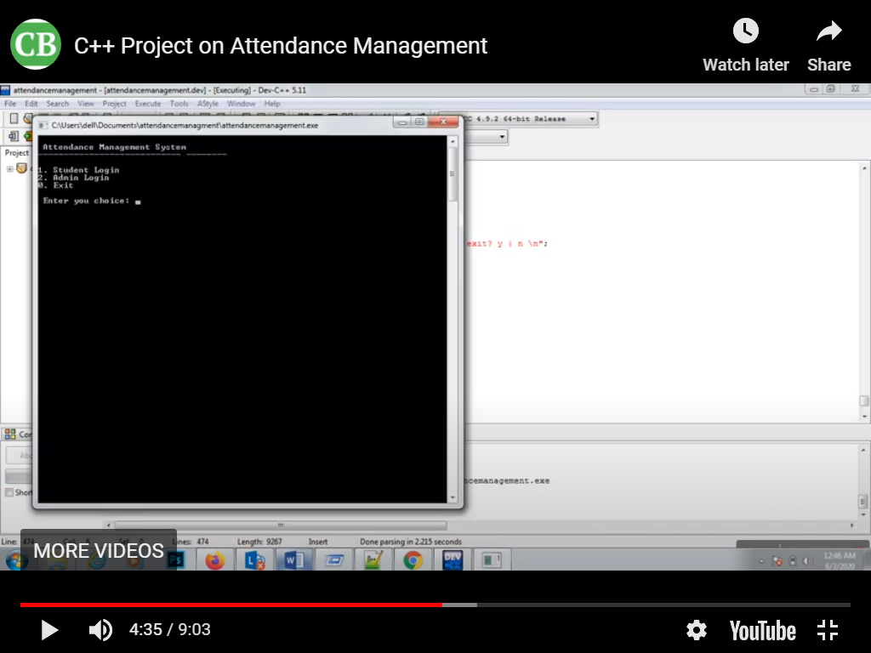

Slide 6
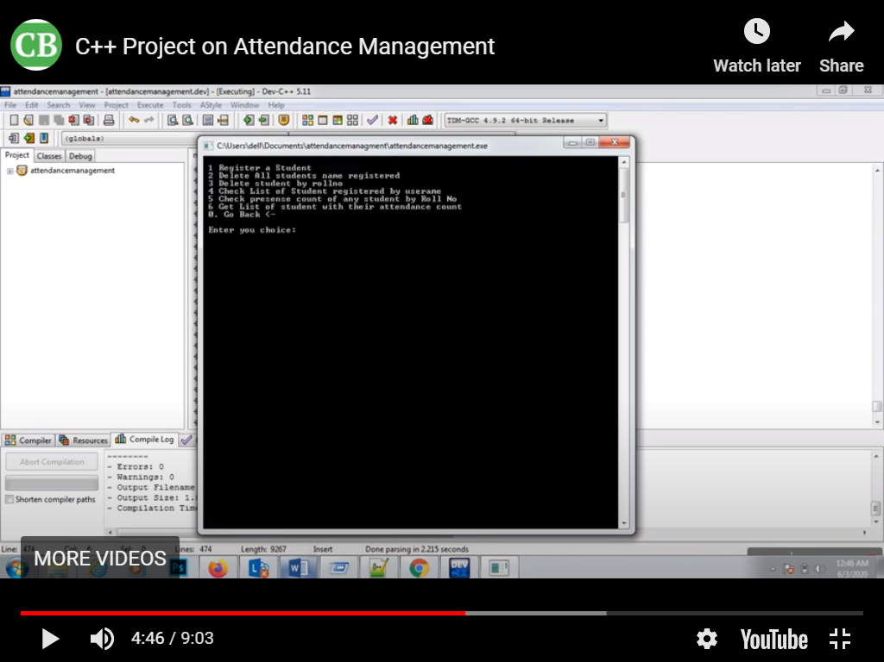
When you are done with your login we get

Slide 7
If we want to enter new student details we have add his/her these details
Name
Username
Password
Roll number
Address
Fathers name
Mothers name

