Slide 1
Latent Factor Models For Collaborative Filtering Based Recommendation Systems
Ashish Rout, Nandeesh KM, Prajakta Borse, Prashant Jadhao, Vinayak Doifode
Indian Institute of Science

Slide 2
Introduction
Recommendation systems are vital tools for personalized suggestions with important role in many industries ranging from e-commerce to entertainment.
Content based filtering involves hand engineering of item features and categorization of user to different item features based on previous feedback. No information about other users are required.
Collaborative filtering involves usage of other users’ data to recommend a product to current user. Features are automatically learned during training.
Matrix factorization based collaborative filtering methods came to prominence during Netflix Prize Challenge.
Recommendation System
Content Based Filtering
Collaborative Filtering
Memory Based
Model Based

Slide 3
PROBLEM STATEMENT
 | Movie 1 | Movie 2 | Movie 3 | Movie 4
User 1 | NaN | 3.2 | NaN | 4.1
User 2 | 2.1 | 4.6 | NaN | NaN
User 3 | 1.9 | NaN | 1.1 | NaN
User 4 | NaN | NaN | 2.8 | 3.9
User 5 | NaN | 4.2 | NaN | NaN
Idea is to predict the ratings for NaN values in this matrix and recommend the movie with high rating to user.
In matrix factorization based latent factor models, both users and items are projected to latent space simultaneously and their similarity in latent space is measured by inner product.
Dataset : MovieLens 100K (943 users, 1682 movies, 1,00,000 ratings)

Slide 4
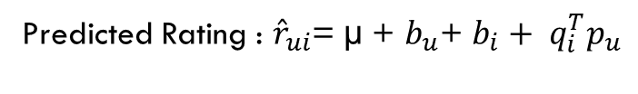
Funk matrix factorization^{[1]}
One of the first and popular matrix factorization technique for recommendation system.
Stochastic Gradient Descent (SGD) was implemented to optimize the loss function.
Predicted Rating : ${\hat{r}}_{ui}$= µ + $b_{u}$+ $b_{i}+ q_{i}^{T}p_{u}$
Loss Function : $L= {{(r}_{ui}−{\hat{r}}_{ui})}^{2}+ λ (b_{i}^{2}+ b_{u}^{2}+{\left|\left|q_{i}\right|\right|}^{2}+ {\left|\left|p_{u}\right|\right|}^{2} )$

Slide 5
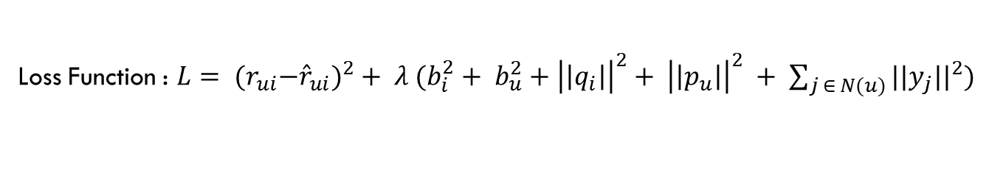
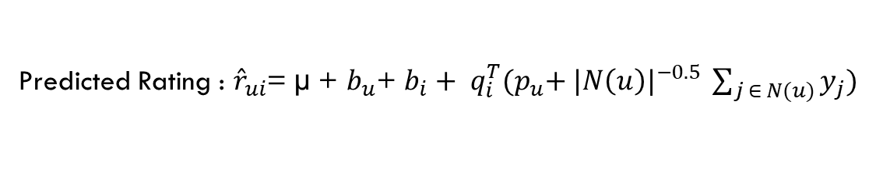
SVD++^{[2]}
Modification of Funk matrix factorization to incorporate implicit feedback.
Stochastic Gradient Descent (SGD) was implemented to optimize the loss function.
Apart from user’s latent factor vector, each user is also characterized by additional implicit item factor vectors in SVD++.
Predicted Rating : ${\hat{r}}_{ui}$= µ + $b_{u}$+ $b_{i}+ q_{i}^{T}{(p}_{u}+ {|N\left(u\right)|}^{−0.5} \sum_{j ∈ N(u)}{y_{j}})$
Loss Function : $L= {{(r}_{ui}−{\hat{r}}_{ui})}^{2}+ λ (b_{i}^{2}+ b_{u}^{2}+{\left|\left|q_{i}\right|\right|}^{2}+ {\left|\left|p_{u}\right|\right|}^{2} + \sum_{j ∈ N(u)}{{{||y}_{j}||}^{2}})$

Slide 6
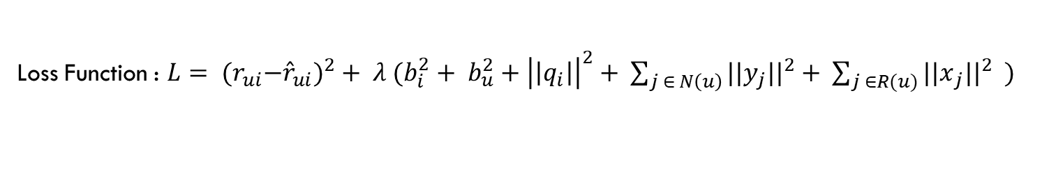
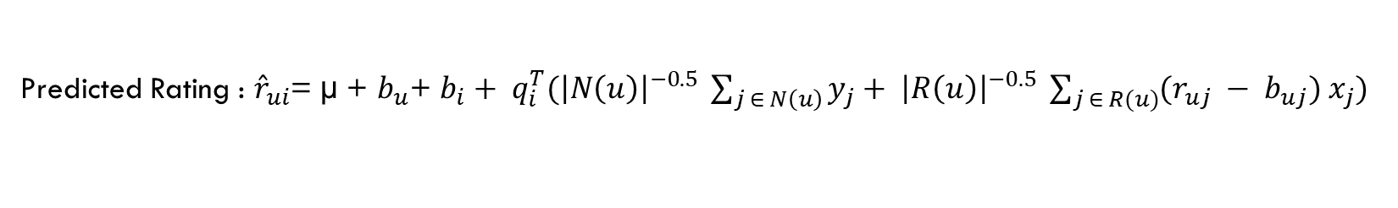
ASYMMETRIC SVD^{[2]}
Modification of Funk matrix factorization to model user with implicit and explicit item factor vectors.
Stochastic Gradient Descent (SGD) was implemented to optimize the loss function.
Typically asymmetric SVD results in a model with fewer parameters, greater explainability and easy integration of new users without the need of retraining.
Predicted Rating : ${\hat{r}}_{ui}$= µ + $b_{u}$+ $b_{i}+ q_{i}^{T}({\left|N\left(u\right)\right|}^{−0.5} \sum_{j ∈ N\left(u\right)}{y_{j}}+ {\left|R\left(u\right)\right|}^{−0.5} \sum_{j ∈ R(u)}{(r_{uj} − b_{uj}) x_{j}})$
Loss Function : $L= {{(r}_{ui}−{\hat{r}}_{ui})}^{2}+ λ (b_{i}^{2}+ b_{u}^{2}+{\left|\left|q_{i}\right|\right|}^{2}+ \sum_{j ∈ N\left(u\right)}{{{||y}_{j}||}^{2}+ \sum_{j ∈R(u)}{{{||x}_{j}||}^{2}}} )$

Slide 7
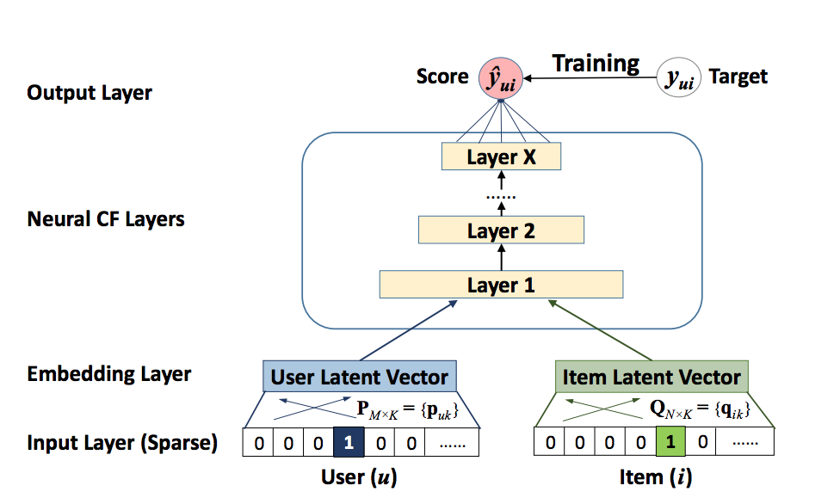
Neural COLLABORATIVE FILTERING^{[3]}

Slide 8
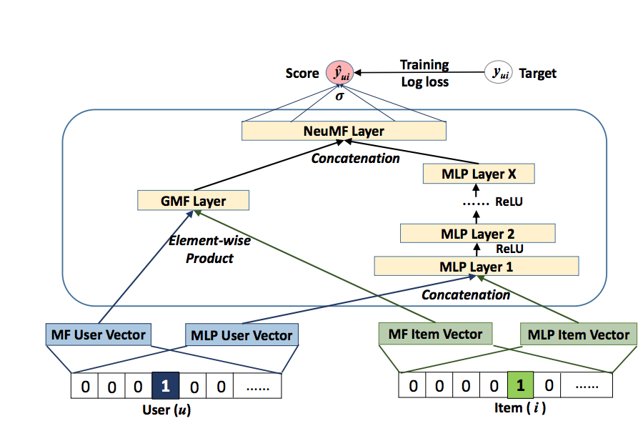
Neural MATRIX factorization^{[3]}

Slide 9
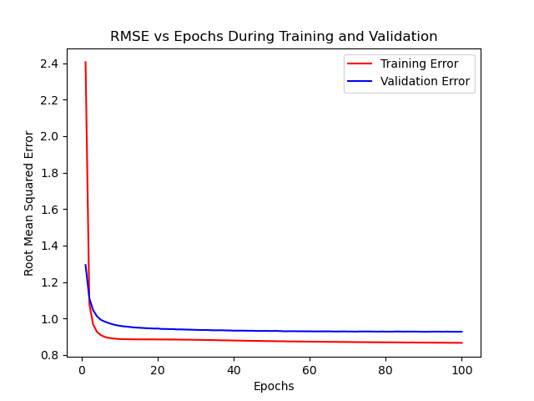
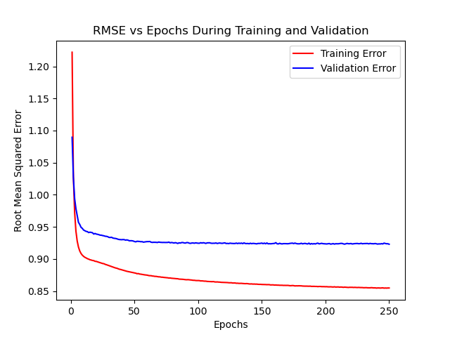
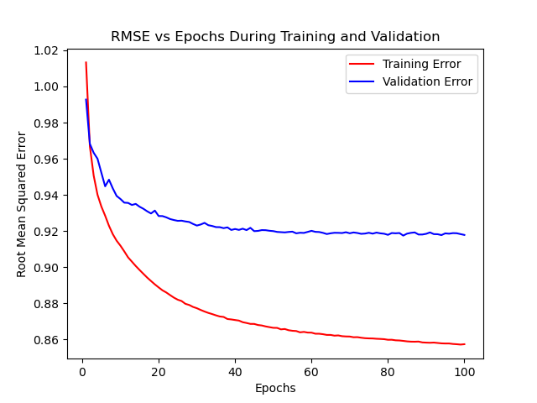
RESULTS
Model | Learning Rate | Regularization Parameter | Number of Factors | Test RMSE
Funk Matrix Factorization | 0.01 | 0.2 | 40 | 0.9253
SVD ++ | 0.01 | 0.2 | 20 | 0.9230
Asymmetric SVD | 0.01 | 0.05 | 40 | 0.9141
Funk Matrix Factorization
SVD++
Asymmetric SVD

Slide 10
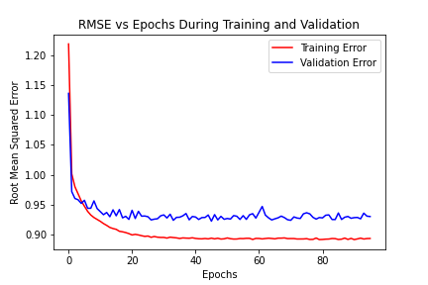
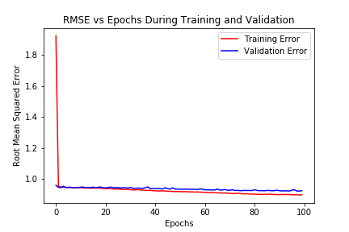
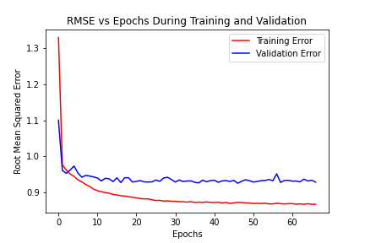
RESULTS
Sl. No. | Learning Rate | Regularization Parameter | Dropout | Batch Size | Test RMSE
1 | 0.001 | 0.005 | 0.2 | 128 | 0.9239
2 | 0.001 | 0.005 | 0.05 | 512 | 0.9238
3 | 0.001 | 0.005 | 0.05 | 128 | 0.9282
NMF Model 1
NMF Model 2
NMF Model 3

Slide 11
SAMPLE Recommendation
Highly Rated Films By User | Genre
The Empire Strikes Back | Science Fiction
Angel Baby | Romance / Drama
Clear and Present Danger | Action / Thriller
Braveheart | Historical / Drama
Dirty Dancing | Romance / Drama
Mr. Holland’s Opus | Drama
Miracle on 34th Street | Christmas Comedy
Recommended Movies | Genre
Star Wars | Science Fiction
Titanic | Romance / Drama
Raiders of the Lost Ark | Action
Schindler’s List | Historical
A Little Princess | Family / Drama
The Shawshank Redemption | Drama
It’s a Wonderful Life | Christmas Comedy
Recommendation System

Slide 12
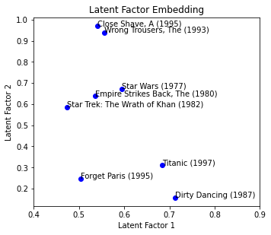
LATENT FACTOR EMBEDDING

Slide 13


FAST INFLUENCE ANALYSIS^{[4]}
Explainability of recommendation is crucial for building user’s trust.
Fast Influence Analysis (FIA) is a technique to explain the effect of training data points on output recommendation.
FIA decouples interpretation stage from prediction stage, hence doesn’t suffer from accuracy-interpretation trade-off.
$$INFL\left(z, x_{t}\right)= \hat{y}(x_{t}, \hat{θ})− \hat{y}(x_{t}, {\hat{θ}}_{−z})$$
$$INFL\left(z, x_{t}\right)=−\frac{1}{n^{′}} {∇_{θ_{t}}L\left(z, \hat{θ}\right)}^{T}H_{θ_{t}}^{−1}∇_{θ_{t}}\hat{y}\left(x_{t}, \hat{θ}\right)$$

Slide 14
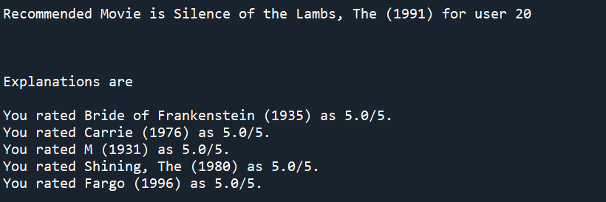
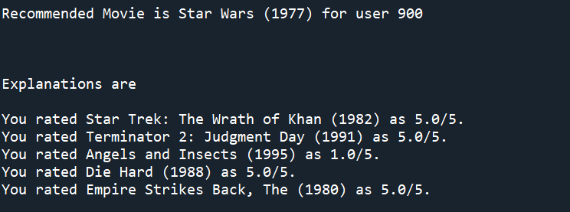
SAMPLE EXPLANATION

Slide 15
CONCLUSION
Recommendation system plays a vital role in modern e-commerce and entertainment industries.
Latent Factor Models are a subclass of Collaborative Filtering techniques based on matrix factorization.
Both traditional techniques such as Funk SVD, SVD++, Asymmetric SVD and neural network based methods were implemented in this work and performance comparison was made.
Despite the simplicity of traditional techniques, it was empirically observed that Asymmetric SVD performed best on this dataset.
To incorporate interpretability into the recommendation system, Fast Influence Analysis was implemented.
The results suggest that we can obtain perceptually good recommendations through the use of this system.

Slide 16
REFERENCES
Simon Funk, “Netflix Update: Try This at Home”, December 2006.
Yehuda Koren, “Factorization Meets the Neighborhood: A Multifaceted Collaborative Filtering Model”, Proceedings of the 14th ACM SIGKDD International Conference on Knowledge Discovery and Data Mining, ACM Press, 2008, pp. 426 – 434.
Xiangnan He et al, “Neural Collaborative Filtering”, Proceedings of the 26th International Conference on World Wide Web (WWW '17), 2017, pp. 173–182.
Weiyu Cheng et al, “Incorporating Interpretability into Latent Factor Models via Fast Influence Analysis”, KDD '19: Proceedings of the 25th ACM SIGKDD International Conference on Knowledge Discovery & Data Mining, 2019, pp. 885 – 893.

Slide 17
Contributions
Name | Contribution
Ashish Rout | Implementation of models, Hyperparameter Tuning, Report Writing
Nandeesh K M | Code Improvement, Hyperparameter Tuning, Report Writing
Prajakta Borse | Hyperparameter Tuning, Report Writing
Prashant Jadhao | Hyperparameter Tuning (Left the Course !!!)
Vinayak Doifode | Hyperparameter Tuning, Building Presentation

