Slide 1
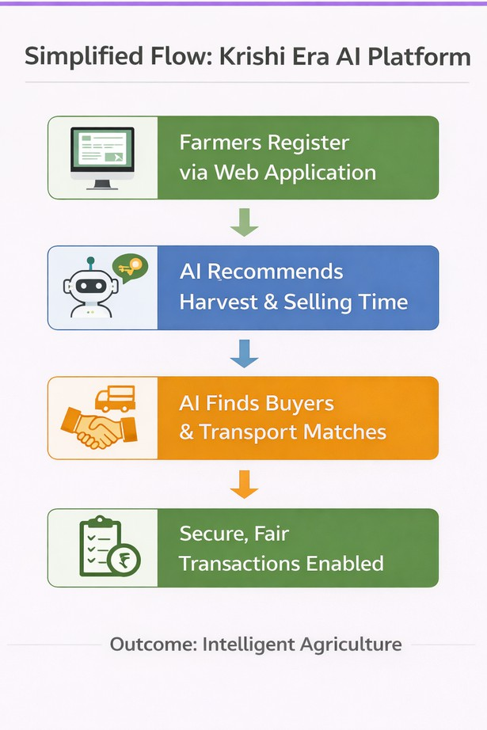
Brief about the Idea:
Krishi Era AI : An AI Orchestrated Rural Resource & Market Intelligence Platform
It is is an end-to-end, AI-powered web applicationthat transforms how agricultural resources are planned, how produce is sold, and how rural livelihoods are enabled without owning farms, trucks, or warehouses. We do not own the supply chain, we make the supply chain intelligent.
What Krishi Era AI Does
Optimizes resource utilization for farmers using weather, harvest, storage, and timing intelligence
Enables fair, data-driven price discovery across markets
Connects farmers, buyers, transporters, and storage providers as independent participants Reduces wastage, stabilizes farmer income, and creates new rural employment opportunities
Core Principle
Krishi Era AI functions as a neutral intelligence layer, clearly separating farmers, buyers, logistics partners, and storage providers while AI orchestrates decisions and coordination across the ecosystem.

Slide 2
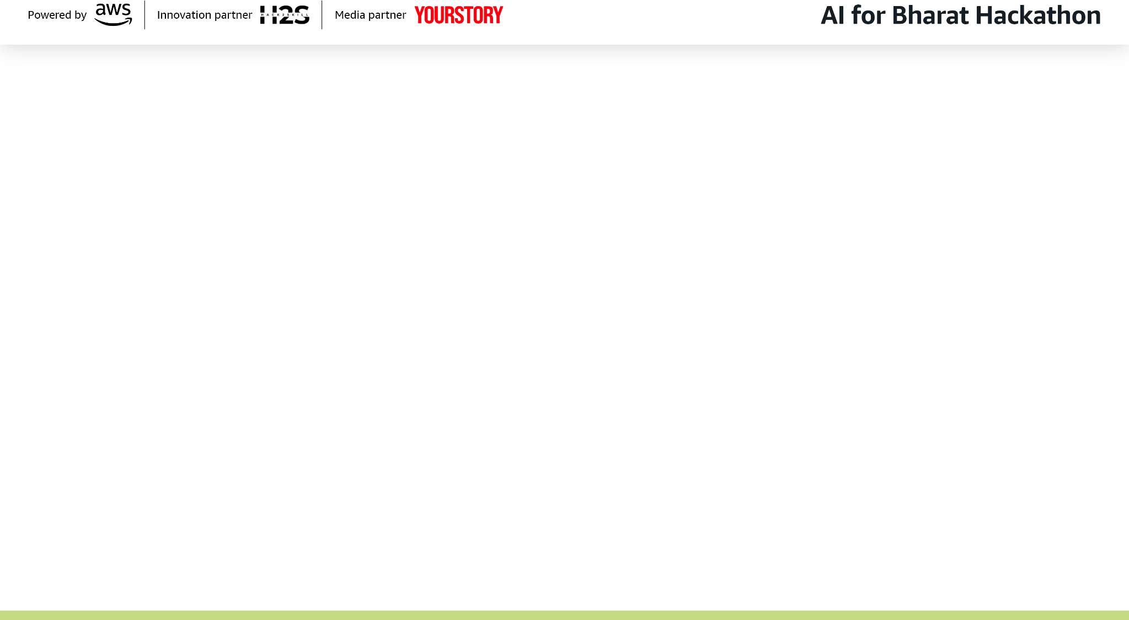
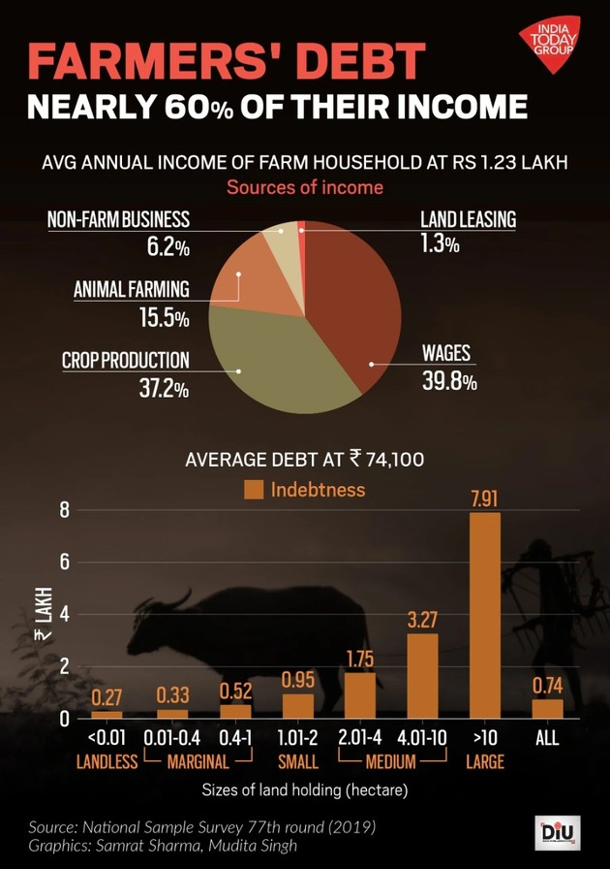
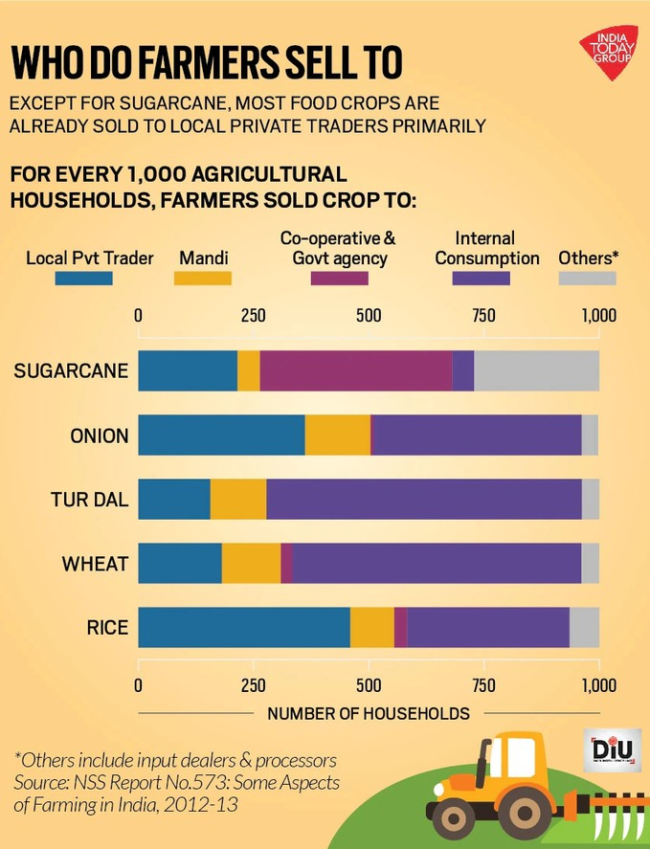
Problem Data:
Issue | Reality in India
Post-harvest loss | ₹92,000+ crore annually (ICAR estimates)
Resource & input misuse | Over-application due to poor planning
Price volatility | 30–50% seasonal swings among perishables
Farmer income instability | 85% farmers are small & marginal
Rural underemployment | Logistics & aggregation handled by few intermediaries
Income and Debt Study
Selling Patterns

Slide 3
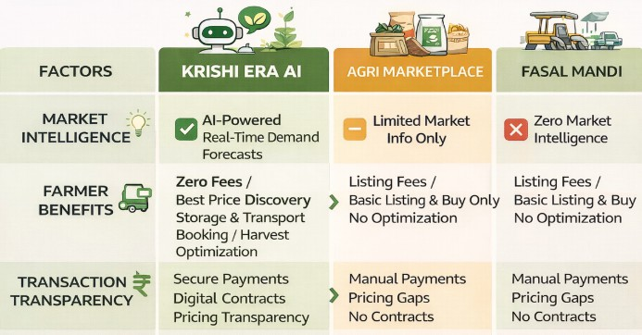
Solution:
Problem (India) | AI Intervention | Measurable Impact
30–50% price volatility | AI price & demand forecasting | 8–12% income uplift
₹92,000+ Cr post-harvest loss | Demand-aligned selling & storage intelligence | 10–15% waste reduction
No quality premiums | AI-based grading + negotiation | 5–8% price premium
Rural underemployment | Onboarding transport & liaison partners | New local gig jobs
USP Element | Why It Matters
AI Market Maker | Not just connecting buyers & sellers—AI coordinates decisions
Intent-Based Matching | Reduces overproduction & panic selling
End-to-End Orchestration | Resource planning → selling → compliance
Asset-Light Model | Scalable & realistic
Data Transparency | Breaks information monopoly
Inclusive Design | Voice-first, local language

Slide 4
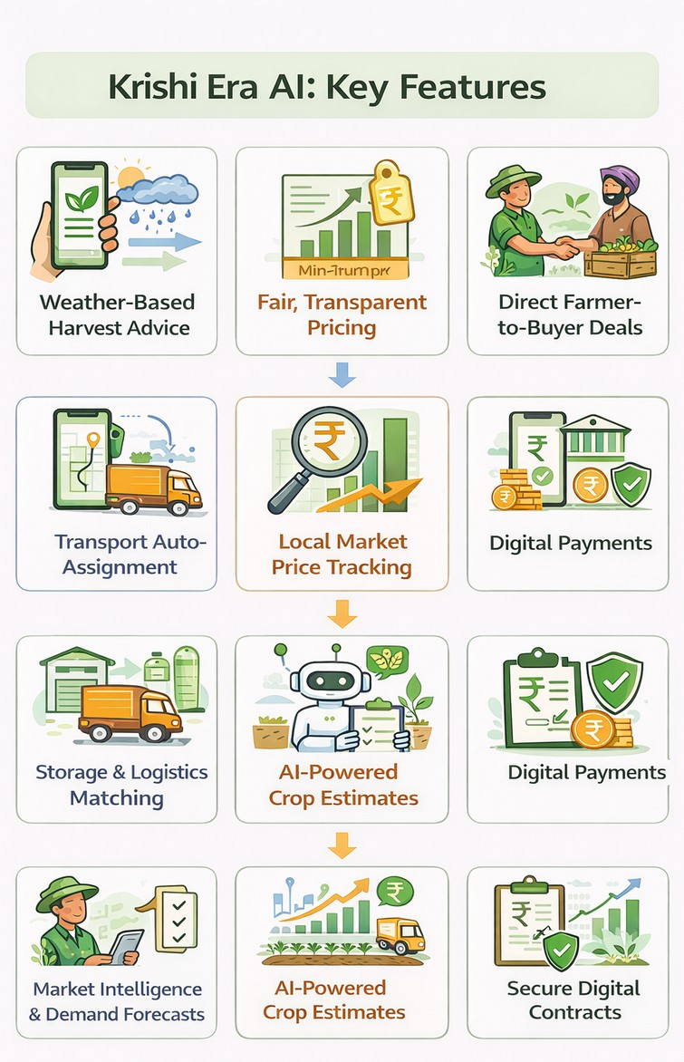
List of features offered by the solution
Krushi Aera AI offers an AI-orchestrated, end-to-end solution that improves resource efficiency, market access, and rural livelihoods without owning physical infrastructure.
Smart Resource & Harvest Planning
AI recommends the best time to harvest, store, or sell to reduce waste and water/input misuse AI Marketplace & Fair Price Discovery
Farmers and buyers list availability and demand; AI predicts transparent price ranges using market intelligence.
AI-Assisted Negotiation
Multi-factor AI optimisation (price, quality, timing) gives small farmers institutional-level bargaining power.
Quality Grading & Premium Mapping
quality grading ensures high-quality produce earns fair premiums.
Cold Storage & Logistics Intelligence
AI suggests storage or transport options only when economically viable—logistics is integrated, not owned.
Ecosystem Partner Enablement
Local transporters and rural liaisons are onboarded as independent service partners, creating employment.
Compliance & Secure Payments
Auto-generated contracts, GST/FSSAI documents, and escrow-based payments ensure trust and transparency.

Slide 5
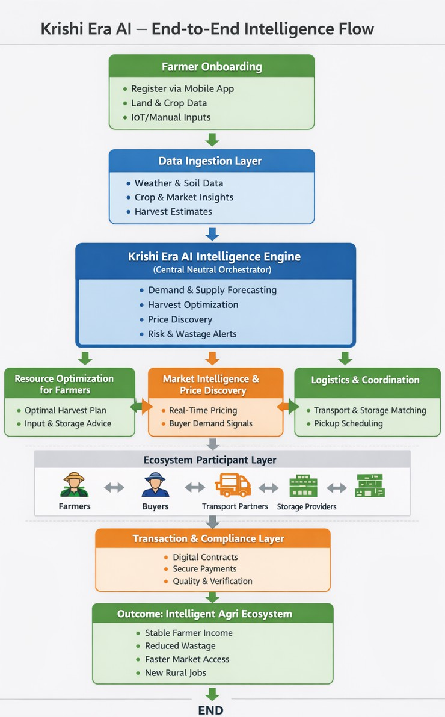
Process flow diagram or Use-case diagram
Case | Crop & Scenario | Problem Today | Krushi Era AI Intervention | Outcome & Impact
Case 1 | Tomato – Excess Production | Prices crash to ₹3– ₹5/kg; distress sales and wastage | AI detects regional oversupply, recommends bulk buyers (processors, | Farmer sells at ₹7– ₹9/kg, wastage reduced, buyers secure bulk supply at
Case 2 | Onion – Right Timing | Farmers sell immediately, missing short-term price spikes | AI predicts 7–10 day price uptick, advises delayed sale (no storage), matches | +12–18% price gain, no storage cost, no change in farmer operations
Case 3 | Turmeric – Excess + Storage + Export | Quality produce sold at average mandi price; export premium lost | AI grades quality, predicts export demand window, recommends | 25–30% higher farmer income, traceable supply for exporter, service

Slide 6
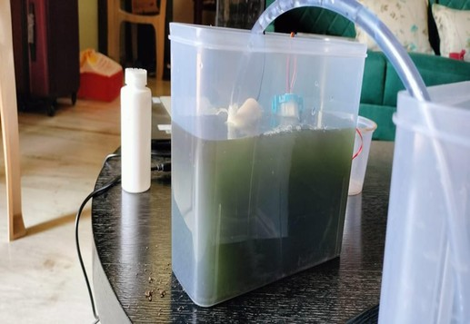

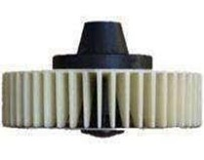
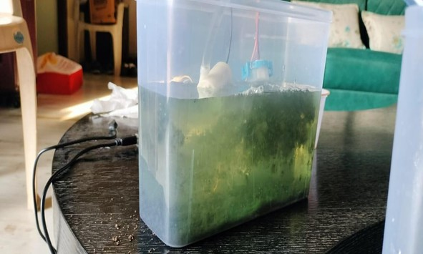
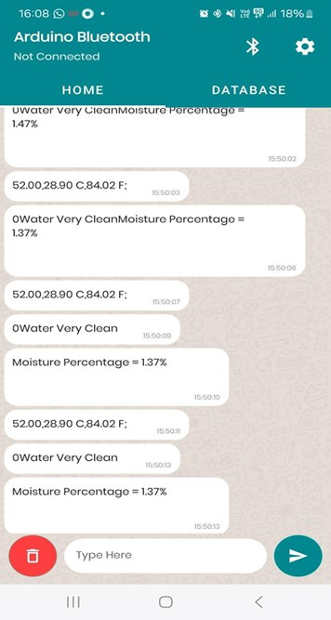

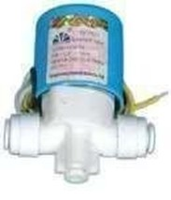
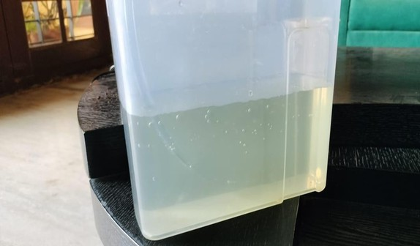

Architecture diagram
Sensor
Aerator
Maturation
Once the primary tank has reached its capacity, algae is added and the tank undergoes aeration to initiate the process of biosorption.
Protein Biosynthesis
After a stipulated time all the impurities are absorbed by the algae by biosorption and settle at the bottom of the tank.
Titanium Dioxide valve filter
Purification
The clean water is then passed through a Titanium dioxide filter into the secondary tank which is ready for usage.
App Monitor

Slide 7
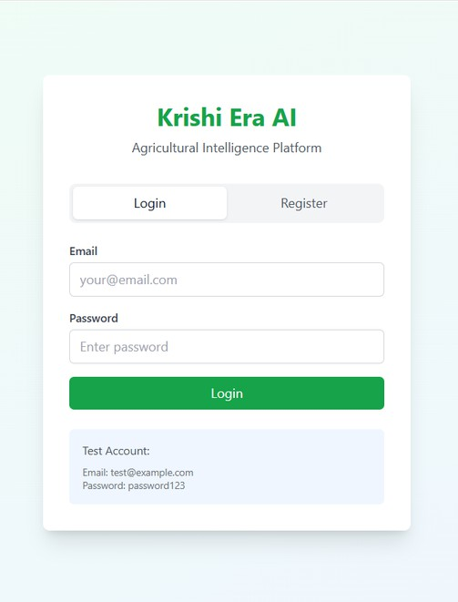
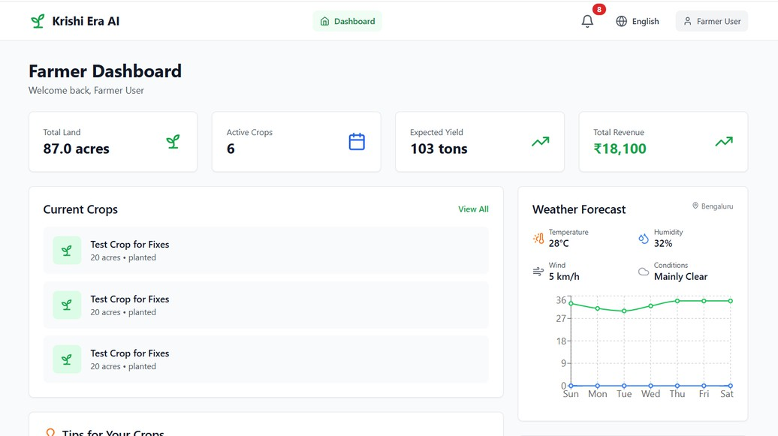
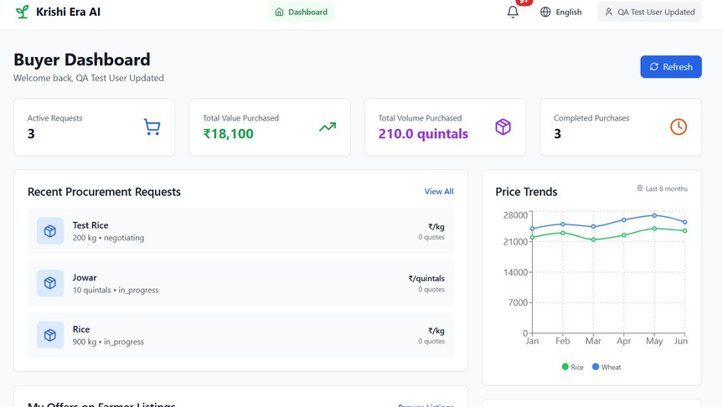
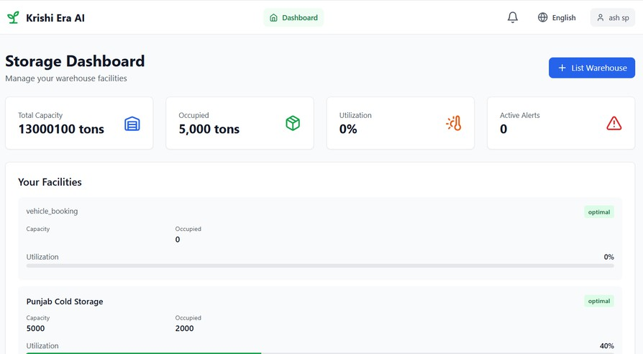
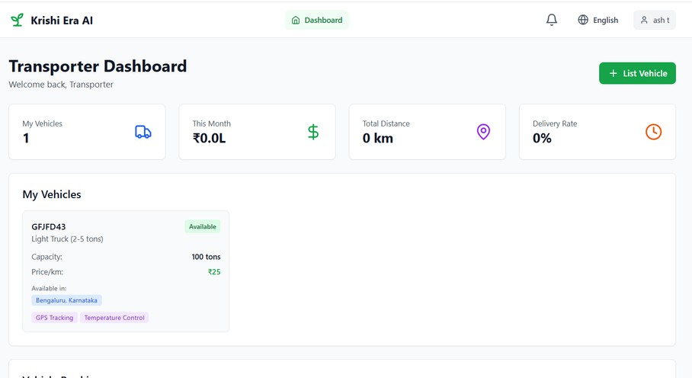
Snapshots of the prototype:

Slide 8

Technology and Business Model
Technology Stack (MVP)
Frontend: React-based web application hosted on AWS Amplify, designed with a simple, voice-first interface for easy farmer adoption
Backend: Node.js REST APIs containerized and deployed on AWS ECS Fargate, managing user onboarding, crop listings, negotiations, and transactions
AI & Intelligence: Time-series models for price and demand forecasting, AI-assisted buyer and transport matching, and LLM-powered summaries and digital contracts using AWS Bedrock, Claude 3.5 Sonnet
Database: Amazon DynamoDB storing user profiles, crop data, marketplace listings, and transaction records
Business Model: Razor Blade
20
15
10
5
0
Item 1
Item 2
Item 3
Item 4
Bootstrapped
50,000/- INR
The Razor
Tank and sensor Installation
The Blade
Algae and App Subscription
Intellectual Property
Algae culture

Slide 9




Revenue Growth: 20% - 30% YoY
12000000
Break Even: 1 year 4 months
Unit Economics:
Packaging Cleaning agent Algae Gross Margin
10000000
8000000
6000000
Packaging 40.6%
Gross Margin 49.5%
4000000
2000000
Manufacturing Cost
Cleaning agent 7.9%
0
Tank cost: 60 Rs/kg(Domestic: 600,Industrial: 6000)
Sensors: 350Rs
Microcontroller: 600Rs
Mesh Valve: 150Rs
Aerator: 350 Rs
Algae cost: 400 Rs/kg (1kg can filter 50 litres)
Packaging cost: 50Rs
-2000000
-200000
150000 500000 1000000 2500000

Slide 10
















Road Map: Business model: Razor Blade Subscription
20
15
10
5
0
Item 1 Item 2 Item 3 Item 4
Dynamic Pricing
Farmers will have dynamic pricing, only large quantities are charged
Govt & Industrial Testimonials
Live Demos and Authentication
Incorporate
CFTRI and Bulk Vendors
Transaction-Based Fee (Razor Blade)
improvements in Cloud and AI setup for optimization
(Only when value is delivered)
Who pays: Buyers / processors / bulk vendors: ₹0.5–1.5 per kg OR
0.5–2% per transaction (capped)
Product Pilot Feb 2026
Modification for Beta MVP Mar 2026
Apply under Pradhan Mantri Krishi Sinchayee Yojana govt subsidies
Expand demography through key distributors

