Slide 1

A project on development of Video chatting website

Slide 2
Project members and project guiide
Project Members
Avish S K Information Science and Engineering ,7th sem ,NMAMIT, Nitte
Ashish Salian Information Science and Engineering ,7th sem ,NMAMIT, Nitte
Project Guide
Exposys data labs

Slide 3
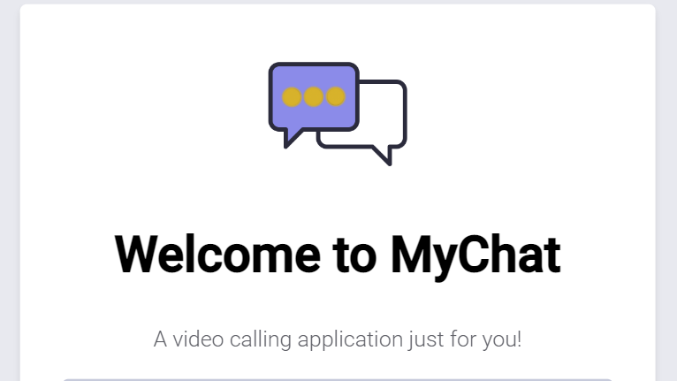
contents
Introduction
Objective
Features
Details of the product
Conclusion

Slide 4
introduction
Build a video calling website with Django and the Agora Video Web SDK. This project will include the following features: Group and peer to peer video calling, full controls such as muting your mic, turning your camera off and displaying usernames.
We used Django and the Agora Video Web SDK.
Django is a high-level Python web framework that enables rapid development of secure and maintainable website .
Agora Web SDK provides a JavaScript and Typescript library. Powered by WebRTC, it enables you to establish and manage audio and video communications or live broadcast services from a web browser

Slide 5
objective
To fulfill the requirements of the internship program i.e. develop a e-commerce website.
To acquire more knowledge related to web development.
To gain experience in the field of web development.
To use this knowledge in the future in order to create more works.

Slide 6
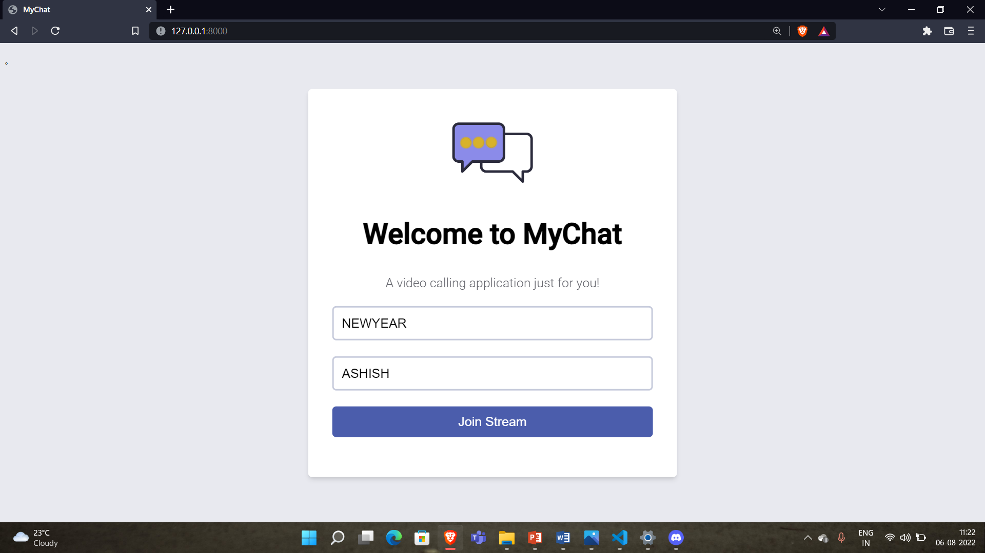
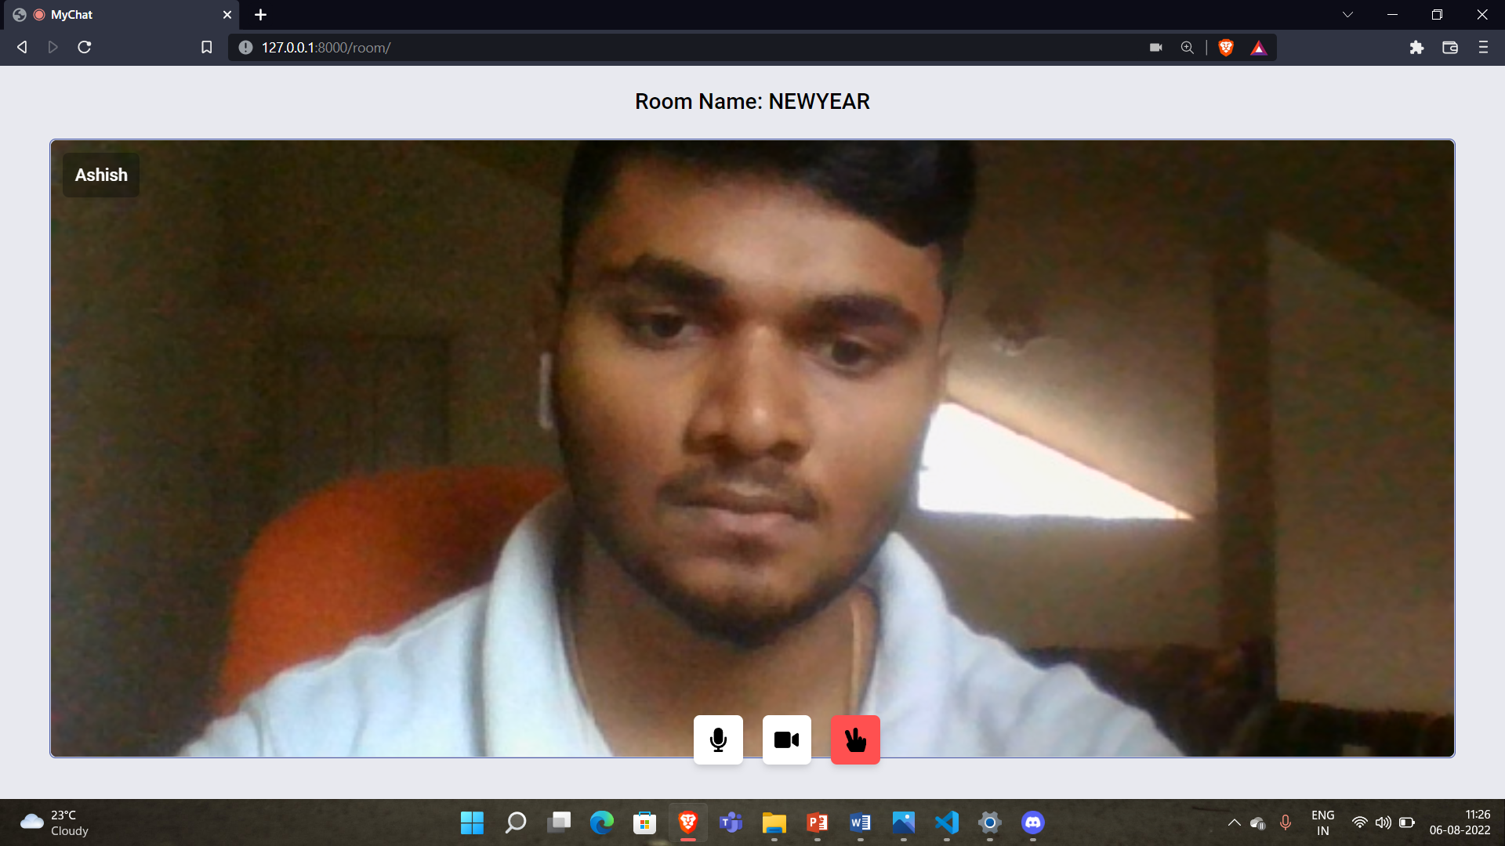
Features and benefits
Features
Multiple Webcam Capabilities
Admin has the authority to add or delete a participant
High quality video and audio
Benefits
More Engaging than Audio Conferencing
More Efficient
Saves money on travelling

Slide 7
Details of the project
Topic: Video Chatting Website.
Languages used: CSS , django and javascripts.
The name of our website is MyChat.
When we open the website, the login page will be opened as default.

Slide 8
conclusion
This application helps in connecting people at just one click.
It is user friendly.

Slide 9
Thank you

