Slide 1
Onion Quality Grading
from a single phone photograph
Detection · Onion gate · Segmentation · Per-onion measurement · AGMARK grade
98.3%
0.998
4
balanced accuracy
detection recall
models in the pipeline
538 hand-labelled onions,
cross-validated by photo
537 of 538 onions found
two trained by us,
two off the shelf
Ashi · September 2026
Notes:
One line: you photograph onions with a normal phone, and the system grades every onion in the photo — how much of its surface is damaged, whether it is sound, and its AGMARK band. 98.3% is balanced accuracy on 538 onions we labelled one by one, cross-validated by photograph.

Slide 2
The problem
Why grading onions from a photograph is harder than it looks
Inconsistent
What the grade must contain
1
Two human graders agreed with each other at only k = 0.701 on the same 120 onions. The same grader repeating herself: 0.852.
Extra Class
no visible defect
Class I
Not a label — an area
up to 1/5 of surface
2
The statutory grade is defined by the fraction of the surface that is damaged (one-fifth, one-half). A model that outputs "rotten" cannot produce that number.
Class II
1/5 to 1/2 of surface
Below minimum
over 1/2 of surface
A photo has no scale
3
A small onion near the lens is pixel-identical to a large one far away. Millimetres cannot be recovered without a reference object.
Plus: firmness, dryness, smell — invisible in a photograph, so every output says "provisional".
Notes:
Three difficulties. Humans do not agree with each other. The grade is an area, not a class. And a photograph carries no absolute scale — that is geometry, not a modelling gap.

Slide 3
Where the literature stops
Six gaps that are common to published onion-grading work
1
Grade is never measured
2
Evaluation can leak
3
Input is assumed valid
Papers output a class label. The statutory grade is defined by damaged SURFACE AREA, which a label cannot express.
Random 80/20 splits on datasets whose images are repeated views of the same physical onion inflate the reported accuracy.
A binary model must answer "healthy" or "unhealthy" for a hand, a potato or a face. No paper reports what happens on a wrong input.
4
Domain shift is only noted
5
Millimetres without a reference
6
Shortcuts go untested
Accuracy drops on a new camera or a new line are reported in the discussion, never detected by the system while it runs.
Size is claimed from a single photograph, in which absolute scale simply is not present.
Studio images on plain backgrounds let a network learn the background instead of the onion; nobody tests for it.
The three most recent onion-grading papers show all six of these concretely — next slide
Notes:
Do not list our solutions here — that is two slides later. State the six gaps, then show them in the actual papers. The two that matter most in a viva are the first two: measurement instead of classification, and an evaluation protocol that cannot leak. Supporting literature: Geirhos on shortcut learning, Kapoor and Narayanan on leakage.

Slide 4
What recent work does
The three newest onion-grading papers — strong results, and the gap each one leaves
P1
Jajur & Siddamallappa
P2
Suryawanshi et al.
P3
Song, Buayai, Makino & Mao
ICTACT IJIVP 16(3), 2026
IEEE ICONAT 2025
Smart Agricultural Technology 11, 2025
Custom CNN vs MobileNetV2 / VGG16 / ResNet50. Whole image in, one label out: healthy or unhealthy.
Conveyor, 2 proximity sensors, PLC, 4-DOF robotic arm with vacuum gripper. YOLOv8 detects, CNN sorts Good / Bad.
Student-teacher anomaly detection trained on normal onions only, plus an air-jet ejector on an industrial roller line.
98.33% own dataset
72.35% on Onion-det
mAP 85.5%
precision 78.4% · recall 80.0%
97.02% test set
86.37% real line (2,236 onions)
Leaves open
Leaves open
Leaves open
No per-onion output, no damaged area, 80/20 random split — and their own accuracy collapses on a second dataset.
Needs a factory line. Claims size and shape but gives no scale or size result; 1 in 5 "bad" calls is wrong.
Accept / reject only, no grade. On the live line it rejected 281 of 2,099 good onions — 13.4% of the crop.
All three answer "is this onion bad?" None answers "how bad, over how much of the surface, and can I see why?"
Notes:
Keep this short in the talk. P1 classifies an image. P2 builds the machine but not the measurement. P3 is the strongest — real factory validation on 2,236 onions — but it is still accept/reject, and it threw away 13.4% of good onions. Be fair if asked: P3 validated on a bigger, harder setting than we did, and their train-on-normal-onions-only idea is something we would like to adopt.

Slide 5
What we solved that they did not
One answer for every gap on the previous two slides, with its measurement
1
A statutory grade, not a label
2
Evidence with every number
3
A whole heap, with no hardware
We output the damaged surface fraction per onion and map it to the AGMARK bands (1/5, 1/2), plus size in mm from a coin. None of the three papers produces an area at all.
Each onion comes with three pictures: the crop, the boundary measured over, and the pixels counted as damage. Their evidence is a confusion matrix or a pass/fail table.
2-15 onions graded per hand-held phone photo, 1.3 s on a CPU. P2 and P3 need a conveyor, PLC and ejector; P1 needs one image per onion.
4
It checks the input is an onion
5
It knows when not to answer
6
It stops throwing away good onions
Not-Onion class + context re-score + face detector + photo refusal: 0 objects graded across 50 non-onion images. None of the three papers tests what happens on a wrong input.
BORDERLINE band 0.3-0.7: 0 of 538 in-domain onions, but 19 of 126 on a new phone. P1 drops 98.33% to 72.35% and P3 97.02% to 86.37% while still sounding confident.
v5 wrongly rejects 3 of 340 sound onions (0.9%). P3, on its production line, rejected 281 of 2,099 (13.4%) — that loss is paid by the farmer.
Honest caveat: these figures come from different test sets, so they are not a like-for-like accuracy race. What IS comparable is what each system outputs, what it does with a doubtful input, and how it was validated.
Notes:
This is the slide to linger on. Six claims, each with a number. If an examiner pushes on the last one, say plainly: their 13.4% is measured on a live industrial line and our 0.9% on tray photographs, so the settings differ — but the false-rejection problem is real and it is exactly what our v5 retrain fixed, from 47 of 340 down to 3 of 340.

Slide 6
The pipeline
Five stages; only the first three use a neural network
1
2
3
4
5
Detect
Verify
Segment
Measure
Grade
YOLO26-m finds
onion boxes
EfficientNet-B0
is this an onion?
MobileSAM makes
a pixel mask
dull + dark pixels
inside the mask
AGMARK band +
health verdict
conf 0.25 · 960 px
reject at p >= 0.8
prompted by the box
isotonic calibration
with confidence
Two independent opinions, reconciled
Three outcomes, not two
Verdict comes from the CNN — 98.3% accurate on hand-labelled onions
Grade comes from the measured area — the statutory definition
They are made consistent, so "HEALTHY + Below minimum" is impossible
If they disagree, the onion is flagged "check by eye" instead of hidden
HEALTHY
p(unhealthy) < 0.3
BORDERLINE
0.3 – 0.7 · check by hand
UNHEALTHY
p(unhealthy) >= 0.7
On familiar photos 0 of 538 onions landed in the borderline band; on a new camera, 19 of 126 did.
Notes:
Walk left to right. Stress that everything after segmentation is deterministic arithmetic — that is what makes the number checkable. The borderline state is measured, not invented: on familiar data it never fires.

Slide 7
Models used, and why
Two trained by us, two used as they ship
YOLO26-m
Trained by us
EfficientNet-B0
Trained by us (v5)
21.77 M params · 1 class
4.01 M params · 3 classes
Current Ultralytics generation: NMS-free end-to-end head, DFL removed, STAL improves label coverage for small objects — a tray photo is many small objects.
Best accuracy per parameter in its class. One forward pass answers both "is this an onion?" and "is it sound?". Runs on CPU inside the app.
MobileSAM
Used as shipped
YuNet
Off the shelf
10.14 M params
~0.08 M params
Class-agnostic, prompted with the detector box. Gives an exact boundary with ZERO segmentation annotation — a U-Net would need thousands of hand-drawn masks.
The classifier once scored a vendor’s face only 12% "not onion". A detector built for faces scores them 0.88–0.92.
Total ~36 M parameters, ~100 MB of weights. No cloud API, no per-image cost: 1.3 s per photograph on a 16-core CPU, 4.7 s on 2 cores.
Notes:
Why CNN at all: we built the classical colour-threshold rule first and measured it — 83% against 93% for the CNN on the same onions. Why B0 and not ResNet-50 or ViT: accuracy per parameter, and it must run on a laptop CPU.

Slide 8
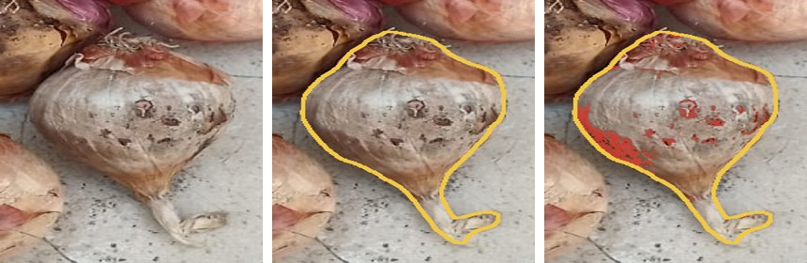
How the grade is measured
The number comes with a picture of the pixels it was computed over
Why this matters
If the outline is wrong, you can see it.
If the red pixels are shadow rather than rot, you can see that too.
The grade is auditable, not a black-box claim — which is exactly what a grading standard needs.
as photographed
the boundary it measured over
the pixels counted as damage
Also reported per onion
damaged pixels ÷ onion pixels → isotonic map → AGMARK band
confidence — distance to the nearest grade line
anomaly score — a different KIND of damage
size in mm + AGMARK code, with a coin in frame
relative size and rank — always exact
A pixel is damage if it is dull AND dark AND inside the mask
The denominator is the onion’s own pixels, never the box — so background and neighbouring onions cannot enter
A 27-point monotone map converts "what the rule flagged" into "what a person would call damaged"
Notes:
This slide answers "how do I know your number is right". Show the three images: the crop, the measured boundary, and the pixels counted in red. The same array that produces the percentage paints the overlay, so the picture cannot disagree with the number.

Slide 9
Training, and honest evaluation
The protocol matters more than the architecture
How the classifier was trained
How it was tested
EfficientNet-B0 from ImageNet, head → 3 classes
AdamW 3e-4, OneCycleLR, label smoothing 0.1, batch 64, AMP
Balanced sampling per class AND per photo type
Background swapped 50% of the time — kills the "soil = rotten" shortcut
Three data sources at once; free Kaggle GPU, ~1 hour
538 onions labelled one by one, from a different camera
Split by SESSION, then 5-fold cross-validation by PHOTOGRAPH
Threshold tuned nested — on the other folds only
The old model scored on exactly the same crops
A random split would have inflated every number we report
The protocol caught our own mistake
Version v4 reached 99.6% validation F1 and 100% on its own held-out split — and we threw it away, because on the independent hand-labelled set it scored 81.1%, worse than the model it was meant to replace. v5 trains on all three sources at once and scores 98.3% cross-validated.
86.1%
81.1%
98.3%
v3 old
v4 rejected
v5 shipped
Notes:
If you remember one thing from this slide: we rejected our own best-validating model because an honest test set said it was worse. That is the difference between a validation number and a generalisation claim.

Slide 10
Results
Every number measured on onions the model never trained on
What changed
Rotten caught: 180 → 193 of 198
Sound wrongly rejected: 47 → 3 of 340 — the old model was costing farmers good onions
Second dataset (VegQual, held out): 97.2% → 98.8%
Non-onion objects graded, 50 test images: 11 → 0
0.819
0.998
1.3 s
0 / 538
agreement with a human grader (quadratic k)
detection recall
per photograph, CPU
borderline cases in domain
two humans agree at 0.701
537 of 538 onions found
no GPU required
19 of 126 on a new camera
Notes:
Always attach the test set to the number. 98.3% is balanced accuracy — the mean of rotten caught and sound passed — on 538 hand-labelled onions, cross-validated by photograph. The system agrees with a human grader better than a second human does.

Slide 11
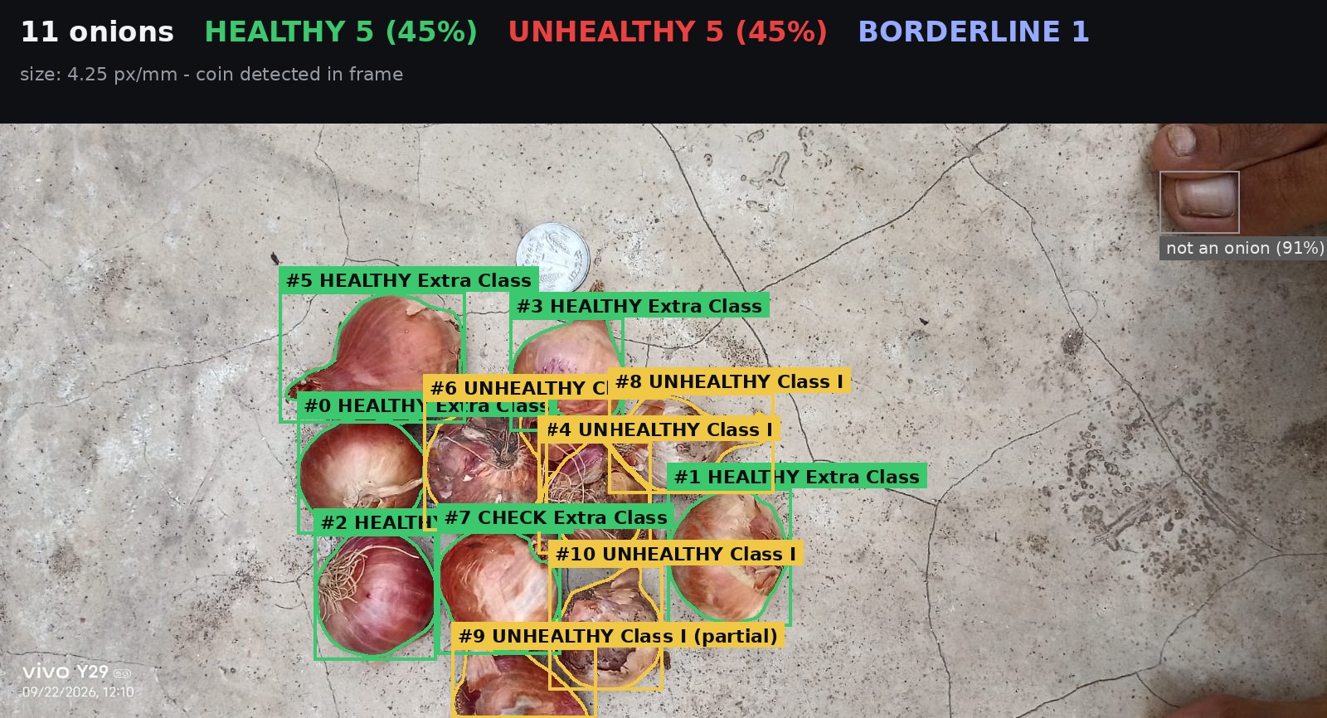
The system in use
Streamlit dashboard, and a live camera mode
Photo mode
Upload, annotated result, JSON export
Healthy / Unhealthy / Borderline tabs
Per-onion view: crop, boundary, damage
Warning when the photo is out of domain
Live camera mode
Two loops: ByteTrack every frame, full grade every few seconds
Each onion keeps a stable id, so a grade follows the right onion
Laptop webcam, phone over IP, or a video file
Real photograph, graded end to end: 11 onions; a ₹1 coin gives 4.25 px/mm; "#7 CHECK" is a borderline onion — and the toe at the top right is greyed out, rejected by the gate at p(not onion) = 0.91.
Notes:
Demo point: the toe in the corner of this real photo used to be graded as a healthy onion. The gate now rejects it at 0.91 because it scores the box widened by 50% as well, so the model sees the foot around it.

Slide 12
Limitations, and what comes next
Stated openly — every one of these is measured, not guessed
Dense piles
Next steps
In a tightly packed heap the detector finds about 17 of 20 onions — a training-data problem, fixed by adding pile photographs.
1
Label the 126 onions just photographed and retrain as v6 — most borderline cases should become confident
Dark cultivars
2
Fine-tune the detector on dense piles
The pixel rule reads dark skin as damage (+0.54 correlation). The CNN verdict is unaffected; the band can be harsh.
3
Multi-frame voting in live mode: average one onion’s score across frames
Live mode unvalidated
Every accuracy figure comes from still photographs. Motion blur is in none of them.
4
GPU + ONNX export, then a FastAPI service for a mandi
Invisible attributes
5
On-phone deployment, so no laptop is needed
Firmness, dryness and smell are part of the legal grade and cannot be seen in a photograph.
A measurement instrument, not a black box: it shows what it measured, refuses what it cannot grade, and says when it is unsure.
Notes:
Close on this: the limitations are measured and surfaced to the user, not discovered by the examiner. Next step is concrete — 126 onions already photographed, ready to label for v6.

