Slide 1

What is efficiency in programming?

Slide 2
Why efficiency is important?

Slide 3
Types of efficiency

Slide 4
Space and Time Efficiency

Slide 5
Our focus - Time

Slide 6
Techniques to measure time efficiency

Slide 7
Techniques
Measuring time to execute
Counting operations involved
Abstract notion of order of growth

Slide 8
Measuring Time

Slide 9
Problems with this approach
Different time for different algorithm | ✔️
Time varies if implementation changes
Different machines different time
Does not work for extremely small input
Time varies for different inputs, but can’t establish a relationship

Slide 10
2. Counting Operations

Slide 11
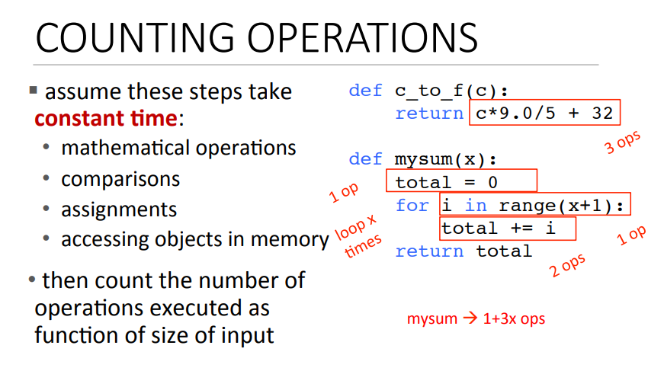

Slide 12
Problems with this approach
Different time for different algorithm | ✔️
Time varies if implementation changes
Different machines different time | ✔️
No clear definition of which operation to count
Time varies for different inputs, but can’t establish a relationship | ✔️

Slide 13
What do we want
We want to evaluate the algorithm
We want to evaluate scalability
We want to evaluate in terms of input size

Slide 14
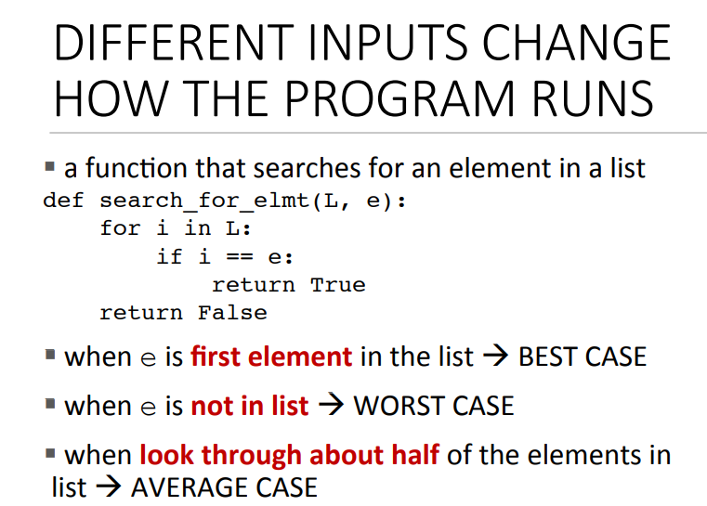

Slide 15
3. Orders of Growth

Slide 16
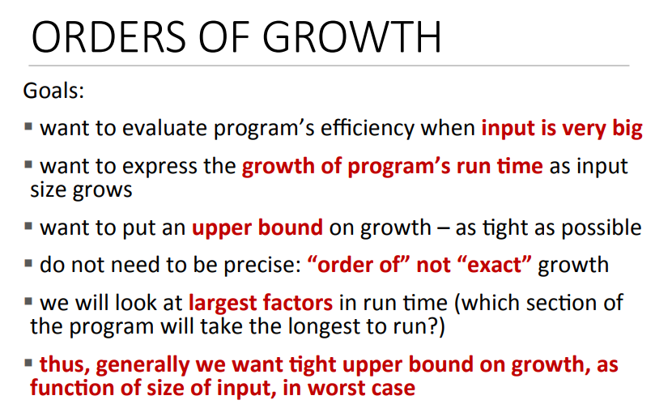

Slide 17
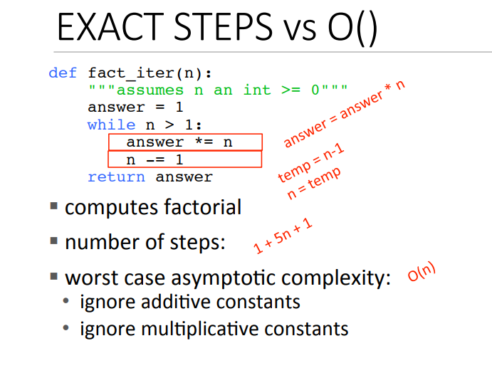

Slide 18
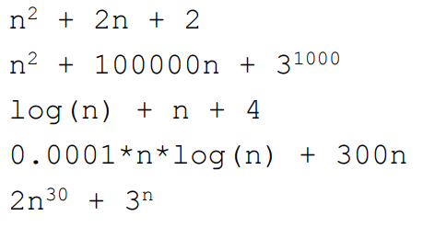
So the idea is simple

Slide 19
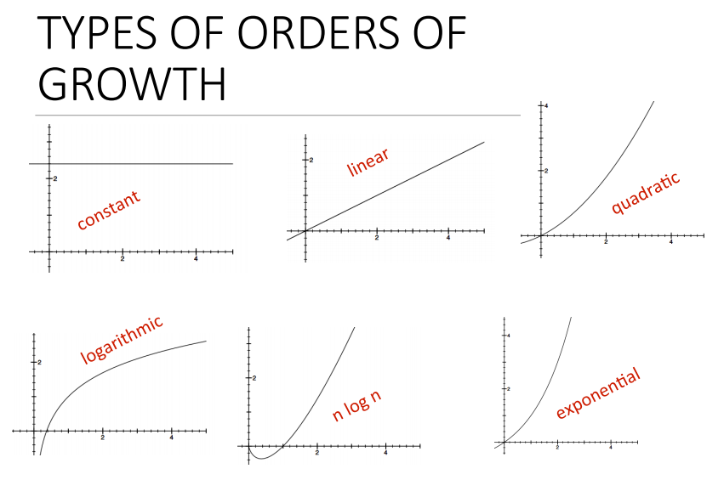

Slide 20
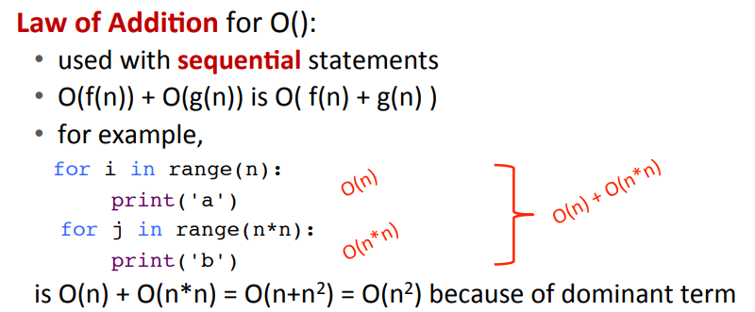
Law of addition

Slide 21
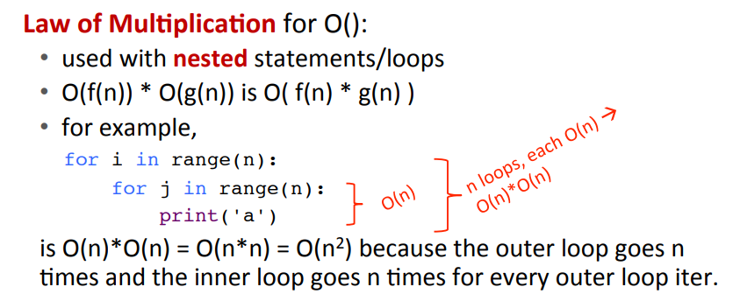
Law of multiplication

Slide 22
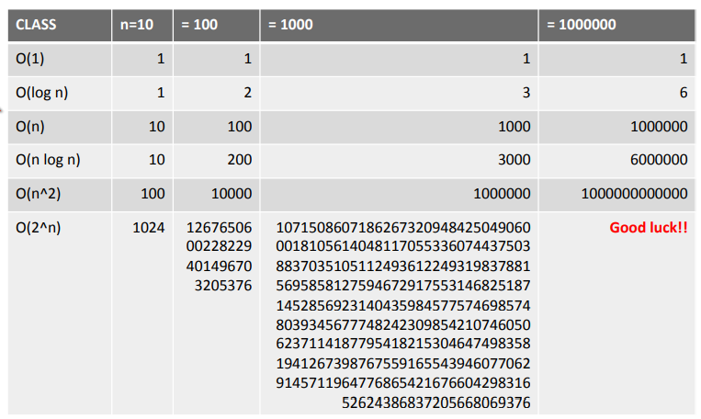
Complexity Growth

