Slide 1
SMART INDIA HACKATHON 2026
TITLE PAGE
• Problem Statement ID – SIH26101
• Problem Statement Title - Comprehensive Privacy-First Health Tracking Platform
• Theme - MedTech / HealthTech
• PS Category - Software
• Team ID - TBD
• Team Name - CodeWithCJ

Slide 2
SparkyFitness - Self-Hosted Privacy-First Fitness Platform
Proposed Solution
A comprehensive self-hosted fitness tracking ecosystem unifying nutrition, exercise, body metrics, and health data into a single platform.
Comprises a robust backend server, a responsive web frontend, and native mobile apps (iOS & Android).
Incorporates an AI conversational interface (SparkyAI) for intuitive, text and image-based data logging.
How it addresses the problem
Eliminates the need for multiple fragmented, costly subscriptions.
Data Ownership: Stores and manages highly sensitive health data on user-controlled infrastructure, removing reliance on third-party services.
Innovation and uniqueness
Offline-first, self-hosted architecture ensures complete data sovereignty.
Broad wearable sync combined with granular family sharing permissions.

Slide 3
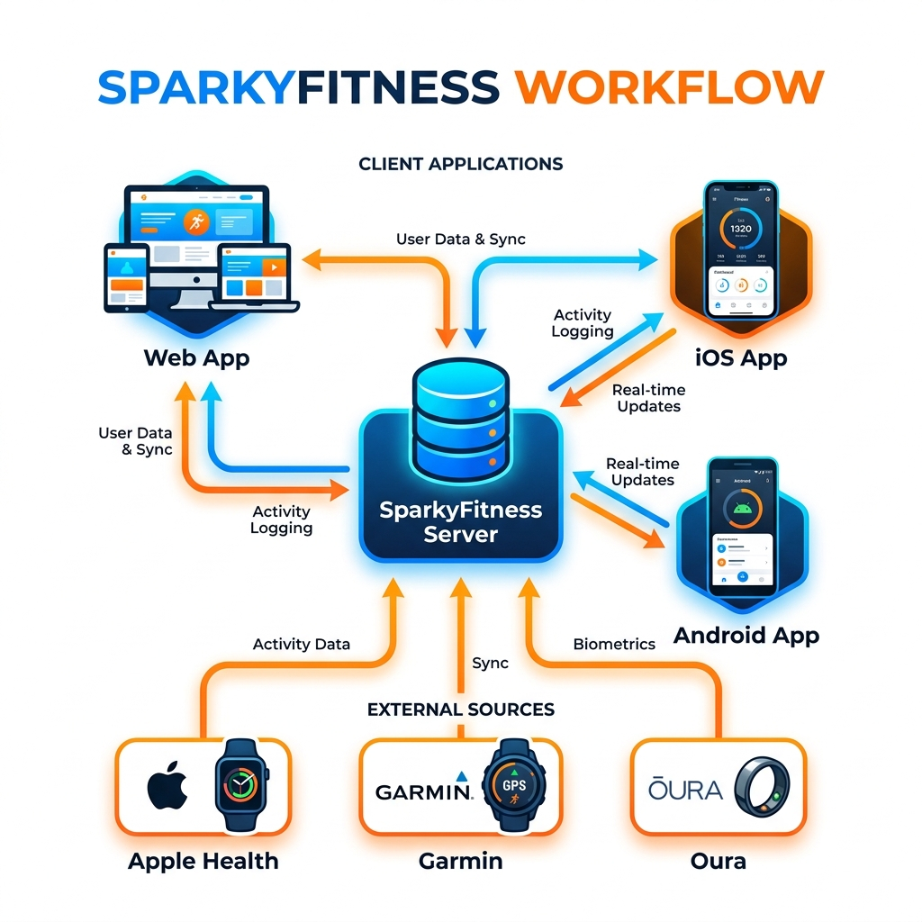
TECHNICAL APPROACH
Technologies Used
Node.js & TypeScript (Scalable API backend)
Docker & Docker Compose (Containerization for self-hosting)
PostgreSQL (Relational database for structured health data)
React.js / Vite & React Native / Expo (Web & Mobile apps)
SparkyAI (Integration with external LLMs for conversational tracking)
HealthKit, Google Health Connect APIs.

Slide 4
FEASIBILITY AND VIABILITY
Analysis of the feasibility of the idea
High Feasibility: The core system is already demonstrable, utilizing standard containerization (Docker).
Pre-built integrations with major health platforms prove the viability of a unified data pipeline.
Potential challenges and risks
Integration Fragility: Third-party APIs (Garmin, Apple Health, Fitbit) frequently change.
Onboarding Friction: Self-hosting can be technically intimidating for average users.
Strategies for overcoming these challenges
Modular Architecture: Isolate third-party integrations into microservices.
Cloud Hosting Partners: Partner with one-click deployment providers (e.g., PikaPods, Zenith).
Community-Driven Maintenance: Leverage open-source for robust API connectors.

Slide 5
IMPACT AND BENEFITS
Potential impact on the target audience
Empowers individuals and families to take total ownership of their health data.
Democratizes access to premium fitness tracking features without paywalls.
Benefits of the solution
Economic: Saves users $40–$100 annually per application.
Social: Facilitates family wellness through shared access with privacy controls.
Security: Radically reduces the risk of sensitive health data breaches.
Holistic Health: Provides a unified view of health, correlating sleep with nutrition.

Slide 6

RESEARCH AND REFERENCES
Project Details & Links
GitHub Repository: https://github.com/CodeWithCJ/SparkyFitness
Documentation & Installation: https://codewithcj.github.io/SparkyFitness/
Comparative Market Analysis: Comparison against 17 existing solutions.

