Slide 1
19CSE205 Program reasoning Lecture 2
Software Verification
Nalinadevi Kadiresan
CSE Dept.
Amrita School of Engg.

Slide 2
Motivation: Software Defects cause BIG Failures
Recap from Lecture -1
In particular, this goes for software systems
Ariane 5
Therac 25
Patriot Missile Error
Heathrow Disruption: 2020
Insurance Mess
…

Slide 3
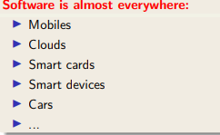
Motivation: Software Defects cause OMNIPRESENT Failures

Slide 4
Motivation: Software Defects cause BIG Failures
Software is now controlling critical machines:
Transportation: cars (>100 M LoC [IEEE]),airplanes, trains, spacecraft, …
Medical: pacemakers, MRI machines, …
Utilities: power grids, telephone carriers, …
Finance: online banking, stock prices, …
…
BUT software is very unreliable

Slide 5
Why software systems are unreliable??
Too many developers
Developers Untrained to check correctness with the requirements spec
Integrating the subsystems
S/W Unreliability
Cost as primary goal rather than efficiency
Insufficient separation of subsystem
Environment factors

Slide 6
Do you know how software's are written / developed ?

Slide 7
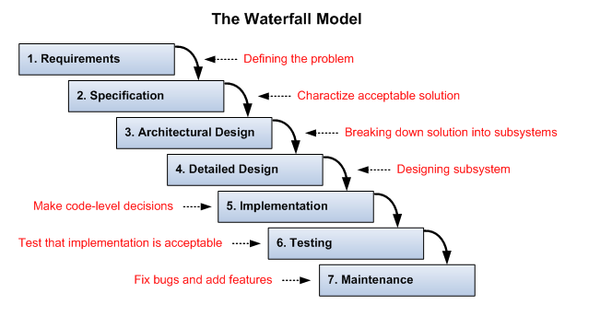
Simple steps in writing a software
Note: This is not a workable model

Slide 8
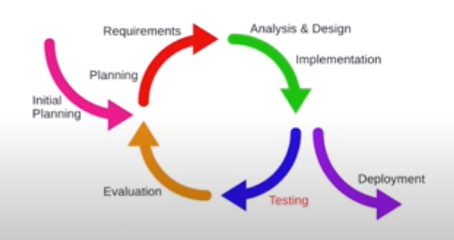
Simple steps in writing a software
Iterative and Incremental development
--- More realistic

Slide 9
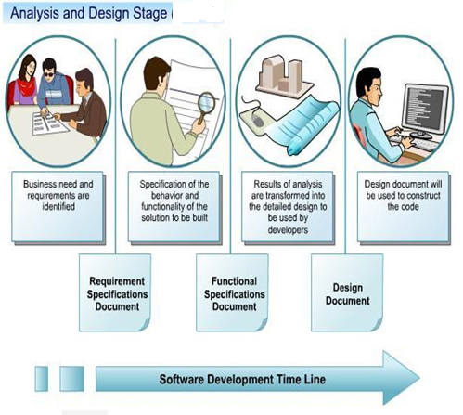
Simple steps in writing a software
How do you prepare these documents ?

Slide 10
Writing a requirement and functional specification document
Requirements specification document(s)
Serve as a contract between client and developer/provider
Identify functional capabilities of a system
Identify non-functional and environmental constraints (expected behaviour of the system)
In general, functional requirements include
Input/output, Processing, Error handling.
In general, non-functional requirements include:
Reliability, Safety, Security, Performance, Delivery, Help facilities.

Slide 11


Writing a requirement and functional specification document
Functional requirements for a video player
Icon | Index | Function Name | Description
 | V1 | Play | Clicking the play causes the video to begin playing. If the video was just paused, then playing the video resumes at the point of pausing. If the video has yet to start playing then a new computer window is created and video begins playing in the window. So long as the video is playing the pause/play button functions as a pause button displaying a pause button image
 | V2 | Pause | Clicking the pause button causes the video to pause at the current play location If the video has already finished playing, then this button has no effect. Clicking the pause button causes the pause/play button to function as a play button, displaying a play button image

Slide 12


Writing a requirement and functional specification document
Functional requirements for a video player (contd)
Icon | Index | Function Name | Description
 | V3 | Increase Volume | Clicking the increase volume button while the volume is less than maximum 80 dB level causes the volume to increase by 5 dB Clicking the increase volume button while volume is at 80 dB level does nothing.
 | V4 | Decrease Volume | Clicking the decrease volume button while the volume is greater than silent (0 dB) level causes the volume to decrease by 5 dB Clicking the decrease volume button while volume is at silent level does nothing.
Non-functional requirements for a video player
Response time, speed of the player, compatibility across different players, ….

Slide 13
Writing a requirement and functional specification document
Software specification documents can be expressed as
Informal specification: Natural language (as in the example, video player application)
ambiguous, incomplete and imprecise
Semi-formal specification: includes Data Flow Diagram, Entity-relationship diagram,…
Could be imprecise based on semantics
Formal specification: apply discrete mathematics to software engineering
Very precise but very hard

Slide 14
Writing a software design document
Software design document focuses on four areas
Data: transformation of individual data elements to data structures.
Architecture: relationship between structural elements.
Interfaces: interaction of software elements with each other, with users and with other systems.
Components: convert structural elements to procedural abstractions.

Slide 15
Implementation
Translation of detailed design to code
Major issues:
choice of programming
Language with cost benefit and low risk is selected.
Use of 4th gen languages
Provides automatic documentation
Use of good programming practices

Slide 16
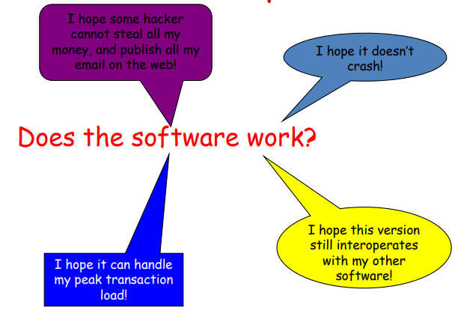
Testing
Software validation problem

Slide 17
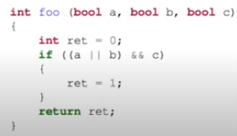
Testing Example
Run the system at chosen inputs and observe its behaviour
Consider the following procedure:
How much testing do we have to do? when are we done?
Function coverage - foo(F, F,F)
Statement Coverage - foo(T, T,T)
Decision/Branch coverage - foo(T, T,T)
foo(T,T,F)
Condition coverage - foo(F, F,T)
foo(T,T,F)

Slide 18
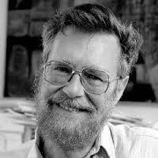
Limitations of Software Testing
Software Testing is difficult due to large number of:
input combinations
execution paths in code
interleavings of threads
Complexity of software and operating environment make testing difficult
“Program testing can be used
to show the presence of errors,
but not their absence.”
- Edgser W. Dijkstra
Adapted from: FDP Material by Dr.Bharat Jayaraman,SUNY, Buffalo.

Slide 19
What are formal methods?
Every phase of software development uses formal methods in the form of
Languages and notations with (mathematical) precise semantics
Logic-based techniques
Formal methods can:
Be a foundation for describing complex systems
Be a foundation for reasoning about systems
Provide support for program development

Slide 20
What are formal methods?
Formal methods do not replace Testing
It replaces many test cases
It improves the quality of specifications
It guides in selection of automatic test case generation.

Slide 21
Why formal methods?
Quality: Important for . . .
Safety-critical applications (railway switches)
Security-critical applications (access control,
electronic banking)
Financial reasons (phone cards)
Legal reasons (electronic signature,
EAL6/7 in Common Criteria)

Slide 22
Two domains of Formal methods
Formal Specification
is to write precise, unambiguous specifications
Formal Verification (This is our course)
is to prove code and abstract systems are correct

Slide 23
Testing vs. Formal Verification
Testing or validation shows presence of errors, not their absence
Validation: Are we building the right product?
refers back to the user's needs
Testing to prove incorrectness: provides a failing test.
To prove correctness we need to test all possible input-output pairs (infinite testsuite).*
Formal Verification shows the absence of software errors
Verification: Are we building the product right?
checks that the specifications are correctly implemented by the system

Slide 24
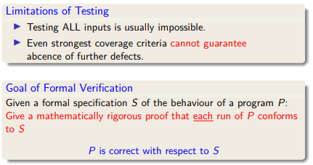
Testing vs Formal verification

Slide 25
Impact of Software Errors
Programming languages and environments have become increasingly more complex.
“Software bugs, or errors, are so detrimental that they cost the U.S. economy an estimated $59.5 billion annually.”
National Institute of Standards and Technology http://www.nist.gov/public_affairs/releases/n02-10.htm
Impact on world-wide economy is ~ $1 trillon!
Adapted from: FDP Material by Dr.Bharat Jayaraman,SUNY, buffalo.

Slide 26
Formal Verification
Ultimate goal: prove the absence of software errors
Easy? NO!
Finite code often has an infinite set of behaviours:
quicksort (a: array int)
Infinite number of a - inputs and outputs
What does it even mean for quicksort to be correct?

Slide 27
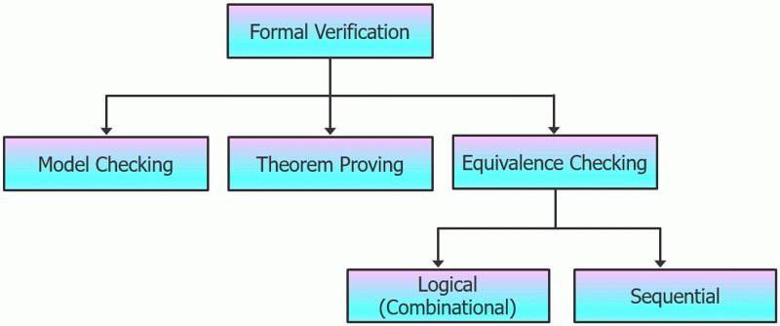
Formal verification techniques
Formation verification techniques are
Courtesy:https://www.eeweb.com/profile/aijazfatima20/articles/introduction-to-formal-verification

Slide 28
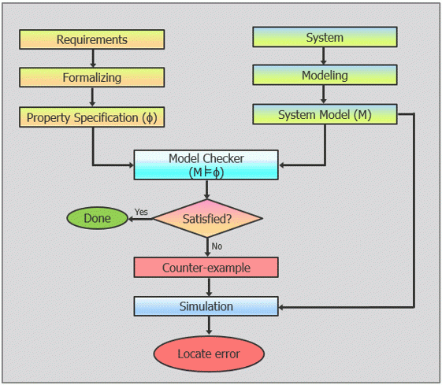
FV Technique: Model checking
Model checking, also known as property checking, is a state-based approach to formal verification.

Slide 29
FV Technique: Model checking
Advantage:
Fully automatic
Limitations
System should be smaller in the number of states.

Slide 30
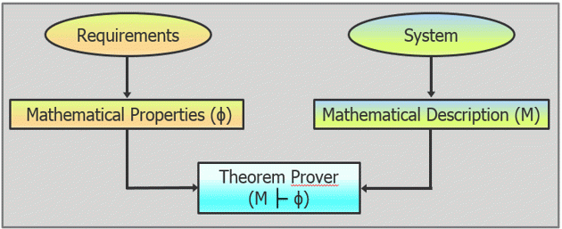
FV Technique: Theorem proving
Process of verifying that the implemented system meets design requirements (or specifications) using mathematical reasoning.
Used for code based verification
It is a proof-based approach to formal verification.

Slide 31
FV Technique: Theorem proving
Advantage:
it can handle very complex systems.
Limitations:
It is not fully automatic - it requires manual intervention to complete the proofs.
in case of a failed proof, no counter-examples are generated, which makes locating the error difficult

Slide 32
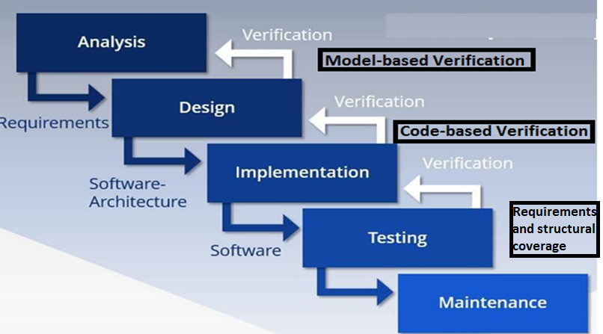
Formal verification in development process
Reference: Yannick Moyet.al. Testing or Formal Verification, DO-178C Alternatives and Industrial Experience, IEEE software, 2013.

Slide 33
Rigorous Software Verification in this course
Start with formal specification of correctness:
- functional correctness
input-output correctness
- behavioral correctness
security, no deadlocks, liveness
Two broad approaches:
- code-based verification (e.g., Frama-C, ALT-Ergo)
Uses logic function contracts
- model-based verification (e.g., SPIN)
Uses temporal logic
Testing, run-time analysis and debugging also important.
Adapted from: FDP Material by Dr.Bharat Jayaraman,SUNY, buffalo.

Slide 34
UNIT-1 and UNIT-2 of the course focuses on code-based verification using weakest pre-condition calculus Tools used: Alt-Ergo and Frama-c

