Slide 1
Welcome

Slide 2
Cake Shop Billing System
SUBMITTED BY:
MR. Dighe Ashit Jijabhau
MISS. Pansare Vrushali Keshav
PROJECT GUIDE:
PROF- Parad S.R

Slide 3
INTRODUCTION
The Cake Shop Billing System is a standalone application which is based on ordering and selling the cake and other items and generating bill. The main principle behind the need of Cake Shop Billing System is easy supervision of shop. It has user friendly and modular approach. The modular approach of the software increases the flexibility of the software.
Data storing is easier. It will be able to check any report at any time. Paper work and manual work is reduced. The system is user friendly and easy to use. The record of each customer is stored that is customer’s name and contact details are added for reference. Next the item is selected , flavours , pounds and quantity is also added.
At the end of the day, report is generated to calculate the payment for each user in each day.

Slide 4
Company profile
» Project Name: Cake Shop Billing System.
» Name of The Shop: Sai Seva Cake Shop .
» Phone no: 8806578051
» Address :A/p Jorve ,Tal. Sangamner, Dist. Ahmednager

Slide 5
Proposed System
In our proposed system we have the provision for generating bill. Another advantage of the system is that it is very easy to calculate the total amount. Here is no facility of internet connection, email facility is also not provided. Online ordering is not possible.
Characteristics of the proposed system:
By developing the system, we can attain the following facilities:
User friendly
Reports are easily generated
No or very few paper work
Computer operator control

Slide 6
Need Of System
This software is needed because of the data.
Data is becoming too much that it can’t be handled with the file system approach.
Because this software is able to handled a very large amount of data.
So one should not worry about the data because it is stored in a data base.

Slide 7
Objective Of System
In This System Main Objectives Are Following :
1.Editing Accounts :
User Can Open the Old Account and Edit the Information In case Of Changes.
2. No Paper Work :
No Need Of Paper Work Because All the Work Done Through the Computer.
3. Fast Results
Since All the Information Can Be Access on The Click of The Mouse So Work Will Be Fast. Any Record Can Easily Find.
4. Save Time
With the Help of This Project Most Time Is Save.

Slide 8
Hardware & Software Requirement
Hardware Requirement:
» Processor : Intel i3
» RAM: 4 GB
» Hard disk: 500GB
Software Requirement:
» Operating System : Windows 10
» Front End : VB.Net
» Back End : SQL Server

Slide 9
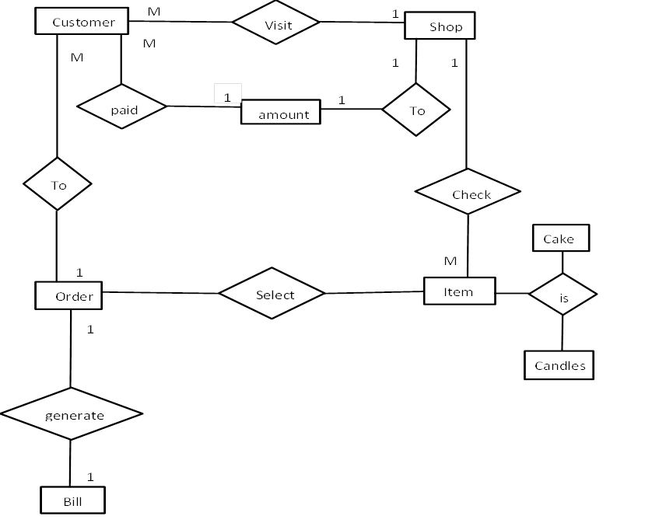
Diagrams
E-R Diagram:

Slide 10
Context Level Diagram(CLD):

Slide 11
First Level DFD:
Item

Slide 13
Database Design (File Design):
Cake Details
Sr. No | Data Field | Data Type | Size | Contraints
1 | Item No | Integer | 10 | Primary key
2 | Category | Text | 20 | Not Null
3 | Flavour | Text | 30 | Not Null
4 | Price | Integer | 10 | Not Null
Candle Details
Sr. No | Data Filed | Data Type | Size | Contraints
1 | C-No | Integer | 10 | Primary Key
2 | Candle Name | Text | 30 | Not Null
3 | Price | Integer | 10 | Not Null

Slide 14
Order Details
Sr. No | Data Field | Data Type | size | Contraints
1 | Order No | Integer | 10 | Primary
2 | Data | Data | 10 | Not Null
3 | First Name | Text | 20 | Not Null
4 | Last Name | Text | 20 | Not Null
5 | Address | Text | 35 | Not Null
6 | Mob Number | Integer | 10 | Not Null
7 | Category | Text | 20 | Not Null
8 | Flavours | Text | 30 | Not Null
9 | Candle | Text | 30 | Not Null
10 | Cake Value | Integer | 10 | Not Null
11 | Candle Value | Integer | 10 | Not Null
12 | Other Value | Integer | 10 | Not Null
13 | Delivery Charges | Integer | 10 | Not Null
14 | Total | Integer | 10 | Not Null

Slide 15
Data Dictionary:
Sr. No | Data Field | Data type | Size | Description
1 | Item No | Integer | 10 | Item No
2 | Category | Text | 20 | Category
3 | Flavour | Text | 30 | Cake Flavour
4 | Price | Integer | 10 | Cake price
5 | C-No | Integer | 10 | Candle No
6 | Candle Name | Text | 30 | Candle Name
7 | Price | Integer | 10 | Candle Price
8 | Order No | Integer | 10 | Order No
9 | Date | Date | 10 | Dates
10 | First Name | Text | 20 | Customer First Name
11 | Last Name | Text | 35 | Customer Last Name
12 | Address | Text | 10 | Customer Address
13 | Mob Number | Integer | 20 | Customer Mob-No
14 | Category | Text | 30 | Category-Cake
15 | Flavour | Text | 30 | Cake Flavour
16 | Candle | Text | 10 | Candle Name
17 | Cake Value | Integer | 10 | Cake Price
18 | Candle Value | Integer | 10 | Candle Price
19 | Other Value | Integer | 10 | Other Item Price
20 | Delivery Charge | Integer | 10 | Delivery Charges
21 | Total | Integer | 10 | Total Amount

Slide 16
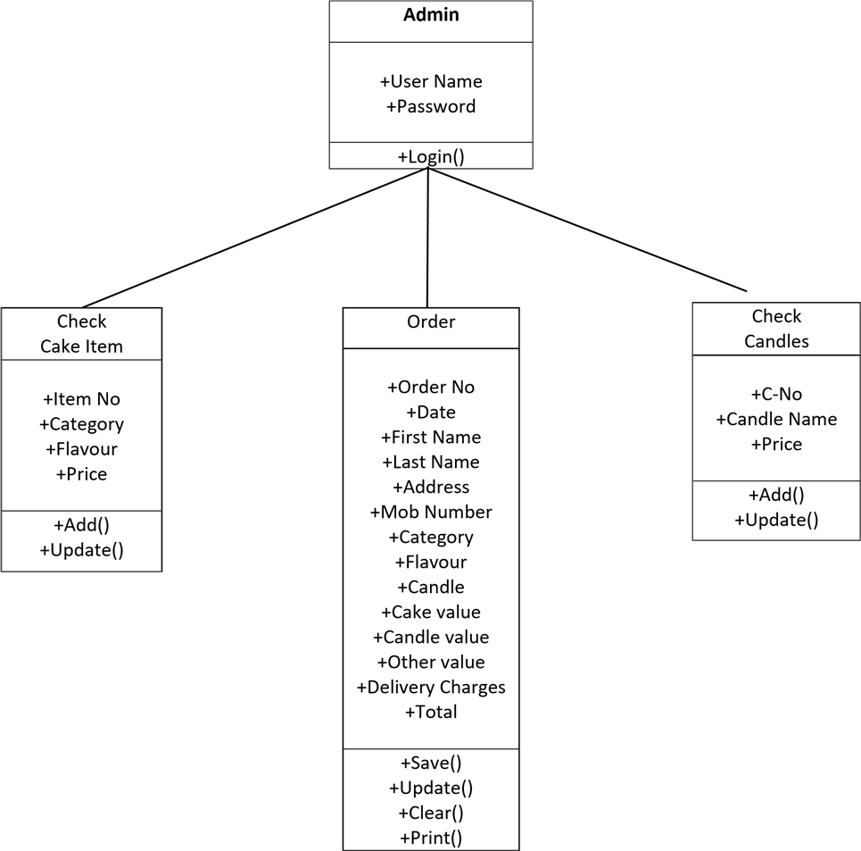
UML DIAGRAM
Class Diagram:

Slide 17
Object Diagram:

Slide 18
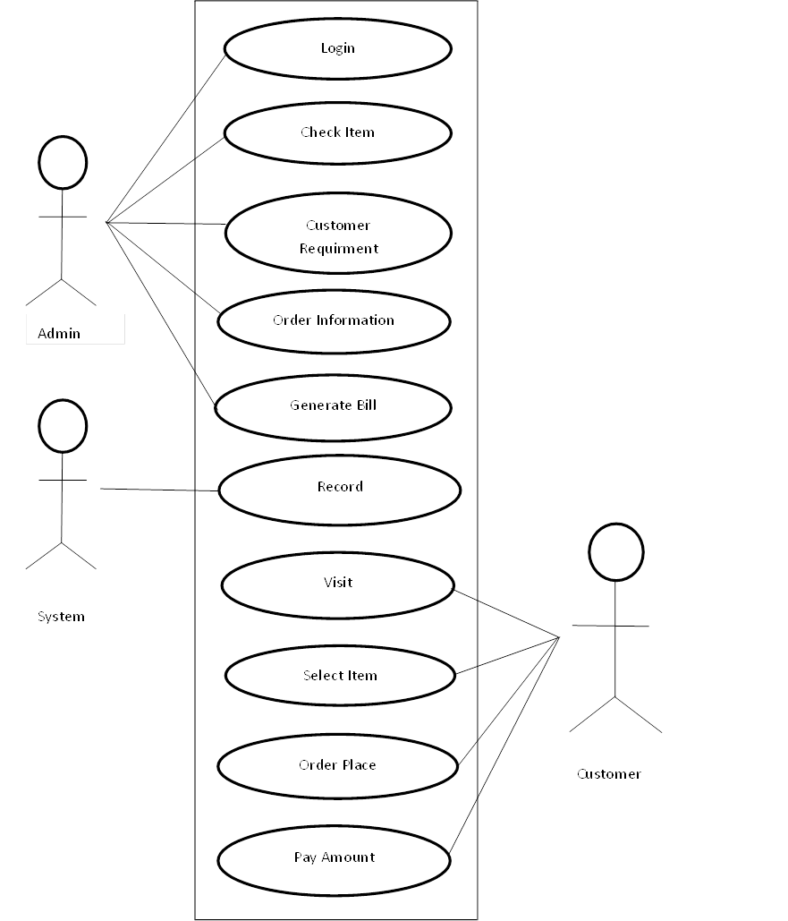
Use Case Diagram:

Slide 19
Activity Diagram:

Slide 20
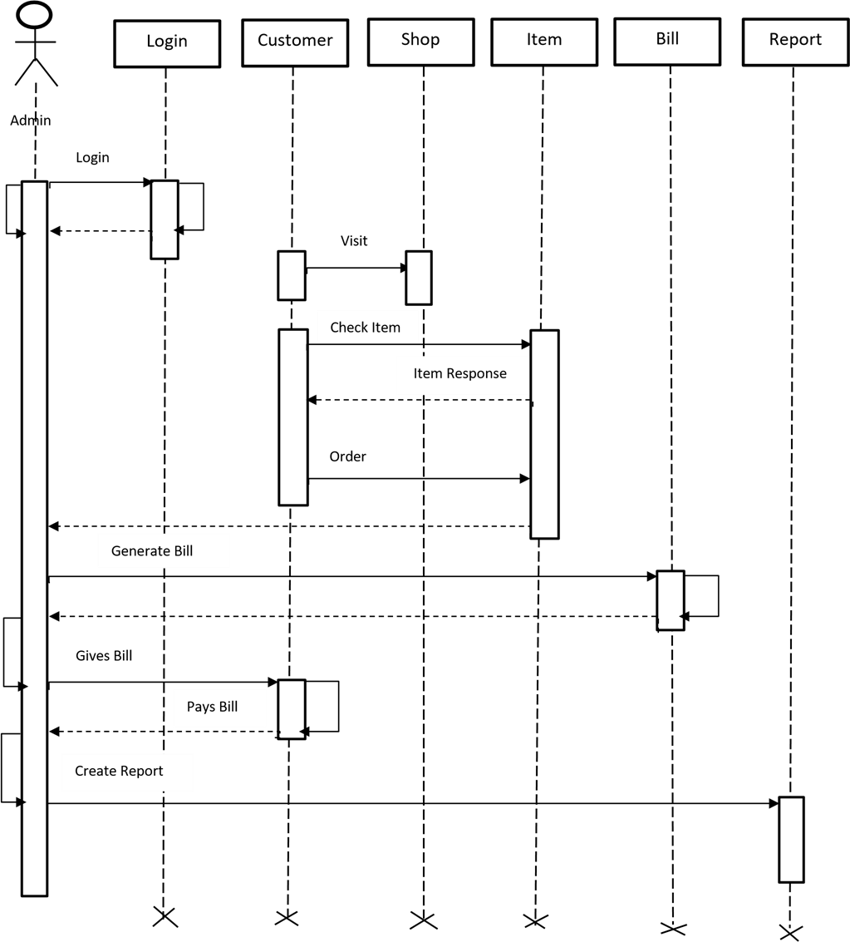
Sequence Diagram:

Slide 21
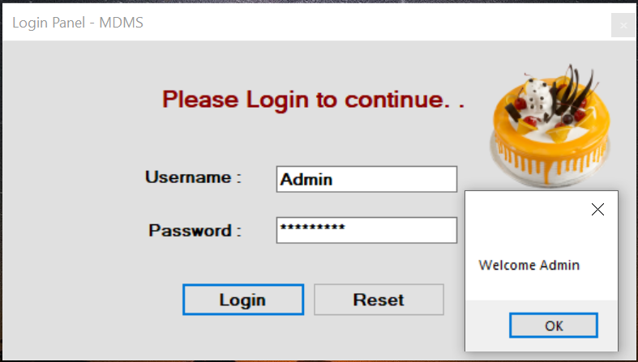
FORM DESIGN
Login Form:

Slide 22
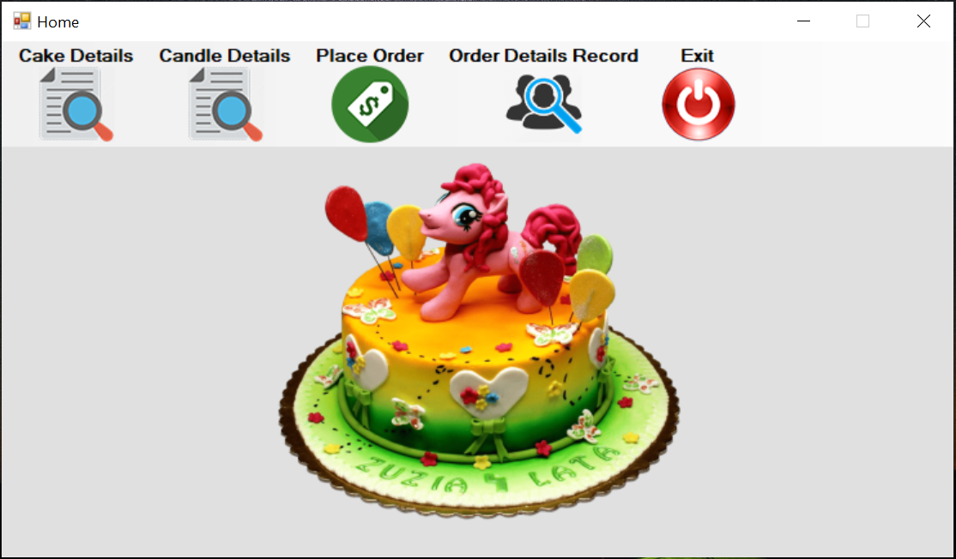
Main Form:

Slide 23
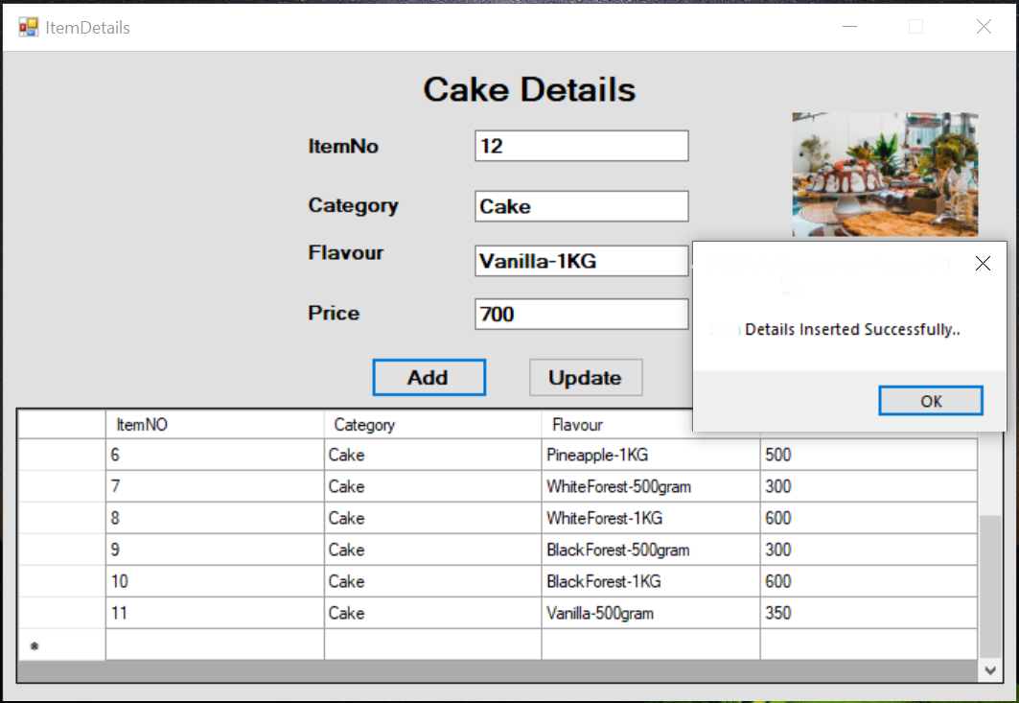
Cake Details Form:

Slide 24
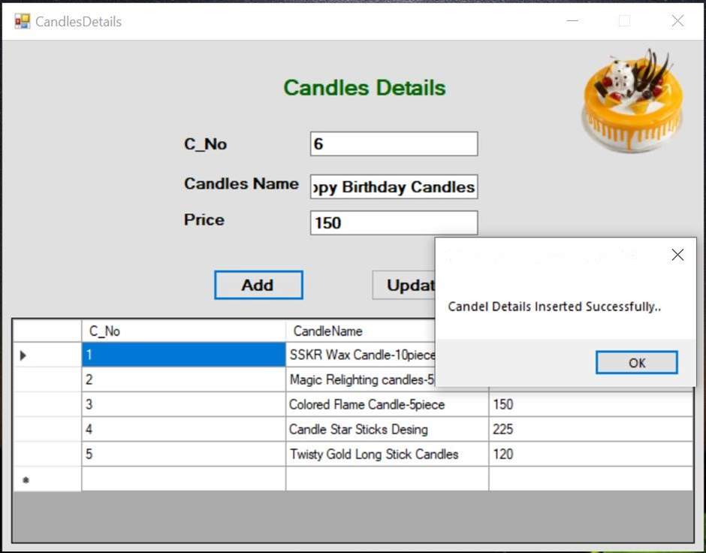
Candle Details Form:

Slide 25
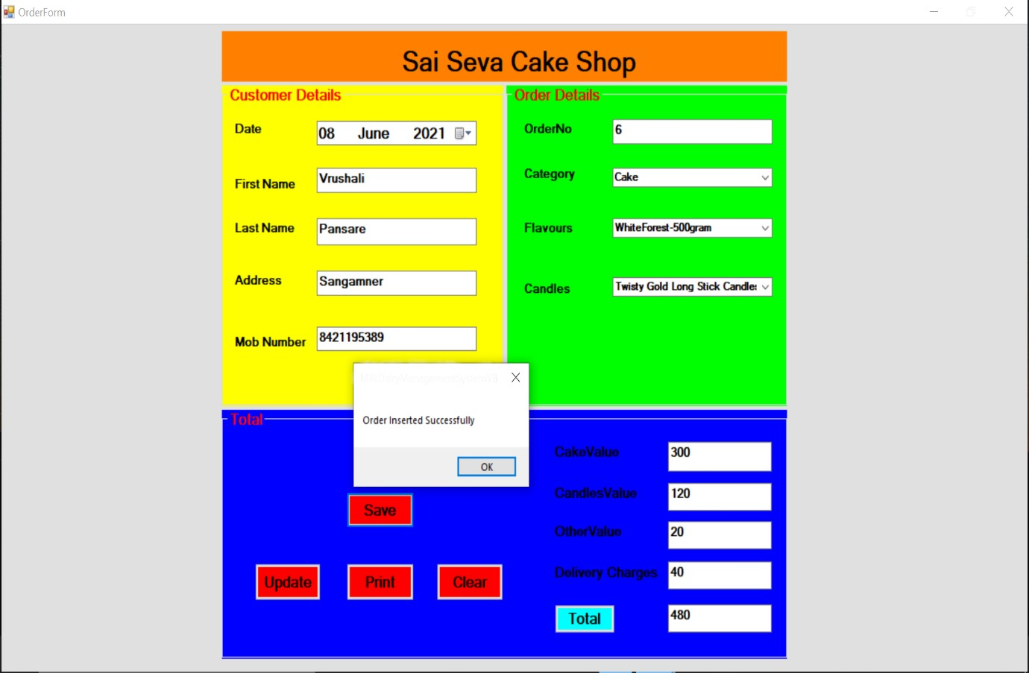
Order Form:

Slide 26
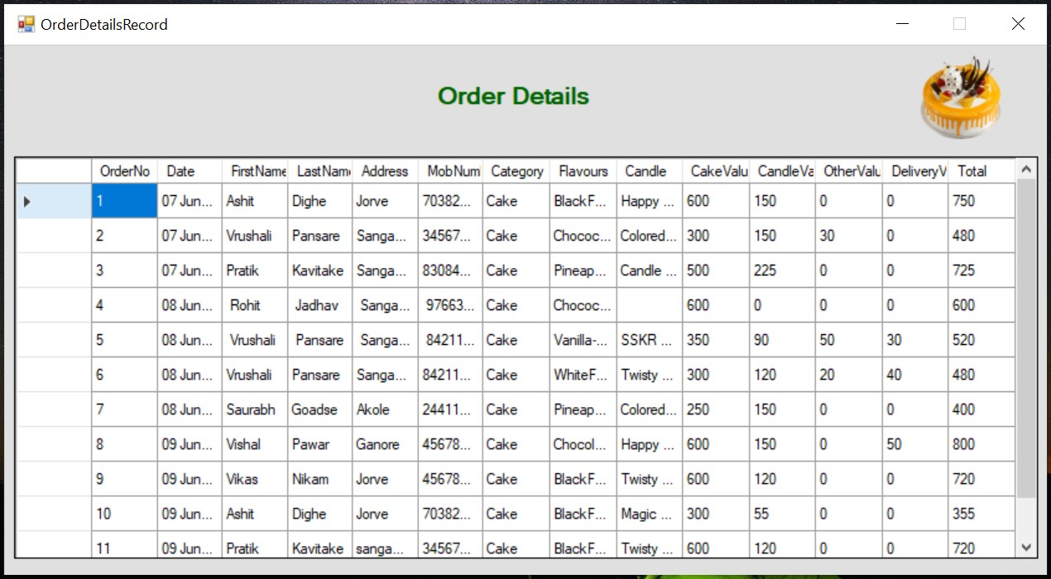
Order Details Form:

Slide 27
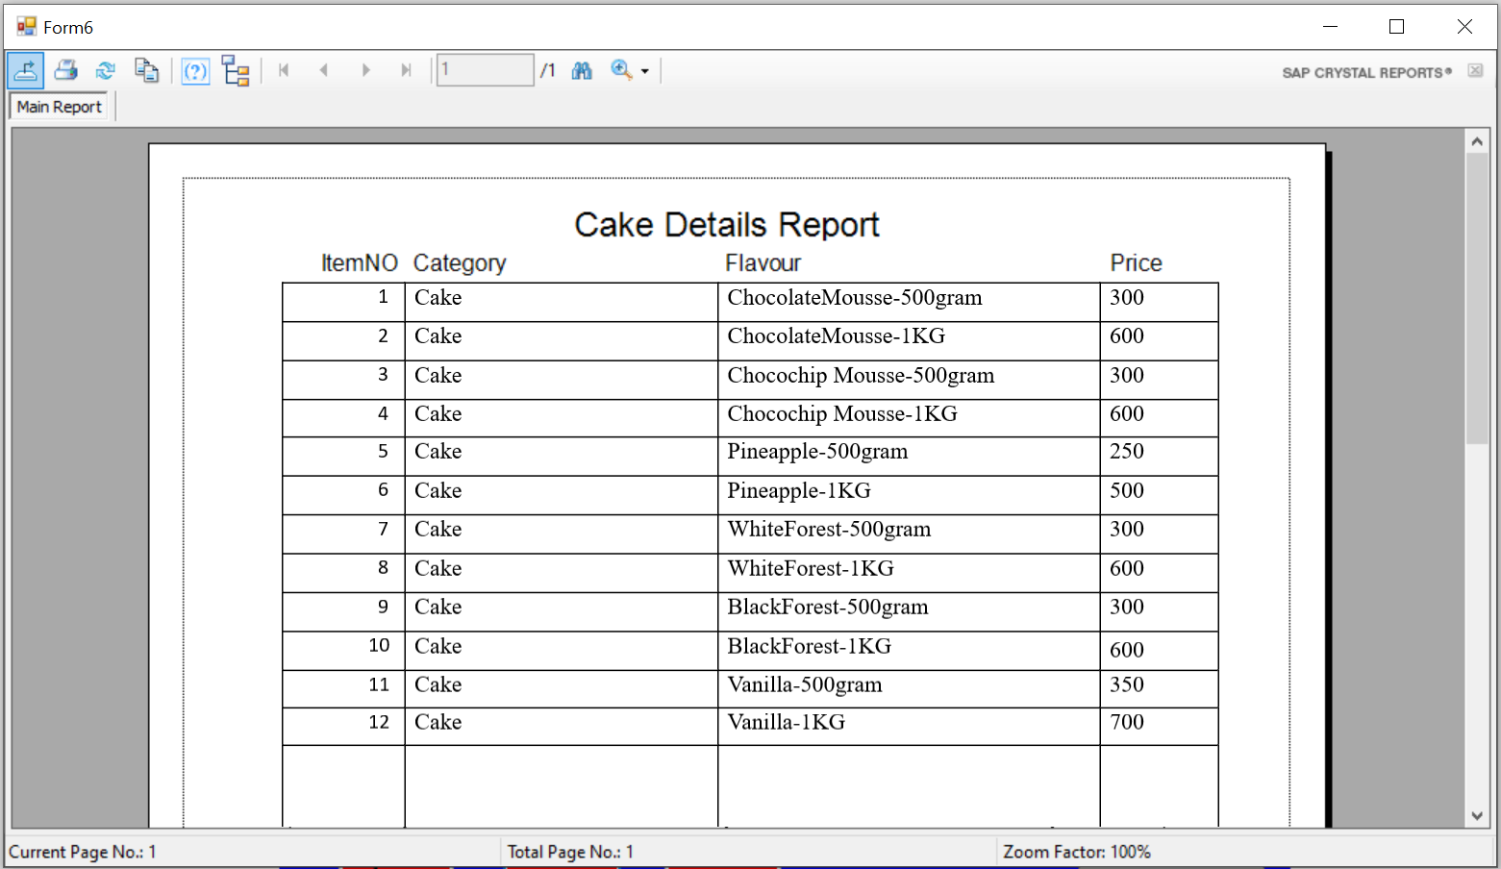
REPORTs
Cake Details Report:

Slide 28
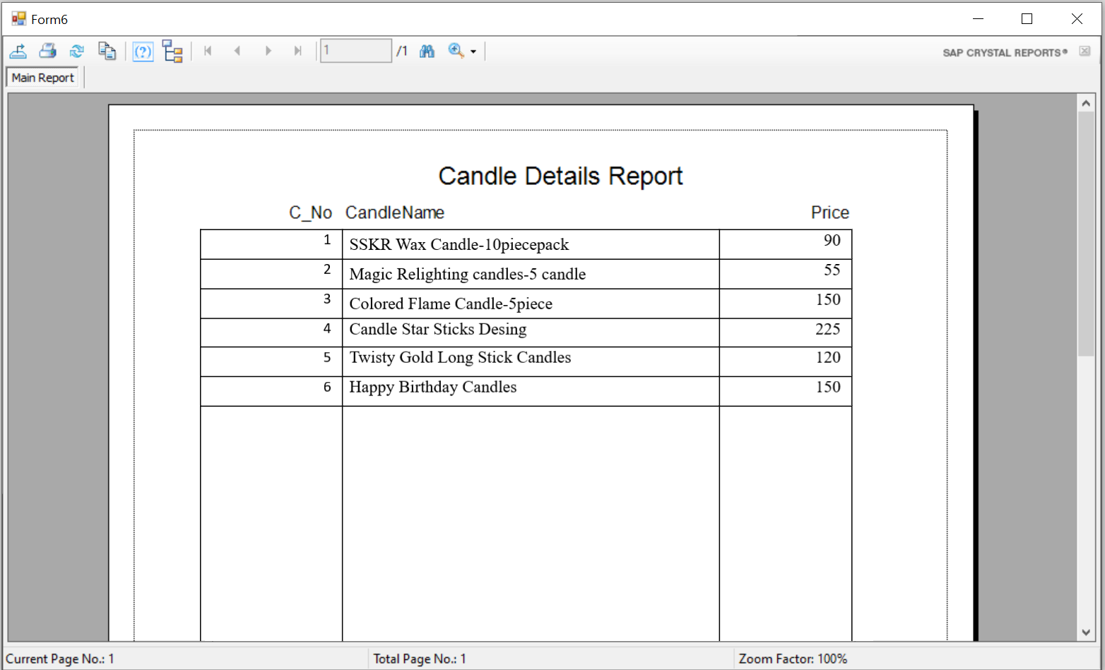
Candle Details Report:

Slide 29
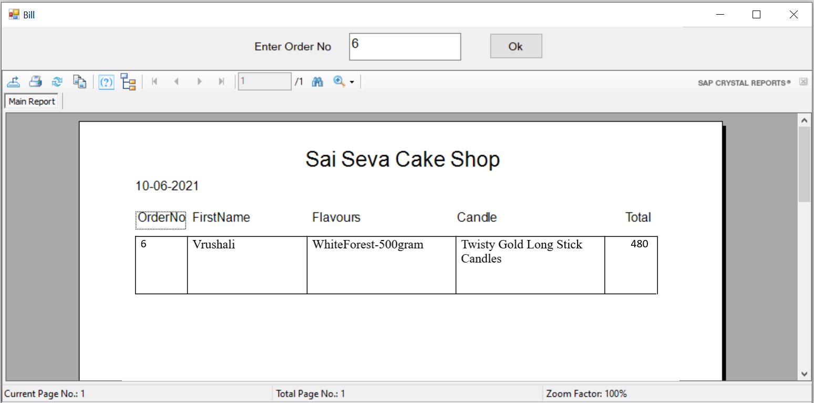
Bill Report:

Slide 30
LIMITATIONS
The System is single user system.
The user has to tack care of the proper flow of system.
There is no full proof security to the system.
System is offline.

Slide 31
FUTURE ENHANCEMENT
Reduction of paper work.
Human effort or Manual Labor can be reduced drastically.
Major operation that are done manually can be done within a matter of seconds.
This project enables the owner of shop to maintain database of customer visited and purchase item from shop.

Slide 32
CONCLUSION
The Cake Shop Billing System is designed to generate bills when customer orders an item.
It has the facility to generate bills and only the authorized user can login in system and view details of customer and items.
This application provides facility for adding customer details (for reference), adding item details and it automatically calculates amount and generate bill.
It also provides Automation of the entire system improves the efficiency, it provides a friendly graphical user interface which proves to be better when compared to the existing system, updating of information becomes so easier.
The system has adequate scope for modification in future if it necessary.

Slide 33
THANK YOU

