Slide 1
Welcome

Slide 2
“Share Market Workflow”
Submitted By
Dighe Ashit Jijabhau
Under The Guidance of
Prof . Sabale.S.B

Slide 3
Introduction
○A Stock market is the place where buying and selling of Stocks takes place. Nowadays due to internet and advanced technology buying and selling of stocks takes place anywhere in india and also form foreign country ,there is no need to be physical present in exchanges like NSE and BSE .Stock market are perfect competitive market.
○ There are 22 Stock exchanges in india.But ,two of them are biggest .
»NSE(National Stock Exchange)
Consist of group of 50 Stocks (Nifty50)
»BSE(Bombay Stock Exchange)
Consist of group of 30 Stocks

Slide 4
System Specifications And Objectives
○ A computer system more effective than existing manual system our system does not any high configuration or software & hardware It easy to understand &use because build as per requirement.
○ No training is required
○ User can easily operate the system
○ View of system is very simple that for not trouble for handling user.
○ Save paperwork & also save time
○Our system is user friendly

Slide 5
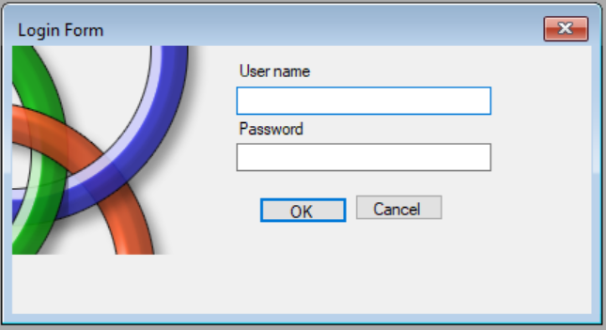
Login page

Slide 6
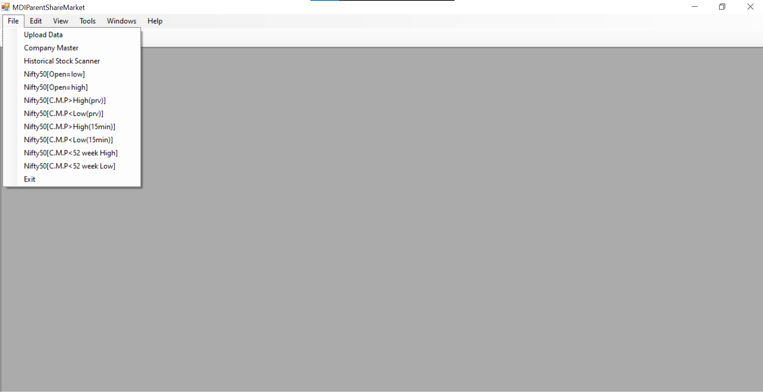
Main Form

Slide 7
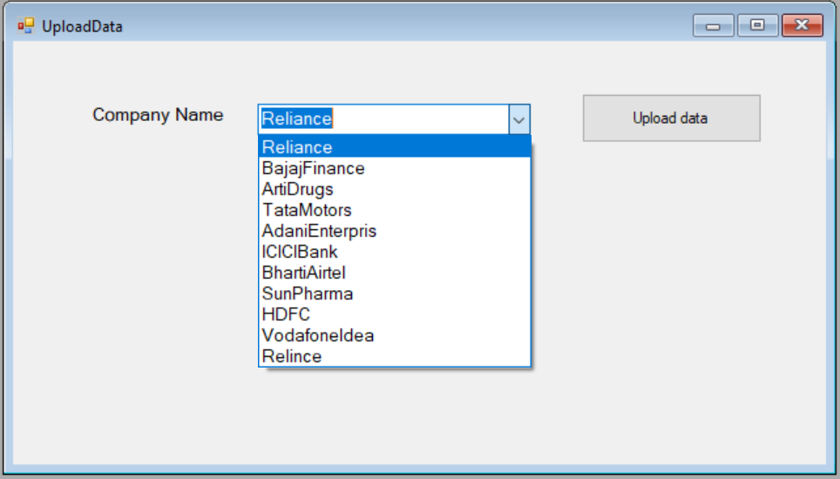
Upload Data

Slide 8
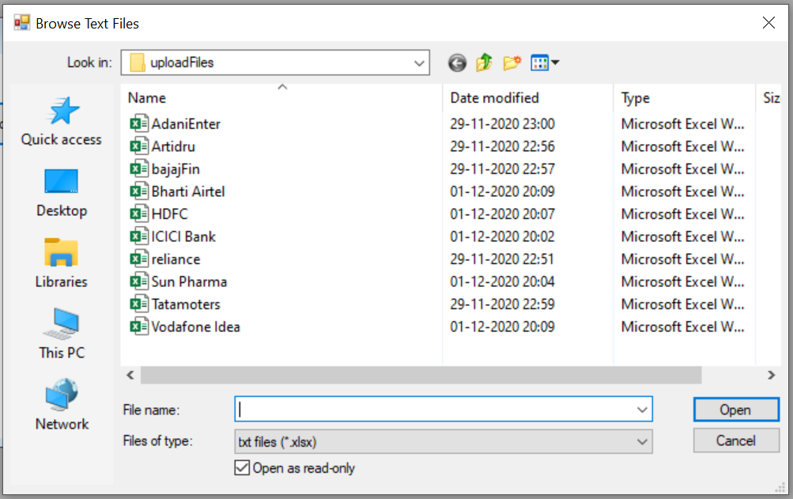
Upload File folder

Slide 9
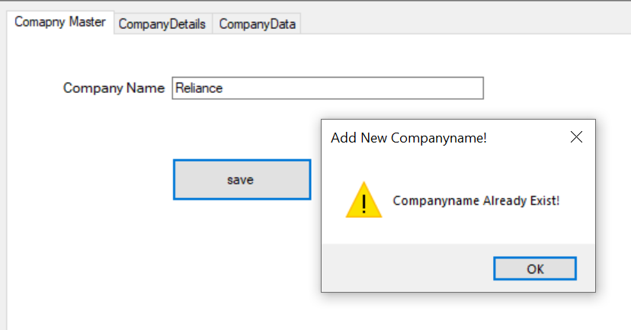
Company Master

Slide 10
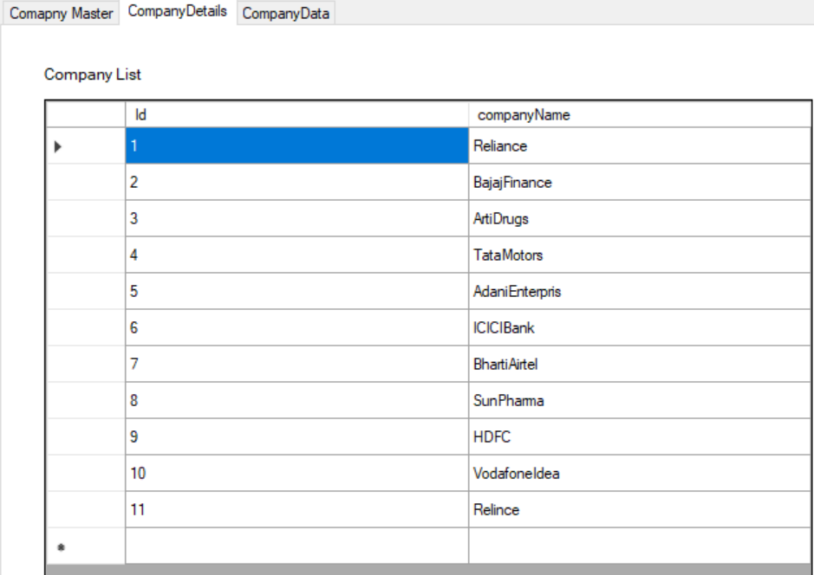
Company Details

Slide 11
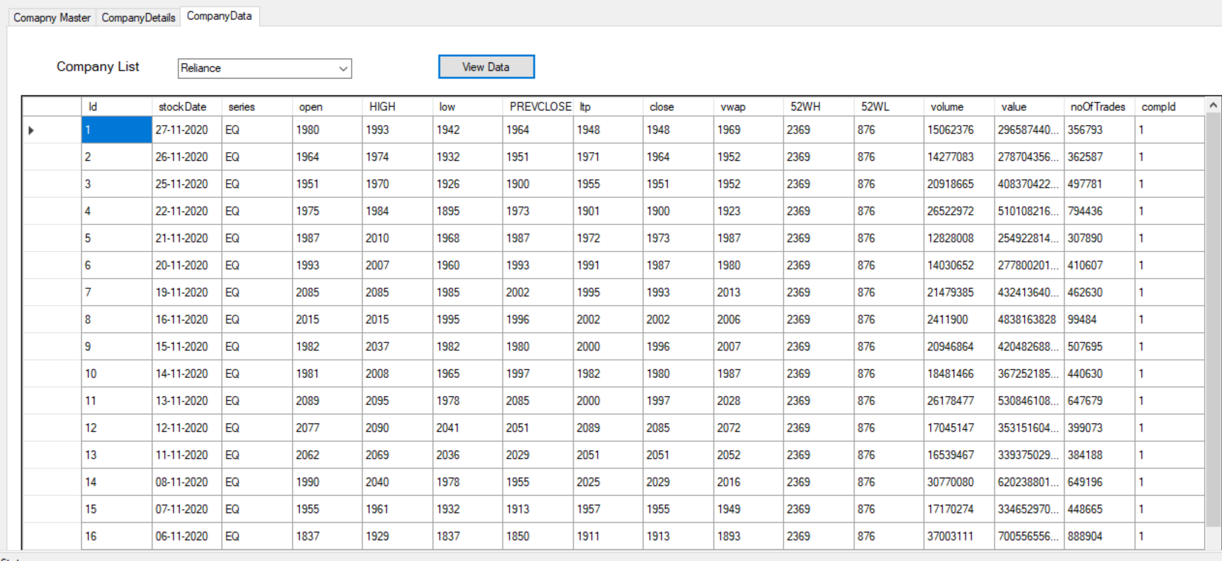
Company Data

Slide 12
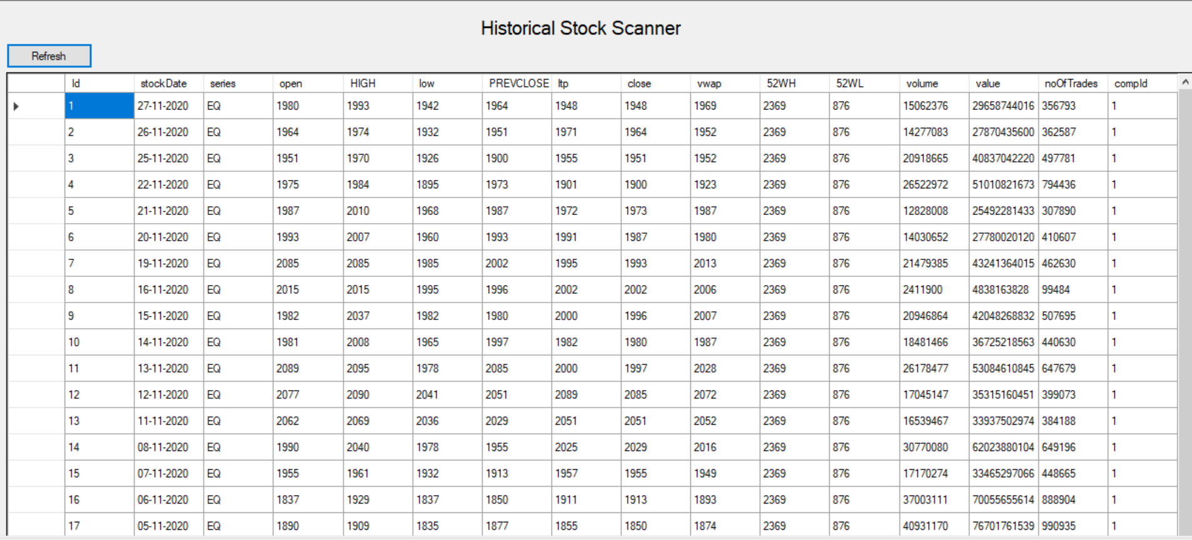
Historical Stock Scanner

Slide 13
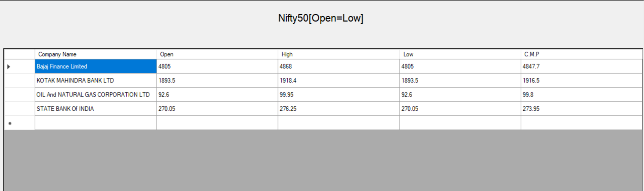
Nifty 50[Open=low]

Slide 14
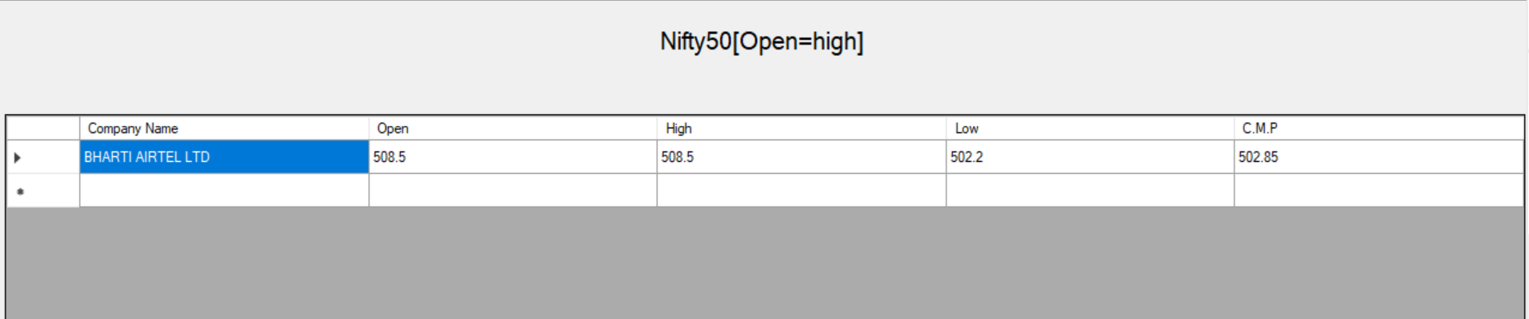
Nifty 50[Open=high]

Slide 15
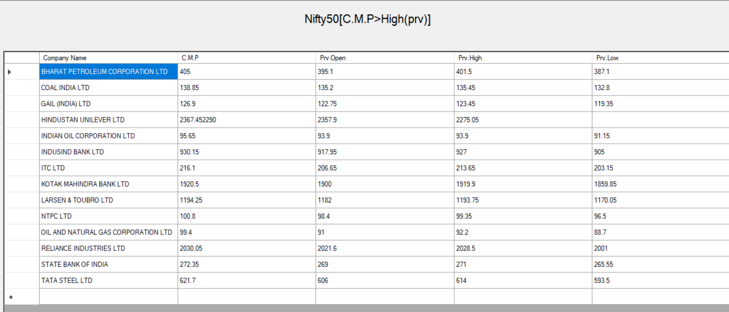
Nifty 50[C.M.P>High(Prv)]

Slide 16
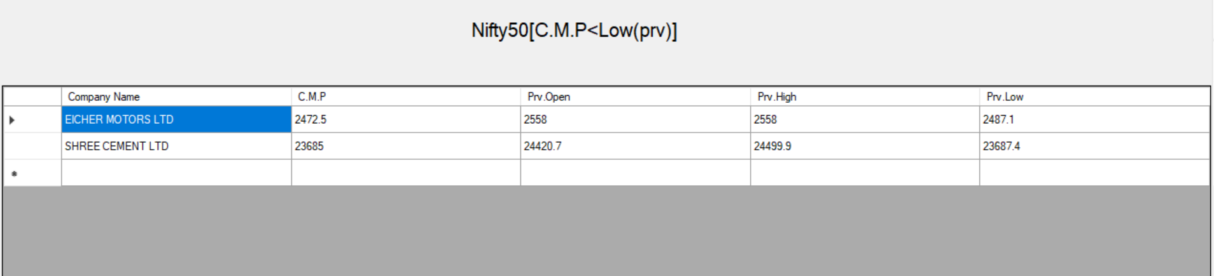
Nifty 50[C.M.P<low(Prv)]

Slide 17
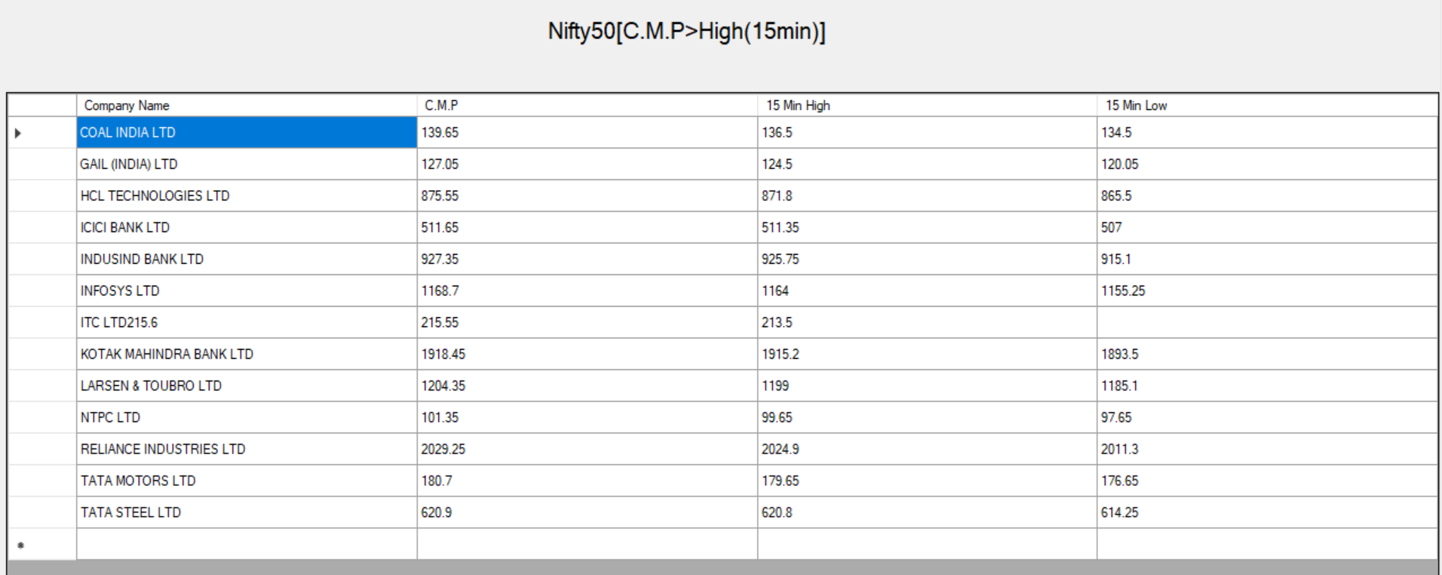
Nifty 50[C.M.P>High(15min)]

Slide 18
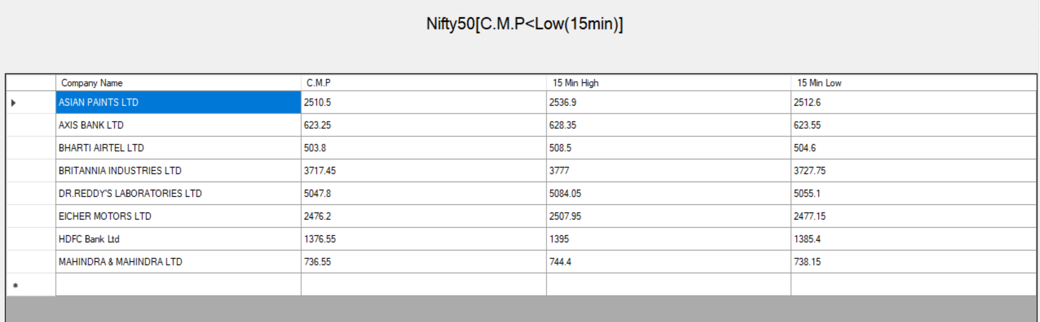
Nifty 50[C.M.P<low(15min)]

Slide 19
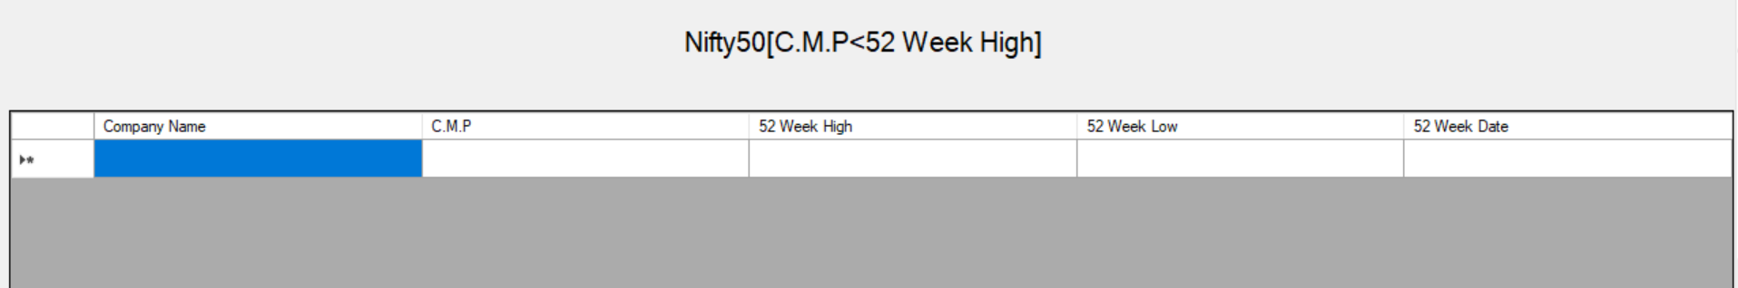
Nifty 50[C.M.P<52 week High]

Slide 20
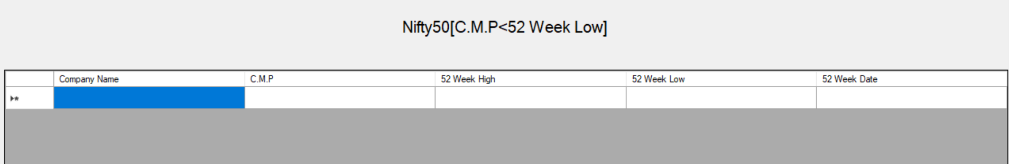
Nifty 50[C.M.P<52 week low]

Slide 21
Thank you

