Slide 1
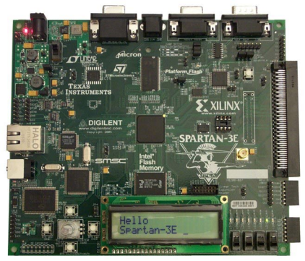

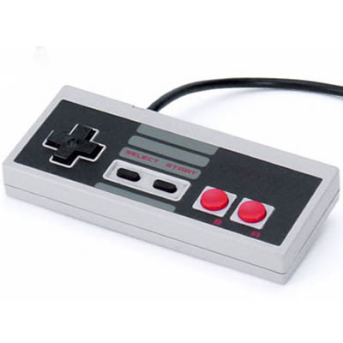
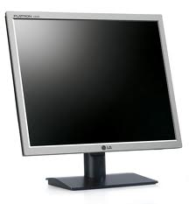
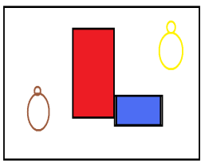
Serial Link Game
Team 1
Levi Balling, Robert Christensen, James Lewis
RS232
9

Slide 2
ALU / Regfile
Instructions followed CR16 specification where possible.
Left/Right shift operations move bits one position.
16 general purpose registers in the regfile
Simplicity of design was a significant goal in the design of the ALU.

Slide 3
ALU and Regfile Verification
Miter tests performed on ALU found no significant differences.
A large test fixture was coded to test boundary cases in the ALU
A module was developed and deployed on the FPGA which would fill the register files with Fib sequence.

Slide 4
Memory
Core Generator was used to generate dual-port memory with 16K words.
Memory structure can be quickly and easily modified by using Core Generator file.
Memory was tested by initializing the memory with large set of prime numbers. Using switches and push buttons on the FPGA board memory location could be viewed or modified.

Slide 5

RS232 Communication
9

Slide 6
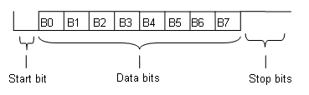
RS232 Protocol
Bit rate of 9600 bits per second
1 start bit, 1 stop bit, and 8 data bit
Built in voltage logic converter
CRC Checksum

Slide 7
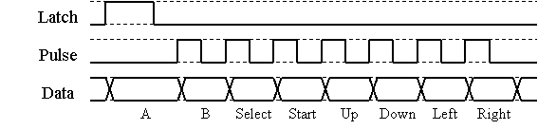
User Input
NES Controller
1 bits for each button
Can be used with 3.3v logic (tested)

Slide 8
VGA Controller
640 x 480 resolution
60 Hz refresh rate
8x8 super pixels
80 x 60 super pixels

