Slide 1

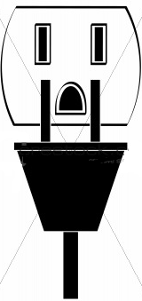




SMART HOME
Christopher Johnson
Dario Bosnjak
Levi Balling
Todd Rogers
Heating
OUTLET
Monitors temperature.
Equalizes room to room temperatures.
Stepper motors control dampers.
Variable PWM fans to move air as needed.
WEB
WIFI
SERVER
Switch power on/off for each socket.
Each socket provides real time power statistics.
Relay controlled sockets.
Hall effect senses power.
Smart Home is controlled by PC or Smartphone via the web.
Persistent server communicates between each home system and provides webpage.
802.11 wireless communication between outlet box and server for portability.
Occupancy
SPRINKLER
Room occupancy detector tracks persons in room.
Provides occupancy data.
Controls room lighting.
Visual infrared motion sensors and laser trip wire for accuracy.
Automated sprinkler system.
Daylight and moisture monitoring provide sprinkler cycles.
Soil conductivity sensors measure moisture.
Photo resistors measure light.

