Slide 1
Amazon sales Analysis
Presented By :- Ashitosh Anil More

Slide 2
Introduction
Amazon Sales data refers to sales, high perform sellers and several other data points. There are millions of Amazon sellers around the world. Nearly half of them are self employed and live of there E-commerce/retail businesses (47%) and (22%) earn income from Amazon Businesses alone.
Amazon sales data analysis focuses on the process of analysing consumer behaviour, sales and several other attributes in order to make improved, data driven decisions.
It’s a key to successfully sustaining their businesses and earning profits and for their purpose, they analyse different metrics.

Slide 3
Objective
Sales management has gained importance to meet increasing competition and the need for improved methods of distribution to reduce cost and to increase profits.
BENEFITS
Determine sales trend, monthly and yearly.
KPI (key performance index) like Profit, Profit %, Customer retention rate, Discount, Sales quantity and Sales amount.

Slide 4
Problem statement
Sales management has gained importance to meet increasing competition and theneed for improved methods of distribution to reduce cost and to increase profits. Sales management today is the most important function in a commercial and business enterprise.
Do ETL: Extract-Transform-Load some Amazon dataset and find for me Sales-trend -> month-wise, year-wise, yearly_month-wise.
Find key metrics and factors and show the meaningful relationships between attributes.

Slide 5
BI Tool used : power bi
Loaded the Amazon Sales Data in Power Bi.
Slicers used are Year.
Prepared Dashboard to showcase KPI’s such as Profit amount, Profit %, Sales Amount, Sales Quantity, Total Sales, Top Product based on Sales Amount.
Included Bar chart for Units solds according to order priority and Total profit by Item type.
Included Line chart for Monthly sales trend.
Included Pie chart for Total profit by Region.
Included Donut chart for Total cost and Total profit by Quarter.

Slide 6
Analysis
As per the Problem statement, we have defined the several used cases to perform the analysis on which helps in not only understanding the meaningful relationships between attributes, but it also allows us to do our own research and come up with our findings.

Slide 7
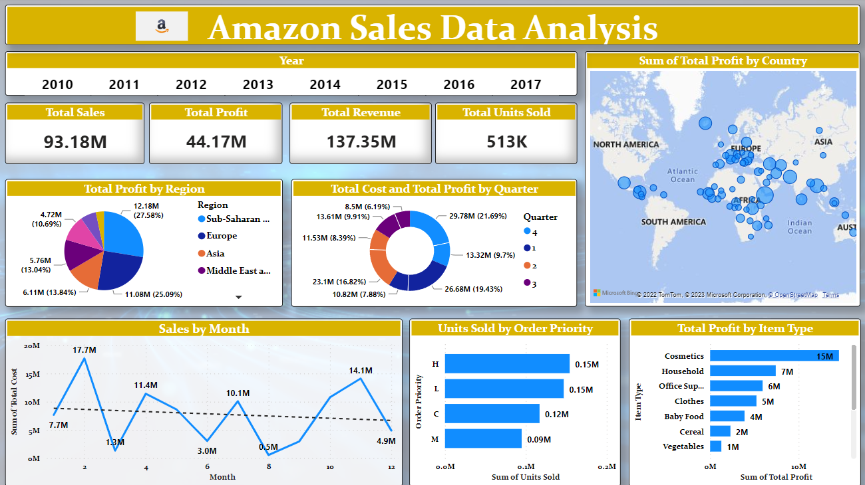
Dashboard

Slide 8
Summary
Top Sold Product :- Office Supplies is around 24M.
Least Sold Product :- Fruits is around 345.99K.
Top Profitable Product :- Cosmetics around 15M.
Least Profitable Product :- Fruits around 120.50K.
Most Profitable Year :- 2012 profit is around 9M.
Highest Sales Year :- 2012 sales is around 23M.

Slide 9
Thank You

