Slide 1
FIFA WORLD CUP (1930-2014) ANALYSIS
Presented By :- Ashitosh Anil More

Slide 2
INTRODUCTION
The FIFA World Cup, often simply called the World Cup, is an international association football competition contested by the senior men’s national teams that belong to the Fédération International de Football Association (FIFA), the sport’s global governing body. The championship has been awarded every four years since the inaugural tournament in 1930, except in 1942 and 1946 when it was not held because of the Second World War. The current champion is France, which won its second title at the 2018 tournament in Russia and the next world cup will happen in 2022 in Qatar. As of 2019, there are 211 teams eligible to qualify for the championship. Only 32 teams make it to the finals to determine one winner. IFA’s Council chooses the host countries. A balloting system is used to determine which bidding nations will become the host country. This system was put into place to avoid boycotts and controversies – problems that had plagued the tournament in its early years.

Slide 3
OBJECTIVE
To get useful insights from the fifa world cup data set and visualize to gives some interesting figures to the football fans.
This project is based on the fifa world cup analysis between 1930 – 2014 to get insights about the matches, pattern about players, patteren about cup winners, home ground advantage and many more things.
BENIFITS
To get a most no. of winning title, No. of goals per country, Attendance, no. of teams, Goals, Matches per cups.
Goals scored teams per world cup, Matches with highest no. of attendance, stadiums with highest avg. of attendance.

Slide 4
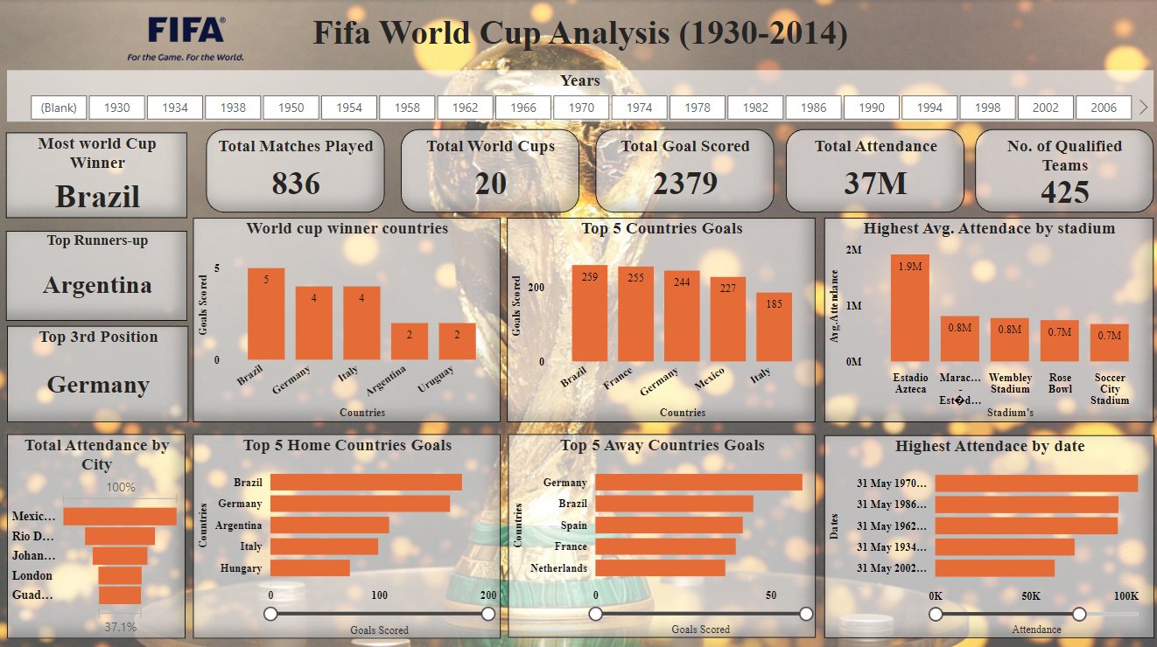
DASHBOARD

Slide 5
INSIGHTS
Brazil has most number of overall goals with 258 goals(180 home goals and 78 away goals).
Brazil, Argentina and Italy are the top 3 countries with most overall goals 258,155,140 goals respectively.
Trinidad and Tobago have lowest overall goals with 0 goals
There is a rapid increase of the attendance in year 1994 of 3587538 people.
There is an increase of popularity trend of football worldcup among the people within the years.
In 1930 and 1950 lowest number of teams have qualified with 13 teams each.
In 1998 the trend of highest number of teams qualification increase to 32 teams.
At an average of every 5 year there is an increase of qualified teams.

Slide 6
In 1998 and 2014 there were most number of goals scored 171 goals and number of matches played is same with 64 matches which are record breaking years.
With increase in number of matches there is uneven increase in goals per year.
The match between Uruguay and Brazil has highest average attendance of audience of 173850 people. It is the most popular match, which means that Uruguay and Brazil are most popular teams in FIFA worldcup.
Maracana and Estadio Azteca stadium has the highest number of average attendance of audience of 101696 and 100924. Which means that they must have high audience capacity in the stadium. I did research and found that Estadio Azteca stadium is the 4th largest stadium in the world with a capacity of 81044.
As Estadio Azteca stadium is in Spain and Uruguay is a Spanish country so that’s conclude that the reason behind Uruguay and Brazil match to be most popular match.
Teams playing at their home country have the highest chances to win the worldcup as the Home Team has highest percentage of winning percentage of 57% and away team winning percentage is 21%.
The draw percentage which is 22% is greater than away team wins percentage which is 21%,which means that teams playing in away country have very less chances to win. .

Slide 7
Links
FIFA World Cup - Jupyter Notebook

Slide 8
THANK YOU

