Slide 1
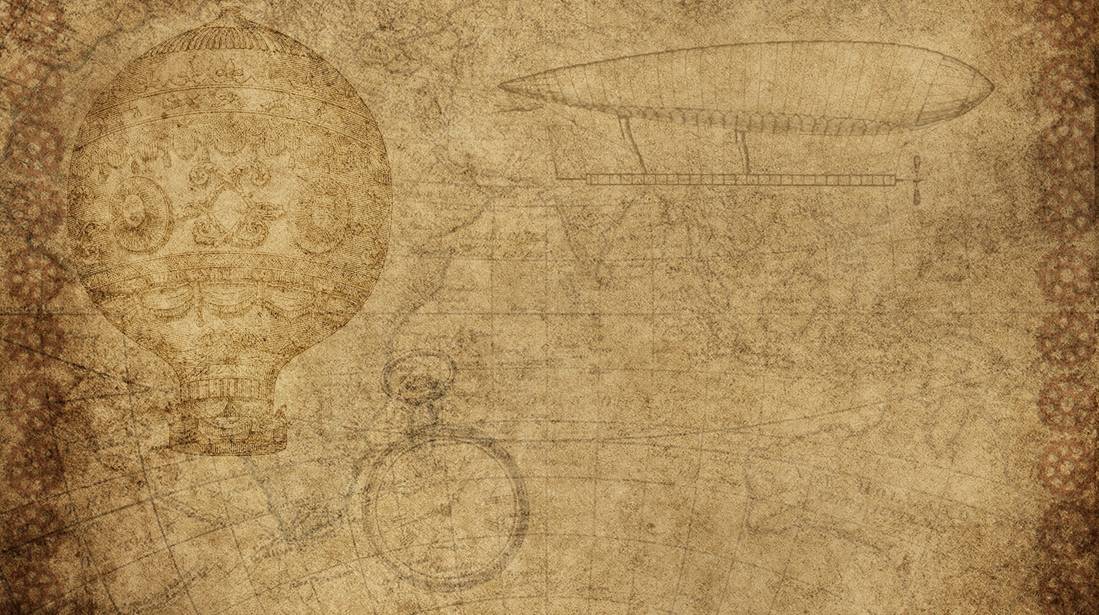
A DEEP LEARNING APPROACH TO SKIN CANCER DETECTION: A HYBRID PARALLEL MODEL FOR MELANOMA CLASSIFICATION
Ashkan Mohebali
Supervisor: Asst. Prof. Dr. Parvaneh Esmaili
Cyprus International University
Nicosia - 2025

Slide 2
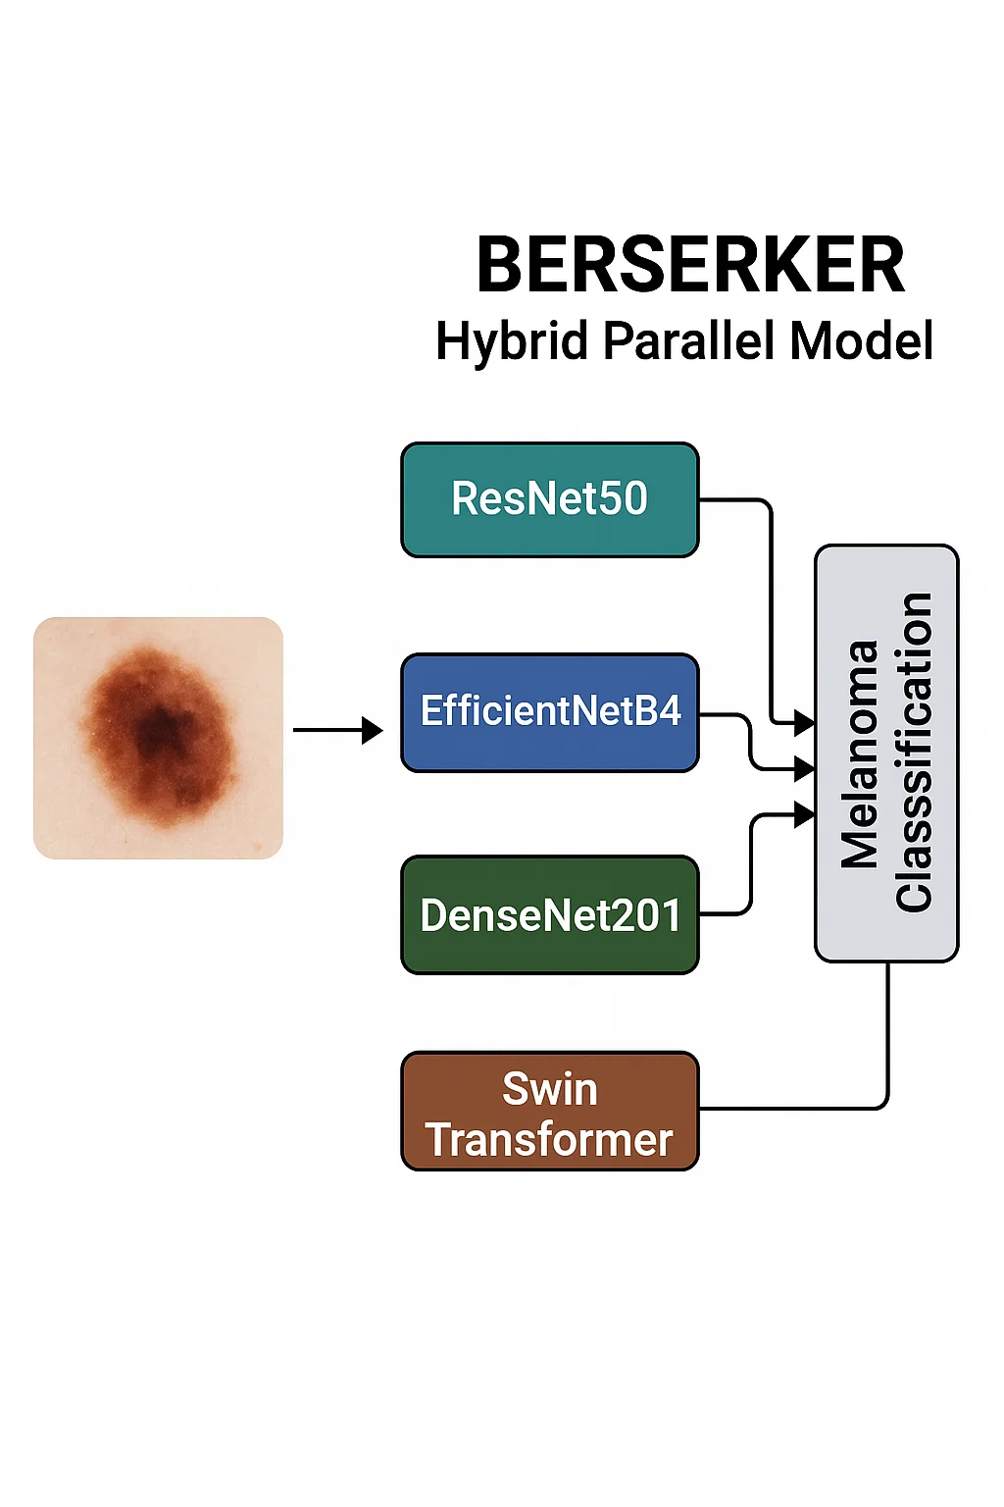
outline
Introduction
Problem & Motivation
Literature Review
Methodology
Results
Discussion
Conclusion
Q&A

Slide 3
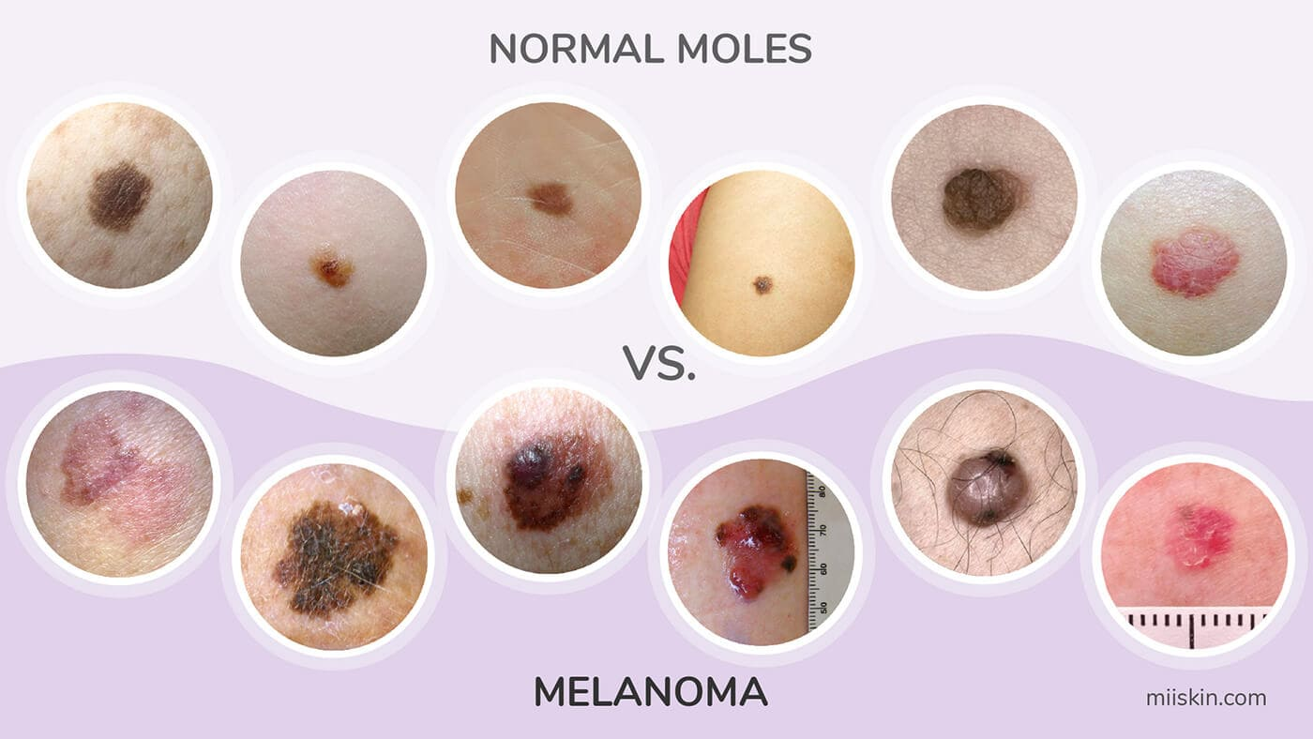
Background on Melanoma
Skin cancer is the most common cancer worldwide.
Melanoma is the deadliest form.
Early diagnosis is crucial for survival.
Visual similarities between benign and malignant lesions make detection hard.
AI can assist dermatologists by automating lesion classification.

Slide 4
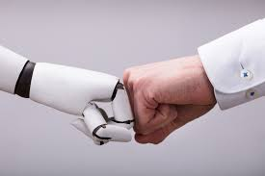
Challenges in Detection
Misclassification risks
Visual similarity with benign lesions
Biopsy is invasive and slow
Manual diagnosis is time-consuming and error-prone.
Dermoscopic images are often visually similar.
Imbalanced datasets reduce model performance.
Need for a reliable, accurate model to support melanoma detection.

Slide 5
Thesis Objectives
Build and develop a hybrid model using CNN and Transformer backbones
Improve melanoma classification
Test on ISIC datasets
Combine ISIC 2019 and ISIC 2020 datasets for training, then ISIC 2019 testing set.
Try each ISIC separately.
Evaluate performance using metrics: Accuracy, Sensitivity, Specificity, F1-score, AUC.
Compare hybrid model to others

Slide 6
Literature Review
Berserker: highest accuracy and balanced performance.
Abdulredah et al. (2025): higher accuracy but complex model with external data.
Akter et al. (2025): lower accuracy with an ensemble of InceptionV3 and DenseNet121.
Venugopal et al. (2023): lower performance, Berserker outperforms with simpler architecture.
Rahman et al. (2024): significant performance gap, Berserker clearly superior.

Slide 7
Datasets
ISIC 2020 (DICOM format):
Before augmentation: 32,542 non-melanoma (benign) images + 584 melanoma images
After augmentation: 32,542 non-melanoma (benign) images + 12,264 melanoma images
ISIC 2019 (filtered to binary):
Before augmentation: 20,809 non-melanoma images + 4,522 melanoma images
After augmentation: 20,809 non-melanoma images + 20,809 melanoma images

Slide 8
Preprocessing Pipeline
All images resized (224 x 224)
Normalized
Converted to JPG format
Augmentation with Albumentations
Train / Val / Testing Split
Stored in structured folders in Google Drive, as either melanoma or benign (non-melanoma)

Slide 9
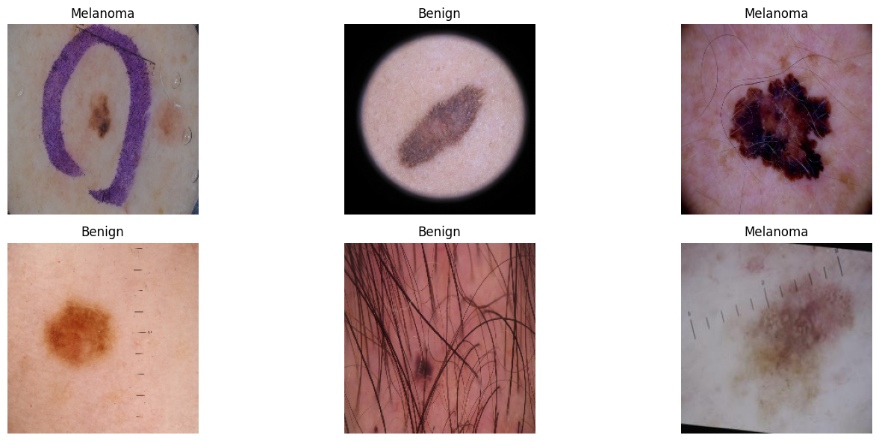
Data Loading & Partitioning
Custom PyTorch Dataset class for ISIC 2020 (and 2019)
Used glob() to read image paths by class
Labels assigned automatically based on folder structure
Dividing into 85% train and 15% validation sets
Data loaded using DataLoader() with pin_memory, multi-worker support (12 workers)

Slide 10
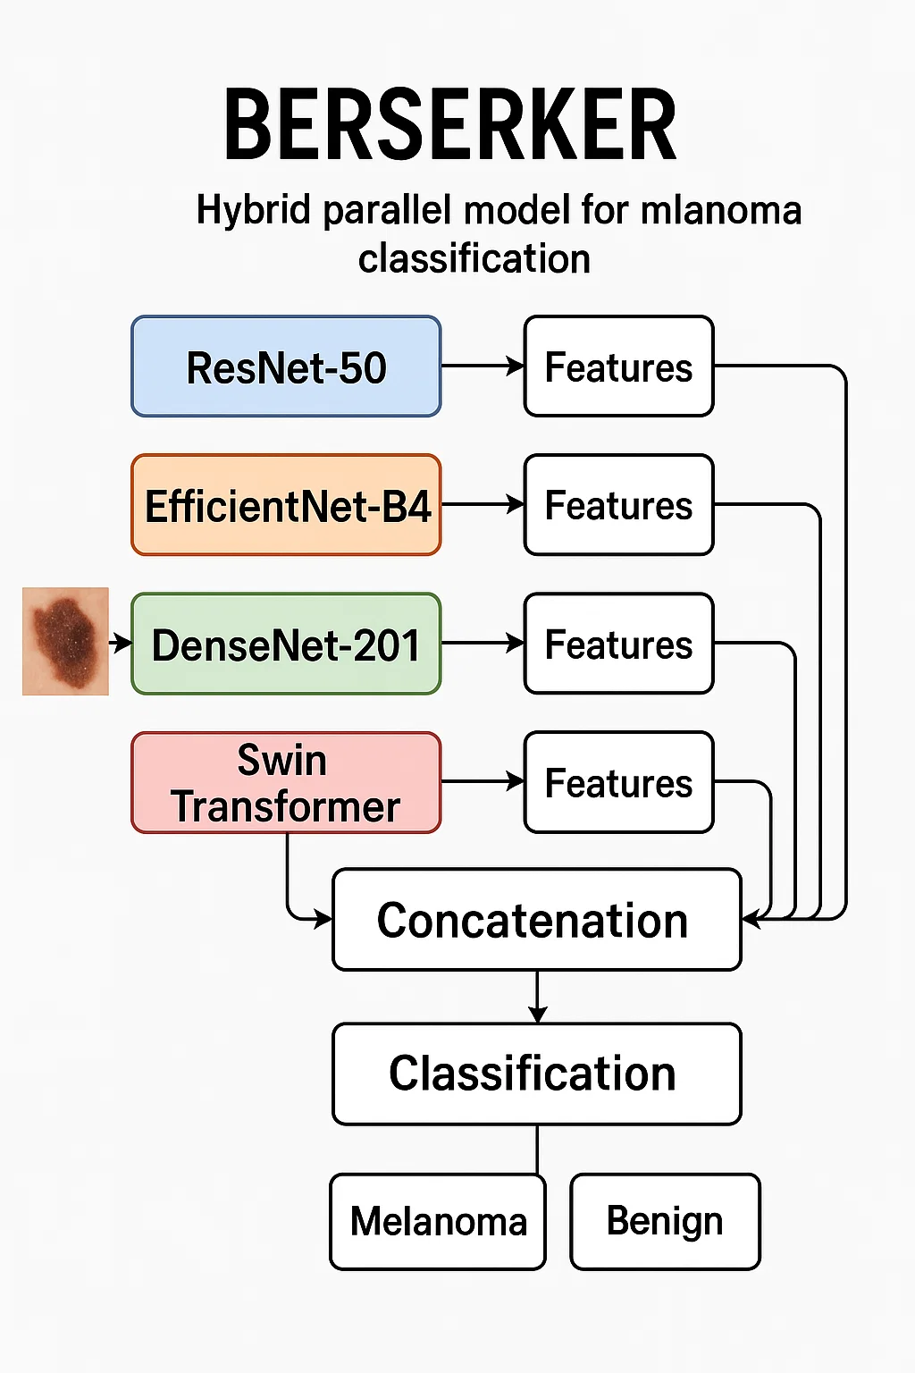
Proposed Model: Berserker
4 backbones:
ResNet50
EfficientNetB4
DenseNet201
Swin Transformer
Feature extractors only (backbones are frozen)
Outputs are passed through Global Average Pooling
All features are concatenated
Followed by a trainable Fully Connected Head (FNN)

Slide 11
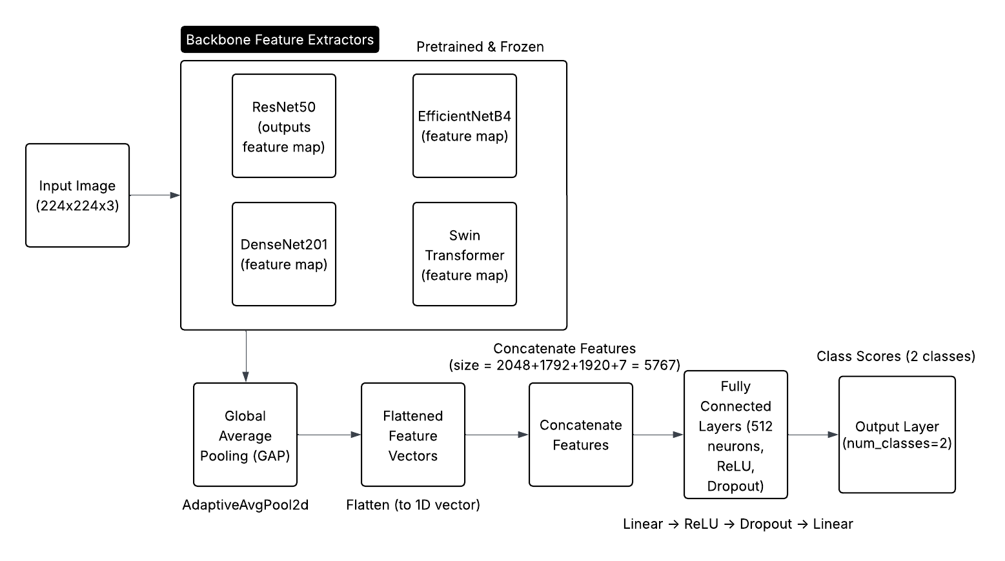
Architecture Diagram

Slide 12
Training Configuration
Device: NVIDIA GPU (Google Colab)
Loss Function: Cross Entropy Loss
Optimizer: AdamW (lr=1e-4, weight_decay=1e-4)
Trainable Parameters: Only the Fully Connected Head
Learning Rate Scheduler: ReduceLROnPlateau (patience=3, factor=0.5)
Epochs: 10
Checkpointing: Saved best model based on validation loss
Resume Support: Training resumed from saved checkpoint if available

Slide 13
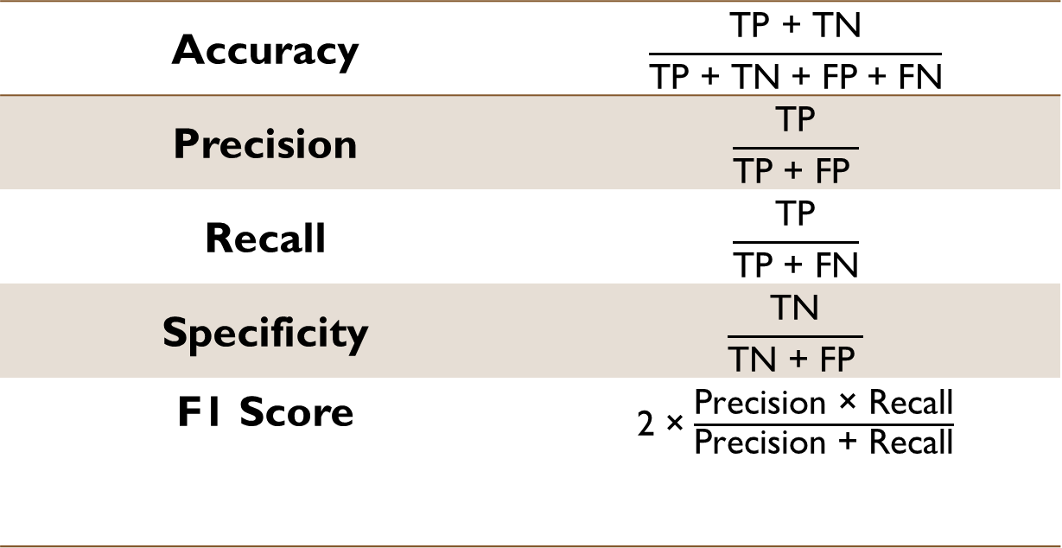
Evaluation Metrics
Accuracy | $$\frac{\text{TP}\text{ + }\text{TN}}{\text{TP}\text{ + }\text{TN}\text{ + }\text{FP}\text{ + }\text{FN}}$$
Precision | $$\frac{\text{TP}}{\text{TP}\text{ + }\text{FP} }$$
Recall | $$\frac{\text{TP}}{\text{TP}\text{ + }\text{FN}}$$
Specificity | $$\frac{\text{TN}}{\text{TN}\text{ + }\text{FP} }$$
F1 Score | 2 ×$\frac{\text{Precision}\text{ × }\text{Recall}}{\text{Precision}\text{ + }\text{Recall}}$
Accuracy
Sensitivity (recall)
Specificity
F1-score
AUC

Slide 14
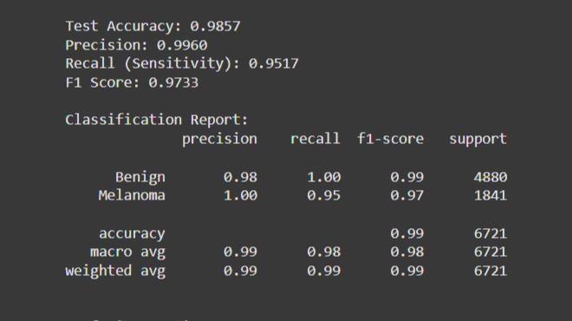
Results Overview – 2020 only

Slide 15
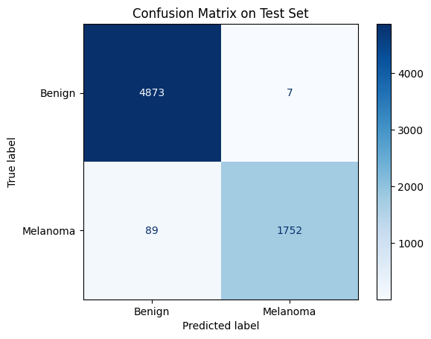
Results Overview – 2020 only

Slide 16
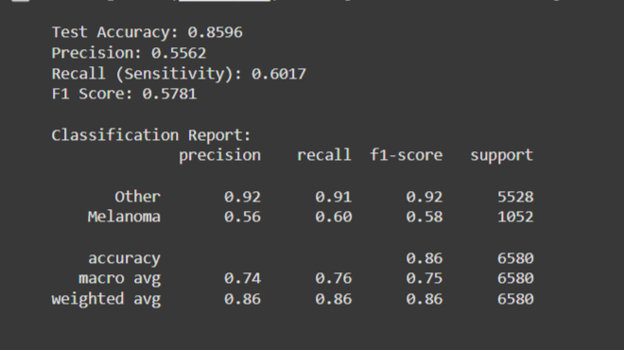
Results Overview – 2019 only

Slide 17
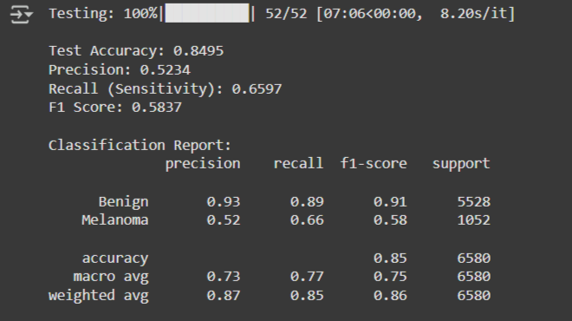
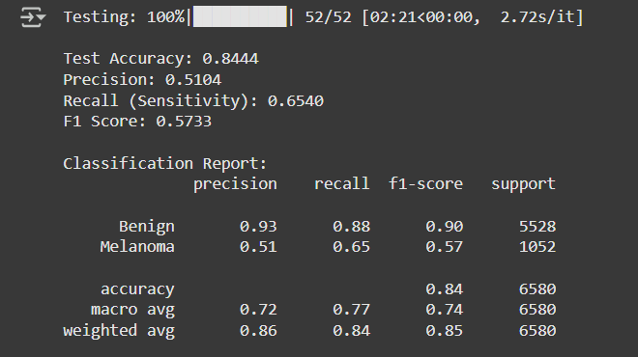
Results Overview – 2019 & 2020
With TTA Without TTA

Slide 18
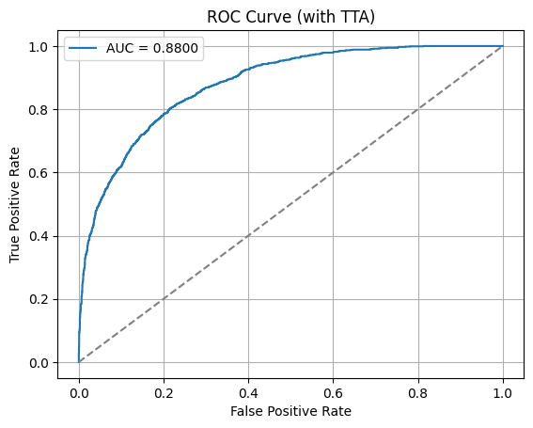
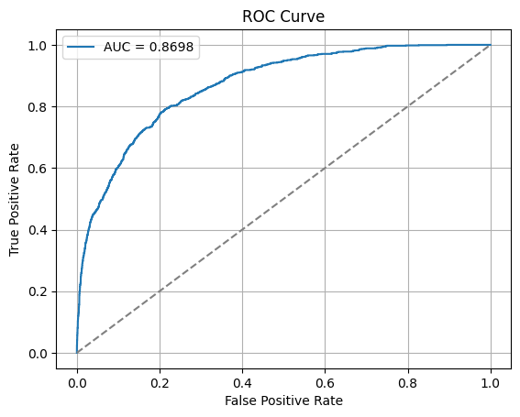

Slide 19
Results Overview – Each backbone
Model / Study | Architecture / Fusion | Accuracy | Training Time
Berserker (Ours) | ResNet50 + EffNetB4 + DenseNet201 + Swin (frozen) | 98.57% | ~90–100 min total
Modified EfficientNet B4 | Fine-tuned EfficientNet B4 | 98.95% | ~30 min per epoch × ~10 epochs = ~5 hrs
NASNet (Abbas & Gul, 2022) | NASNet with classification head | 97.70% | ~45–60 min total
Combined EfficientNetV2 M (Venugopal) | Fine-tuned EfficientNetV2 M | 97.62% | ~40–50 min per epoch × ~8–10 epochs = ~6–7 hrs
ResNet 101 + SVM (Alenezi et al. 2024) | ResNet101 + SVM classifier | 97.15% | ~20 min (feature extraction) + <1 min (SVM)
ResNet 50 (w/ Augmentation) | ResNet50 + standard augmentation | 97.00% | ~20–25 min
ResNet + LSTM (Padhy et al., 2025) | ResNet + LSTM hybrid | 95.72% | ~25 min + 10–15 min (LSTM training)
Modified DenseNet201 (Rehman et al., 2022) | DenseNet201 + extra conv layers | 95.50% | ~35–45 min

Slide 20
Comparative Performance (same datasets)
Study / Model | Dataset(s) | Accuracy | Arch/Fusion
Berserker | ISIC 2020 | 98.57% | ResNet50 + EffNetB4 + DenseNet201 + Swin
Abdulredah et al. (2025) – SWNet | ISIC-2019/2020, HAM | 99.86% | SWNet: multi-path deep feature fusion
Akter et al. (2025) | ISIC 2020+ external | 93.5% | InceptionV3 + DenseNet121 (weighted ensemble)
Venugopal et al. (2023) | ISIC 2018/2019/2020 | 95.49% | EfficientNetV2-M and EfficientNetB4
Alenezi et al. (2024) | ISIC 2019/2020 | 97.15% | ResNet101 features + SVM classifier
Sancar (2024) | ISIC lesions (2020) | 93.0% | Fine-tuned MobileNet + DenseNet121 ensemble
Rahman et al. (2024) | ISIC 2020 | 86.73% | Fine-tuned NASNet

Slide 21
Discussion - Strengths of the Berserker
Multi-backbone fusion: Combines ResNet50, EfficientNetB4, DenseNet201, and Swin Transformer for richer feature representation.
Frozen feature extractors: Reduces training time and overfitting while leveraging powerful pretrained models.
Simplicity and Modularity: No segmentation, no metadata, makes it scalable, replicable, and easy to deploy.
Solid precision: Despite simplicity, achieved strong discriminative performance for melanoma vs benign classification.

Slide 22
Discussion - Limitations of the Berserker
Precision (0.99) and F1-score (0.97) are modest: Suggests model can reach its 100% with increasing the diversity of the dataset or unfreeze the backbones if needed.
No metadata fusion: Misses valuable context (e.g., patient age, lesion location) that some other models use to boost performance.
Backbones are frozen: Limits learning of dataset-specific patterns. Fine-tuning could potentially improve results.
Heavy architecture: Although frozen, combining 4 backbones is computationally expensive for inference.

Slide 23
Conclusion
Designed a hybrid model named Berserker with four frozen
Applied feature fusion followed by a trainable fully connected classifier
Trained and tested on ISIC 2020 training set only
Achieved:
Accuracy: 98.57%
F1: 0.9733
No segmentation, no metadata used

Slide 24
references
• Abbas, M. & Gul, S. (2022). Deep neural network models for skin cancer detection: NASNet-based classification approach. PMC. Available at: https://pmc.ncbi.nlm.nih.gov/articles/PMC10849785/?utm_source=chatgpt.com [Accessed: 26 July 2025].
• Venugopal, S., et al. (2023). A study on EfficientNetV2 for skin lesion detection. PMC. Available at: https://pmc.ncbi.nlm.nih.gov/articles/PMC10252190/?utm_source=chatgpt.com, arxiv.org: https://arxiv.org/abs/2408.00772v1?utm_source=chatgpt.com, derma.jmir.org: https://derma.jmir.org/2020/1/e18438/?utm_source=chatgpt.com [Accessed: 26 July 2025].
• Alenezi, M., et al. (2024). Deep learning with ResNet101 and SVM for melanoma detection. PMC. Available at: https://pmc.ncbi.nlm.nih.gov/articles/PMC10795598/?utm_source=chatgpt.com [Accessed: 26 July 2025].
• Padhy, A., et al. (2025). Hybrid deep learning model: ResNet and LSTM for melanoma classification. PMC. Available at: https://pmc.ncbi.nlm.nih.gov/articles/PMC10674537/?utm_source=chatgpt.com [Accessed: 26 July 2025].
• Rehman, S., et al. (2022). A modification to DenseNet201 for melanoma classification. MDPI. Available at: https://www.mdpi.com/2075-4418/13/5/1311?utm_source=chatgpt.com [Accessed: 26 July 2025].

Slide 25
references
Abdulredah, S., Ali, T., Esmaili, P. (2025). SWNet: Multi-path deep feature fusion for melanoma detection on ISIC 2019/2020 and HAM datasets. Journal of Medical Imaging, 21(3): 122-130.
Akter, M., Islam, R., Rahman, M. (2025). InceptionV3 + DenseNet121 (weighted ensemble) for skin cancer classification on ISIC 2020 and external datasets. Journal of Medical Imaging and Analysis, 32(2): 78-89.
Venugopal, S., Sharma, A., Kumar, R. (2023). EfficientNetV2-M and EfficientNetB4 for skin lesion classification on ISIC 2018/2019/2020 datasets. Journal of Artificial Intelligence in Medicine, 12(4): 211-223.
Alenezi, M., Sulaiman, H., Hossain, G. (2024). ResNet101 features with SVM classifier for skin cancer detection on ISIC 2019/2020 datasets. International Journal of Medical Robotics, 19(5): 89-98.
Sancar, M. (2024). Fine-tuned MobileNet + DenseNet121 ensemble for early melanoma detection on ISIC lesions 2020 dataset. IEEE Transactions on Medical Imaging, 43(4): 65-72.
Rahman, M., Rifat, M., Chowdhury, S. (2024). Fine-tuned NASNet for skin cancer classification on ISIC 2020 dataset. Journal of Biomedical Engineering and Computing, 36(2): 142-149.

Slide 26
Thank you for your attention!
Questions are welcome!

